Slide 1
CHILD DRAWING CLASSIFIER
CSE4288 Introduction to Machine Learning
Group 9
16.11.2024

Slide 2
Project Introduction
Aim: Develop a machine learning model to classify children’s drawings into predefined categories.
Applications:
- Educational and developmental tools
- Insights into children’s cognitive and artistic growth

Slide 3
Problem Statement
Challenges:
- Abstract shapes, exaggerated proportions, and imaginative styles in children's drawings.
- Limited labeled data for effective model training.

Slide 4

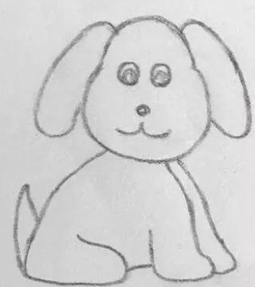

Dataset Overview
Source: Hand-drawn images by children
Categories: Animals, plants, everyday objects, etc.

Slide 5
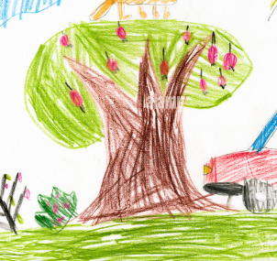


Dataset Overview
Size: ~300 images per category
Challenges: Variability and creativity in styles

Slide 6
Methodology
Preprocessing:
- Data augmentation (rotation, flipping, cropping)
- Normalization (0-1 scale)
Model Architecture:
- Convolutional layers with ReLU and max-pooling
- Fully connected layer with softmax
Optimization:
- Categorical cross-entropy loss
- Adam optimizer

Slide 7
Timeline
Week 1-2: Dataset collection and organization
Week 3-4: Feature Engineering and exploratory data analysis (EDA)
Week 5: Data preprocessing, Model development and initial training
Week 6: Model evaluation and optimization
Week 7: Final testing, analysis, and presentation preparation

Slide 8
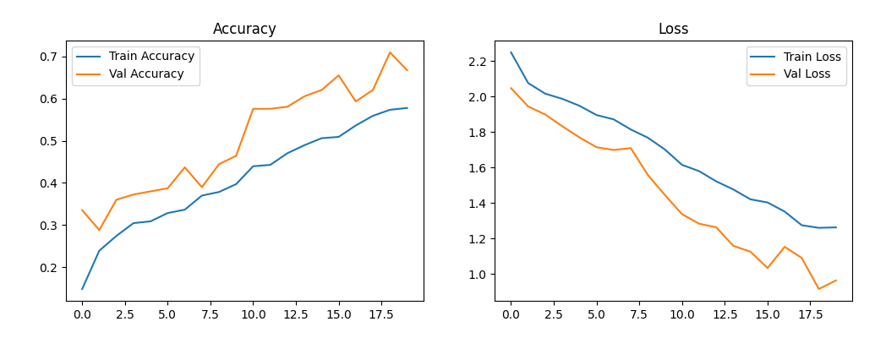
Initial Training Results
Accuracy Plot (Left):
Both training and validation accuracy steadily improve as the number of epochs increases.
Loss Plot (Right):
The training and validation loss decrease consistently, indicating effective learning.

Slide 9
Expectations
Expected Outcomes:
- Insights into children’s artistic creativity
- A functional model to classify children’s drawings
- Validated success metrics: accuracy, precision, recall, F1 score

Slide 10
Q&A

