Slide 1
CHILD DRAWING CLASSIFIER
CSE4288 Introduction to Machine Learning
Group 9

Slide 2
Abstract
Objective: Develop a machine learning model to classify children’s hand-drawn images into ten categories.
Outcome: Achieved significant accuracy using CNN, with applications in AR games and educational tools.

Slide 3
Project Introduction
Motivation: Creativity meets technology—using machine learning to interpret children's abstract and imaginative drawings.
Significance: AR gaming applications, educational tools, and cognitive development insights.

Slide 4

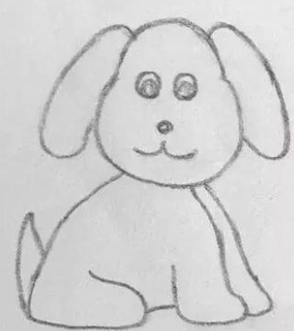

Dataset
Sources: Authentic children’s drawings and online hand-drawn images.
Categories: Birds, Cars, Clouds, Dogs, Flowers, Houses, Humans, Mountains, sun and Trees
Preprocessing: Cropping, resizing (256x256 pixels), normalization, data augmentation (rotations, flips, scaling).

Slide 5
CNN Model Overview
Architecture:
Input Layer: 256x256 images.
Convolutional Layers: Feature extraction.
Fully Connected Layers: Classification.
Train/Validation(and Test) Split: 80/20
Framework: TensorFlow/Keras
Baseline Models: Naive Bayes, Decision Tree, Logistic Regression, KNN.

Slide 6
Baseline Model Overview
Architecture:
Feature Extraction: ResNet-50
Train/Test Split: 80/20
Baseline Models: Naive Bayes, Decision Tree, Logistic Regression, KNN.

Slide 7
CNN Model Training
Training Configuration:
Batch size: 32, Epochs: 20
Loss: Cross-entropy
Optimizer: Adam
Performance Metrics: Accuracy and loss trends.

Slide 8
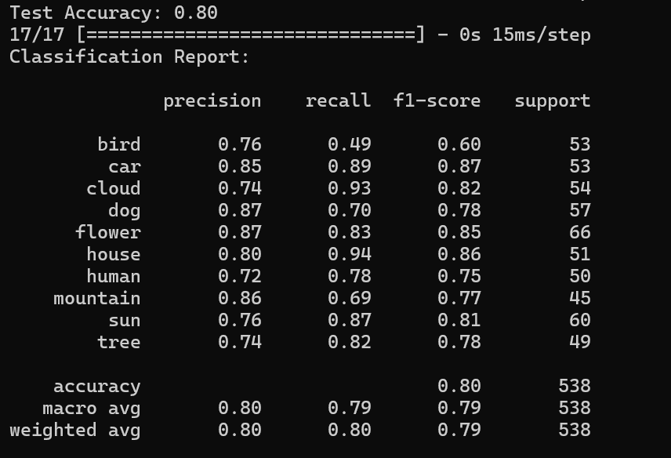
Results
CNN Performance:
Training Accuracy: 60.07%
Validation Accuracy: 79.55%
Validation Loss: 0.6221
Baseline Comparison(Accuracy):
Logistic Regression: 90.32%
KNN: 84.60%
Naive Bayes: 71.99%
Decision Tree: 57.92%

Slide 9
Conclusion
Successful classification of abstract drawings with CNN, outperforming simpler models with still room to improve.

Slide 10

Q&A

