Slide 1
AI/ML INTERNSHIP PROGRAM · CAPSTONE PROJECT
Diabetes Risk Prediction
A machine learning screening tool that flags diabetes risk from routine diagnostic measurements
Syed Muhammad Ali Bokhari
Weeks 5–6 · Final Presentation & Demo

Slide 2
THE PROBLEM
Why this matters
Diabetes is routinely under-flagged in low-resource screening settings, where full diagnostic testing isn't always immediately available.
768
Goal
Patient records
Build a supervised ML model that predicts diabetes risk from 8 routine diagnostic measurements, and surfaces the key risk factors behind each prediction — a low-cost, early screening signal, not a diagnosis.
8
Diagnostic features
WHY IT MATTERS
A false negative — telling a diabetic patient they're low-risk — is the costlier error in a screening context. That single idea shapes every modeling decision in this project.
35%
Diabetic in dataset
2

Slide 3
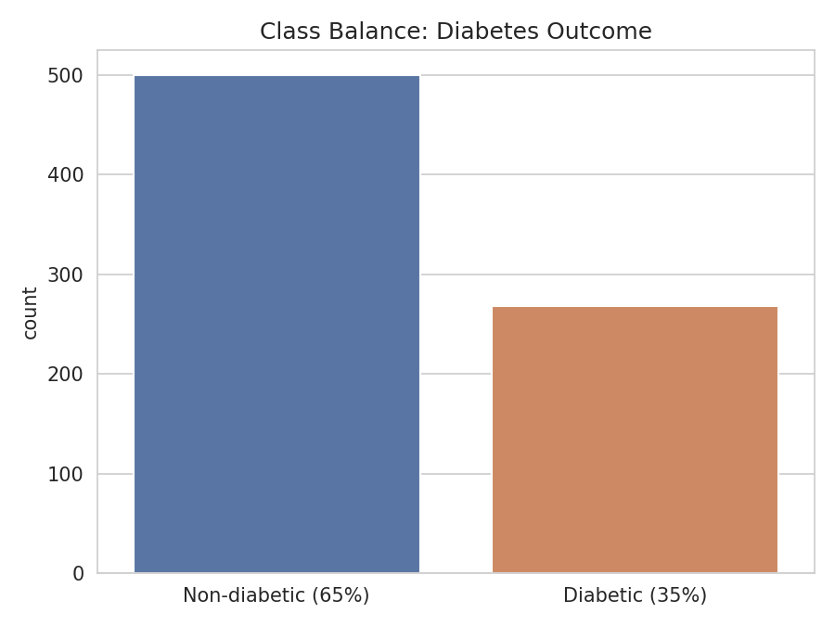
THE DATA
Pima Indians Diabetes Dataset
Pregnancies | Number of times pregnant
Glucose | Plasma glucose concentration
BloodPressure | Diastolic blood pressure (mm Hg)
SkinThickness | Triceps skin fold thickness (mm)
Insulin | 2-hour serum insulin (mu U/ml)
BMI | Body mass index
DiabetesPedigreeFunction | Diabetes likelihood from family history
Age | Age in years
TARGET
Outcome
Binary: 1 = diabetic, 0 = non-diabetic
~65% / 35% class split
→ mild imbalance, recall-focused metrics
3

Slide 4
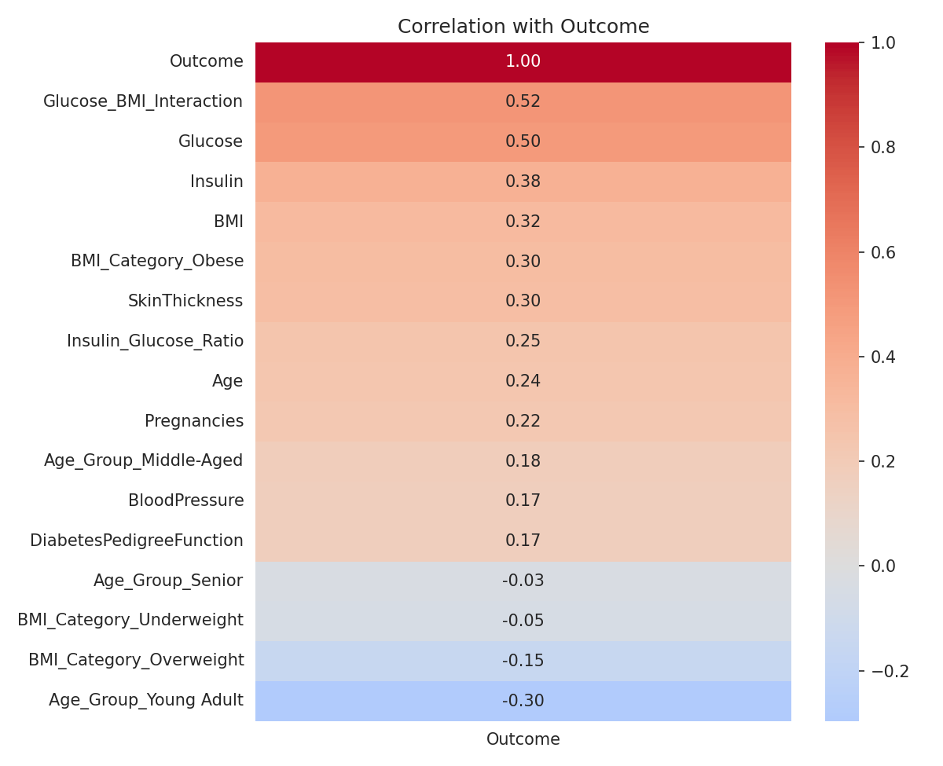
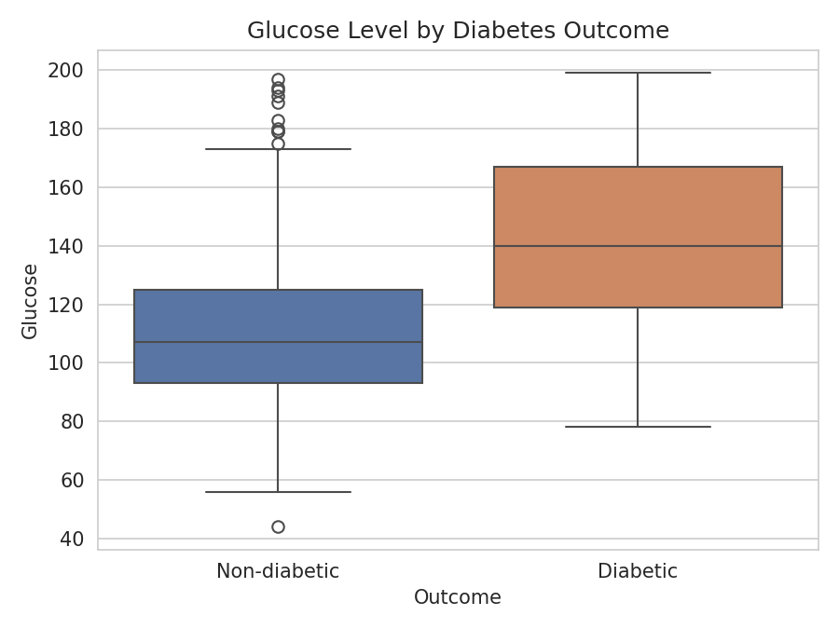
EXPLORATORY ANALYSIS
Glucose is the clearest signal
Diabetic patients show a visibly higher glucose median and interquartile range — consistent with glucose being the primary clinical marker for diagnosis.
4

Slide 5
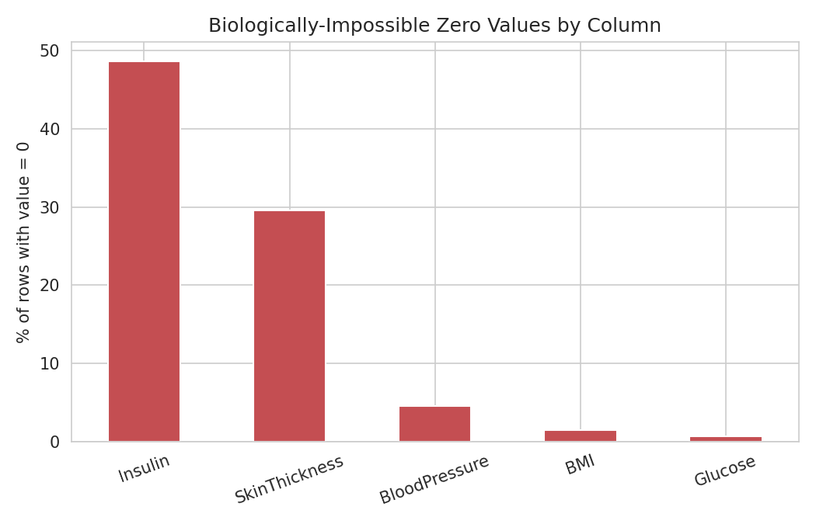
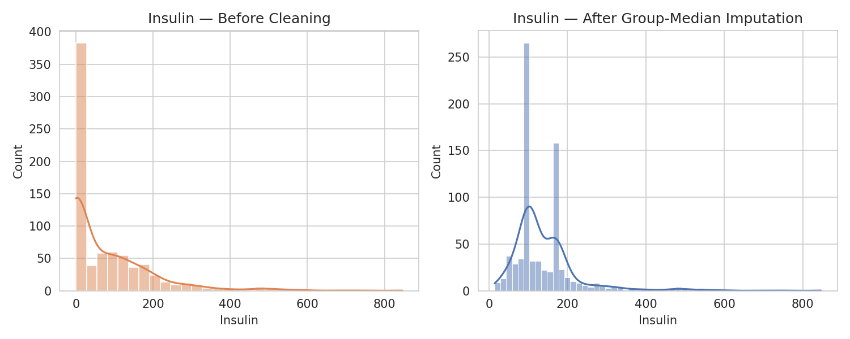
DATA CLEANING
A hidden data quality problem
Five features contained biologically-impossible zeros — used as an implicit "not recorded" marker instead of an explicit missing value. Standard null checks never caught it.
THE FIX
Convert the zeros to explicit NaN
Impute using the median, grouped by Outcome — not a single global median
Preserves the real distributional difference between diabetic and non-diabetic patients
5

Slide 6
FEATURE ENGINEERING
Four clinically-grounded features
1
2
3
4
BMI_Category
Age_Group
Glucose × BMI
Insulin / Glucose
Clinical BMI bands (Underweight / Normal / Overweight / Obese)
Age bands reflecting the risk rise after ~45
Interaction term for compounding risk
Ratio proxy for insulin resistance
Both interaction/ratio terms ranked among the strongest correlates with the target — real signal, not noise.
6

Slide 7
METHODOLOGY
Models compared
Logistic Regression
Tuned via GridSearchCV
SELECTION RULE
K-Nearest Neighbors
Baseline comparison
Recall on the diabetic class first
ROC-AUC as the tiebreaker
not raw accuracy — a missed diagnosis is costlier than a false alarm
Decision Tree
Baseline comparison
Random Forest
Tuned via GridSearchCV
Keras Neural Net
Dropout + EarlyStopping + class weighting
7

Slide 8
RESULTS
Random Forest leads on every axis
TARGET (LAB 1)
ROC-AUC > 0.80
ACHIEVED
0.941
Random Forest, test set
Beats baseline by 88% ROC-AUC and catches ~4 in 5 diabetic cases at default threshold.
8

Slide 9
MODEL SELECTION
Random Forest vs. the neural net
The Keras network edges out Random Forest on raw recall — but only by trading away ROC-AUC and precision. Not a good trade for a screening tool.
Keras Neural Net
Random Forest
SELECTED
Dropout + EarlyStopping
Tuned via GridSearchCV
Recall
0.852
Recall
0.796
ROC-AUC
0.880
ROC-AUC
0.941
Precision
0.648
Precision
0.811
Why Random Forest: a 6-point ROC-AUC gap is a real difference in discriminative power, and 16 points of precision means far fewer false alarms — for only a 5.6-point recall trade-off that threshold tuning fully recovers (next slide).
9

Slide 10
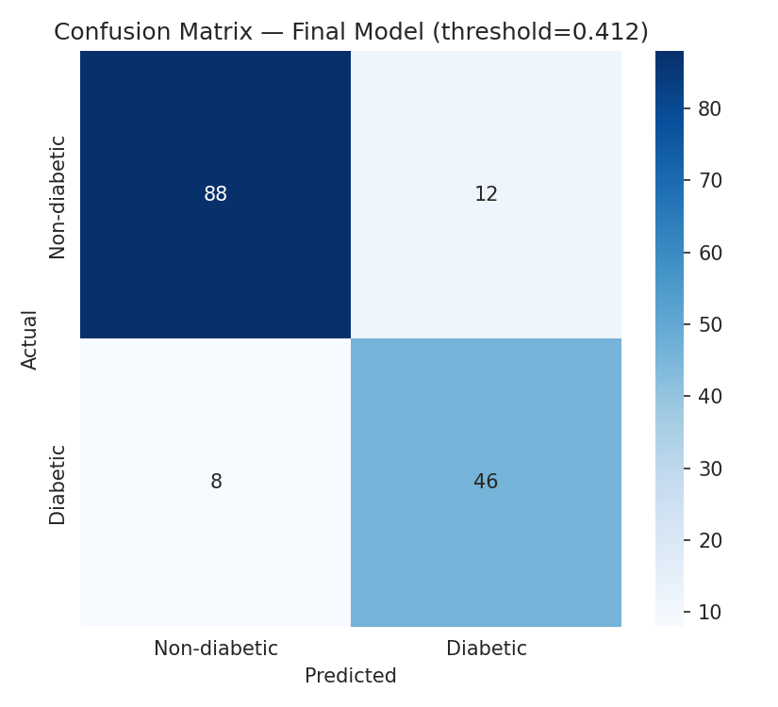
TESTING & REFINEMENT
Threshold tuning closes the gap
Lowering the decision threshold from 0.5 to 0.412 lets Random Forest match the neural network's recall — without giving up its precision advantage.
10

Slide 11
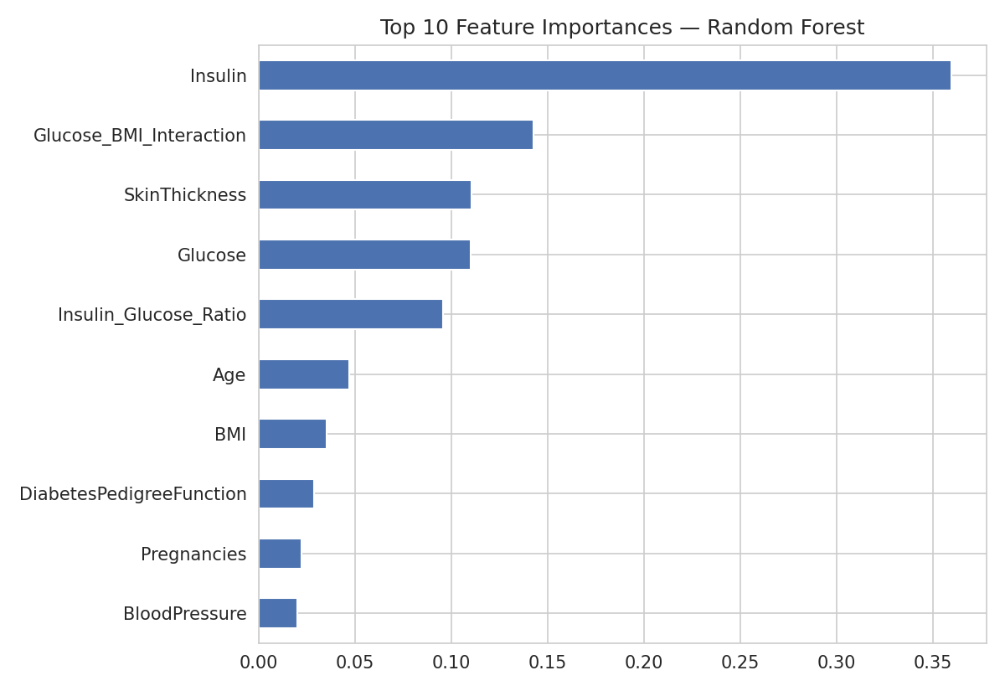
ROBUSTNESS
Is this result stable?
BOOTSTRAP 95% CI · 500 RESAMPLES
[0.901, 0.972]
Tight interval around the 0.941 ROC-AUC point estimate — the result is stable, not a lucky split.
HONEST LIMITATION
Subgroup performance across age bands was checked, but the 154-row test set makes group-level numbers directional, not conclusive — flagged in the report rather than glossed over.
11

Slide 12
CONCLUSION
A screening aid, not a diagnosis
0.941
0.852
0.793
ROC-AUC
Recall (tuned)
Precision (tuned)
WHAT'S NEXT
Validate Insulin's feature importance against non-imputed data
Broaden the age-subgroup check on a larger sample
Optional: LLM layer for plain-language risk explanations
Thank you
Syed Muhammad Ali Bokhari · github.com/[repo-link]

