Slide 1


Slide 2
30,000,000+
Fastest Growing
2nd Most Fatal
Cases by 2030 according to UF
Prevalence
According to the WHO
According to the CDC

Slide 3
Parkinson’s Disease
Hallmark Symptoms Include:
Facial Masking
Vocal Changes
Tremors
Dementia
Slowed Movement
Treatments are much more effective when administered
at the
Early Stages
As such,
Early and Accurate diagnosis is vital

Slide 4
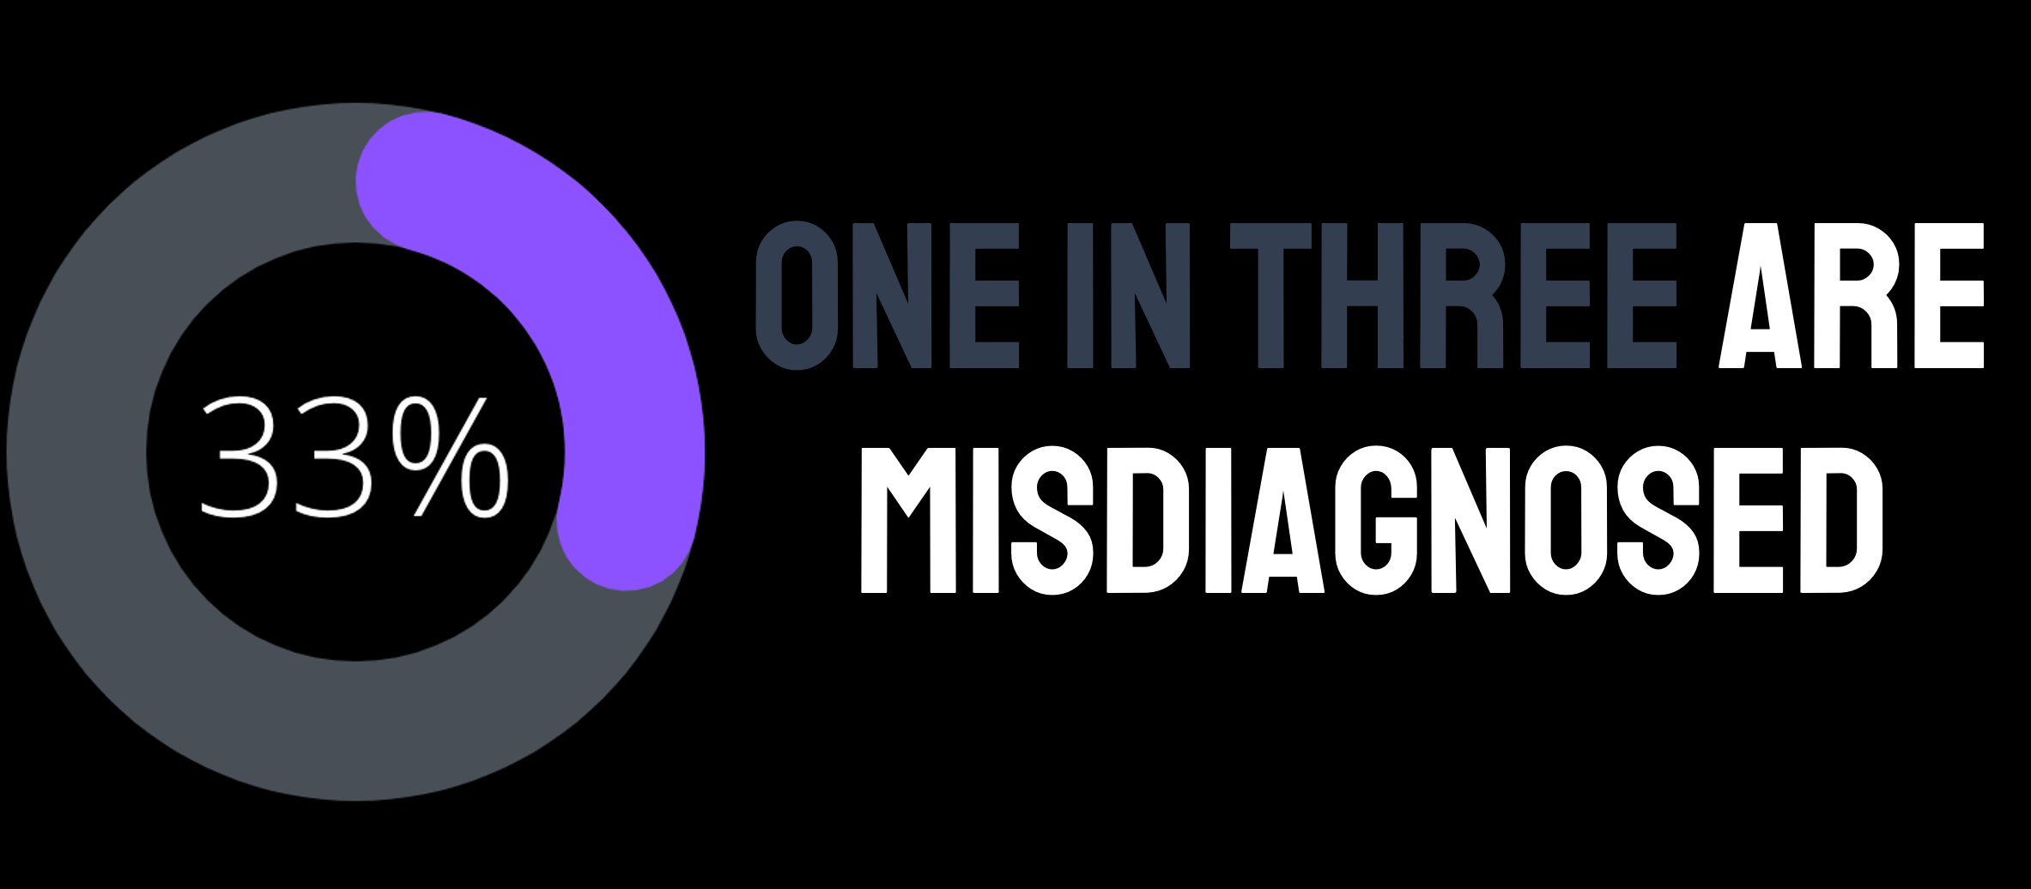

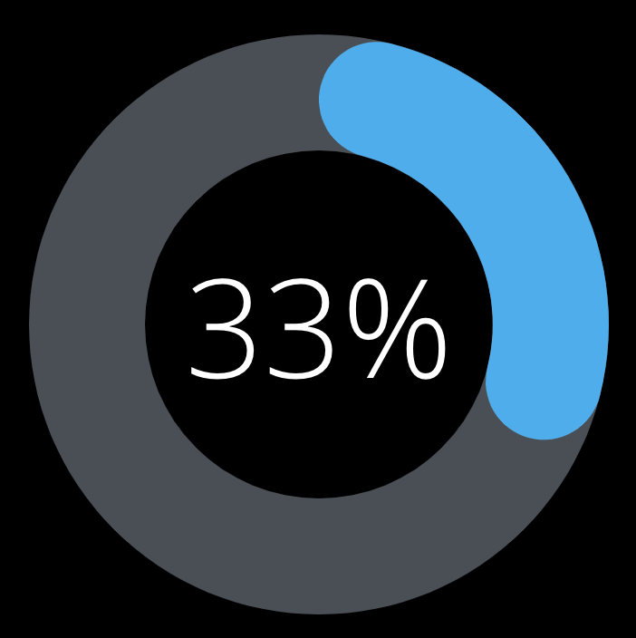




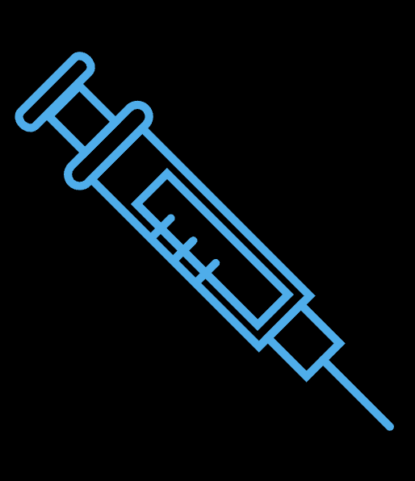
Current diagnosis shortcomings
According to the NIH

Slide 5
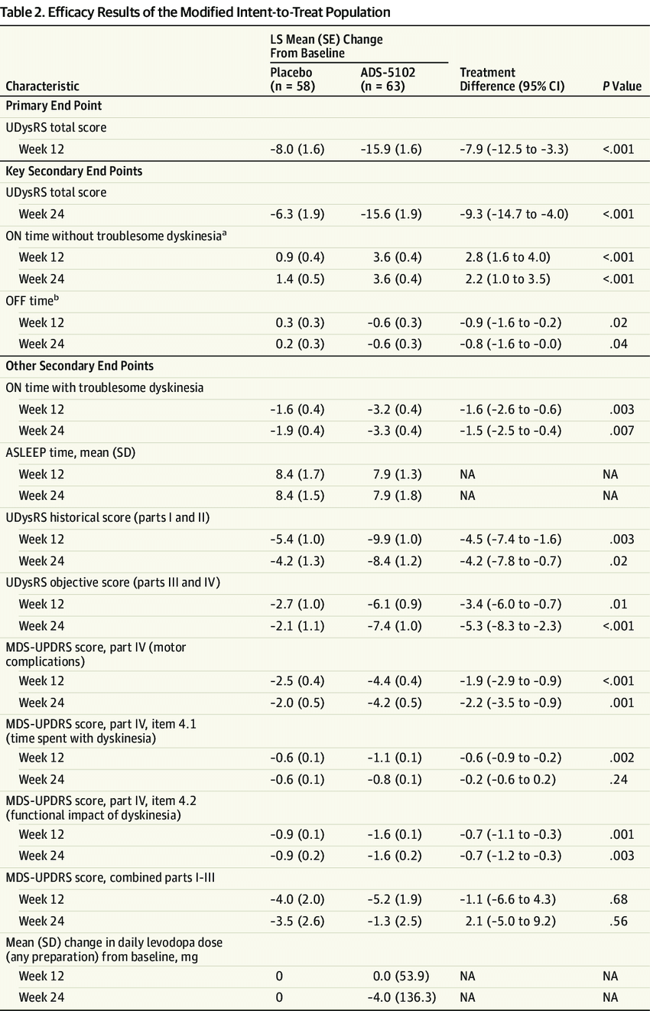
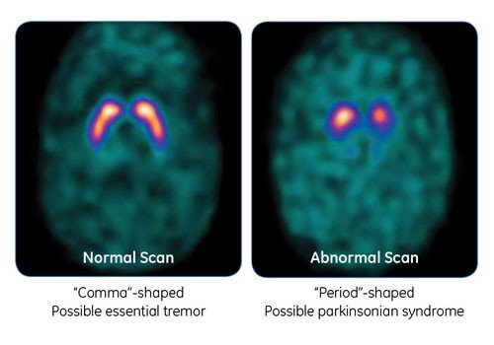
Industry Approaches
DaTScan
High Risk + High Cost($4-5k)
Inaccurate (38%)
1 day – 2 weeks for results
Requires Trip to supporting facility
Questionaries
8-24 hours of exhaustive and tiring tasks
Requires trained neurologist and clinical visit
Very Subjective to the clinican (30-60% accurate)
Little Standardization and Research

Slide 6
Financial, geographic, and accuracy barriers renders diagnosis inaccessible to billions
With COVID-19 access to healthcare has been severely LIMITED, especially in rural areas, and 3rd world countries

Slide 7

Recent advances
Machine Learning
Wearable Tech
Variety of approaches: MRIs, DNA Sequencing, CT scans
Improved Accuracy, Rapidness, and Accessibility
Physical Apparatus(Cost + Distrubution barriers)
Inaccurate and only analyzes one symptom(60-80% accurate)
No Released Public Solution
Mostly used for monitoring not diagnosis

Slide 8
Contactless Diagnosis
Contactless diagnosis ensures Accessibility
Rural Areas
Limited Healthcare regions
Poverty-stricken areas
3rd world countries
According to the UC Berkley, contactless technology is the most effective method of facilitating worldwide healthcare
Recent contactless machine learning approaches
Rochester: facial expressions
MIT: Sleep patterns
Oxford: Speech Signals
According to the UC Berkley, contactless technology is the most effective method of facilitating worldwide healthcare

Slide 9
GAPS in Research
Certain SymptomS
Eye Blink Rate
PD patients have significantly lower
Eye Saccades
High latency, low precision in horizontal rapid eye movements
Multimodal Machine Learning
Combining symptoms for improved accuracy
Improved accuracy in Alzheimer's Diagnosis by 12% in a Duke study
Can be vital, as according to John Hopkins certain symptoms may not show for over 20 years
Research Question: What information can eye blink rate and eye saccades, derived as digital biomarkers from a contactless application, independently and multimodally provide for the rapid and accurate diagnosis and prognosis of Parkinson’s Patients from a sample of adults including healthy controls over the age of 40?

Slide 10
Research Method
Correlational Analysis
Materials & Tools:
Google Colab
Laptop
Machine Learning
SciKit Learn, TenserFlow, Mathplotlib, Numpy
Website Development
React, Javascript

Slide 11


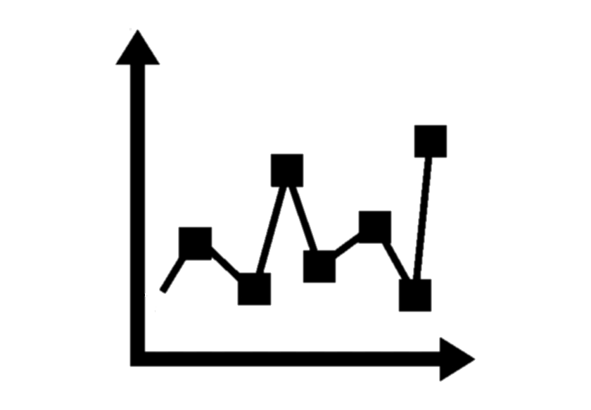

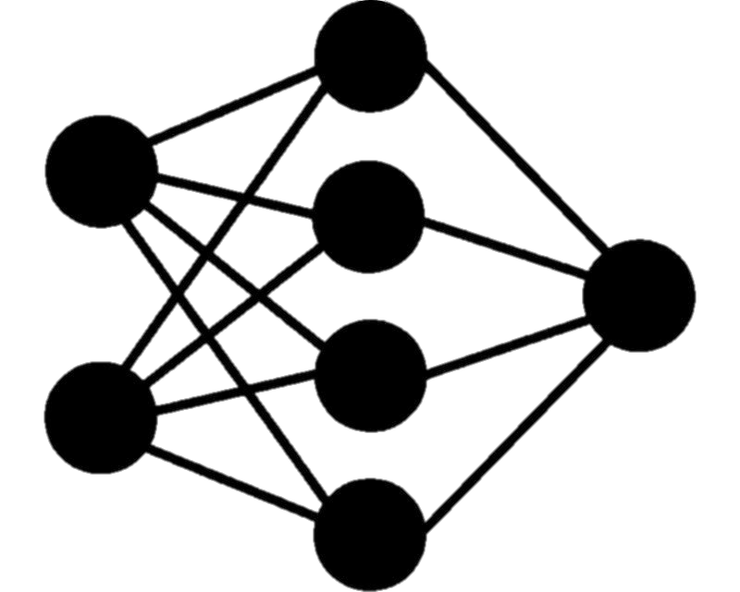
Methodology
Development
DATA
Featurization
Validation
Analysis
Retrieve Data
Prune and Aggregate Data
Intersect Dataset features
Dataset Augmentation
Calculate EBR POI
Derive Numerical Features
K-Fold cross validation on individual classifiers
Match and validate on Synthetic Patients
Iterate
Calculate analysis metrics
Analyze power of various biomarkers
Analyze ease of website
Compare against current methods
Develop Classifiers and Regressors
Fuse and Ensemble
Iterate

Slide 12
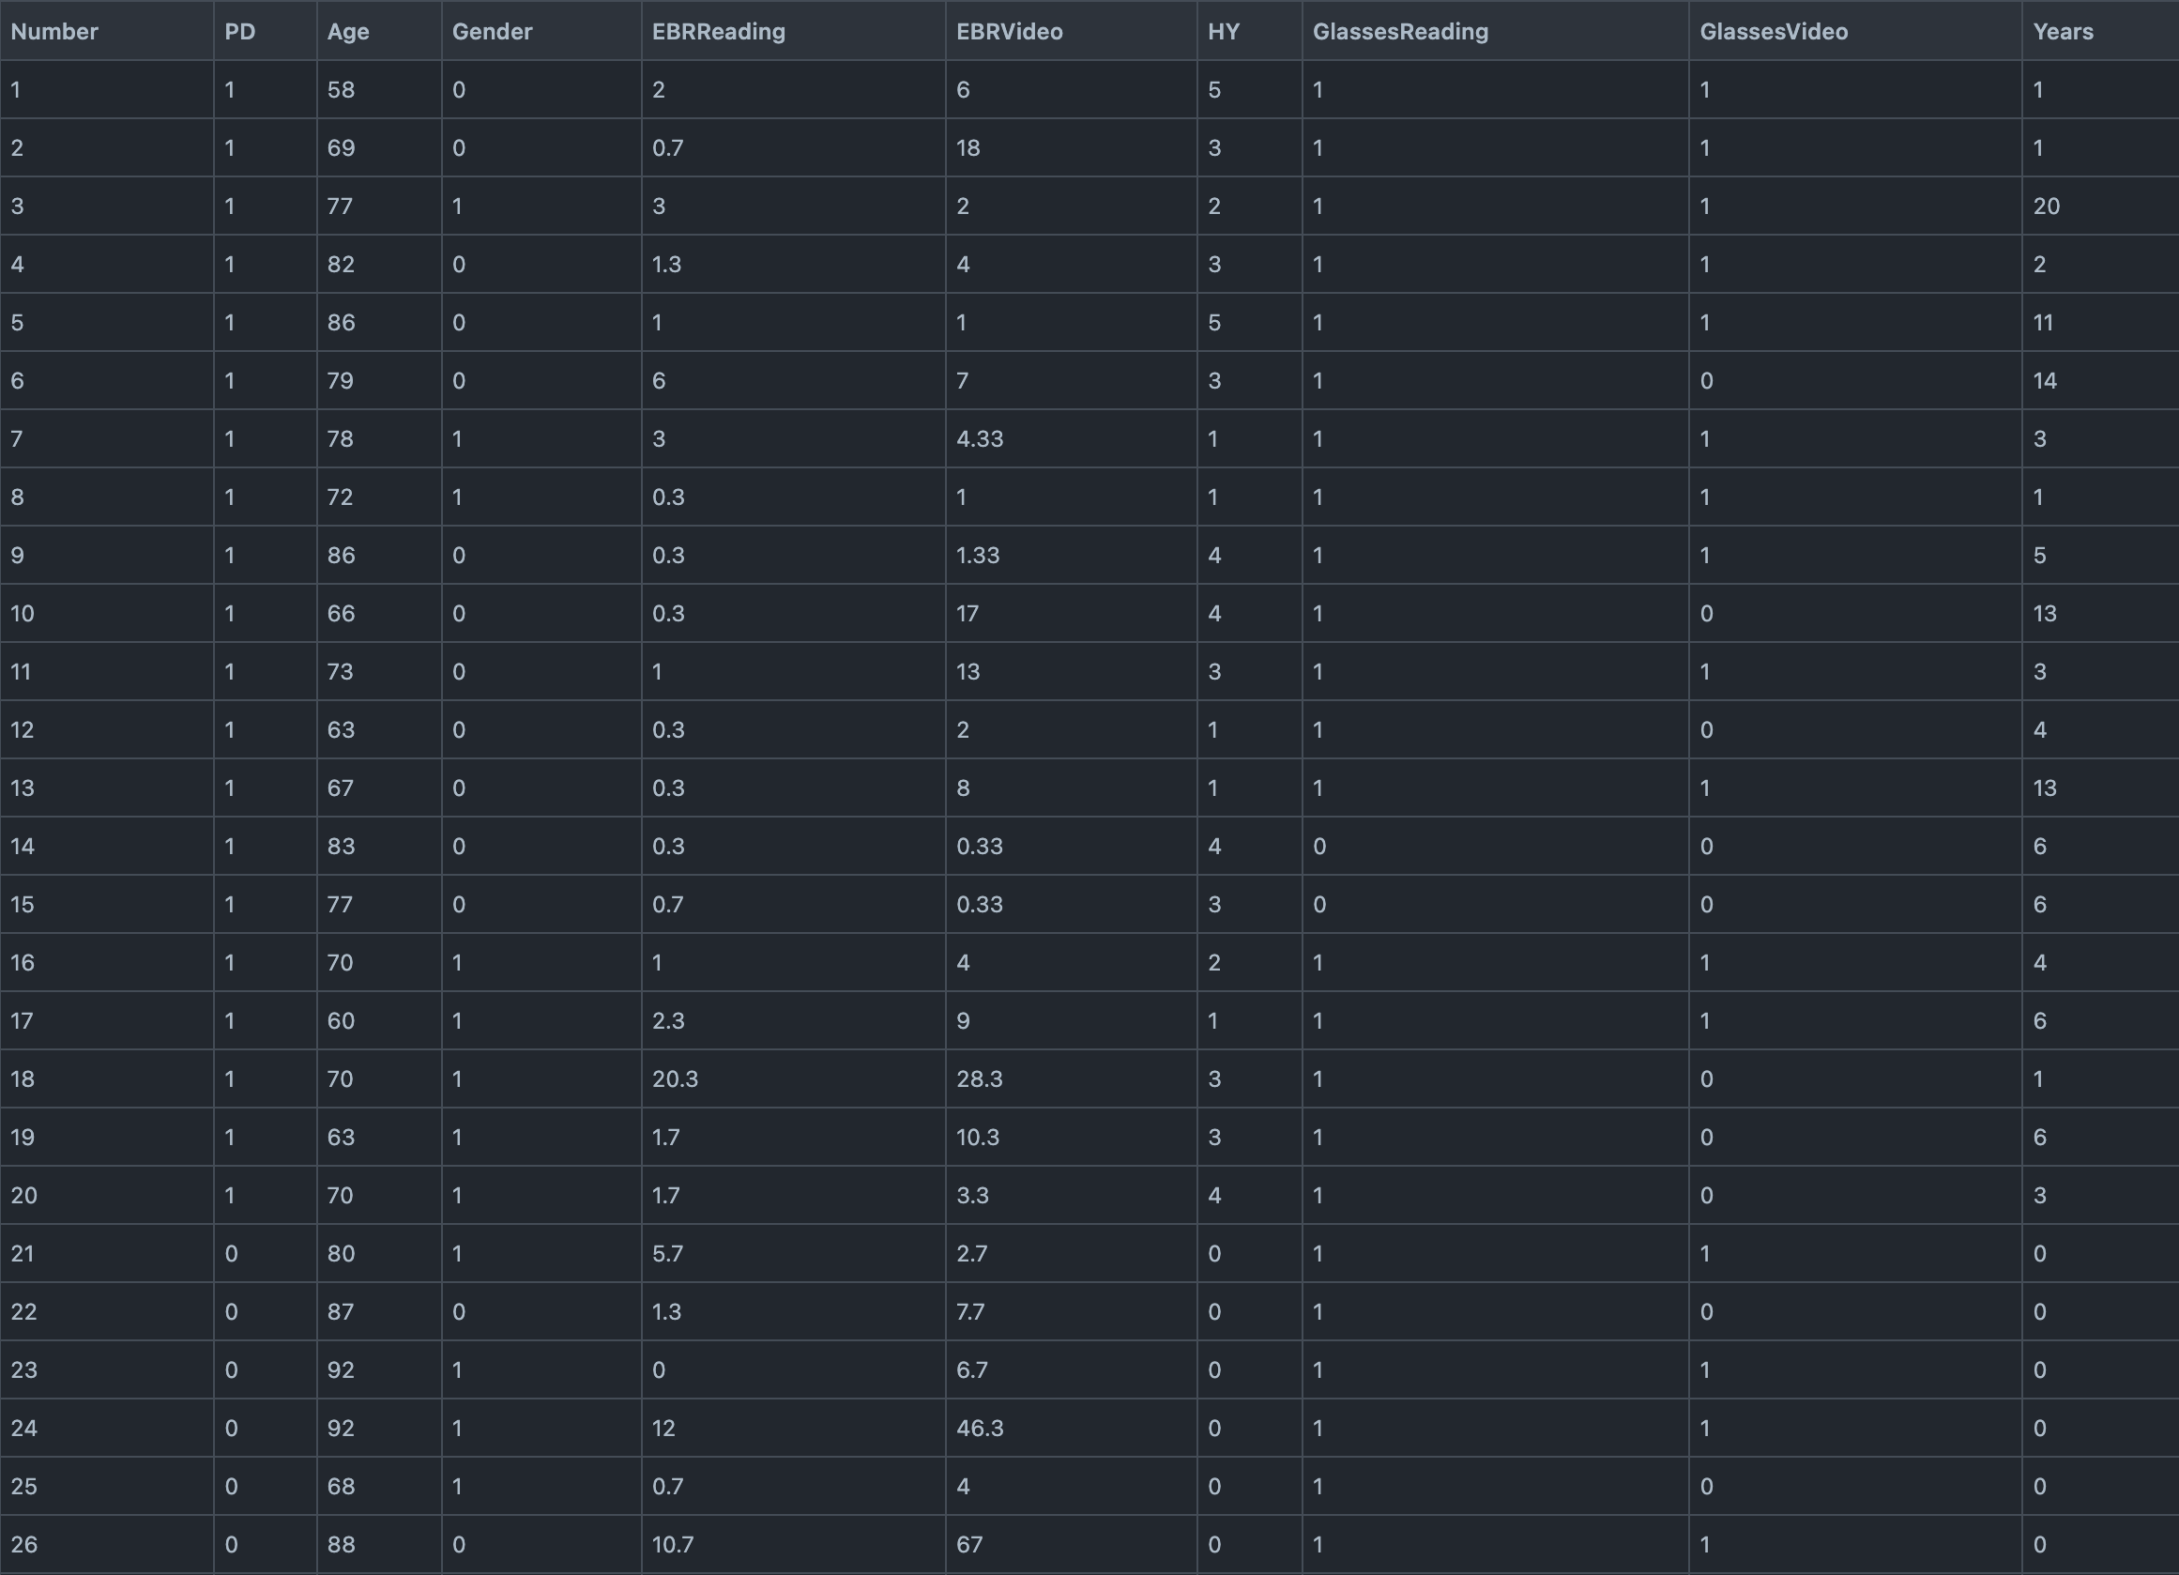
Data & Featurization
De-identified Data
Saccade data from University College London from gaze-following task
Contains data on both PD patients and healthy patients
Also provides PD severity on a scale of 1-5
EBR data from Griffith University from reading Task
About 20 features In total (like saccade amplitude, years since diagnosis, eye velocity, etc…)
Preprocessing & Featurization
Data Pruning (deleting incomplete rows)
Choosing a subset of the 20 features
This can be done with Recursive or Genetic Feature Elimination
Or with variational autoencoders
Splitting data for training the model and for testing
Potentially augmenting the dataset via SMOTE to have more samples to work with
Data collection template example

Slide 13
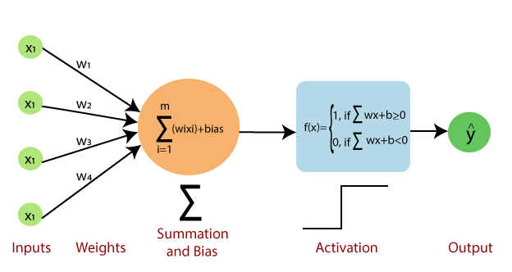
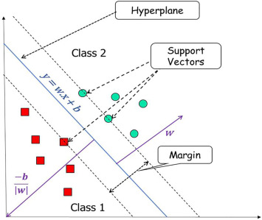
Machine Learning Pipeline
Machine Learning
Trying different classification and regression algorithms to find the one with the best performance
Ensemble Learning
Combining multiple types of algorithms to increase accuracy
Multimodal Learning
Testing the algorithm individually against symptoms, and together with soft voting
Iteration
Iterating via Bayesian Optimization to find optimal conditions
Output
outputs a binary diagnosis, and severity estimation (1-6) for positive patients

Slide 14
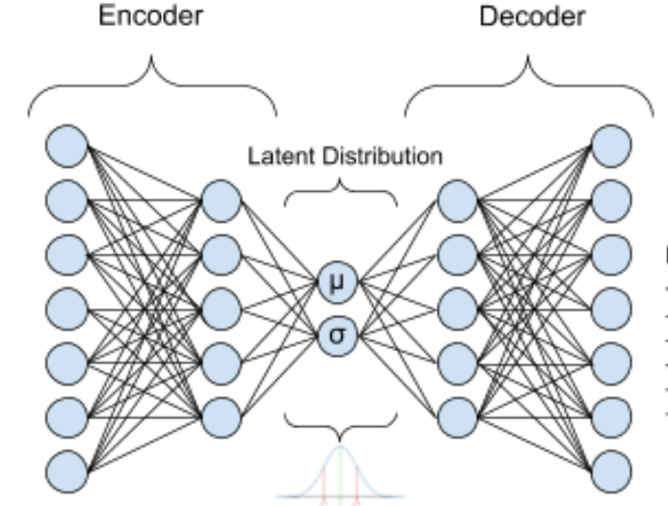

Multimodal Validation: Synthetic
Saccade Data
Synthetic Saccade Patients
Matching for multimodal synthetic patients
K-fold
cross validation
High-fidelity
Synthetic
Patients
Eye Blink Rate
Synthetic EBR Patients
Loose Matching Criteria:
Severity
Age
Years since diagnosis
Wearing Glasses
Match by minimizing Propensity score for Loose Criteria:
Strict Matching Criteria:
Gender
PD Diagnosis

Slide 15
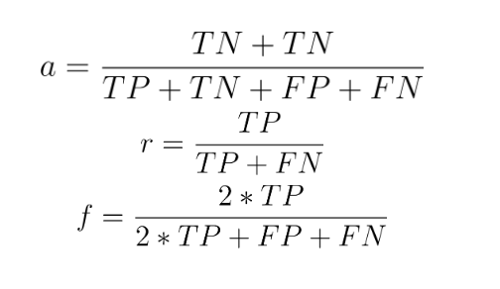
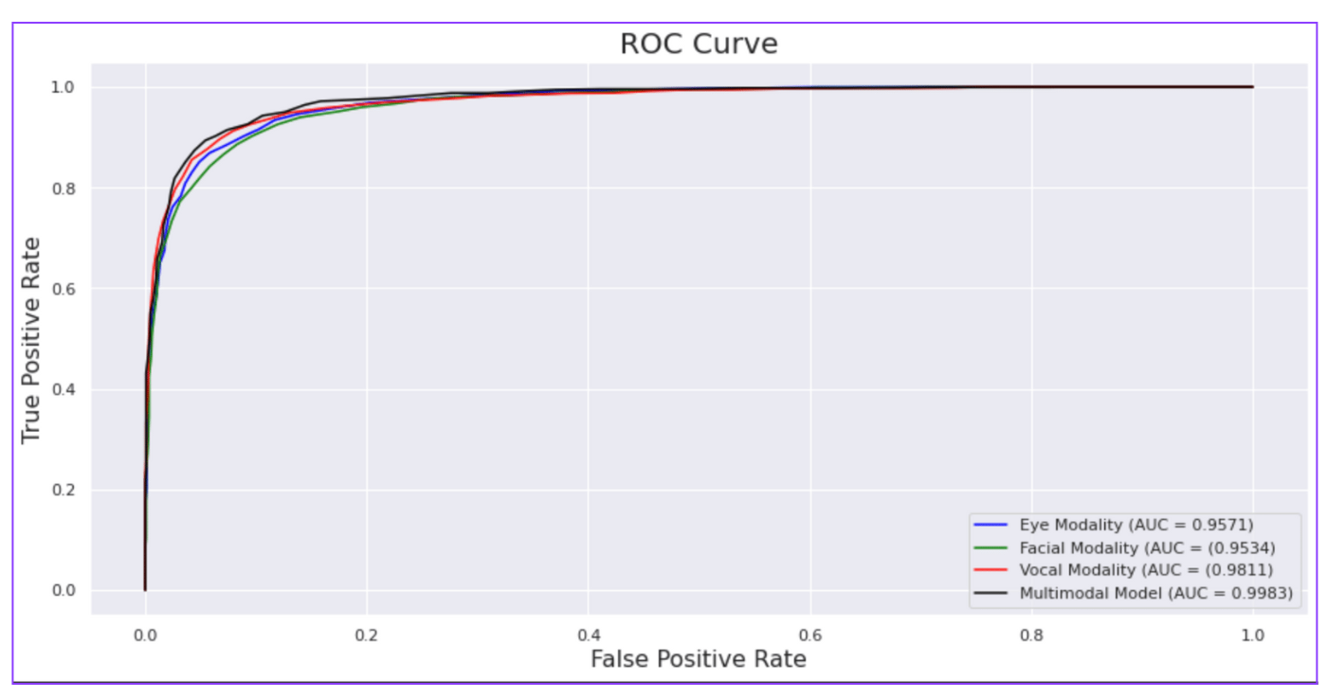
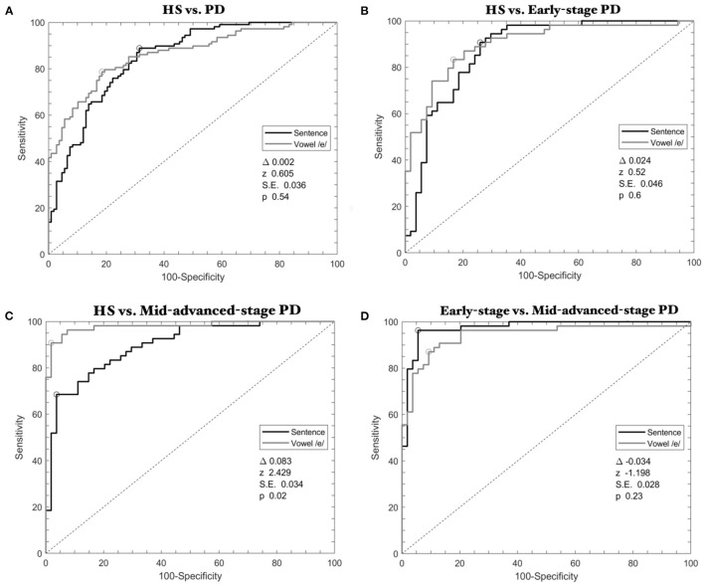
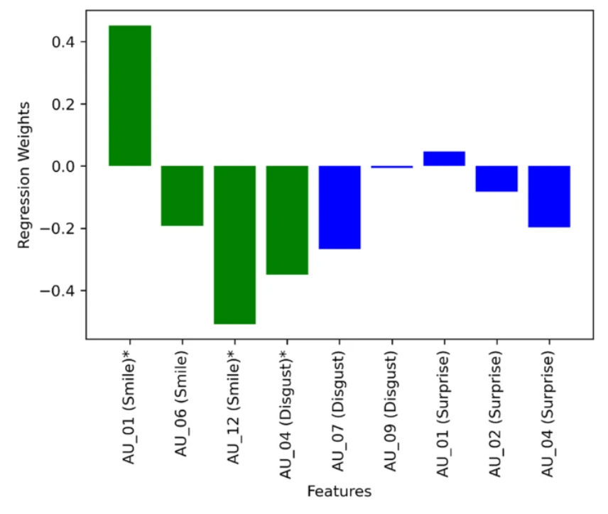
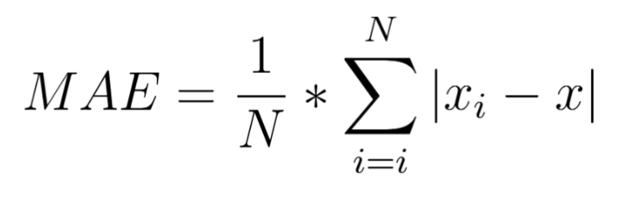
Results analysis
Accuracy, Recall, F-1, AUC ROC for diagnosis
I will compare or analyze:
Effectiveness with EBR vs Saccades (multimodal)
With and without ensembles
These symptoms against other PD symptoms in Literature
This model vs other PD diagnosis in Literature
This model vs other PD Severity analysis in Literature
Length of diagnosis against other methods in in Literature
Effectiveness with and without augmentation
Effectiveness at various PD stages
Weight of certain features in correct diagnosis
Mean Absolute Error for Severity analysis

Slide 16
Best method because:
Research question involves finding correlations between diagnosis and symptoms
Machine learning is essentially finding hidden correlations
Allows us to understand what features of the symptoms play a large role in determining diagnosis or severity (like saccade velocity, blink rate, blink spacing, etc..)
Is able to answer all parts of the research question
Relates to research question because:
Provides information on how certain features of saccades and eye blink rate correlate to a positive/negative diagnosis and severity analysis
These symptoms are derived contactlessly (website or mobile phone)
Analyzing if the method is accurate and rapid
Conducting this on PD and healthy patients over the age of 40
Reflection
Correlational
Analysis

Slide 17
Select REFERENCES
[1] L. Shen, “Gut, oral and nasal microbiota and Parkinson's disease,” Microbial Cell Factories, vol. 19, no. 1, 2020.
[2] L. D. Zerden, T. Guan, J. Shurer, L. Kreitzer, and E. Book, “Social work, Parkinson's disease care, and covid-19,” Social Work in Health Care, vol. 61, no. 3, pp. 139–157, 2022.
[3] M. Öberg, I. Fabrik, D. Fabrikova, N. Zehetner, and A. Härtlova, “The role of innate immunity and inflammation in Parkinson's disease,” Scandinavian Journal of Immunology, vol. 93, no. 5, 2021.
[4] W. Dauer and S. Przedborski, “Parkinson's disease,” Neuron, vol. 39, no. 6, pp. 889–909, 2003.
[5] A. H. Rajput, “Frequency and cause of Parkinson's disease,” Canadian Journal of Neurological Sciences / Journal Canadien des Sciences Neurologiques, vol. 19, no. S1, pp. 103–107, 1992.
[6] M. Lew, “Overview of Parkinson's disease,” Pharmacotherapy, vol. 27, no. 12 Part 2, 2007.
[7] W. Poewe, K. Seppi, C. M. Tanner, G. M. Halliday, P. Brundin, J. Volkmann, A.-E. Schrag, and A. E. Lang, “Parkinson disease,” Nature Reviews Disease Primers, vol. 3, no. 1, 2017.
[8] M. Stacy, P. Hickey, and M. Stacy, “Available and emerging treatments for Parkinson's disease: A Review,” Drug Design, Development and Therapy, vol. 2011, pp. 241–254, May 2011.
[9] F. L. Pagan, “Improving outcomes through early diagnosis of Parkinson's disease,” The American Journal of Managed Care, vol. 18. pp. 176–182, 2012.
[10] M. Olson, T. E. Lockhart, and A. Lieberman, “Motor learning deficits in Parkinson's disease (PD) and their effect on training response in gait and balance: A narrative review,” Frontiers in Neurology, vol. 10, 2019.
[11] J. C. Greenland and R. A. Barker, “The differential diagnosis of Parkinson's disease,” Parkinson’s Disease: Pathogenesis and Clinical Aspects, pp. 109–128, 2018.
[12] “The Unified Parkinson's Disease Rating Scale (UPDRS): Status and recommendations,” Movement Disorders, vol. 18, no. 7, pp. 738–750, 2003.
[13] J. Jankovic and A. Tarakad, “Faculty opinions recommendation of measuring Parkinson's disease over time: The real-world within-subject reliability of the MDS-UPDRS.,” Faculty Opinions – Post-Publication Peer Review of the Biomedical Literature, 2020.
[14] E. Tolosa, G. Wenning, and W. Poewe, “The diagnosis of Parkinson's disease,” The Lancet Neurology, vol. 5, no. 1, pp. 75–86, 2006.
[15] W. H. Chen, T. J. Chiang, M. C. Hsu, and J. S. Liu, “The validity of eye blink rate in Chinese adults for the diagnosis of Parkinson's disease,” Clinical Neurology and Neurosurgery, vol. 105, no. 2, pp. 90–92, Apr. 2003.
[16] N. P. Quinn, “Parkinson's disease: clinical features,” Baillieres Clin Neurol., vol. 6, no. 1, pp. 1–13, 1997.

