Slide 1
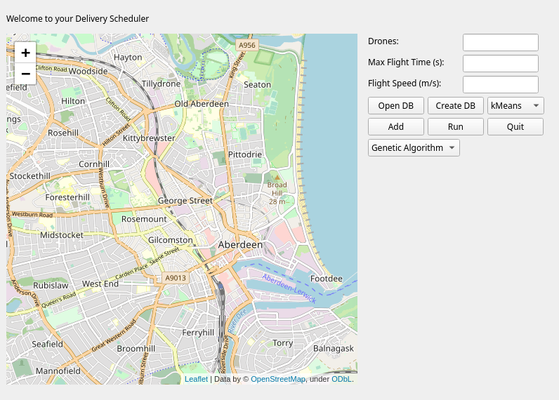
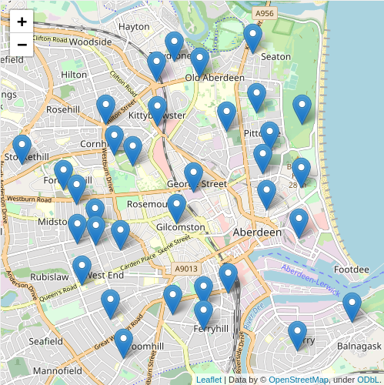
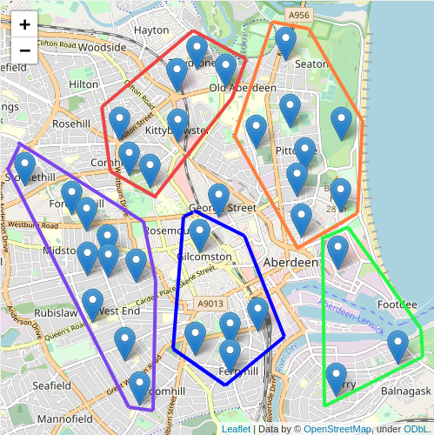
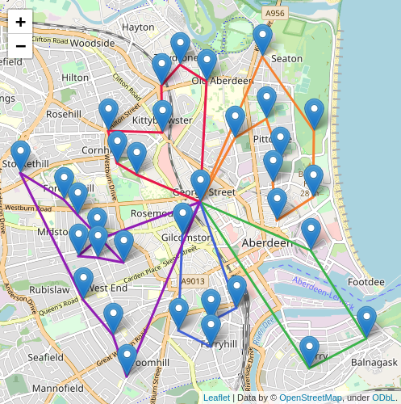
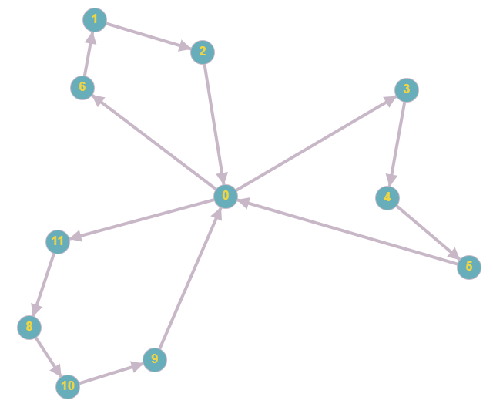
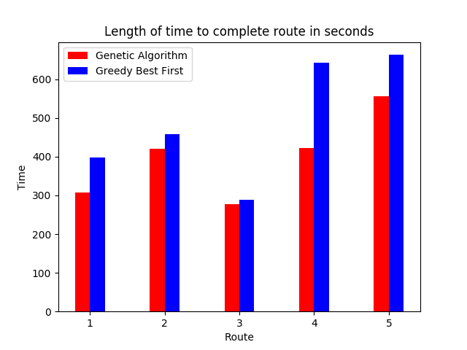
Ensuring efficiency of drone delivery using artificial intelligence
Clustering and Path Finding to produce a schedule
Andrew Trail & Kit-ying Hui
Introduction
Figures and Results
Conclusion
Drones are an up-and-coming method of delivering items to customers. They have not been extensively used as of yet due to being a relatively new technology, as well as some hardware limitations of the drones (Doring et al.,2017). Due to this they will likely be restricted to delivery from a depot in a city to the customers door.
The demand from customers is great, with many being happy to pay extra for same-day delivery (McKinsey & Company, 2016). With future advances in drone tech allowing drones to fly further and carry more weight, it is safe to assume that they will only become a more prevalent delivery method in future.
figures
Figure 2: The solution GUI
The project demonstrates that artificial intelligence can be a useful tool in delivery scheduling. The solution created is able to produce an efficient schedule quickly and easily. It also allows comparison of different path finding algorithms.
The algorithms are potentially not as optimal as possible, as many factors haven’t been considered due to time limitations of this project. Factors such as the amount of time a customer has been waiting could be considered, so that customers who have waited a long time are given priority in the queue.
Additionally, the software could be expanded to provide more of a ‘real-time’ environment, showing the current location of drones and sorting new orders into new groups to be completed once drones have completed the route they are on.
Future work could be carried out to implement these features, allowing for a system more fit for commercial use.
Figure 3
Figure 4
Figure 5
Project Aim
Figure 2 shows the software solution that was produced. Figures 3, 4 and 5 show a sample set of data before any processing is applied, with clusters shown and with routes shown respectively.
The customers were split into 5 groups using the kMeans clustering algorithm. From here, GA and GBF were used to produce routes. The time a drone would take to complete each route is shown in figure 6, assuming the drone’s flight speed is 15 m/s.
Figure 6 shows that across all routes, GA out-performed GBF. Route 3 shows similar results, with GBF producing a route 3.76% greater than GA. However, in route 4, GBF produced a route with a massive 51.89% increase.
Interestingly, there are occasions where the Genetic Algorithm produces a longer route by distance, but takes less time to complete. This is because the Genetic Algorithm is able to try many different combinations, allowing it to produce a route where it flies with a tailwind for as long as possible.
The aim of this project is to build a software solution to create an efficient delivery schedule. The schedule should be optimised to reduce the total amount of time taken for each customer to receive their item.
Methods
Figure 1: A set of customers split into groups with routes generated
References
The schedule is created by first creating groups of customers based on how close they are to one another geographically. A path-finding algorithm is then used to find a route for each drone to follow, visiting each member of the group only once. Two path-finding algorithms were implemented to allow comparison of their suitability for the task: Genetic Algorithm (GA) and Greedy Best First (GBF).
1 - Dorling, K., Heinrichs, J., Messier, G. and Magierowski, S. (2017). Vehicle Routing Problems for Drone Delivery. IEEE Transactions on Systems, Man, and Cybernetics: Systems, 47(1), pp.70-71.
2 - McKinsey & Company (2016). Parcel delivery. The future of of last mile. [online] pp.9-9. Available at: https://mck.co/34XcEXR
Figure 6: Results of running both algorithms on sample data with 5 drones
BSc. (Hons) Computing
(Application Software
Development

