Slide 1
Drone Delivery Scheduling
Clustering and Path Finding to produce a schedule
Andrew Trail & Dr Kit-ying Hui

Slide 2
Motivation
I am a regular online shopper
Delivery times can be unnecessarily long
Exciting new technology
Saving the environment

Slide 3
Aims
To provide a software solution to create a scheduler for drone deliveries
To compare the effectiveness of different path finding algorithms for the task

Slide 4
Introduction
A drone is a small unmanned flying vehicle.
Many companies are looking into using them as a method of delivering items
Amazon’s “Prime Air”
DHL’s “Parcelcopter”

Slide 5
Advantages of drone delivery
Speed – Drones are not affected by traffic on the roads
Cost – The cost of flying a drone is much lower than that of driving a van around a busy city
Environment – The damage done to the environment is reduced
High demand – many customers are willing to pay more for faster delivery

Slide 6
Drawbacks
Flight time – Drones are limited by their battery life
Weight capacity – The more weight, the less flight time you have
Weather – Adverse weather such as strong wind may prevent drones from being practical
Legal issues – Rules and regulations are still not in place and will likely change in the coming years

Slide 7
Amazon’s Prediction
5 mile range
5 lb capacity
Restricts how many customers can be served at once
We assume that tech will advance to improve these limits
Allows one drone to carry multiple items

Slide 8
The need for a schedule
Save time for the company
Faster delivery for the customer
More accurate timing predictions
Make resources more cost-effective
Prevent wasted electricity

Slide 9
The Travelling Salesman Problem
An old mathematics problem
Number of routes increases exponentially
5 customers = 120 possible routes
10 customers = 362,800 possible routes
15 customers = 1,307,674,368,000 possible routes
Quickly becomes unmanageable
No known solution

Slide 10
Breaking down the problem
Group the customers into smaller, manageable groups
Find routes for each of these groups
Clustering algorithm
Path-finding algorithm

Slide 11
Clustering
Allows us to group customers together
Grouping by customer location allows one drone to serve one cluster of customers
Speeds up route finding algorithms
Improves odds of finding a fast route

Slide 12
“kMeans” clustering
Randomly selects “k” number of centres of clusters
Assigns each customer to a cluster based on which centre they are closest to
Recalculates the centres by taking the mean distance to each customer in that cluster and picking the closest one
Repeats until no changes are made to clusters

Slide 13
Path Finding
Once the clusters are decided we need to make a route
for the drones
Many potential algorithms
Brute Force
Greedy Best First
Genetic Algorithm

Slide 14
Brute Force
Calculate every possible route
Pick the shortest one
Guaranteed to give best route
Takes a long time
Takes a lot of memory

Slide 15
Greedy Best First
Calculate the flight time from current location to each other unvisited location
Pick the shortest one
Repeat until drone is back at the depot
Faster than brute force
Not guaranteed to find the best route

Slide 16
Genetic Algorithm
Design to emulate Darwin’s Theory of Evolution
Starts with a ‘population’ of randomly generated routes
Calculates a score for each route
High scoring routes are selected to ‘breed’ and swap some characteristics
Potential to ‘mutate’
Low scoring routes are removed from the search
Repeats for a set number of ‘generations’

Slide 17
Genetic Algorithm
Good at searching problems with many possible solutions
Compares many possible routes at once and picks the best one
Iteratively improves the route
Reasonably fast
Parameters can be adjusted for better performance
Not guaranteed to give the best route

Slide 18
The Software Solution
Written in Python
Provides a GUI to interact with
Data is saved to a database for later use
Allows easy adjustment of number of drones, flight speed and max flight time
Uses “kMeans” for clustering
Allows a choice of Greedy Best First and Genetic Algorithm search algorithms
Visually shows the clusters and routes once they are calculated
Generates an HTML file giving an overview of the last run of the application

Slide 19
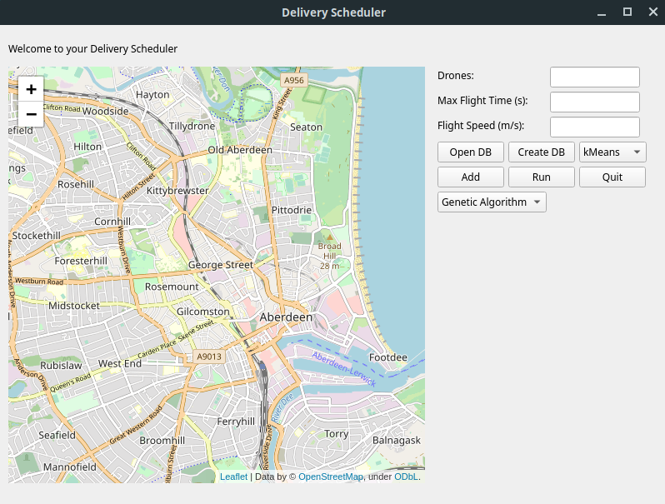
The GUI
Map
Number of drones
Max flight time
Flight speed
Database create or open
Database create or open
Run using the current settings
Add a new customer
Path finding algorithm

Slide 20
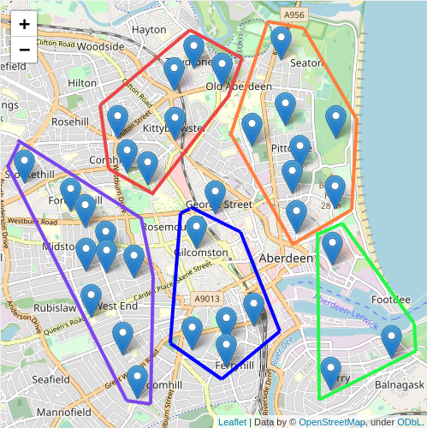
Clustering
Blue markers represent a customer
Grouped into 5 clusters
The centre marker is the depot

Slide 21
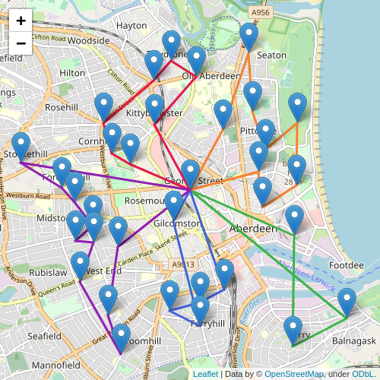
Path Finding
Routes for each of the 5 clusters
Each different coloured line represents the route for that cluster
Found using the genetic algorithm

Slide 22
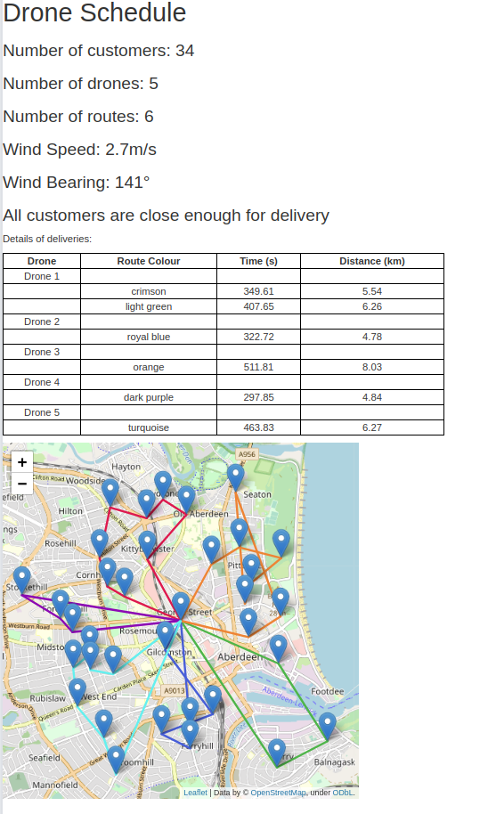
HTML Output
Very basic HTML file
Little styling
Gives an overview of parameters and weather of last run
Shows resulting routes in a table
Shows the map

Slide 23
Requirements Specification
Was created earlier on in the project
Details Must haves, Should haves and Could haves of the project functionality

Slide 24
Must Haves
Essential functionality
Must all be completed
Function | Requirement Met
A GUI | Yes
Real City Map | Yes
User input from GUI | Yes
User controlled parameters from GUI | Yes
Clustering Algorithm | Yes
Path finding algorithm | Yes

Slide 25
Should Haves
Good to have functionality
Should all be completed
Function | Requirement Met
Solution produced in a reasonable timeframe | Yes
Simple to use GUI | Yes
Explore alternative path finding algorithms | Yes
Weather conditions considered | Yes
Interactive user input | Yes
Delivered as a .exe | No

Slide 26
Could Haves
Extra features
Not necessary for the application to complete the main functions
Function | Requirement Met
Display current state of routes | No
Show where drones are on their routes | No

Slide 27
Evaluation

