Slide 1
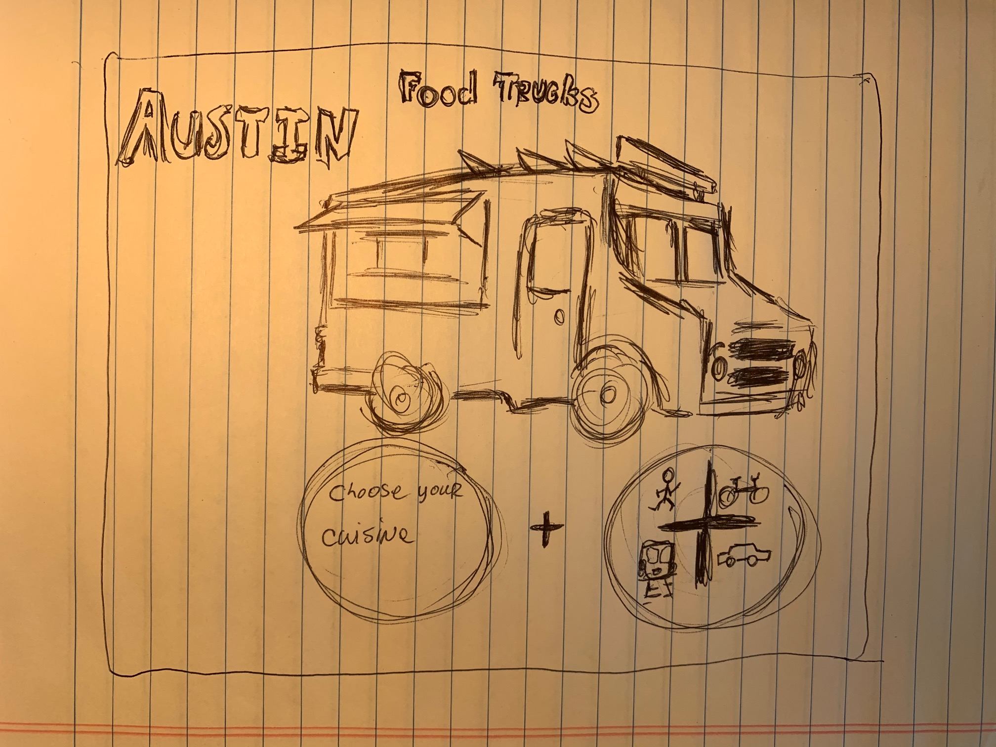
Welcome Page

Slide 2

FoodTrucksATX
Feeling flakey…start over . . . . . . .
What looks good?
Name of place
Distance
Cuisine
Name of place
Distance
Cuisine
Name of place
Distance
Cuisine
Name of place
Distance
Cuisine
Name of place
Distance
Cuisine
Name of place
Distance
Cuisine
Name of place
Distance
Cuisine
Name of place
Distance
Cuisine
Results Page

Slide 3

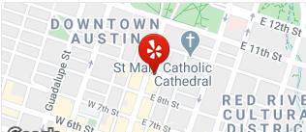
FoodTrucksATX
Feeling flakey…start over . . . . . . .
Is this it?
Name of place
Distance
Cuisine
Address
Hours?
Directions ;alsdkfja;sdlkfjasdf;lkjsadf;lkasdjf;lasdjfa;ldksaf;lkjadf;ksajdf;aksdjf;akfjaskfsa;lkfjsad;lfkjsa;ljsf;sajf;lskdj;lsakdjf;alskdfjasd;lkfjsda;lkjsda;lkfjsadlfj;fjsf;kasdjf;lkasdjf;lsadkjaskfjas;kfjasd;lkjasf;lkjsadf;lkjsdaf;lkjsadf;ljsf;ksjaf;lksajf;lkasjdf;lkasjf;lkajsdfas;dlkjasd;lfjasd;flkjasdf;lkjsadf;lkasjdfjas;dlkfjj
Fun Facts
Rating, verbiage from API, etc.
Selection Page

