Slide 1
OOD - group 12
OOAD Spring-2020-A1

Slide 2
Actors
Main actors:
Moderator: the manager of each group, occupied in creating group, inviting watchers and movie watching related business.
Watchers: group member, participating in movies events and then voting to elect the best movies.
Secondary actors:
Server: provide movie list, publish notification and keep history records.
Trailer service: provide movie trailers links for each movie in the movie list.
Movie review service: provide movie reviews links for each movie in the movie list.

Slide 3
Use cases - moderator
Create group: the moderator can create a movie watcher’s group
Invite to group: the moderator can invite family and friends to join the group
Populate movie list: the moderator can populate movie watcher’s groups with a list of potential movies that could be watched.
Pull movie list: the moderator can pull a movie list from a movie list server/API
Create watching event: the moderator can create a movie watching event that will occur in the specified date and time defined by the moderator.
Open voting period: the moderator can open a voting period for a specific movie watching event.
Close voting period: the moderator can close a voting period for a specific movie watching event.

Slide 4
Use cases - moderator
Add trailers’ link: the moderator links each movie’s trailer to the movie in the movie list.
Add reviews’ link: the moderator links each movie review to the movie in the movie list.

Slide 5
Use cases - watcher
Join group: watchers can join a group of movie watchers.
Unsubscribe group: watchers can unsubscribe from movie watcher’s groups.
Watch the trailer: watchers can watch the trailer of the movies that have been populated by the moderator.
Read reviews: watchers can browse the review of the movies that have been populated by the moderator.
Vote to watch or not: watchers can cast their votes.
Search and browse movies: watchers can search and browse the movies that have been populated by the moderator.

Slide 6
Use cases - server
Provide movie list: the server can provide movie list for moderators to pull.
Notify to watch movies: the server notify watchers that a movie watching event was created.
Notify to vote: the server notify watchers that they can vote for the movies that they want (or do not want) watch in this movie watching event
Keep history: the server can keep the history of movie watching events, votes, and winners for each movie watching group.
Elect winner: the server can elect a single movie winner for a movie watching event.

Slide 7
Use cases - trailer service
Provide trailers’ link: the trailer service can provide trailers’ link for moderator to add.

Slide 8
Use cases - movie review service
Provide reviews’ link: the movie review service can provide reviews’ link for moderator to add.

Slide 9
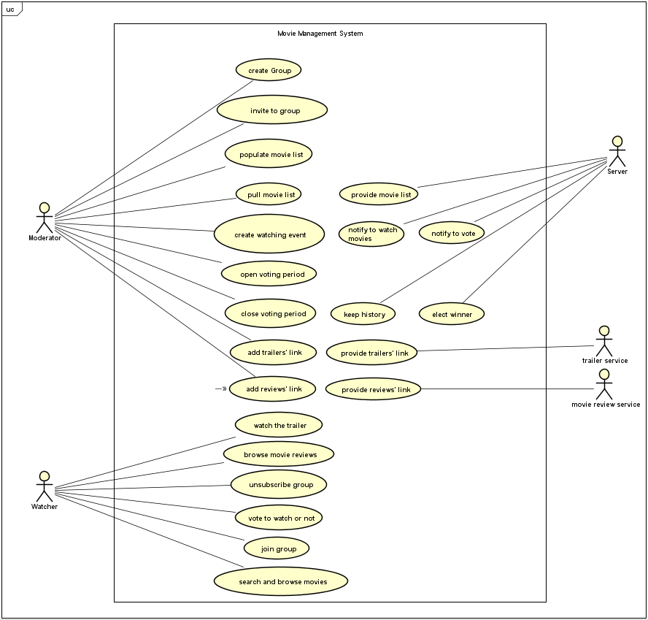
Use case diagram

