Slide 1
ConnectFourJS
Notes:
Welcome to our presentation about programming Connect Four in JS. My name is Hannes Reindl (switch to bernhard) and my name is Bernhard Vergeiner

Slide 2
Outline
The Game – Connect four
Requirements
Core ideas
Main classes and interfaces
Main game loop
Undo/Redo
Save/Load
Design Patterns
Improvements
Live demo
Notes:
First we will talk about the game itself - connect four – and the requirements which had to be fullfilled
Next up are the core ideas for our program, where we explain the main classes, the main game loop, how undo/redo as well as save/load was implemented
After that we talk about some used design patterns and show some code snippets of our implementation.
In improvements we will talk about things we could do better in retrospect and at last we show a small live demo of our game.

Slide 3
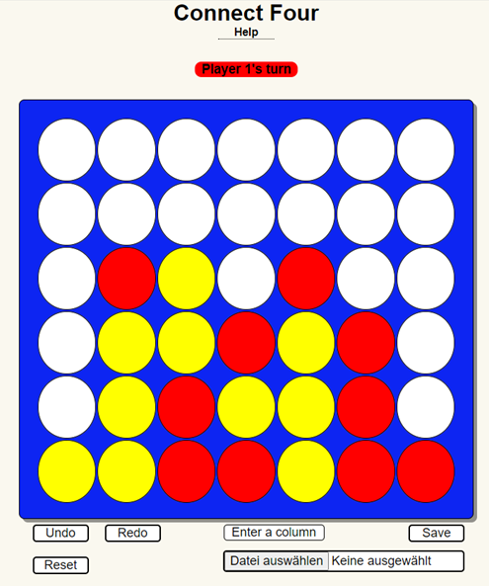
The Game – Connect four
Users alternate between moves
Only valid moves allowed
Player who connects 4 in a row wins
Graphical User Interface
Undo/Redo
Save/Load
Notes:
On the right side you can see our graphical interface which consists of a 6 x 7 grid and various buttons. You can play a chip by simply clicking in the respective column on the grid or enter a column in the text field below (where enter a colum is written). The buttons are rather self-explanatory, you can undo/redo save/load a game and reset the game. Users alternate between moves, only valid moves are allowed and the first person to connect 4 in a row wins the game.
We opted for the programming language java script since it allowed to use to create a GUI wihtout much hassle using html. Furthermore it should be able to undo/redo moves meaning that you can go from for example a finished game to an empty grid. It should also be possible that you can start playing after doing some undo‘s, altering time itself to maybe win the game instead of loosing. Save/load should also be implemented, which can be used to save a board state and load it again at any time.

Slide 4
Core ideas
Main classes and interfaces
Model
2D array to store board
List of playedMoves
Save/Load
View
Interface to draw the board / current player
Controller
Implementation of game logic (win condition; undo/redo)
main
Interface between JS and HTML
Instantiation of other classes
Notes:
Alright, the main classes and interfaces. We used the model-view-controller design pattern, thus it is only reasonable that we have a model, view and controller class. The main class is used to link the HTML and JS code as well as instantiate the model/view and controller. The model class takes care about everyting storing/loading related, thus it holds a 2d array which stores the state of the connect four board, a list of all played moves, which can be used to recreate the entire history of the board as well as a save/load method to – well – save and load a game. The view class is responsible for everything draw onto the screen of the players (updating the board after playing a chip, show the current player). The controller takes care of the game logic(checking for the win condition, undo/redo moves)

Slide 5
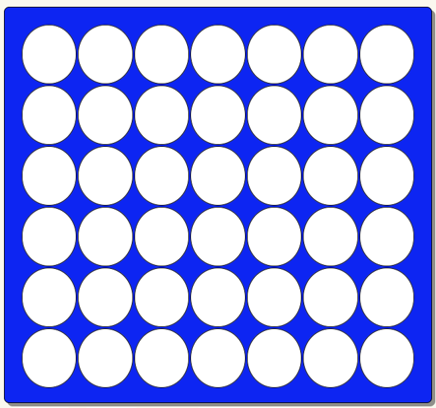
Core ideas
Main game loop
Event Listener for each HTML table cell
Event Listener calls the playChip(col) function
playChip(col):
updates model
Board content + List of playedMoves
updates view
Checks win condition
Notes:
Next we talk about the main game loop. Like most of the other students we created an eventListener for each cell (picture top right). If the player clicks in any of the cells an array listener will call the playChip function of the controller, providing the column where the cell is. The playChip function then updates the stored model and list of played moves. Then it also asks the view to update, thus showing the user the played move and in the end checks if a player won.

Slide 6
Core ideas
Undo/Redo
playedMoves holds the clicked columns as a list
Allows to recreate the entire history
Undo decrements reference to the previous element in playedMoves
Removes last played chip from board
Redo increments it
Plays the “new” move
Notes:
Now we explain how undo/redo was implemented. The playedMoves list holds all the clicked columns of the previous moves. If for example the last entry in playedMoves is a 0, the last played chip is in the first column at the first non-empty cell searching from the top. With this information and the knowledge of current player (i.e. the player wich can place the next chip) all states of the game can be recreated. To keep track of where we are in the undo/redo chain, we created an index which is basically a pointer to the last played move. Undoing is then done by taking the value at which the pointer points to, using, searching the column from top to bottom provided by this value and setting the first non-empty field to empty. The list of played moves keeps unchanged for undos and redos. Only after playing a move the list of playedMoves gets updated which can simply adding an item, but also deleting the other timeline branch.

Slide 7
Core ideas
Save/Load
Save stores the list of playedMoves in a file
Load reads the file and replays the game (using the main game loop)

Slide 8
Design Patterns - Overview
Model - View - Controller
Singleton
Façade
Iterator
Notes:
Erklärung von DP in 2-3 Sätzen
DP Begründung
Code ausschnitt / impementierung ?

Slide 9
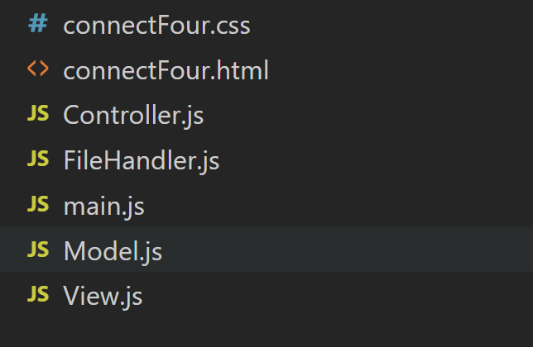
Design Patterns: Model - View - Controller
Responsibilities of data management (Model), visualizing (View) and processing (Controller) are separated
Suitable for GUI applications
Loose coupling between data and visualization
Notes:
Erklärung von DP in 2-3 Sätzen
DP Begründung
Code ausschnitt / impementierung ?
MVP

Slide 10
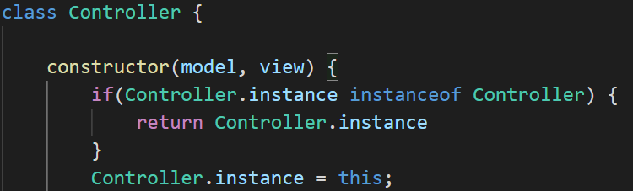
Design Patterns - Singleton
Ensure that only one instance for a class exists
Provides a global access point to the instance
Notes:
Verwendung von Singleton:
Global access war praktisch bei der callback function für ‘load’ (FileHandler kennt Controller nicht, aber singleton stellt global access point zur Verfügung)
Problem: We need global access to the Controller class and want to ensure there’s only one controller.
Solution: If there is already an instance of the controller class, return the same instance. This is the singleton pattern.

Slide 11
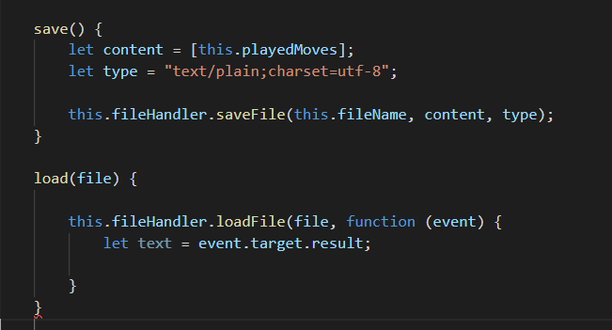
Design Patterns - Façade
Provide a higher-level interface for the client to be used
FileHandler class implements an easier to use interface to save/load the board the state
Notes:
Erklärung von DP in 2-3 Sätzen
DP Begründung
Code ausschnitt / impementierung ?
Problem: We need to convert our internal object to a text file which can easily be stored by the user.
Solution: We created a FileHandler class which takes care of this conversion and allows the two interfaces to be compatible.
Basically we convert our internal object to a text file and vice versa.
We implement a common interface for file handling. The saveAs and loadFIle function are from two different libraries thus we implemented an adapter for inter-compatibility. The entire fileHandler class is our adapter.
Problem: We have two interfaces: one textual saved history of the board state and a local object in the program.
Solution: Use an adapter to convert the text file content to an object.
Vl Observer

Slide 12
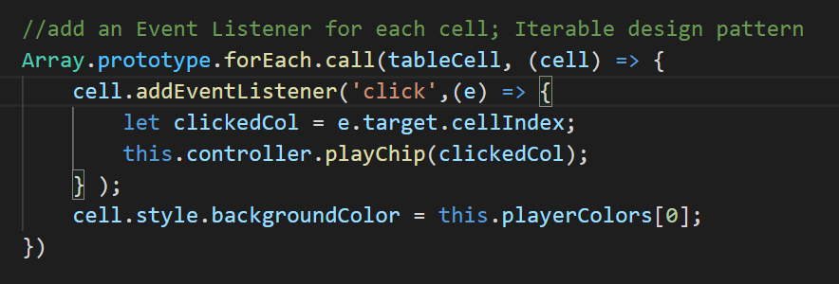
Design Patterns - Iterator
Iterator allows to access every element in a data structure
Without exposing the underlying representation
Notes:
Erklärung von DP in 2-3 Sätzen
DP Begründung
Code ausschnitt / impementierung ?
The forEach term implements the iterator and we use it to iterate over all cells of the table. (i.e. board)

Slide 13
Improvements
Command Pattern for Undo/Redo
Smaller granularity in the main game loop
Name methods corresponding to design patterns to increase readability of our code
Load: file content sanity check
Build the HTML table in the view (rather than hard-coded in the corresponding HTML file)
Notes:
Erklärung von DP in 2-3 Sätzen
DP Begründung
Code ausschnitt / impementierung ?

Slide 14
Live Demo

Slide 15
Questions

Slide 16
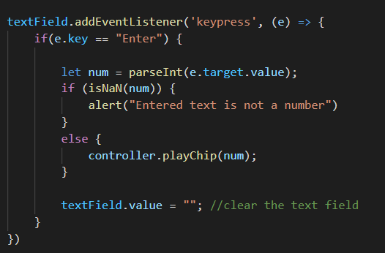
Design Patterns - Adapter
Wrap around a class to make it compatible to another interface
Text box interface:
Notes:
Erklärung von DP in 2-3 Sätzen
DP Begründung
Code ausschnitt / impementierung ?
Problem: We need to convert our internal object to a text file which can easily be stored by the user.
Solution: We created a FileHandler class which takes care of this conversion and allows the two interfaces to be compatible.
Basically we convert our internal object to a text file and vice versa.
We implement a common interface for file handling. The saveAs and loadFIle function are from two different libraries thus we implemented an adapter for inter-compatibility. The entire fileHandler class is our adapter.
Problem: We have two interfaces: one textual saved history of the board state and a local object in the program.
Solution: Use an adapter to convert the text file content to an object.
Vl Observer

Slide 17
Live Demo
Chip einwerfen (Maus; Textbox)
Winning condition (Ziel des Spiels)
Undo / Redo
Save / Load
Undo / replay ganzes spiel
Undo -> place -> no redo
Reset button

Slide 18
Design Patterns - Memento
Allows to save/restore a previous state of an object
Implementation details of the class remain hidden
Model class implements memento (via save/load)
Notes:
Erklärung von DP in 2-3 Sätzen
DP Begründung
Code ausschnitt / impementierung ?
Problem: How to save/load the state of the board.
setSate: board[i] = 1
getState: board

