Slide 1
Machine Learning Project
Nicklaus Rhodes, Cizhen wu, Shuai yuan, Uddipan Chatterjee

Slide 2
Data Cleanup & Preprocessing
The following columns were discarded while data preprocessing due to having least impact on the outcome attribute loss_amount.
Vehicle_Annual_Miles
Vehicle_Comprehensive_Coverage_Limit
Driver_Minimum_Age
Driver_Maximum_Age
EEA_PolicyYear
Vehicle_New_Cost_Amount
Vehicle_Make_Description
EEA_Policy_Zip_Code_3

Slide 3
Data Cleanup & Preprocessing
The column which contained invalid values occurring in a small number of occasions we deleted those records. The columns are given as follows:
EEA_Policy_Tenure
Vehicle_Symbol
Vehicle_Days_Per_Week_Driven
Vehicle_Anti_Theft_Device

Slide 4
Data Cleanup & Preprocessing
We replaced invalid data in some column where they occurred in a large no of instances in some occasion by the mean of the column or by an unique numeric values (as 00000 for invalid zip code). These columns are as follows:
Policy_Zip_Code_Garaging_Location : 00000
Vehicle_Miles_To_Work: mean
Vehicle_Passive_Restraint:Y (most recurring value)
Vehicle_Med_Pay_Limit: mean
Vehicle_Physical_Damage_Limit : 0000
Vehicle_Collision_Coverage_Deductible: 0000

Slide 5
Two step modeling approach
We had run our whole dataset on Linear Bayesian Models as well as Neural Networks but did not get an accurate results due to the fact that the data contains large number of rows with 0 claim count.
Thus we decided to do a two step model where at first we we run our dataset through a decision tree which determines the probable policies which can have a claim count. Once we have identified the policies we run the dataset on our 2nd model which is neural network giving us the loss_amount for those policies.

Slide 6
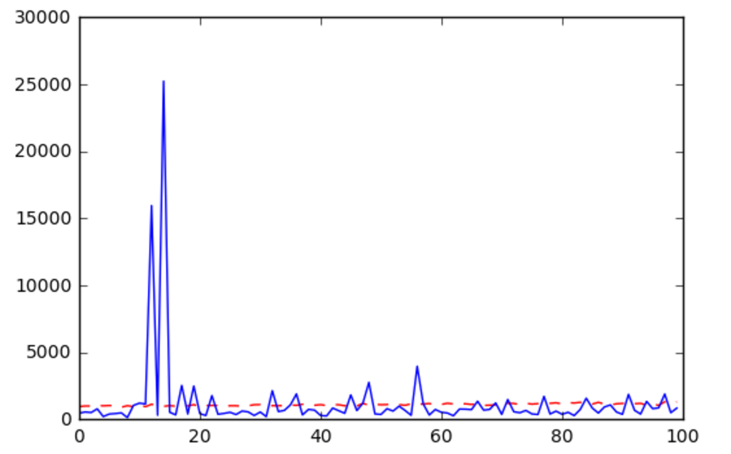
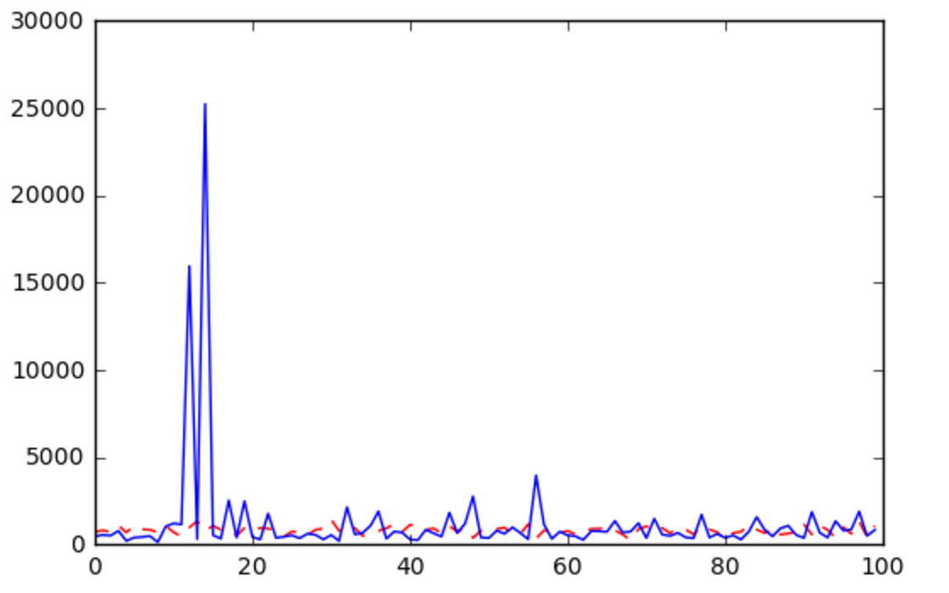
Linear Baysian & Neural Network

Slide 7
Model -1 & 2
Setting training and testing data size
Categorizing continuous data columns
Encoding the dataset
Applying Ridge regression to the model
Apply feature selection with help of RFE

Slide 8
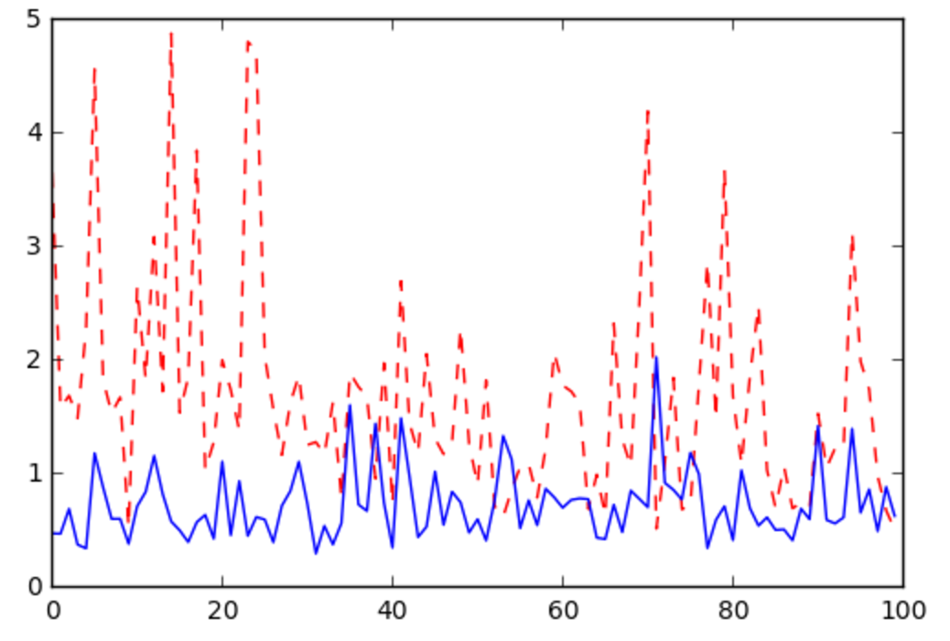
Model -1 & 2
Standardize features by removing the mean and scaling to unit variance(StandardScaler)
Applying dimensionality reduction (PCA)
Applying decision tree to determine if the record is likely to have a claim or not
If it has a claim pass the record to the neural network where the loss_count would be predicted.

