Slide 1
i5 Cyber Course CTF Fundamentals
05 November 2024 C/4C Nacanaynay

Slide 2
Overview
Intro to CTFs
Styles of CTFs
Competitions Format
Writeups
Ground Rules
Air Recommendations
General Solving Strategy
Additional Tips

Slide 3
Into to CTFs
Capture The Flag
Fun games where you try to find the password (flag) to submit for points
Exercises for learning about cybersecurity
Often have small prizes for winners (money, t-shirts, subscriptions)

Slide 4
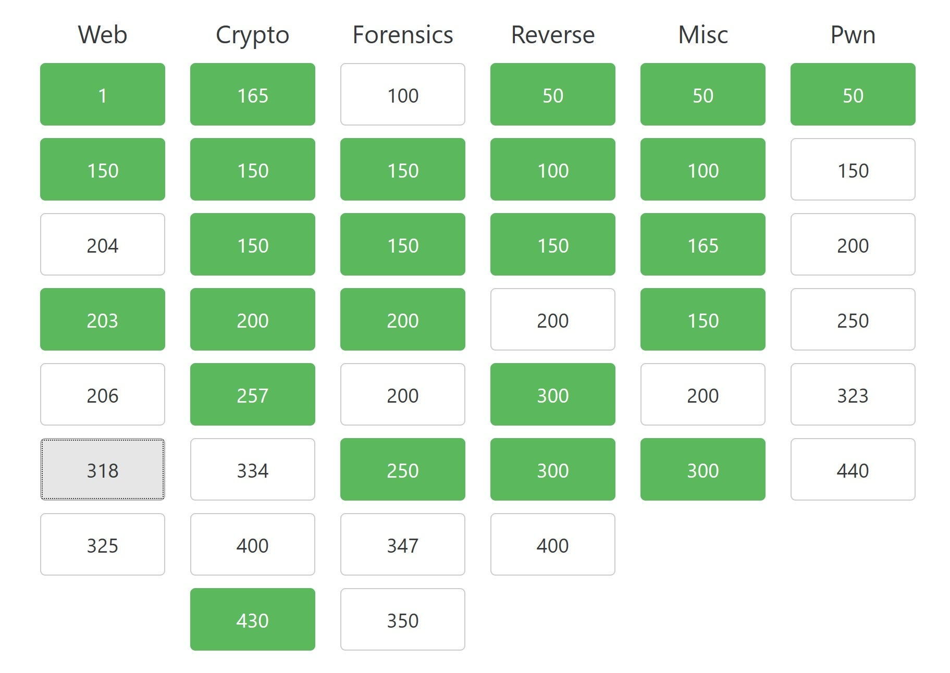
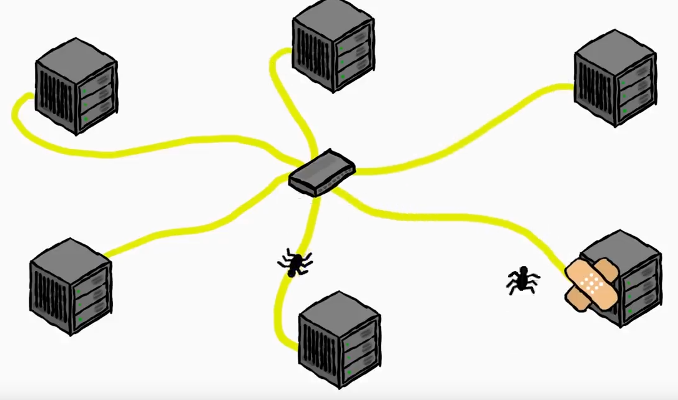
Styles of CTFs
Jeopardy
You vs the creators
Solve challenges under different categories for points
Attack-Defense
You vs other players
Protect your own assets and attack other players’ things for points

Slide 5
Competitions Format
Teams of ~4-6 people
Generally 48 hours long, some are over a week
Top websites with CTF listings:
https://ctftime.org
https://picoctf.org

Slide 6
Writeups
Walkthrough for solving a CTF challenge
Can be video but usually text
Less formal writing style

Slide 7
Ground Rules
Do not attack host infrastructure (Denial of Service attacks)
Do not share info with other teams
You will usually have to wait at least a week before publishing solutions.

Slide 8
Air Recommendations
GOOGLE GOOGLE GOOGLE BING YANDEX CHATGPT
Use all tools at your disposal
There are no “correct” solutions
The space’s the limit

Slide 9
General Solving Strategy
Read the Challenge
Challenge descriptions will point you in the right direction
Pay attention to category and number of solves
First Impression
If you are given a website, explore it
If you have any files, run them and explore
Also read all files in notepad
Research
Tinker
Repeat

Slide 10
Additional Tips
Use all the tools at your disposal
Most challenges should be solvable in a few minutes
This often rules out brute forcing
If what you’re doing feels really stupid or inefficient, there’s probably a faster way
Again, pay attention for any hints the challenge authors might be dropping
Research laterally
Try a different problem if you feel stuck

Slide 11
Summary
Intro to CTFs
Styles of CTFs
Competitions Format
Writeups
Ground Rules
Air Recommendations
General Solving Strategy
Additional Tips

