Slide 1
Abortion Legalization and Crime
Aubhik Mazumdar, Yuan Tian

Slide 2
Introduction
Problem Statement & Hypothesis
Datasets
Techniques

Slide 3
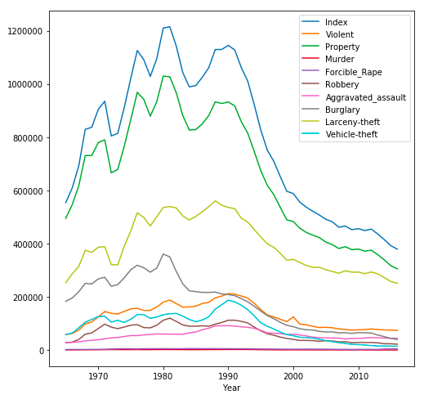
Crime Rates by Year
Facts:
All rates decline after 1990
People who born in 1973 are 18 yrs old in 1991
NY legalized abortion in 1973
(Roe vs Wade case in 1972)
Source: Bureau of Justice Statistics (BJS)
Notes:
Talk about the graph showing the correlation of crime (plot.png in github) We can see that crime reduced dramatically roughly 18 years after 1972. This was the exact time that the people born in 1972 turned 18

Slide 4
Explanation
In the book “freakonomics” the authors argue that the reason for the decline in crime was:
“Abortion legalization meant that parents who thought they were not fit to raise a child could avoid this. This also reduced the number of children who were neglected thus leading them to a life of crime.”

Slide 5
Problem Statement
Research Topic:
To determine how the legalization of Abortion affected crime in the US.
Hypothesis:
legalization of abortion contribute to the reduce of crime rates in the US.
Notes:
What we did was that we evaluated whether this claim is valid as many other confounding factors could also have lead to a decrease in crime. We thus found the contribution of legalization of abortion to the reduce in the rates of crime in the US.

Slide 6
Datasets
Features:
Abortion Rate (Center of Disease Control and Prevention)
Dow Jones Index Average (Bloomberg)
Incarceration (Bureau of Justice Statistics)
Crime rates (Uniform Crime Reporting Statistics + National Crime Victimization Survey)
Problems:
Insufficient data for NYC? ------ Use nationwide data
Stationary or Non-stationary? ---- Statistical Tests
Notes:
Insufficient data for NYC
So we chose the US to get a type-level causal effect instead of a token level causal effect.

Slide 7
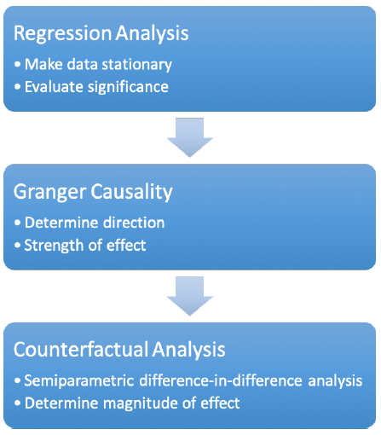
Techniques
Stationary conversion - Yuan
Linear Regression - Yuan
Granger Causality - Aubhik
Counterfactual Analysis - Aubhik

Slide 8
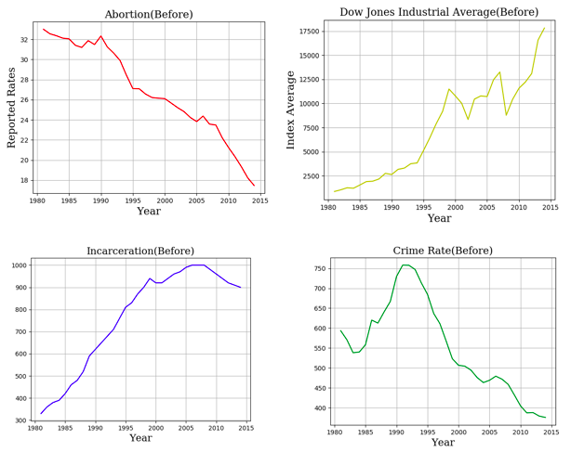
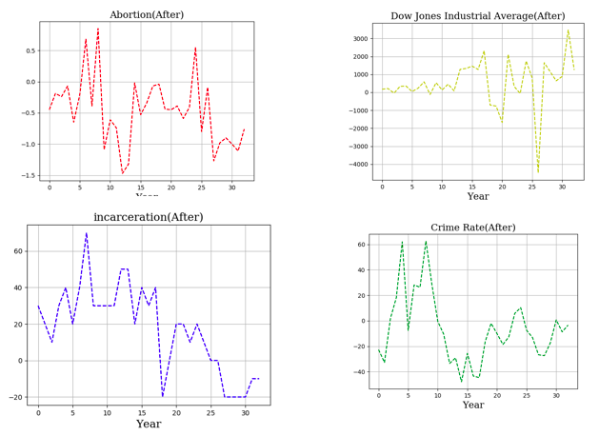
TECHNIQUE 1: Stationary conversion
Statistical Test Result: Trend Stationary - Detrend by differencing method
Notes:
Dont write much...talk and show the graphs before after for all.

Slide 9
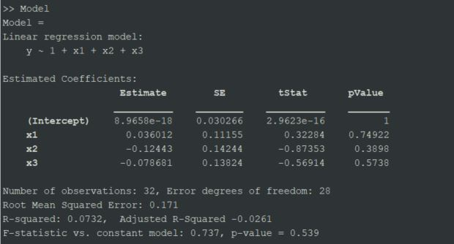
TECHNIQUE 2: Linear Regression
Normalization is still needed
Use MATLAB and SAS
Notes:
Talk about the normalization Compare the SAS and MATLAB results

Slide 10
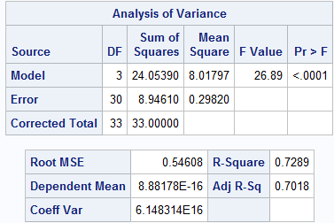
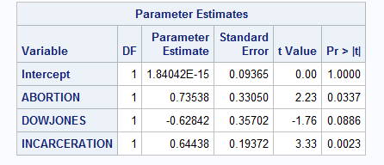
TECHNIQUE 2: Linear Regression
A better result in SAS
Notes:
Talk about the normalization Compare the SAS and MATLAB results

Slide 11
TECHNIQUE 2: Linear Regression
Conclusion:
We are still not 100% sure about the significance of abortion but it is definitely not insignificant….
Thus, we need to study it further using Causal inference techniques
Notes:
Talk about the normalization Compare the SAS and MATLAB results

Slide 12
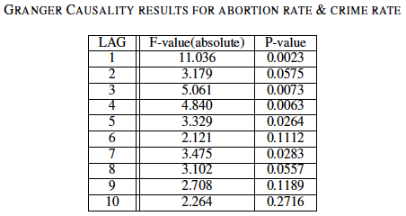
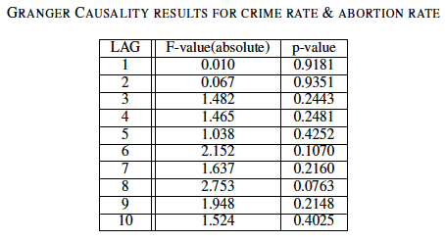
TECHNIQUE 3: Granger Causality
Tested the direction for the cause and the effect by using Granger Causality
Results were not ideal
Tested for other variables and got similar results
Notes:
Tested the direction for the cause and the effect by using Granger Causality available in the Python statsmodels package. We tested the direction for all the variables in our
The results were not the best but we did find that the direction is from the abortion rate to the crime rates. We verified this by also testing the direction for the incarceration rate, and the dow jones index and saw that the same applies for them as well. Unfortunately, granger causality does not tell us the magnitude of the effect.

Slide 13
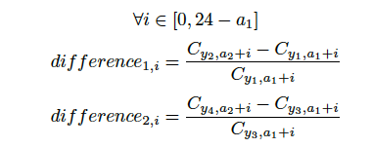
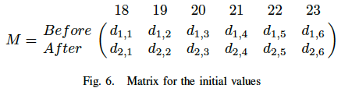
TECHNIQUE: Counterfactual Analysis
Semi-parametric difference in differences approach
Terrible drawing incoming..
Country-wide data, crimes by age
Notes:
Talk about the limitations. Trends in the crime data are reflected. The sign depends on that.

Slide 14
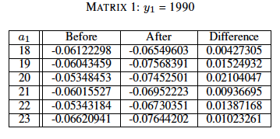
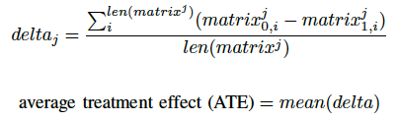
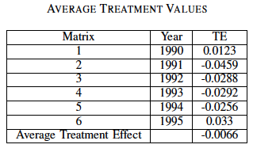
Results

Slide 15
Future Work
Structural Equation modelling can be applied if we have the right data
Better counterfactuals may exist
Australia, Russia
Carry out this experiment in a controlled environment where abortion is still illegal.
Apply this technique on other laws. Eg. Gun control

Slide 16
What we have learned about Causality?
Granger Causality is a compass not a navigator
Counterfactuals are hard to find
Extremely valuable!
VS Machine Learning?
Answering why something happens and not just when
Maybe robots should be taught causality instead of simple pattern matching
“All the impressive achievements of deep learning amount to just curve fitting,” - Judea Pearl
“I don’t need it to be easy. I just want it to be worth it!” -Lil Wayne

Slide 17
CODE AVAILABLE HERE - https://github.com/Det2sial/CausalInference
“Everything should be made as simple as possible, but not simpler.”
- Albert Einstein

Slide 18
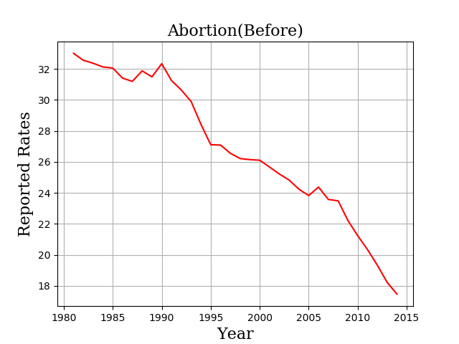
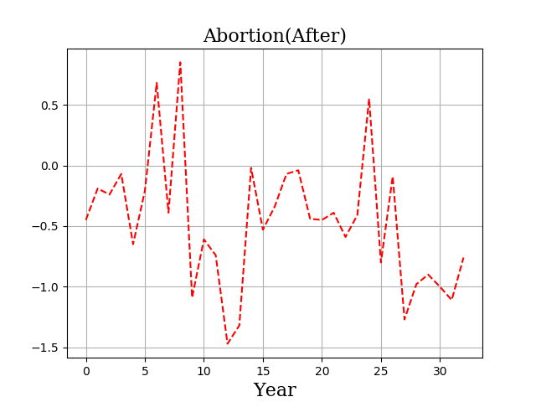
Appendix

Slide 19
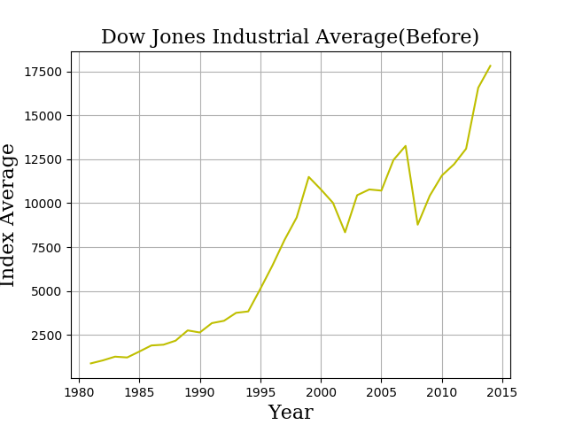
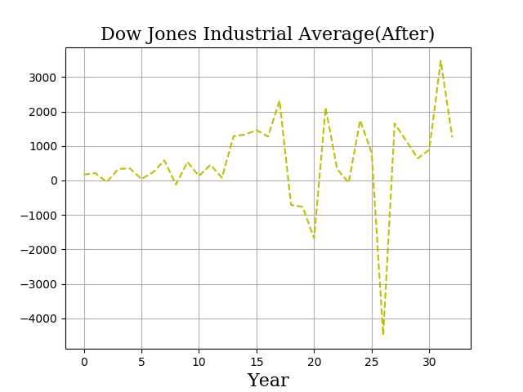
Appendix

Slide 20
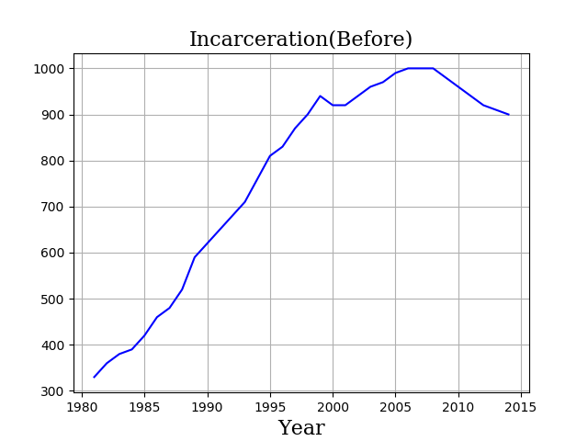
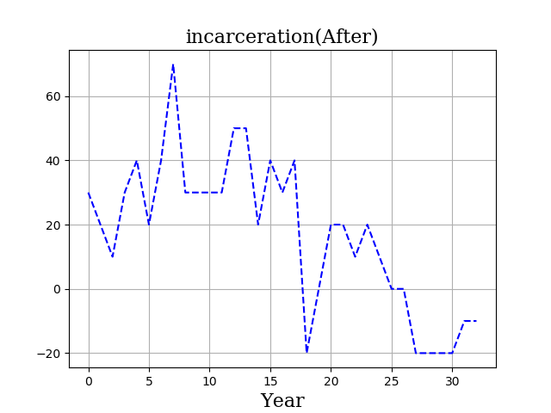
Appendix

Slide 21
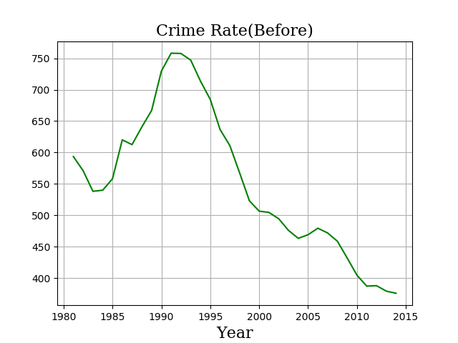
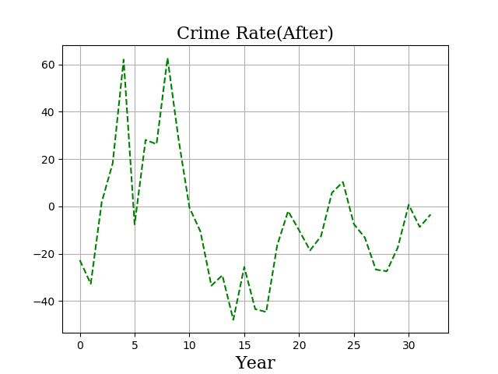
Appendix

Slide 22
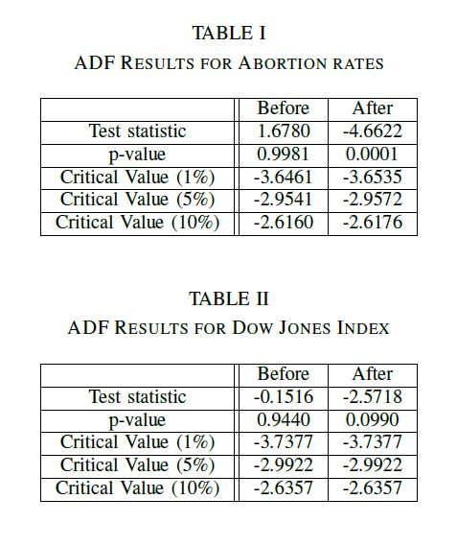
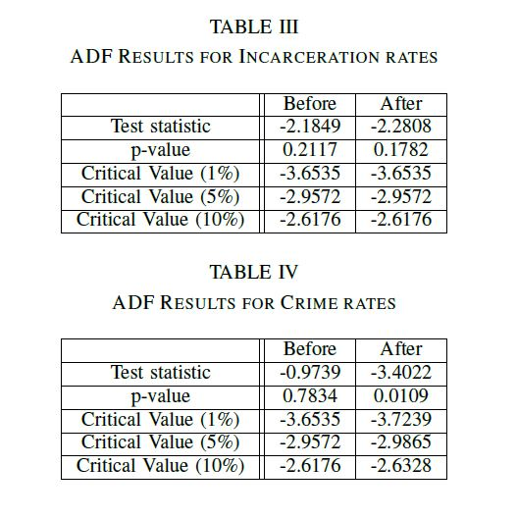
Appendix

