Slide 1

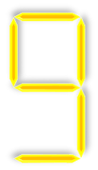







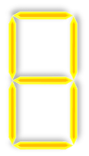


tekhnologic
Notes:
Scores are from 1 – 100
Caution: If you accidentally press the left arrow key it will reset the animations for the score board.

Slide 2
Class Quiz
START
Notes:
Clicking ‘Start’ will go to slide 3 and begin the game.

Slide 3
Question
Answer
Answer
Answer
Answer
Scores
>
tekhnologic
Notes:
A: Correct

Slide 4
Question
Answer
Answer
Answer
Answer
Scores
>
tekhnologic
Notes:
B: Correct

Slide 5
Question
Answer
Answer
Answer
Answer
Scores
>
tekhnologic
Notes:
C: Correct

Slide 6
Question
Answer
Answer
Answer
Answer
Scores
>
tekhnologic
Notes:
D: Correct

