Slide 1

CMPE/SE 257 Machine Learning Feb 12
Department of Computer engineering
San José state University
Spring 2018
Instructor :Bhavana Bhasker

Slide 2
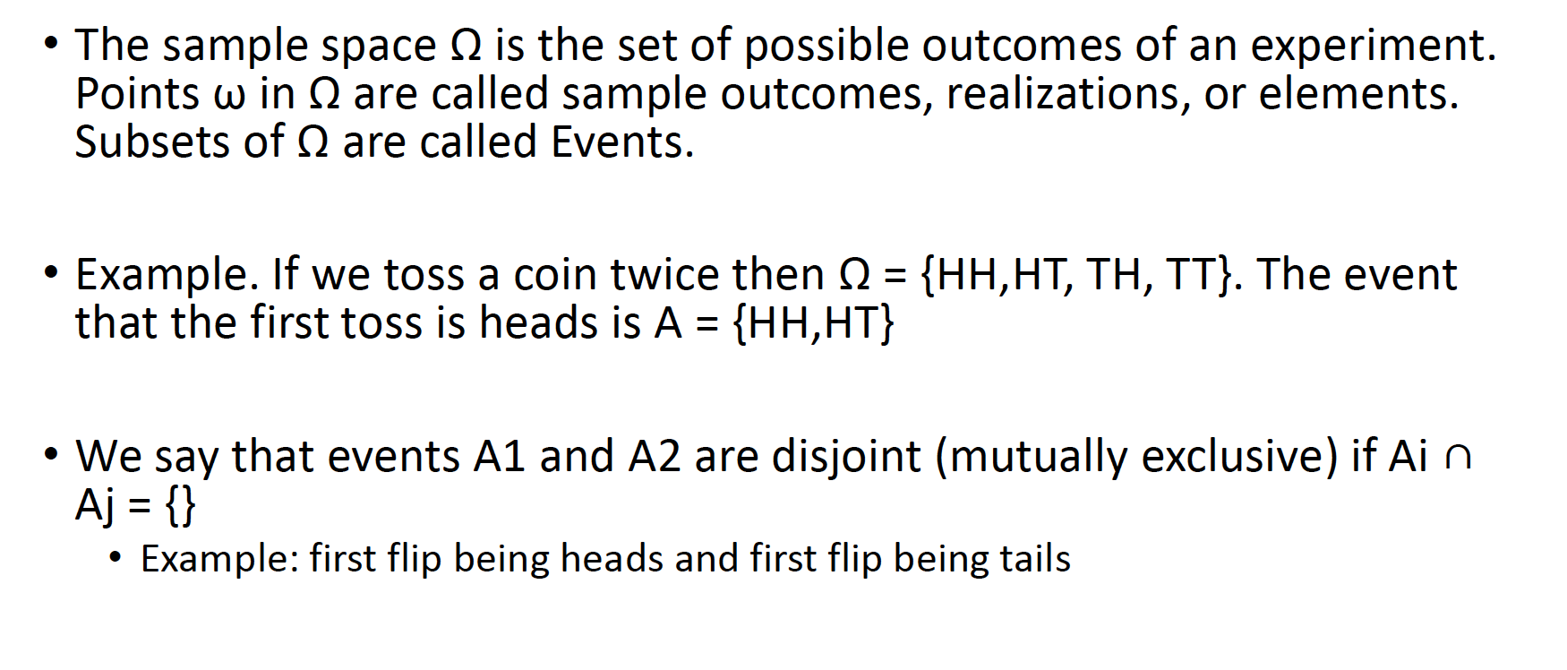
Sample Space

Slide 3
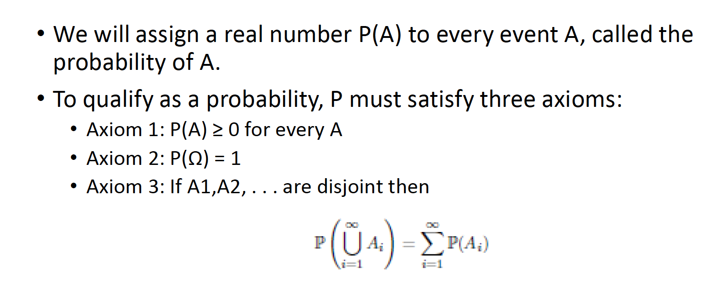
Probability

Slide 4
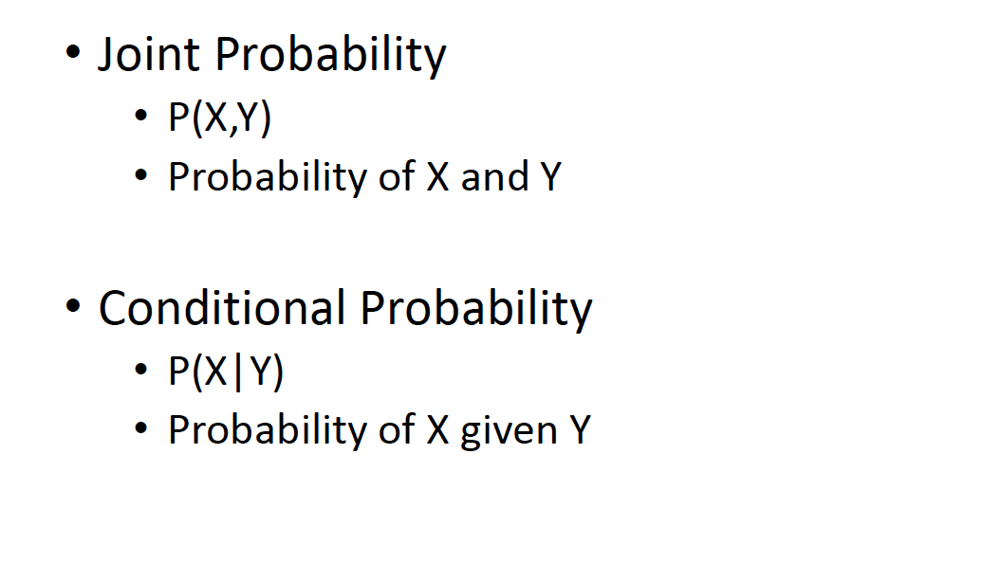
Joint and Conditional Probabilities

Slide 5
Practice Problem:
The number of patients seen in the ER in any given hour is a random variable represented by x. The probability distribution for x is:
x
10
11
12
13
14
P(x)
.4
.2
.2
.1
.1
Find the probability that in a given hour:
a. exactly 14 patients arrive
b. At least 12 patients arrive
c. At most 11 patients arrive

Slide 6
Practice Problem:
The number of patients seen in the ER in any given hour is a random variable represented by x. The probability distribution for x is:
x
10
11
12
13
14
P(x)
.4
.2
.2
.1
.1
Find the probability that in a given hour:
a. exactly 14 patients arrive
b. At least 12 patients arrive
c. At most 11 patients arrive
p(x=14)= .1
p(x≥12)= (.2 + .1 +.1) = .4
p(x≤11)= (.4 +.2) = .6

Slide 7
Review Question 1
If you toss a die, what’s the probability that you roll a 3 or less?
1/6
1/3
1/2
5/6
1.0

Slide 8
Review Question 1
If you toss a die, what’s the probability that you roll a 3 or less?
1/6
1/3
1/2
5/6
1.0

Slide 9
Review Question 2
Two dice are rolled and the sum of the face values is six? What is the probability that at least one of the dice came up a 3?
1/5
2/3
1/2
5/6
1.0

Slide 10
Review Question 2
Two dice are rolled and the sum of the face values is six. What is the probability that at least one of the dice came up a 3?
1/5
2/3
1/2
5/6
1.0
How can you get a 6 on two dice? 1-5, 5-1, 2-4, 4-2, 3-3
One of these five has a 3.
∴1/5

Slide 11
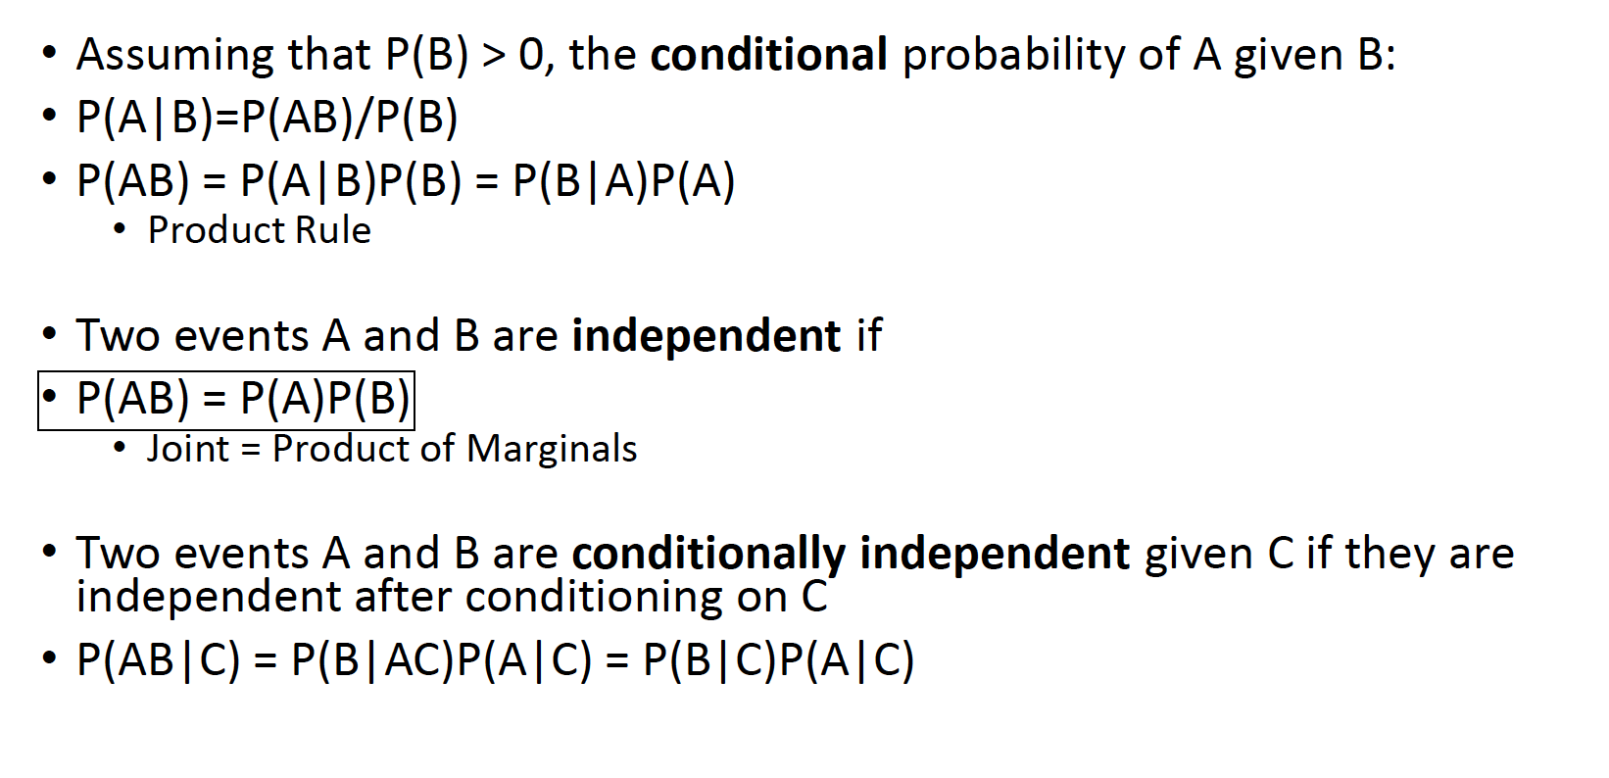
Independent and Conditional Probabilities

Slide 12
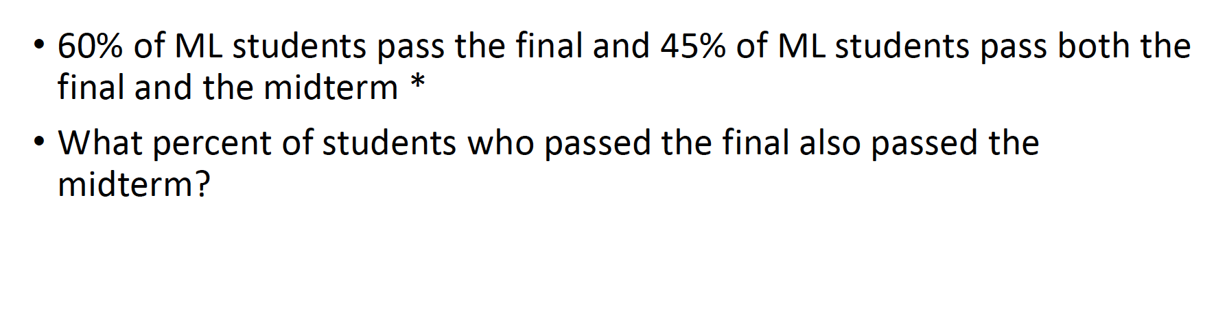
Example

Slide 13
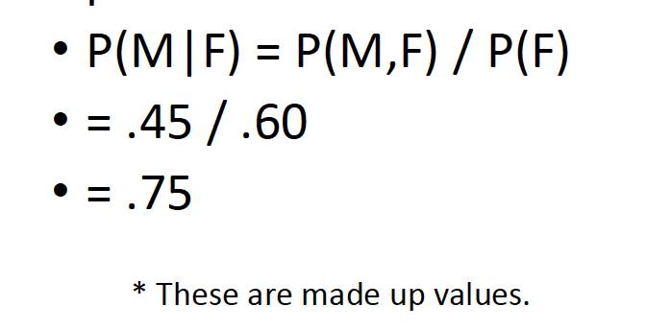
Example

Slide 14
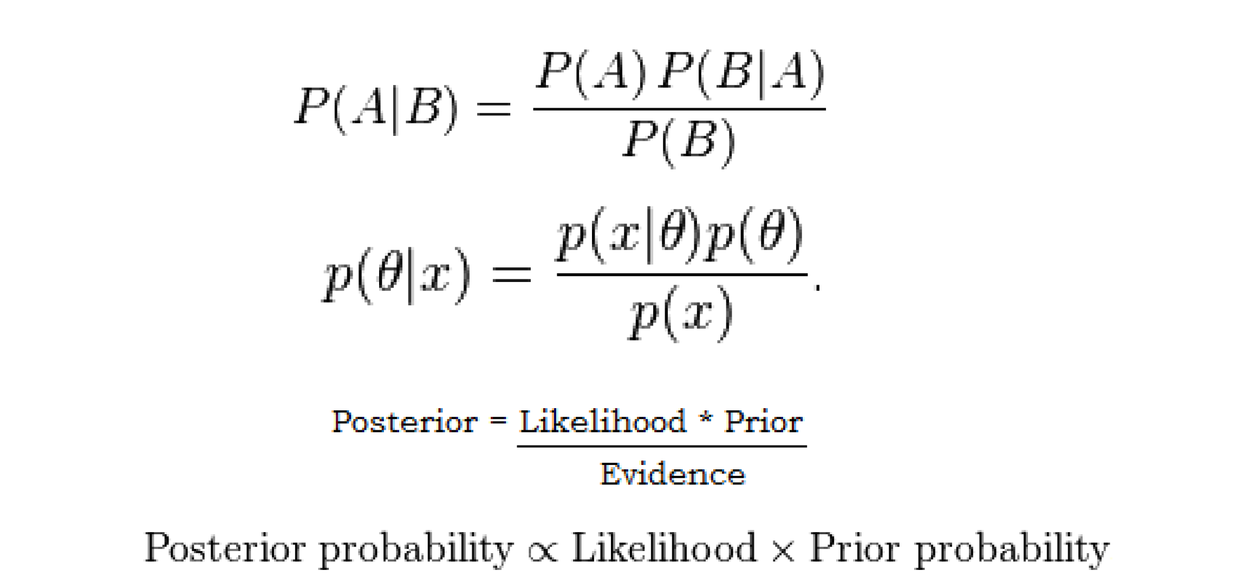
Baye’s Rule

Slide 15
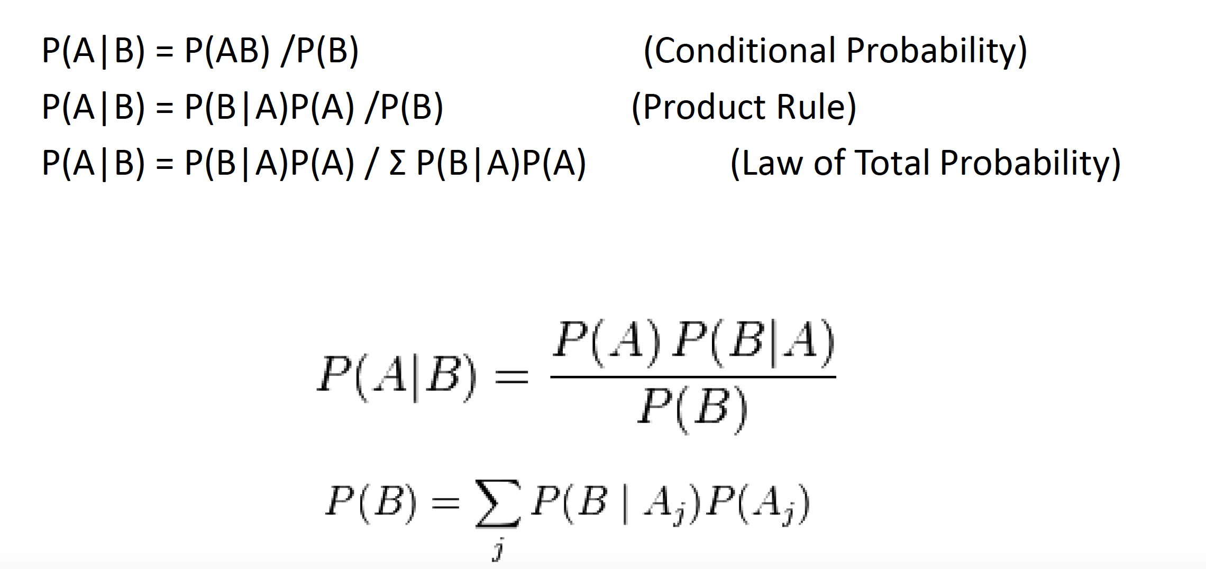
Baye’s Rule

Slide 16
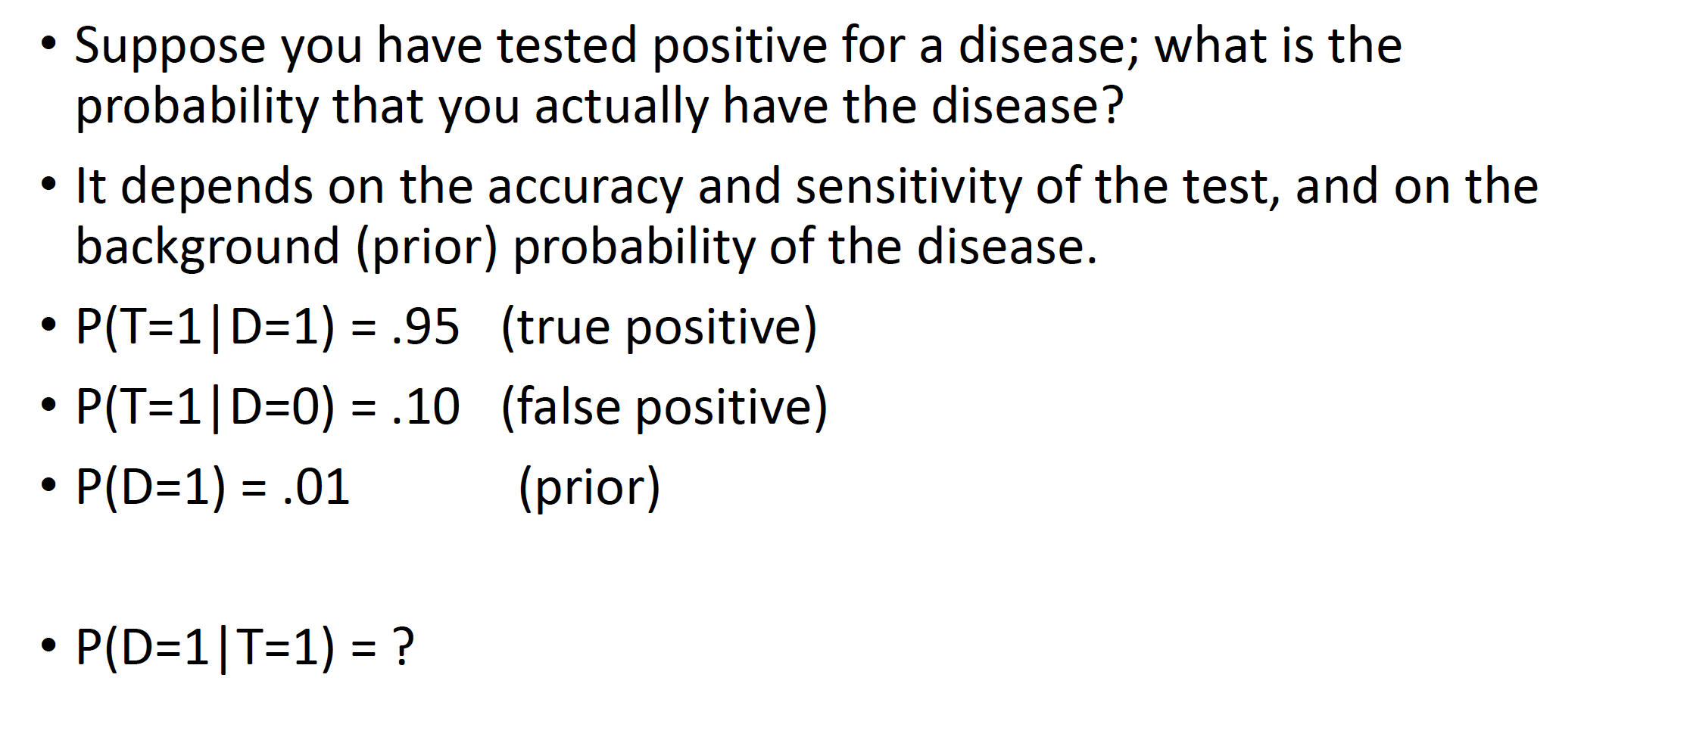
Example

Slide 17
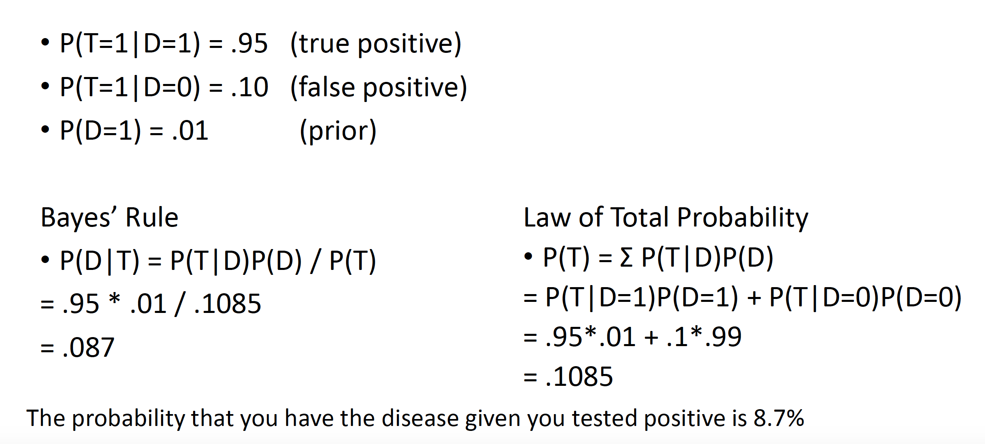
Example

Slide 18
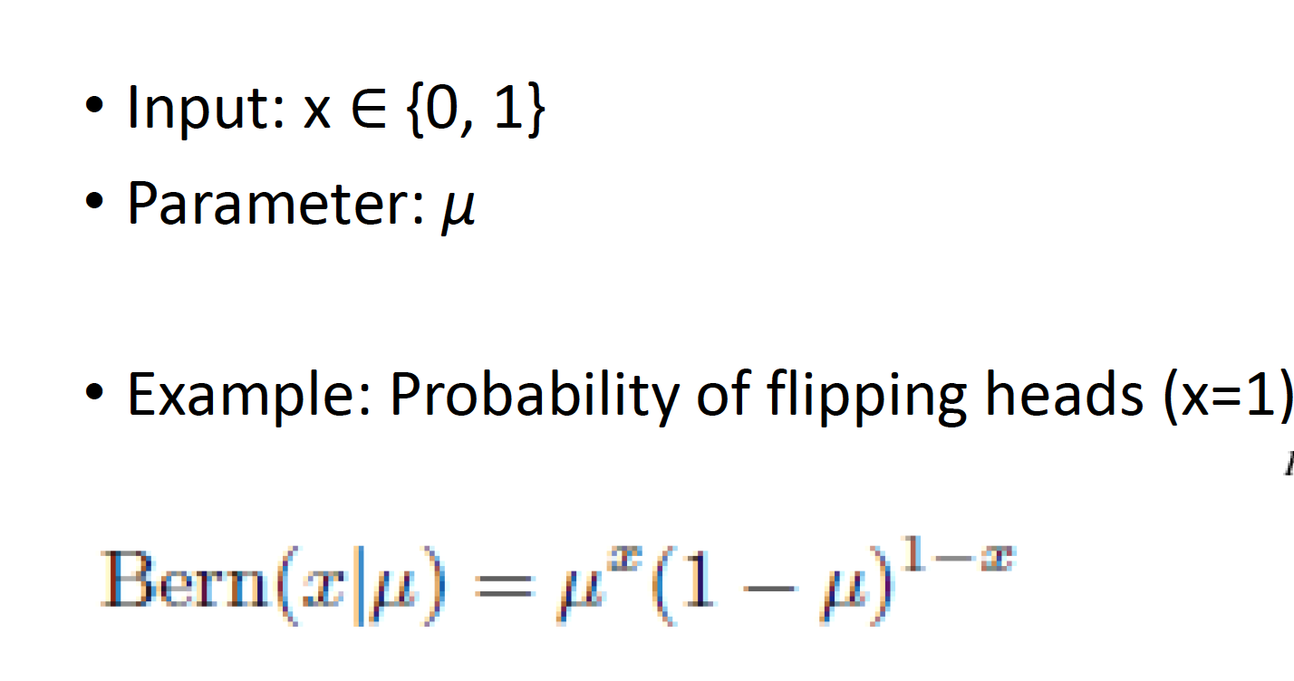
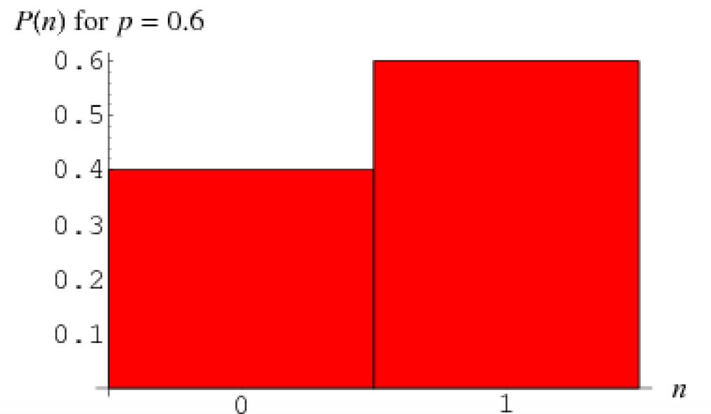
Bernoulli Distribution

Slide 19
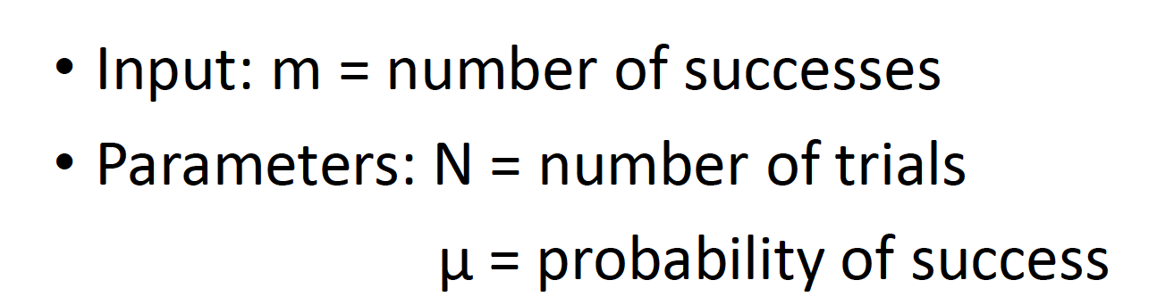
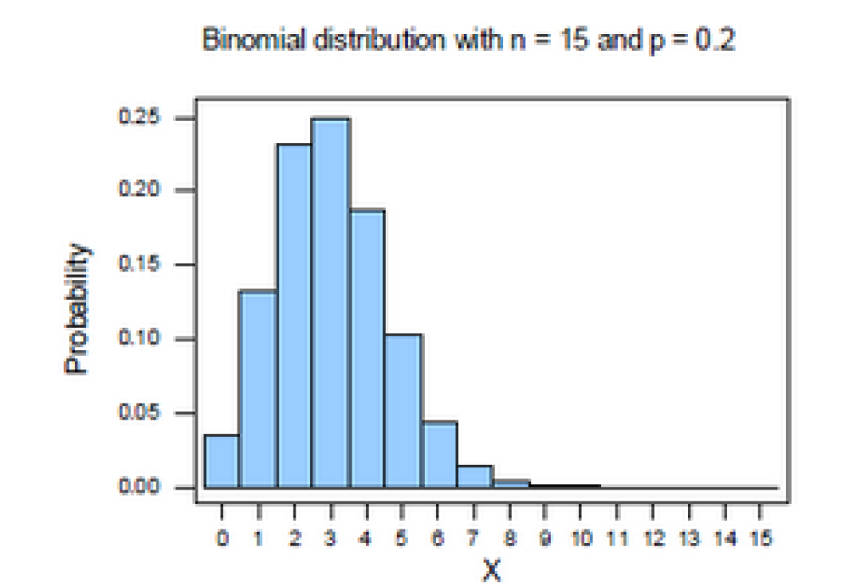
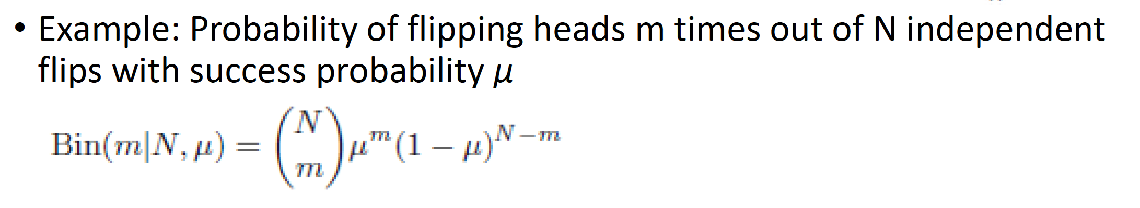
Binomial Distribution

Slide 20
Binomial distribution: example
If I toss a coin 20 times, what’s the probability of getting exactly 10 heads?

Slide 21
Binomial distribution: example
If I toss a coin 20 times, what’s the probability of getting of getting 2 or fewer heads?

Slide 22
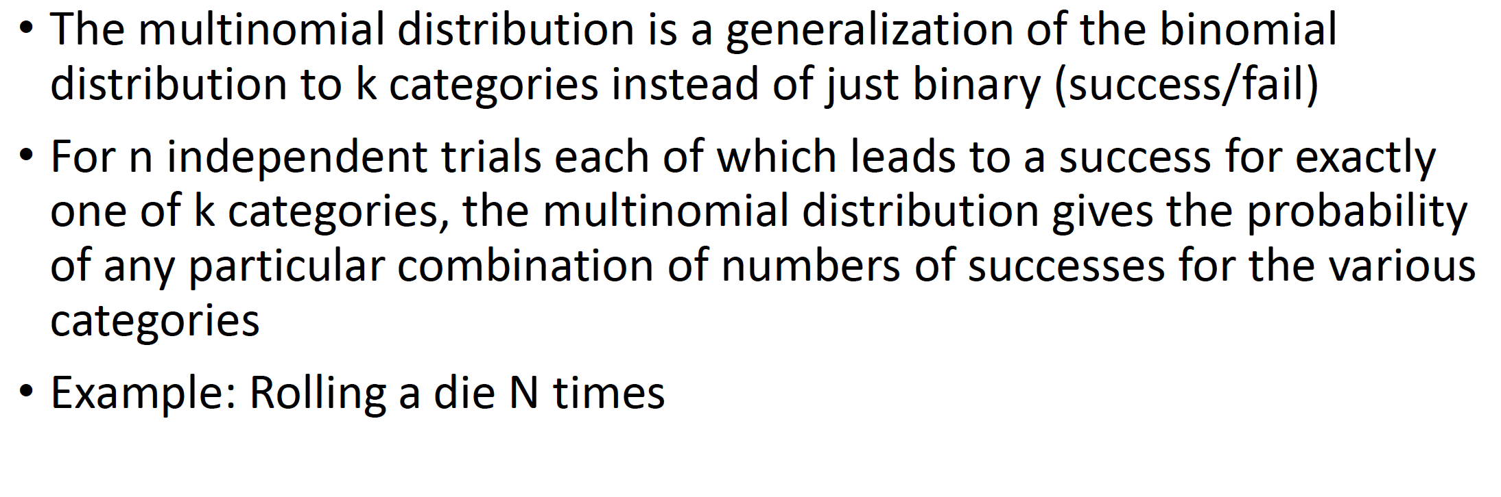
Multinomial Distribution

Slide 23
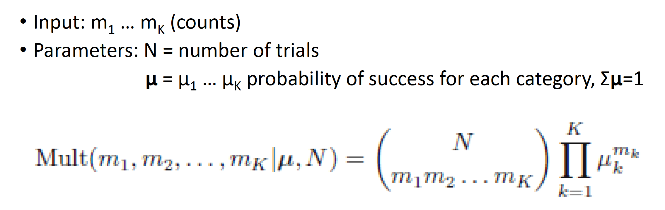
Multinomial Distribution

Slide 24
What is the mean and variance of these distribution?
1. Bernoulli
2. Binomial
2. Multinomial

Slide 25
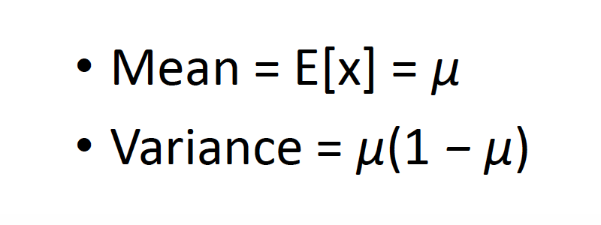
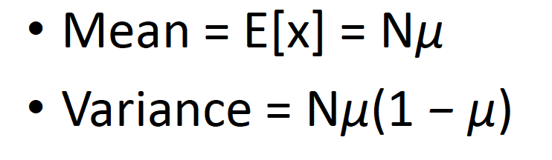
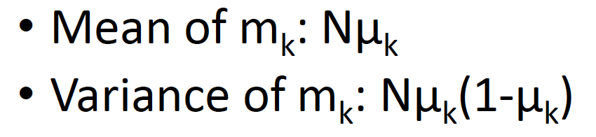
What is the mean and variance of these distribution?
1. Bernoulli
2. Binomial
3. Multinomial

Slide 26
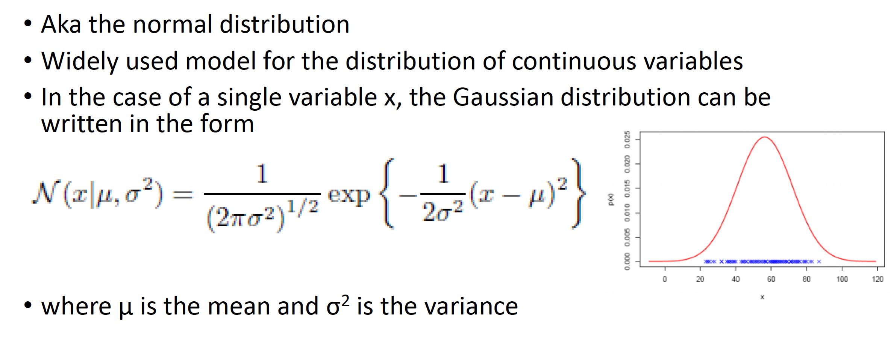
Gaussian Distribution

Slide 27
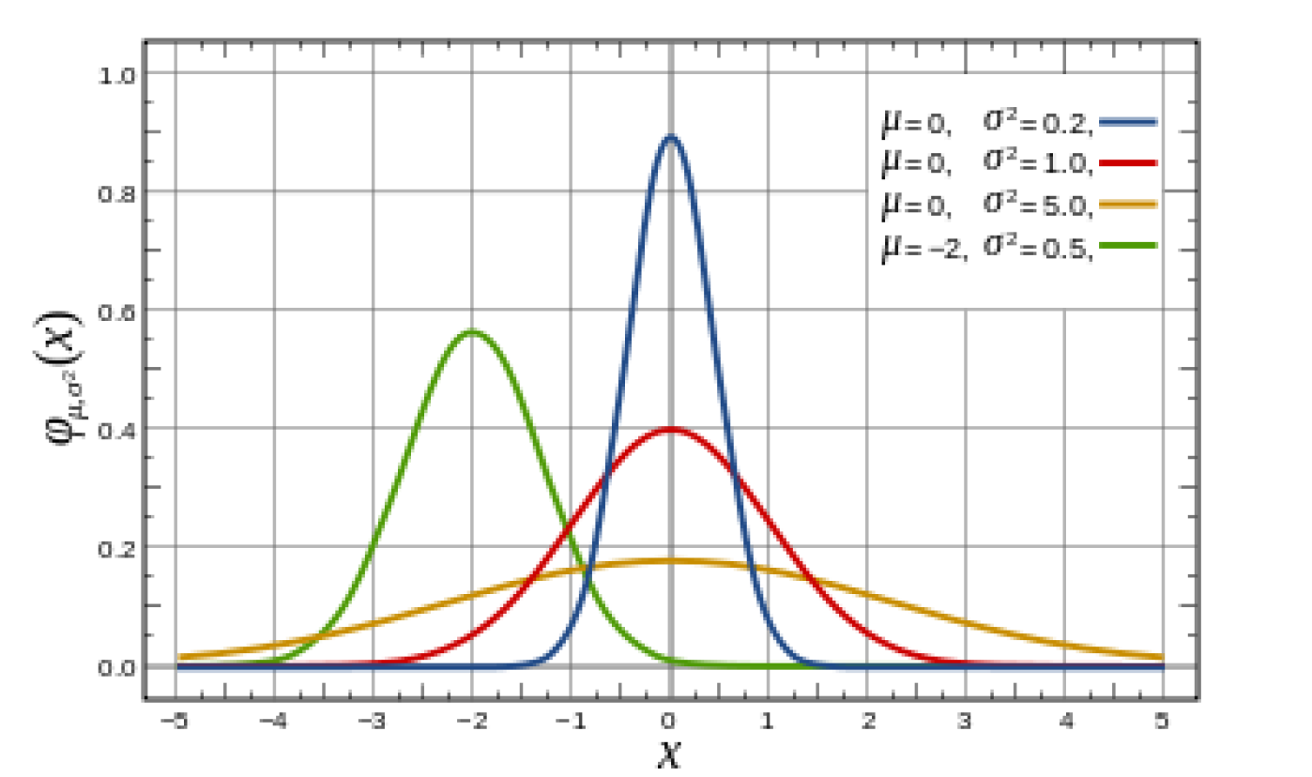
Gaussian Distribution

Slide 28
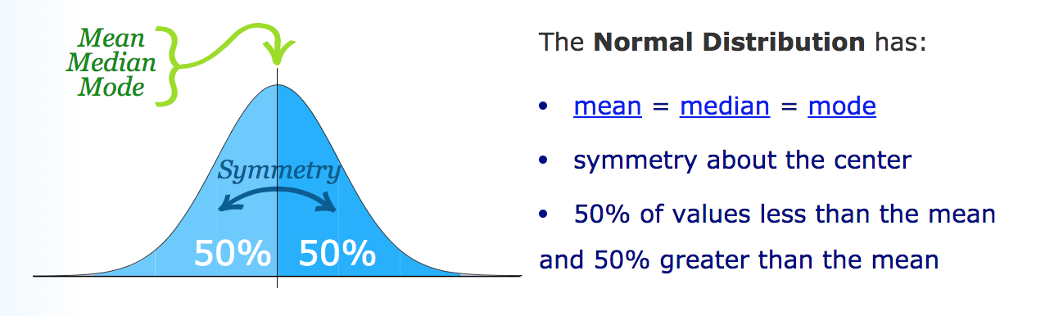
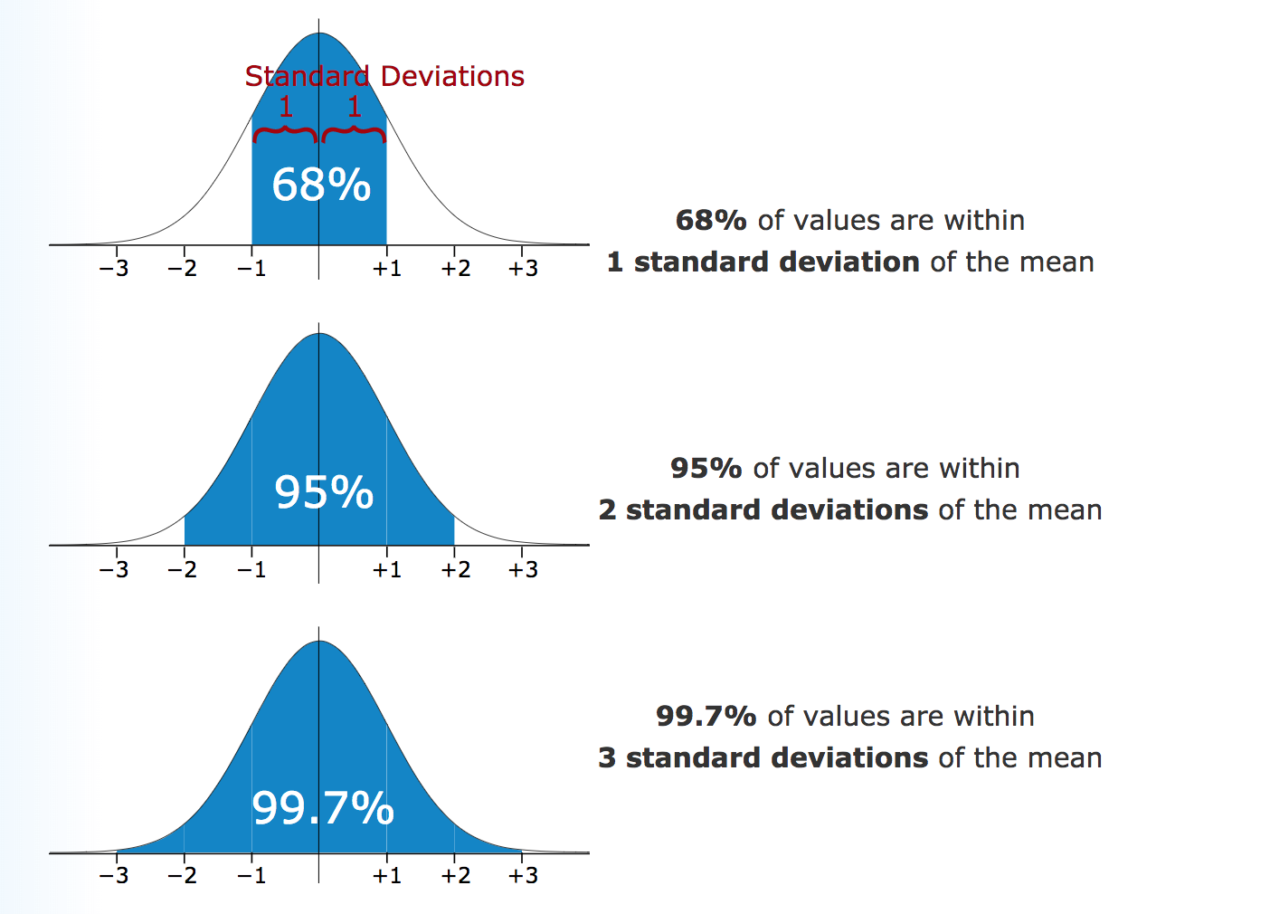
How to identify a Gaussian distribution?

Slide 29
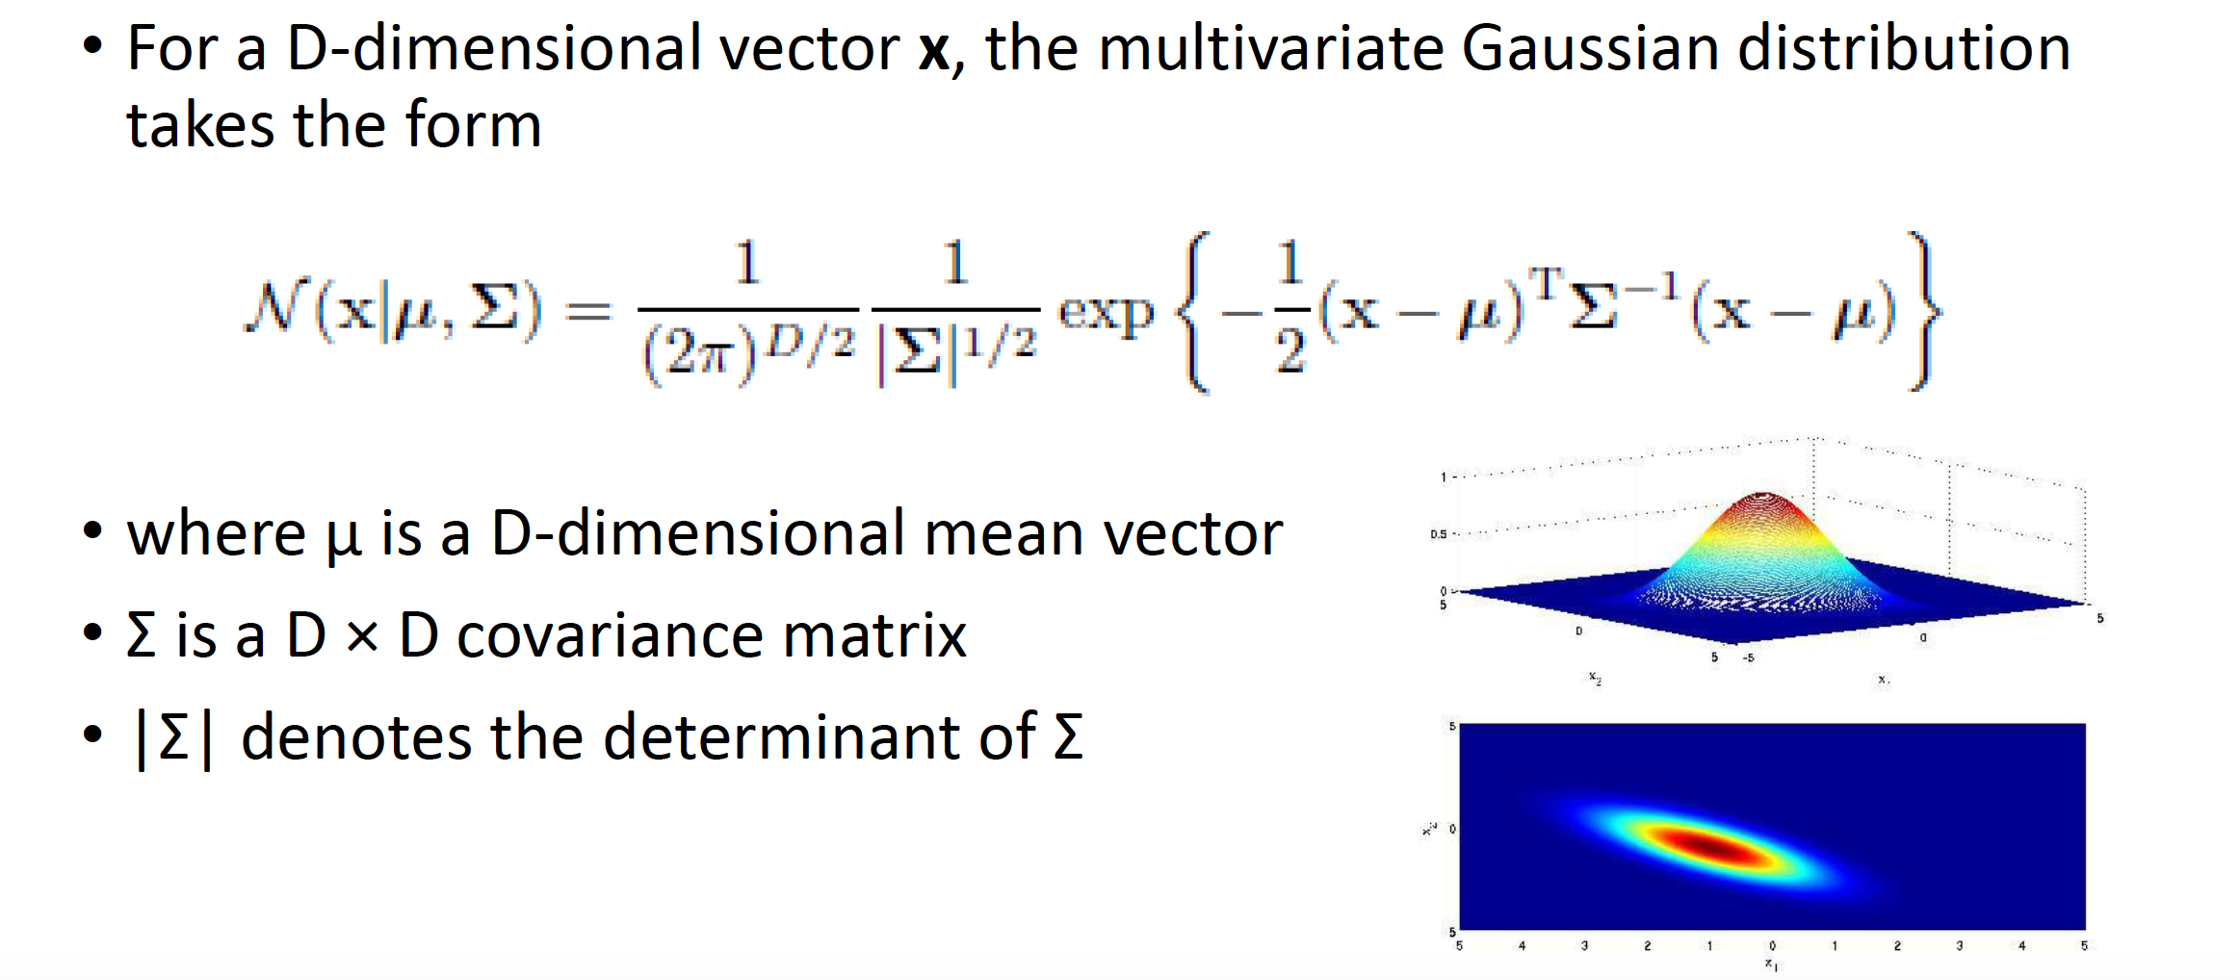
Multivariate Gaussian Distribution

Slide 30
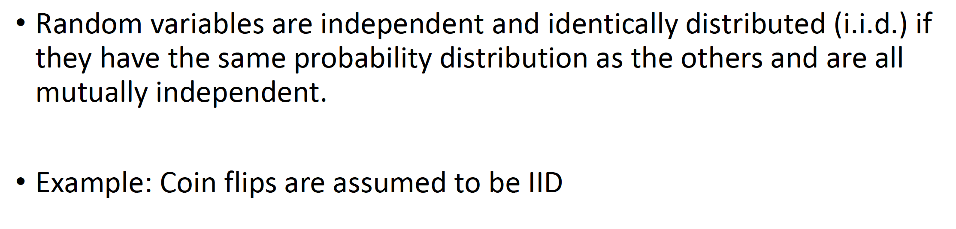
I.I.D.

Slide 31
Lab1
Ingest any dataset from internet
Clean the dataset
Analyze mean, median and variance of the dataset
Use graphs to display that

Slide 32
Summary
Probability
Baye’s Rule
Probability Distributions
Lab1

