Slide 1

CMPE/SE 257 Machine Learning Feb 05
Department of Computer engineering
San José state University
Spring 2018
Instructor :Bhavana Bhasker

Slide 2
Basics of Linear Algebra
Scalar
Scalar is a single number. These values are written in lower case.
Example: Let p ∈ R be the price per sqft Here p is the real-valued scalar.

Slide 3
Basics of Linear Algebra
Vector
Vector is an array of real numbers. They are arranged in order and can be accessed using their index
Example : x = [x₁, x₂, … x_{n} ]

Slide 4
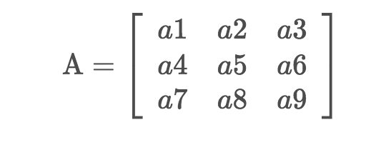
Basics of Linear Algebra
Matrix
Matrix is a 2-D array of numbers. An element in a matrix is identified by a_{ij} where i and j indicate the row and column index respectively. The size of the the matrix is represented as (m,n) where m is no. of rows and n indicates the no. of columns.
Example :

Slide 5
Basics of Linear Algebra
Tensor
For some use cases like image processing, we will need an array with more than two axes. The arrays with >2 dimensions are called tensors. An element in the tensor is identified as A_{ijk} where (i,j,k) are the coordinates of element A.

Slide 6
Basics of Linear Algebra
Transpose
This operation flips the matrix over its diagonal. The transpose of a matrix A is denoted as A^{T} .

Slide 7
Basics of Linear Algebra
Transpose
import numpy as np
A = np.array([[1,2,3],[3,4,5],[5,6,7],[7,8,9]])
At = np.transpose(A)
print("Given Matrix")
print(A)
print("Shape -----> ",A.shape)
print("Transposed Matrix")
print(At)print("Shape: ", At.shape)

Slide 8
Basics of Linear Algebra
Matrix Multiplication by Scalar
import numpy as np
A = np.array([[1,2],[3,4]])
print("Given Array")
print(A)
c = 2
result = A * c
print("Multiplying the given matrix with a scalar")
print(result)

Slide 9
Basics of Linear Algebra
Addition and Subtraction
a. Adding two matrices of shape (m,n) result in a third matrix of shape (m,n)
b. Adding the matrix A with itself scales the elements of the matrix A by the factor of 2
c. Subtracting two matrices of shape(m,n) will result in a output matrix where each element in the output is the difference between the corresponding elements.

Slide 10
Basics of Linear Algebra
Addition and Subtraction
import numpy as np
A = np.array([[1,2],[3,4]])
print("Given Array")
print(A)
print("A + A ")
print(A + A )
print("A - A")
print(A - A)

Slide 11
Basics of Linear Algebra
Matrix Multiplication
Matrix A with the shape(m,n) when multiplied with matrix B of shape (n,p) will result in matrix C of shape (m,p). In other words, two matrices can be mutliplied only if the no of columns in A = no of rows in matrix B.
In general, Matrix multiplication is not commutative
AB ≠ BA
Note: The dot product between two vectors x and y of the same dimensionality is the matrix product x^{T}y

Slide 12
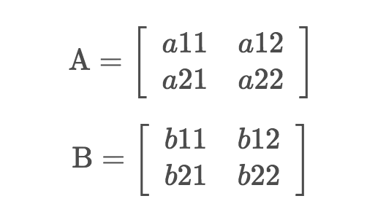
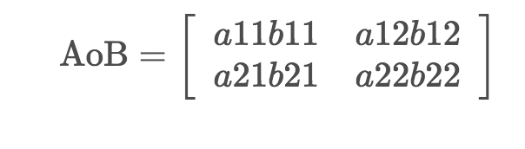
Basics of Linear Algebra
Hadamard product/Element-wise product
The Hadamard product A o B, is a matrix with the elements given by
(AoB)_{i,j} = (A)_{i,j}(B)_{i,j}
For example,
then element-wise product is,

Slide 13
Basics of Linear Algebra
Identity Matrix
The identity matrix is a square matrix whose diagonal values are set to 1 with all other values being 0. The identity matrix is denoted as I_{n}, where I_{n} ∈ R ^{n x n}.
The output of multiplication of a square matrix A by the identity matrix is the same matrix A.
AI = A = IA

Slide 14
Basics of Linear Algebra
Matrix Properties
1. Rank
The rank of a matrix A is the number of linearly independent rows or columns.
How to find the rank of a matrix?

Slide 15
Basics of Linear Algebra
Matrix Properties
1. Rank
Find the row echelon form of a matrix
The row echelon form should satisfy the following conditions:
The first non-zero element in each row, called the leading entry, is 1.
Each leading entry is in a column to the right of the leading entry in the previous row.
Rows with all zero elements, if any, are below rows having a non-zero element.

Slide 16
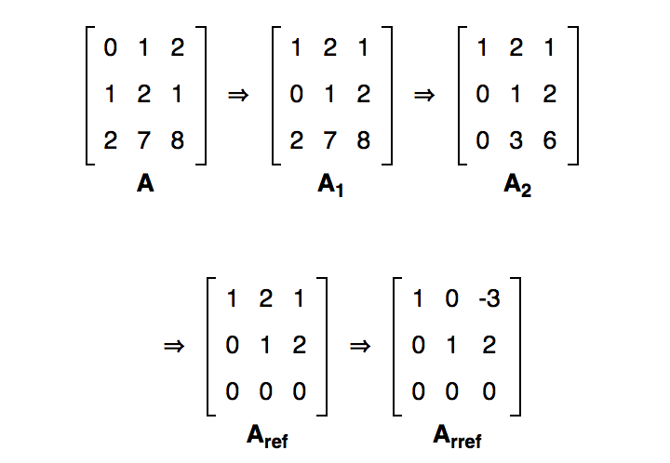
Basics of Linear Algebra
Row-echelon form of matrix A

Slide 17
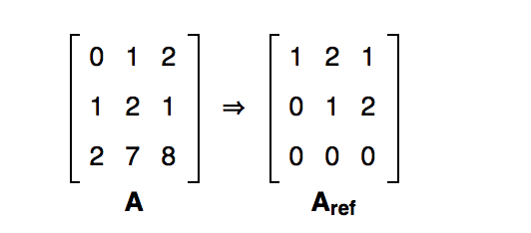
Basics of Linear Algebra
The rank of matrix A :
Because the row echelon form A_{ref} has two non-zero rows, we know that matrix A has two independent row vectors; and we know that the rank of matrix A is 2.

Slide 18
Basics of Linear Algebra
Find the rank of a matrix
import numpy as np
A = [[4, -5, -13], [-2,3,9]]
print("Given matrix”)
print(A)
rank = np.linalg.matrix_rank(A)
print("Rank of A =", rank)

Slide 19
Basics of Linear Algebra
Find the rank of a matrix
import numpy as np
A = [[4, -5, -13], [-2,3,9]]
print("Given matrix”)
print(A)
rank = np.linalg.matrix_rank(A)
print("Rank of A =", rank)

Slide 20
Basics of Linear Algebra
A matrix in R^{n x n} is said to have full rank if its rank is n.
A matrix is said to be rank deficient if it does not have a full rank.

Slide 21
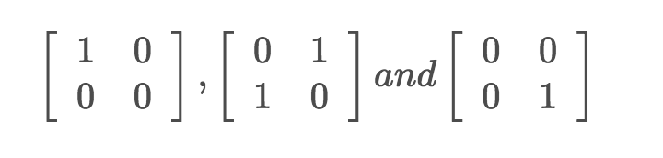
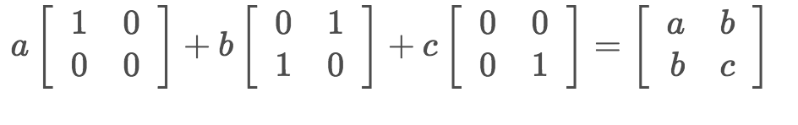
Basics of Linear Algebra
Span of a matrix :
Linear span of a set of vectors S = {v1,v2,v3, …vn} in the vector space V is the intersection of all the subspaces containing the set S
The span of
consists of all matrices of the form,

Slide 22
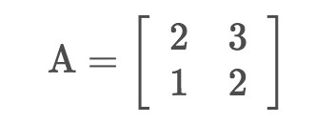
Basics of Linear Algebra
Determinant
The determinant of a matrix,
is: 2 x 2 - 3 x 1 = 4 - 3 = 1.
It is computed from the elements of a square matrix. Determinant of a matrix A is denoted by |A|

Slide 23
Basics of Linear Algebra
Determinant
import numpy as np
A = np.array([[2,3],[1,2]])
det = np.linalg.det(A)
print("The determinant is", det)

Slide 24
Basics of Linear Algebra
Gradient
Consider f : R_{m×n} → R, which is a function that takes as input a matrix of size m x n and returns a real value. The gradient of f is a matrix of partial derivates.
Numpy package in python offers a function numpy.gradient to compute gradient. This function uses forward, backward and central differences where appropriate.
Let’s compute the gradient for numpy array in python

Slide 25
Basics of Linear Algebra
Gradient
Consider f : R_{m×n} → R, which is a function that takes as input a matrix of size m x n and returns a real value. The gradient of f is a matrix of partial derivates.
Numpy package in python offers a function numpy.gradient to compute gradient. This function uses forward, backward and central differences where appropriate.
Let’s compute the gradient for numpy array in python

Slide 26
Basics of Linear Algebra
Gradient
import numpy as np
A = np.array([1,2,4,6],dtype=np.float)
grad = np.gradient(A)
print(grad)

Slide 27
Basics of Linear Algebra
Gradient
Let’s see how numpy computes the gradient.
The output from the above function is [1,1.5,2,2]
Forward difference is used for the first element, (2 - 1)/1 = 1
Central differences is used for the second and third element, (4 - 1)/ 2 = 1.5 (6 - 2)/2 = 2
Backward difference is used for last element, (6 - 4) / 1 = 2

Slide 28
Probability and Statistics
Random Variable
Random variable is a variable that takes different values randomly. The random variable can be either categorical or continuous.
Categorical Variable
A variable that takes one of fixed number of possible values/states.
Bernoulli variables are the categorical variables that have a binary outcome such as yes/no or success/failure.
A multi-way variable is a categorical variable that have three or more outcomes.
Continuous Variable
Continuous variable is a variable that has infinite number of possible values.
A continuous variable is associated with a real value.

Slide 29
Probability and Statistics
Random Variable
Random variable is a variable that takes different values randomly. The random variable can be either categorical or continuous.
Categorical Variable
A variable that takes one of fixed number of possible values/states.
Bernoulli variables are the categorical variables that have a binary outcome such as yes/no or success/failure.
A multi-way variable is a categorical variable that have three or more outcomes.
Continuous Variable
Continuous variable is a variable that has infinite number of possible values.
A continuous variable is associated with a real value.

Slide 30
Probability and Statistics
Population v/s Sample
A major purpose of data science is to give us information about some group, known as a population
Eg: population of students enrolled in a class
population of people living in a country
purchases made at a store

Slide 31
Probability and Statistics
Population v/s Sample
we randomly extract a subset from the population (a random group of people, a random selection of purchases), called a sample
Note:
1. It is expensive to get data from all members of a population
2. Sampling is performed to learn about the population as a whole
Statisticians use the sample statistics to infer information about the entire population from which the sample is taken.

Slide 32
Probability and Statistics
Central Tendency
Use pandas library to create a dataframe with one attribute height.
import pandas as pd
# Make a blank data frame
df = pd.DataFrame()
# Populate it with data.
df[‘height'] = [5.5, 5, 4, 3, 3.5, 5.4, 3.5, 3.7]

Slide 33
Probability and Statistics
Central Tendency
1. Mean
mean = sum(x) / n
Sum(df[‘height’]) /len(df[‘height’])
# Using NumPy
import numpy as np
np.mean(df[‘height'])

Slide 34
Probability and Statistics
Central Tendency
2. Median
The median represents the middle value in a variable when the values are ordered from least to greatest
odd values : - > median is the middle value
Even values :-> median represents the average of two middlemost values

Slide 35
Probability and Statistics
Central Tendency
2. Median
# Using NumPy.
import numpy as np
np.median(df[‘height'])

Slide 36
Probability and Statistics
Central Tendency
3. Mode
The mode represents the value in a variable that occurs the most frequently.
If two or more values in a variable occur with equal frequency, there will be multiple modes.

Slide 37
Probability and Statistics
Central Tendency
3. Mode
# Generate a list of unique elements along with how often they occur. (values, counts) = np.unique(df[‘height'], return_counts=True)
# The location in the values list of the most-frequently-occurring element.
ind = np.argmax(counts)
# The most frequent element.
values[ind]

Slide 38
Probability and Statistics
Bias
An estimate is "unbiased" if, across multiple representative samples, the sample estimates converge on the population value
A "biased" estimate would converge on a value that was either higher or lower than the population value.
Unbiased estimates are useful because they let us use a small group of observations to make generalizations about a much larger group.
The mean, median and mode are unbiased estimates

Slide 39
Probability and Statistics
Bias
An estimate is "unbiased" if, across multiple representative samples, the sample estimates converge on the population value
A "biased" estimate would converge on a value that was either higher or lower than the population value.
Unbiased estimates are useful because they let us use a small group of observations to make generalizations about a much larger group.
The mean, median and mode are unbiased estimates

Slide 40
Probability and Statistics
Variance
The variance of a variable describes how much values differ from the central tendency, and how much they differ from each other.
If all the values in a variable are close to the central tendency, then variance is said to be low
If values in a variable vary widely, with some far away from the central tendency, variance is said to be high.
v = sum((x - mean) ** 2) / (n - 1)

Slide 41
Probability and Statistics
Variance
df[‘height'].var()

Slide 42
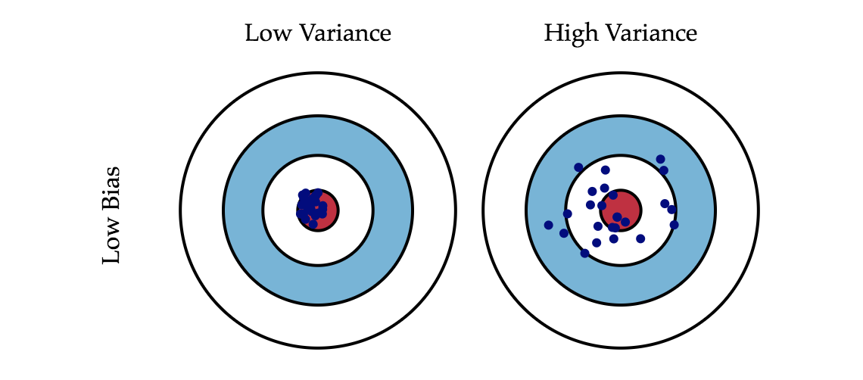
Probability and Statistics
Bias –Variance tradeoff

Slide 43
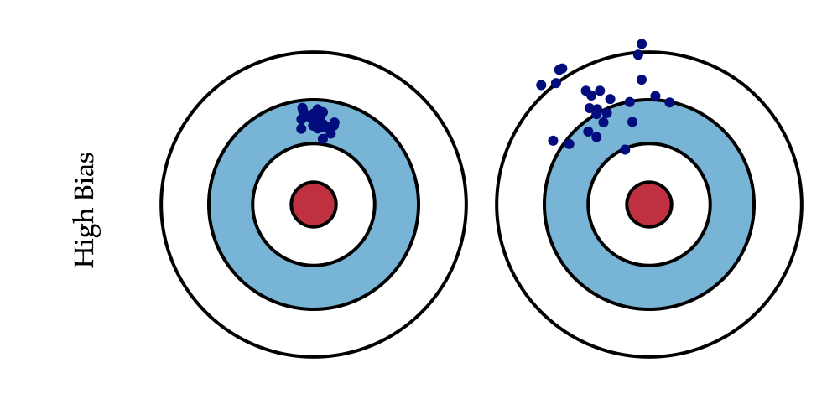
Probability and Statistics
Bias –Variance tradeoff

Slide 44
Probability and Statistics
Bias –Variance tradeoff
Consider a classifier,
High bias in case of classifier- > when it is underfitting
High Variance -> when it is overfitting
We will see this in detail later

Slide 45
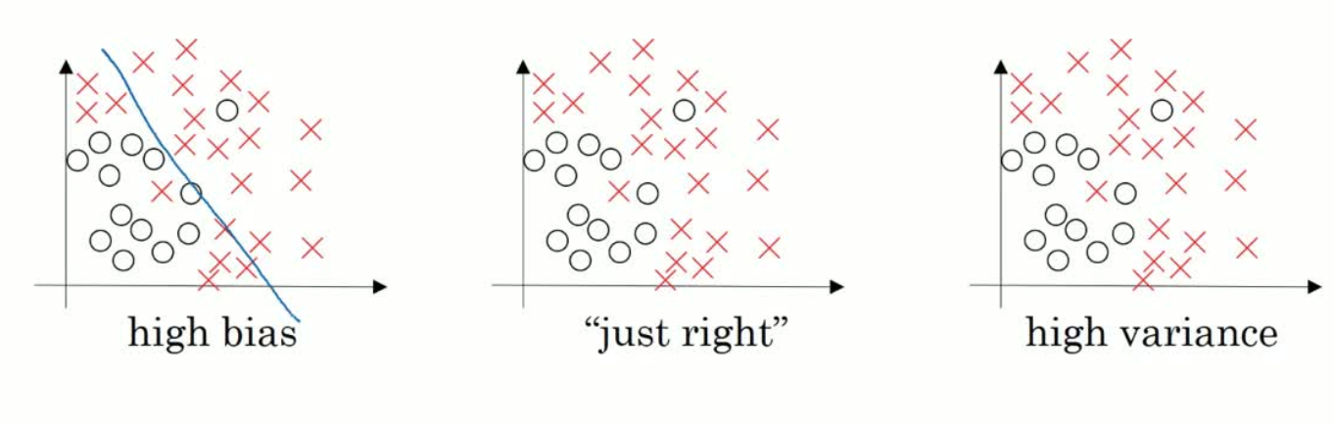
Probability and Statistics
Bias –Variance tradeoff

Slide 46
Summary
Basics of Linear Algebra
Probability and Statistics
1. Types of variable
2. Population v/s sample
3. Central Tendency
4. Bias
5. Variance
6. Bias – Variance tradeoff

