Slide 1
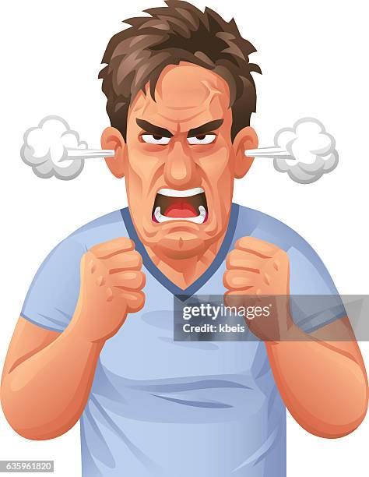

State Bans of Critical Race Theory
Nate Harris

Slide 2
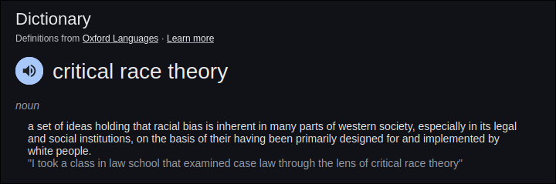
What is CRT?!
It’s basically the idea that race should be considered when teaching history, or just social studies in general. When instructing CRT one may discuss minstrel shows in Jim Crow America and open discussion on what this meant for the people of the time and the lasting effect it would have on American culture. Oh it also addresses it as a systemic problem on not just “these bad guys were racist now we’re not racist”. It addresses how policy can perpetuate race-based oppression.

Slide 3
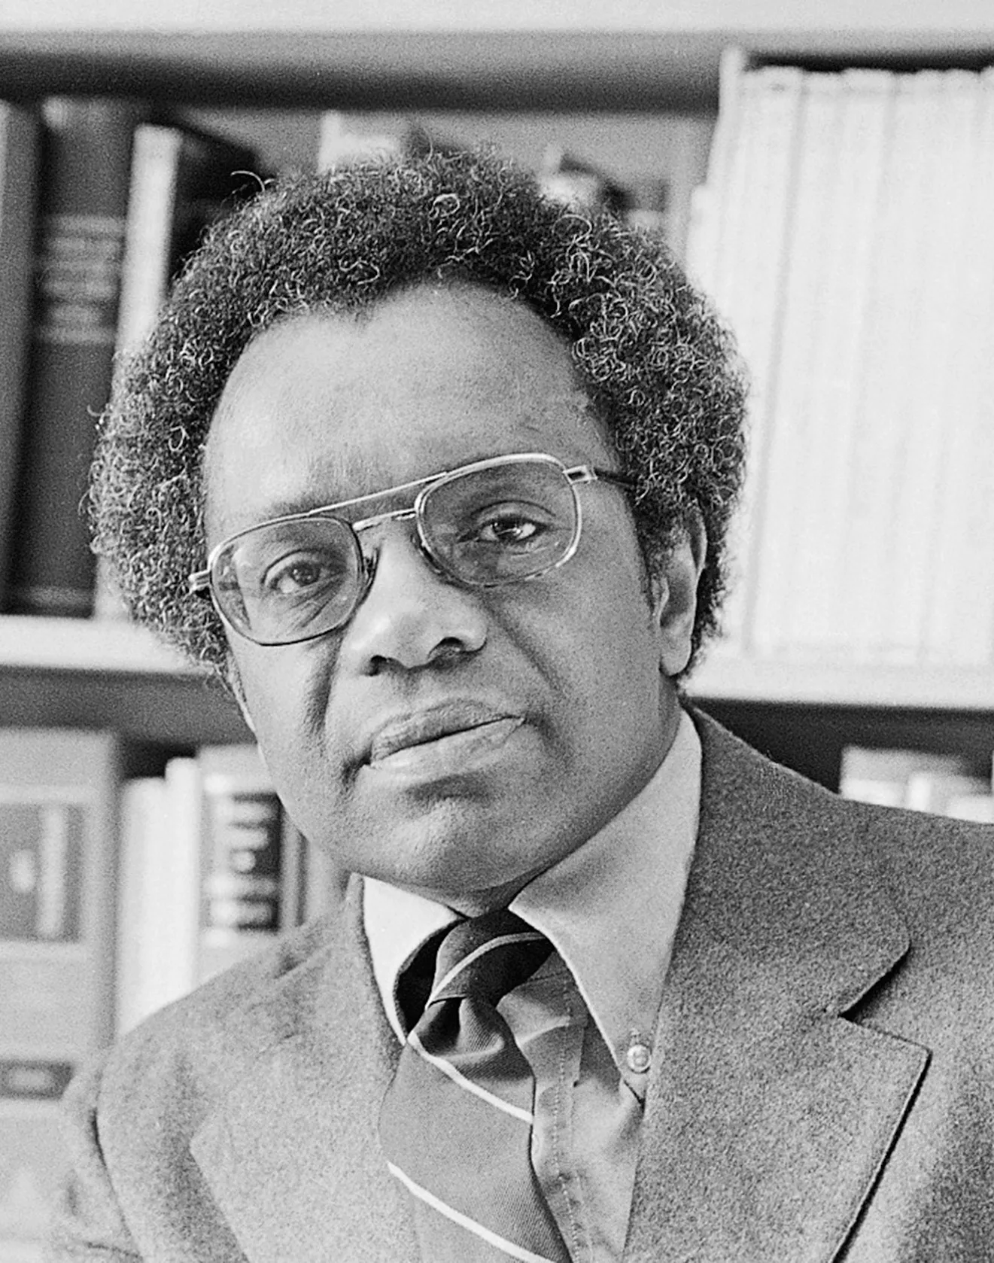
Why CRT Came About
- It was a school of thought designed to address race as America desegregated.
- Conceived by Derrick Bell and many other civil rights activists
- There needed to be a language to analyze racial disparity in the US in order to address it.
Derrick Bell

Slide 4
Why People Want it Gone?
Here are the main claims against CRT:
It teaches kids that “America is racist”
It sets a precedent for “anti-white” policy
(not mentioned here) infantilizes minorities
Note: the definition of “racist” here is intended to have the effect of a word like “evil”. Gernally the claim is that CRT is propaganda that would give minorities unfair advantages in modern non-racist America.

Slide 5
Misfounded Fear
The call for its removal is due to the belief that CRT oversimplifies history into white oppressors and black oppressed. This is untrue, removing CRT, or the racial element of history, would be neglecting to craft a more wholistic view of history.

Slide 6
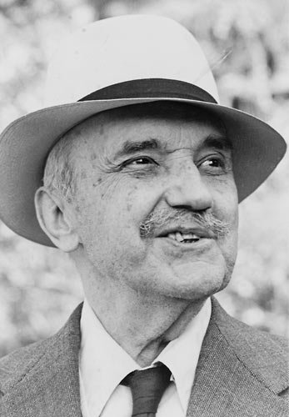
Why it Should Exist
“Those who cannot remember history are condemned to repeat it.” – George Santa yana
It is obvious that race has impact on American policy, or, at the
very least, American life . To teach CRT is to acknowledge this.
Saying you don’t want CRTmeans you don’t want to address the
systemic element of race at all! This doesn’t make sense! Race itself
was created as a construct by those inpower!

Slide 7
Modern Implications
CRT influences policy such as DEI acts
It opens a dialogue to discuss what race is and how it effects American life
Without this school of thought classes like this would not exist

Slide 8

Questions
Is it possible to have a raceless America given its history?
Do y’all like CRT or not? Could teaching children this lead to new racial prejudices?
Derrick Bell, as a professor, was very open both liberal and conservative views in his class (according to a past student from a New Yorker article). Does teaching CRT encourage a similar bipartisan exchanging of ideas?

Slide 9
Sources
https://www.newsweek.com/what-critical-race-theory-why-do-some-want-ban-1587389 https://youtu.be/_dHt4HFLCaM?t=112
https://kffhealthnews.org/news/article/vermont-gives-blacks-and-other-minority-residents-vaccine-priority/
https://www.brookings.edu/articles/why-are-states-banning-critical-race-theory/
https://www.newyorker.com/magazine/2021/09/20/the-man-behind-critical-race-theory

