Slide 1

Impact of Increase in customer satisfaction and improve operational efficiency

Slide 2
Agenda
Executive Objective
Context & Background
Key Insights
Technical Recommendations
Impact Summary
AppendiX
Data Source
Data Methodology

Slide 3
Executive Objective
improve service efficiency customer satisfaction
Improve revenue performance,
Provide early recommendation

Slide 4

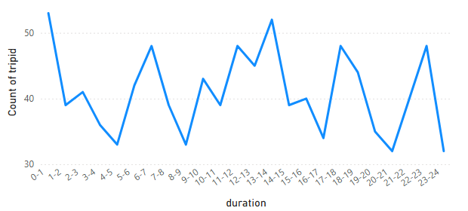
Opportunity to increase the ride counts in peak hours
Demand varies sharply by hour,
Peaking during morning and evening commute windows.

Slide 5
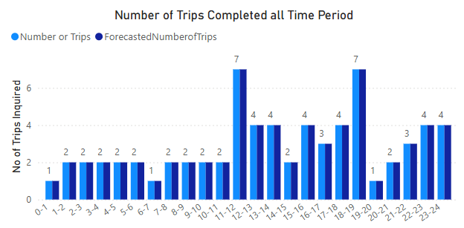
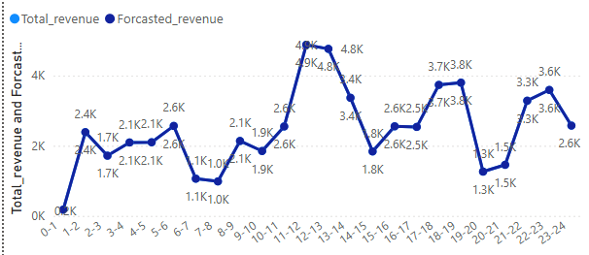
Increase the revenue generation across all the zones
Revenue is concentrated in high-demand assemblies such as Yeshwantpur and Bangalore South.
Where peak time is in afternoon and evening with almost 24K revenue Generation.

Slide 6
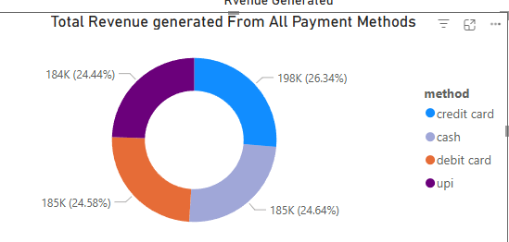
Can introduce the Promotional offers (Discounts) in Digital modes to increase customer engagement
Payment behavior shows strong adoption of digital modes (UPI, cards).
With almost 75% of the transactions with digital method
Generating 566k of total revenue

Slide 7
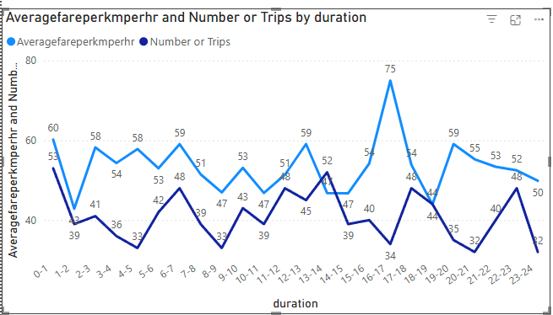
Forecasting of the Fare along with the demand of the rides
Price sensitivity is visible, where higher fares reduce trip confirmations.
When there is high demand, we see the Fare price moving along. Other wise the ride completion in hampering

Slide 8
Operational Challenges
• High cancellation rates during peak hours due to driver unavailability.
• Imbalance between search demand and completed trips in certain assemblies.
• Variation in fare acceptance leads to inconsistent trip conversions.
• Limited supply during late-night hours reduces completion rate.
• Lack of forecasting leads to unplanned supply shortages.

Slide 9
Technical Recommendations
Implement
Implement demand forecasting models using hourly and geospatial patterns.
Enhance
Enhance data model normalization for time, geography, and trip event sequences.
Build
Build machine-learning–based dynamic allocation engine to reduce cancellations.

Slide 10
Impact Summary
Better demand–supply alignment can increase completion rates significantly.
Price elasticity insights enable smarter fare strategies.
Technical automation reduces manual coordination and enhances platform scalability.

Slide 11
Appendix Data Sources
Namma Yatri internal trips database
Search and quote logs
Assembly-level pickup geodata
Payment records

Slide 12
Appendix Data Methodology
Cleaned and standardized time-based columns.
Derived duration categories and hourly slots.
Modeled revenue and fare metrics.
Built what‑if parameters for pricing and demand elasticity.

Slide 13
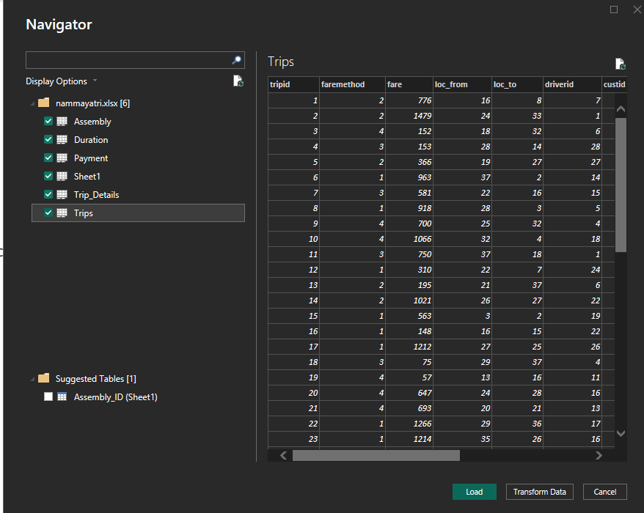
Appendix Data Methodology
Cleaned and standardized time-based columns.
we transform the data first, by default the data type for some columns were in numeric we converted them into text.
E.g. ID column in each sheet, loc_from, loc_to,

Slide 14
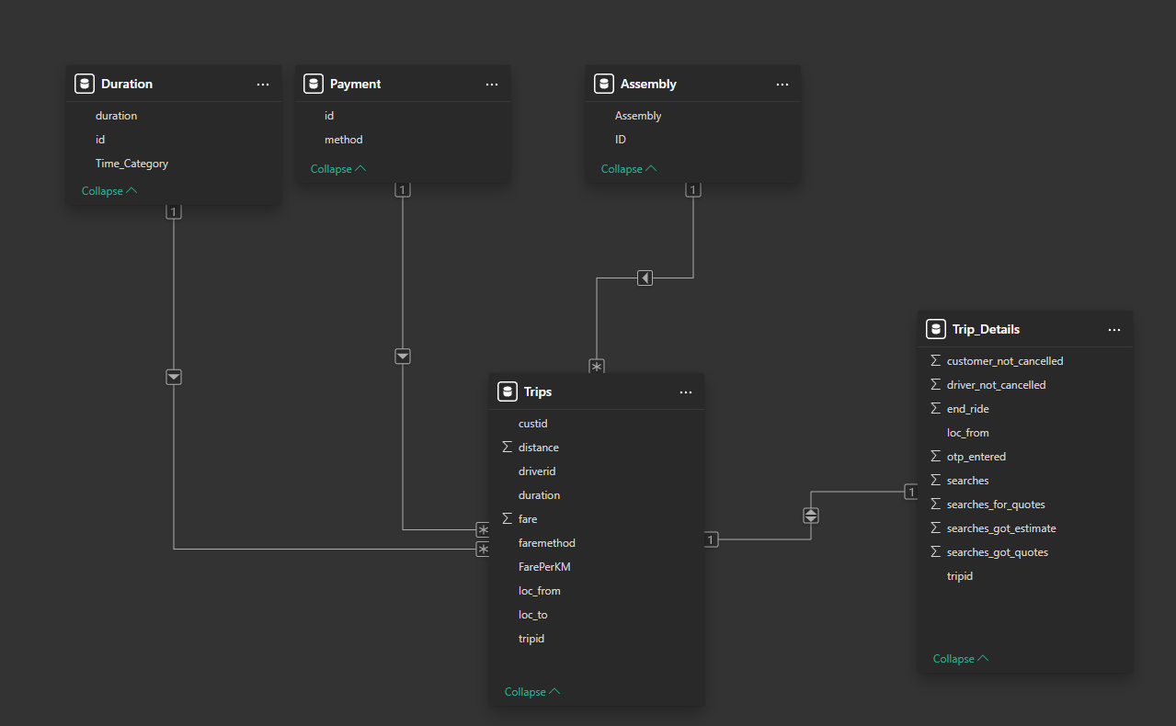
Appendix Data Methodology
Cleaned and standardized time-based columns.
We join fact table like Duration, Assembly, Payment with the dimension table Trips with cardinality as one to many and extension of dimension table Trips with its extension Trips detail with it as one to one cardinality

Slide 15
Appendix Data Methodology
Derived duration categories and hourly slots.
Created new column in duration sheet of time category which describes whether the triip Is taken ‘late night’, ‘Early morning’, ‘morning’, and so on using M code in power query.

Slide 16
Appendix Data Methodology
Modeled revenue and fare metrics.
We created the measures like average fare per km, total revenue, average fare per hr, average fare per km per hr. using dax functions
Then we have created the forecasted revenue parameter which has 1:1 ratio
  i.e. The revenue generation will increase by the same percent as increase in the rides

Slide 17
End of Slides
THANKYOU

