Slide 1
Software Engineering
Research Project--AI & Interactive Theorem Proving
2023/12/12
Langze YE
Xuan ZHANG
Jiaheng XIONG
Notes:
Hello everyon, balabala

Slide 2

AI & Interactive Theorem Proving(LEAN)
Politecnico di Milano
1
About LEAN
2
Mathematical Theorem Proving
3
Future steps of LEAN
4
Machine Learning & Formal math
5
Conclusion
Notes:
Here is our summary, we will begin with balabala, secondly balabala

Slide 3
Mathematical Theorem Proving What is Lean?
3
Lean is an advanced programming language designed to advance mathematical reasoning, formal verification, and logical inference.
It blends computer science and mathematics to provide powerful tools for formal methods.
Lean emphasizes precision and logic, it can be used not only to write algorithms, but also to prove the correctness of those algorithms
Notes:
都就行，读完可以用vs来Show some basic code. 随便穿插点自己的句子。

Slide 4
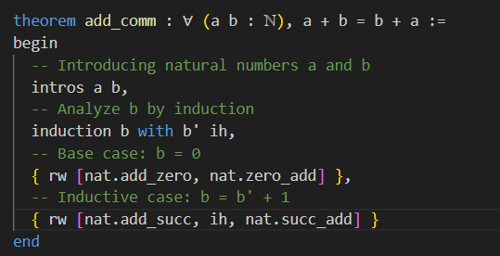
II. Mathematical Theorem Proving How lean works?
4
Additive exchange law
-Formalization of the problem
- Write the proof process and verify correctness
Notes:
Let’s just give an example.

Slide 5
II. Mathematical Theorem Proving Axioms of Peano
These five axioms of Peano are described in a non-formalized way as follows:
0 is a natural number;
For every definite natural number a, there is a definite successor a', and a' is also a natural number;
For every natural number b, c, b = c if and only if the successor of b = the successor of c;
0 is not a successor of any natural number;
Any proposition about natural numbers which proves that: it is true for the natural number 0, and which is assumed to be true for the natural number a, can be proved to be true also for a'. Then the proposition is true for all natural numbers.
Notes:
Peano的五个公理是所有数学的基础，不读也行，简单概括总结一下几个公理的目的。 可见知乎https://www.zhihu.com/question/371541708/answer/1013734082

Slide 6
II. Proving infinity of prime numbers Axioms of Peano
Using Peano axioms to prove a+b=b+a:
It holds true for b=0. Assuming it holds for b=k, we prove for b=succ(k). Through successor function and the inductive hypothesis, we get a+succ(k)=succ(k)+a. Therefore, by mathematical induction, for all natural numbers b, a+b=b+a
[1] CVE - CVE-2014-0160. https://www.cve.org/CVERecord?id=CVE-2014-0160.
Notes:
We need to understand the entire math logic before we can complete our code. 右边就是通过定理证明加法交换律的数学逻辑，左边图是代码实现，里面包括了“induction”，数学归纳法，“succ”后继数，具体的一些代码的意思，我们可以通过一个number game 来更好的explain.
Number games: https://adam.math.hhu.de/#/g/leanprover-community/NNG4/world/Tutorial/level/4

Slide 7
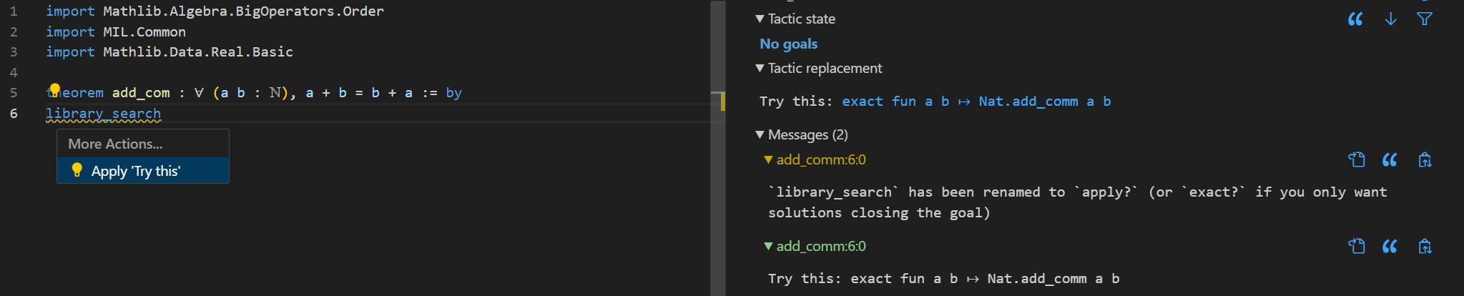
II. Proving infinity of prime numbers Mathlib & “library_search”
Mathlib is a library which contains most of mathematical language and mathematical theorems
Notes:
当我们使用lean3的时候，代码库还不够完善，在lean4中导入mathlib的库后，很多基础的数学定理将不再需要过于复杂的过程。可以直接通过libaray_search来实现。
这里打开代码演示。

Slide 8
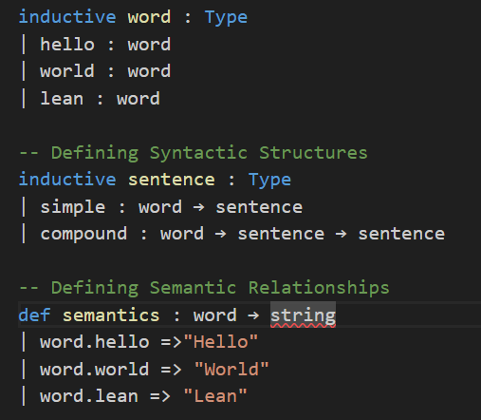
III. Future steps of LEAN Natural Language Processing
LEAN can be used to formalize natural language, build libraries similar to mathlib but related to natural language and analyze the logic of natural language.
Notes:
这里要打开我们关于weekend 的代码来更好的解释。 Lean可以用来定义自然语言

Slide 9
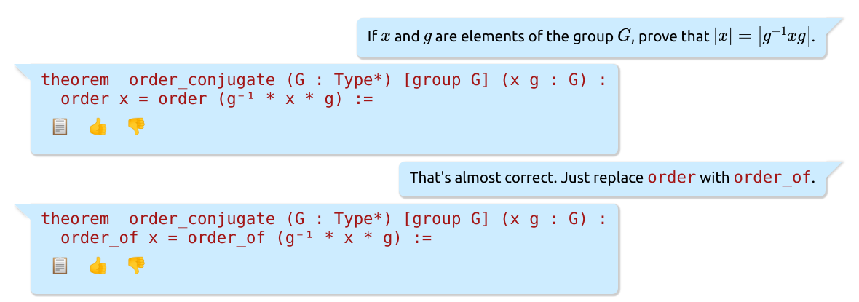
III. Future steps of LEAN Automated theorem proving & LEAN Chat
“Given the statement of a theorem, simply push a button, and the proof comes out.”
Notes:
在chatroom， 一位作者正在尝试做lean chat， 这是一个试图实现Automated theorem proving 的模型。（目前lean是交互证明，也就是半自动证明），全自动证明的定义大概就是这页ppt红字。
这个目的是，输入latex形式的的数学公式，可以得到关于这个公式用lean语言证明的代码，是通过mathlib里的数据集来训练的。
可以打开vs尝试下， 我在chatroom联系了作者,目前已经404了。

Slide 10
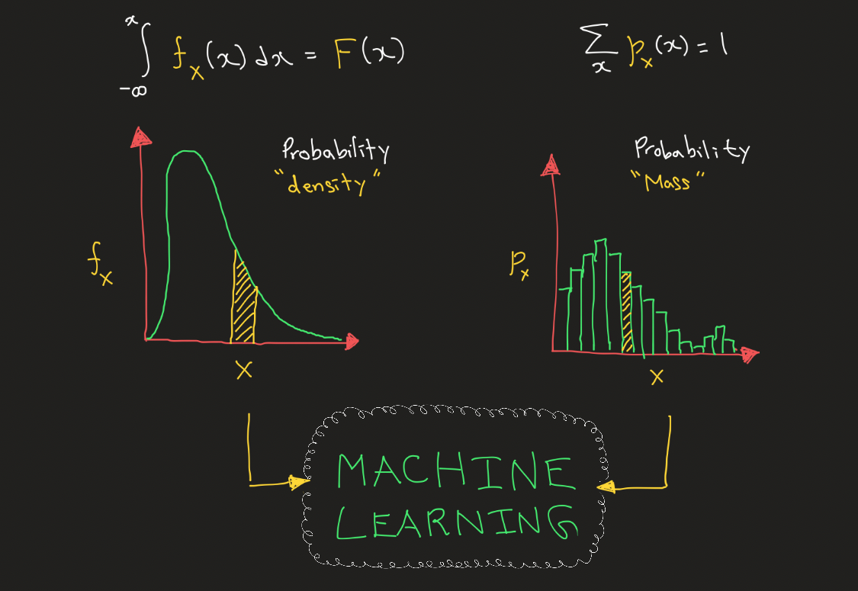
IV. Machine Learning & Formal math
Formal Mathematics for Machine Learning
Foundations and Rigor
Algorithm Analysis
Optimization Theory
Probability and Statistics
Linear Algebra
Notes:
We have already talk a lot about how Lean can contribute to the formal math. It seems that, lean is even a language where even for loops are difficult to implement, how it can work for ML? With this question, we want to talk about the relationship between Mathematics and ML. Firstly, how Formal Mathematics contributes to Machine Learning?
Let’s explain it one by one, let’s begin with “Foundations and Rigor”, The basis of the concepts used in machine learning is math, Mathematics helps to define and prove theorems about algorithms, models and optimization methods, ensuring their correctness and reliability. Second, Math can help analyze and evaluate the efficiency and scalability of algorithms. Third, Machine learning often involves optimization problems, and formal mathematical optimization theory provides a systematic framework for studying and developing optimization algorithms. This includes techniques for finding optimal parameters in machine learning models. Forth, The theoretical framework of probability and statistics in formal mathematics helps to understand uncertainty, model distributions.
Finally, Linear algebra is a cornerstone of many machine learning algorithms, especially those involving matrices and vectors. Formal mathematical structures and theorems in linear algebra contribute to the development and understanding of machine learning models.

Slide 11
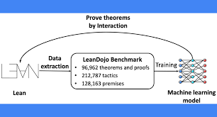
IV. Machine Learning & Formal math
Machine Learning for Formal Mathematics
Automated Theorem Proving
Pattern Recognition in Mathematics
Assisting Mathematical Problem Solving
Symbolic Mathematics and Algebraic Manipulation
Data-Driven Discoveries
Notes:
Then Machine Learning for Formal Mathematics:
Automated Theorem Proving:
Machine learning techniques, such as neural networks and automated reasoning systems, can be applied to automated theorem proving. These systems can help discover new proofs, identify patterns, and assist mathematicians in solving complex mathematical problems.
Pattern Recognition in Mathematics:
Machine learning algorithms excel at pattern recognition, which can be applied to discover new relationships or identify recurring patterns in mathematical structures. This can aid mathematicians in formulating conjectures or proving theorems.
Assisting Mathematical Problem Solving:
Machine learning models can be trained to assist mathematicians in solving mathematical problems. For example, by analyzing the steps taken by mathematicians to solve certain types of problems, machine learning algorithms can provide suggestions or guidance in similar problem-solving scenarios.
Symbolic Mathematics and Algebraic Manipulation:
Machine learning can be used to improve symbolic mathematics, aiding in algebraic manipulation and simplification of mathematical expressions. This can enhance the capabilities of computer algebra systems and facilitate the exploration of mathematical structures.
Data-Driven Discoveries:
Machine learning techniques can analyze large datasets of mathematical structures, proofs, and theorems to uncover hidden relationships or properties. This data-driven approach can lead to new insights and discoveries in formal mathematics.
自己整理下句子，引出leandojo。

Slide 12
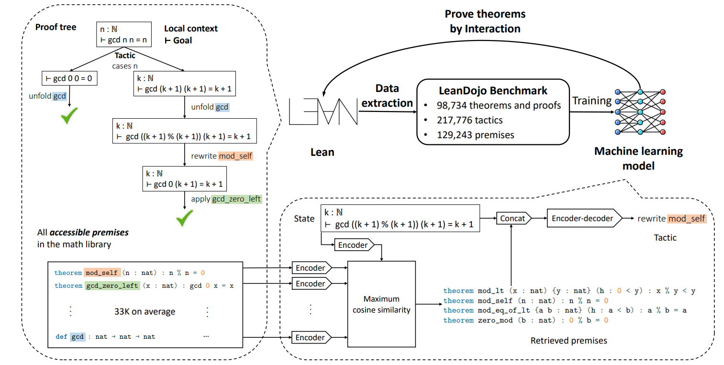
IV. Machine Learning & Formal math
LeanDojo
LeanDojo extracts proofs in Lean into datasets for training machine learning models.It also enables the trained model to prove theorems by interacting with Lean’s proof environment.
Notes:
https://github.com/lean-dojo/LeanDojo
知乎和论文链接在这里https://zhuanlan.zhihu.com/p/640568994
挺难讲的感觉，不好懂

Slide 13
V. Conclusion
Advantages and disadvantages of the lean language
Advantages
Disadvantage
Lean supports highly accurate formal verification that can be used to prove the correctness of mathematical theorems, software
Interactive theorem provers can help prove or enliven the user's mind
LEAN 4 has a relatively steep learning curve and takes some time and effort to master
Facing complex problems will require more expertise and programming ability.
The configuration of the compilation environment and the import of libraries are complex
Notes:
读就行，每读完一句话加一句小总结。 例如，“LEAN 4 has a relatively steep learning curve and takes some time and effort to master”， it’ quite different from other code, it requires a foundation in math to understand what each function in the code does. 自己发挥，讲完最后一个缺点后提一下，lean的版本还在社区中不断的更新，今年刚刚逐步实现从lean3到lean4的过渡。

Slide 14
Thank you!
Notes:
Thank you for your attention! I’m here. Please if you have any question, I will be happy to answer your questions.

