Slide 1
A Few Things You Probably Didn’t Know About Solid Water….
Martin McCoustra

Slide 2
Ballistic Deposition… Or Not?
We all assume, that at our typical laboratory working surface temperatures, water ice deposition is ballistic…
Peeling the Astronomical Onion
A. Rosu-Finsen, D. Marchione, T. L. Salter, J. Stubbing, W. A. Brown and M. R. S. McCoustra, Phys. Chem. Chem. Phys., 2016, 18, 31930-31935
Notes:
2

Slide 3
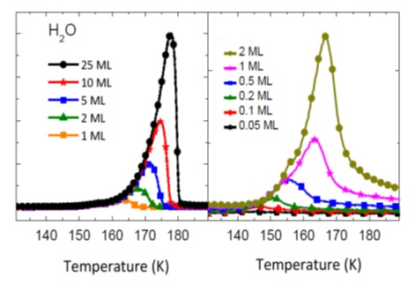
Ballistic Deposition… Or Not?
But let’s do a simple experiment…
Deposit various doses of H₂O on amorphous silica at any temperature below 20 K
TPD consistent with zero order kinetics which suggests that H₂O de-wets from the silica surface
Notes:
3

Slide 4
Ballistic Deposition… Or Not?
A simple RAIRS experiment
Fix temperature at 15 K
Deposit sub-monolayer quantity of H₂O
Anneal to 18 K and wait for an hour and cool to 15 K, record spectrum and repeat…
Intensity of O-H stretching band increases with time in a regime where there is no increase in the number of H₂O on the surface!
18 K
Agglomeration of isolated H₂O and small clusters of H₂O into bulk islands on the silica!
Notes:
4

Slide 5
Ballistic Deposition… Or Not?
First order kinetics analysis straight from the undergraduate laboratory
E_{a} ≈ 0 kJ mol⁻¹
T ≈ 25 K
Repeat at new temperature!
Arrhenius analysis as a function of annealing temperature
E_{a} ≈ 2 kJ mol⁻¹
Barrier to Agglomeration of 2 kJ mol⁻¹ Below 25 K
Notes:
5

Slide 6
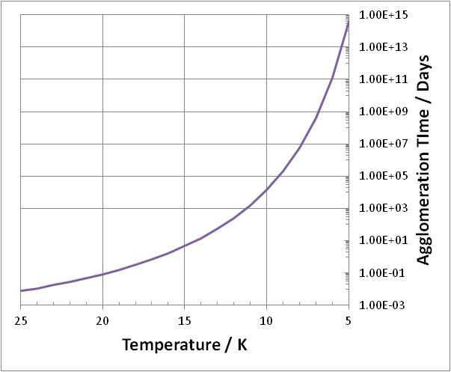
Ballistic Deposition… Or Not?
Deposition is only truly ballistic if the experimental timescale is significantly shorter than the agglomeration timescale, τ_{agg}, i.e. 1/k_{agg}!
18 K → τ_{agg} is ca. 8 hours
15 K → τ_{agg} is ca. 4.5 days
10 K → τ_{agg} is ca. 38 years
Notes:
6

Slide 7
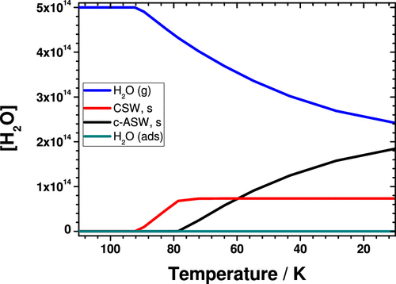
Ballistic Deposition… Or Not?
Deposition is only truly ballistic if the experimental timescale is significantly shorter than the agglomeration timescale, τ_{agg}, i.e. 1/k_{agg}!
18 K → τ_{agg} is ca. 8 hours
15 K → τ_{agg} is ca. 4.5 days
10 K → τ_{agg} is ca. 38 years
In Cooling Environments Water Ice Will Agglomerate; First as Crystalline Solid Water and then as Amorphous Solid Water!
Notes:
7

Slide 8
Spontelectric Water…
Amorphous solid water deposited at temperatures below 20 K spontaneously expresses a bulk electric field which can be experimentally observed using Kelvin Probe methods!
We can express this in terms of <μ_{z}/μ>, the average dipole orientation perpendicular to the thin solid film
Effect of Microstructure on Spontaneous Polarization in Amorphous Solid Water Films
C. Bu, J. Shi, U. Raut, E. H. Mitchell and R. A. Baragiola, J. Chem. Phys., 2015,142, 134702

Slide 9
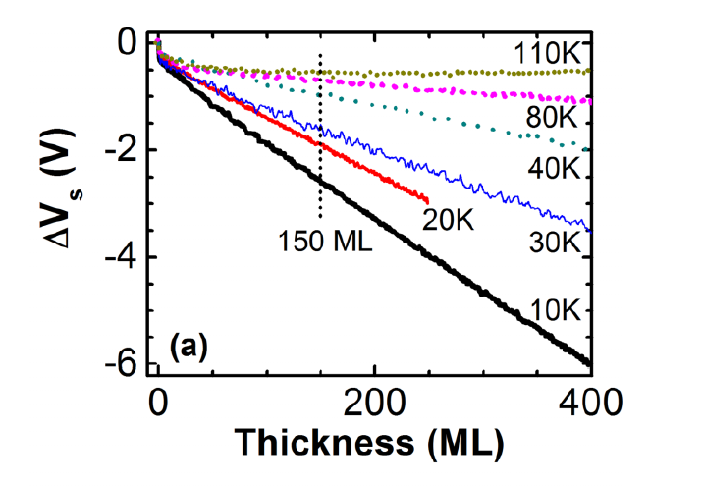
Spontelectric Water…
The presence of the electric field is revealed through changes in the work function (surface potential) of the film
The potential scales linearly with film thickness
The potential decreases with increasing deposition or annealing temperature and pretty much disappears over 100 K
The potential is the same whether the substrate is a metal or crystalline ice

Slide 10
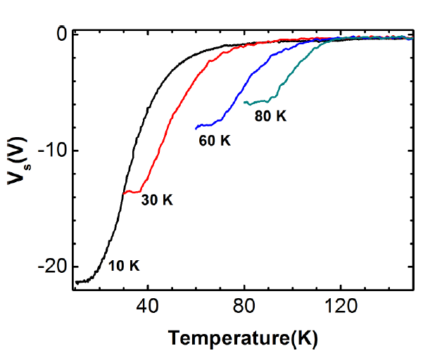
Spontelectric Water…
The presence of the electric field is revealed through changes in the work function (surface potential) of the film
The potential scales linearly with film thickness
The potential decreases with increasing deposition or annealing temperature and pretty much disappears over 100 K
The potential is the same whether the substrate is a metal or crystalline ice
This Behaviour is Characteristic of a Spontelectric Thin Film!

Slide 11
Spontelectric Water…
The spontelectric effect has been characterised by Field and co-workers over the last 10 years
Spontaneous Electric Fields in Solid Films: Spontelectrics
D. Field, O. Plekan, A. Cassidy, R. Balog, N.C. Jones and J. Dunger, Int. Rev. Phys. Chem., 2013, 32, 345-392
A Review of Recent Progress in Understanding the Spontelectric State of Matter
O. Plekan, A. Rosu-Finsen, A. M. Cassidy, J. Lasne, M. R. S. McCoustra and D. Field, Eur. Phys. J. D, 2017, 71, 162
Experimental observations made using Zero Kinetic Energy Electron Attachment, RAIRS and VUV Absorption Spectroscopy on thin films of many dipolar molecules
Results from a balance of counter-intuitve electrostatic interactions and thermal effects and is independent of the growth substrate

Slide 12
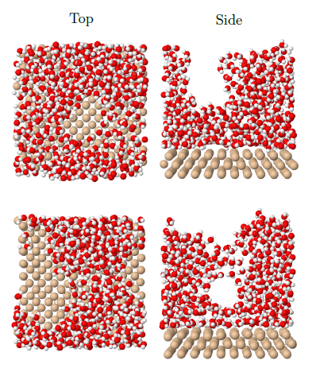
Spontelectric Water…
Deposition simulations using realistic water (TIP4P) and water-silica potentials allow exploration of the effects of surface and gas temperature
Temperature Dependence of Molecular Structure of Amorphous Solid Water: A Numerical Experiment
P. D. Elkind, J. M. Miller, G. Nyman and H. J. Fraser, In Preparation

Slide 13
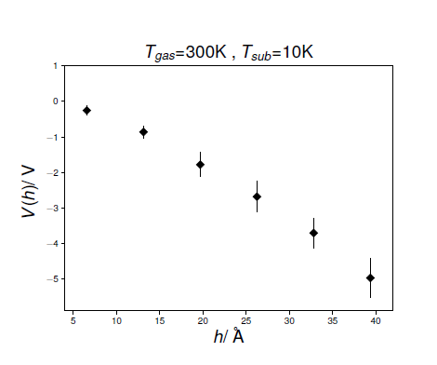
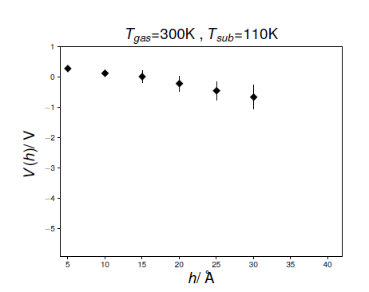
Spontelectric Water…
Deposited structures express net dipole orientation <μ_{z}/μ> and hence a bulk electric field
Detailed analysis of these simulations reveals increasing electric field with increasing thickness and decreasing field with increasing temperature
Experimental behaviour is reflected in the simulations
A Theoretical Study on Spontaneous Dipole Alignment in Ice Structures
S. R. Hashemi, M. R. S. McCoustra, H. J. Fraser and G. Nyman, In Preparation

Slide 14
So What with Spontelectric Water?
We have demonstrated that spontelectric behaviour in solid CO can be used to fill important gaps in our understanding of the evolution of pre-stellar cores
Dust grains with a CO ice mantle reduce the degree of ionization of pre-stellar cores by a factor of between 5 and 6
This reduces the timescale for expulsion of magnetic fields from cores, a key step in promoting gravitational collapse, by a similar factor suggesting an explanation for the discrepancy between observed and calculated timescales for star formation
If water ice on such grains is also spontelectric this will further assist in this process
Enabling Star Formation Via Spontaneous Molecular Dipole Orientation In Icy Solids
A. Rosu-Finsen, J. Lasne, A. Cassidy, M. McCoustra and D. Field, Astrophys. J. 2016, 832, 10.3847/0004-637X/832/1/1

Slide 15
Conclusions
Ballistic deposition of water is not so ballistic! Water agglomerates on short timescales above 10 K which means that grains will have “wet” and “dry” areas
Water deposited at temperatures below 120 K exhibits spontelectric behaviour and expresses a substantial bulk electric field
Experimental and computational studies of spontelectric behaviour in water are consistent
Spontelectric behaviour of CO films has been proposed as playing a key role in switching off magnetic support of star-forming core, spontelectric behaviour of water underlying the CO will assist in this process

Slide 16

Acknowledgements
Dr.’s Mark Collings and Jerome Lasne
John Dever, Simon Green, Rui Chen, John Thrower,
Vicky Frankland, Ali Abdulgalil, Demian Marchione,
Alex Rosu-Finsen, Skandar Taj and Rushdi Senevirathne
££
Framework 7
EPSRC and STFC
Leverhulme Trust
University of Nottingham
Heriot-Watt University
££
This research was (in part) funded by the LASSIE Initial Training Network, which is supported by the European Commission's 7th Framework Programme under Grant Agreement No. 238258.

