Slide 1
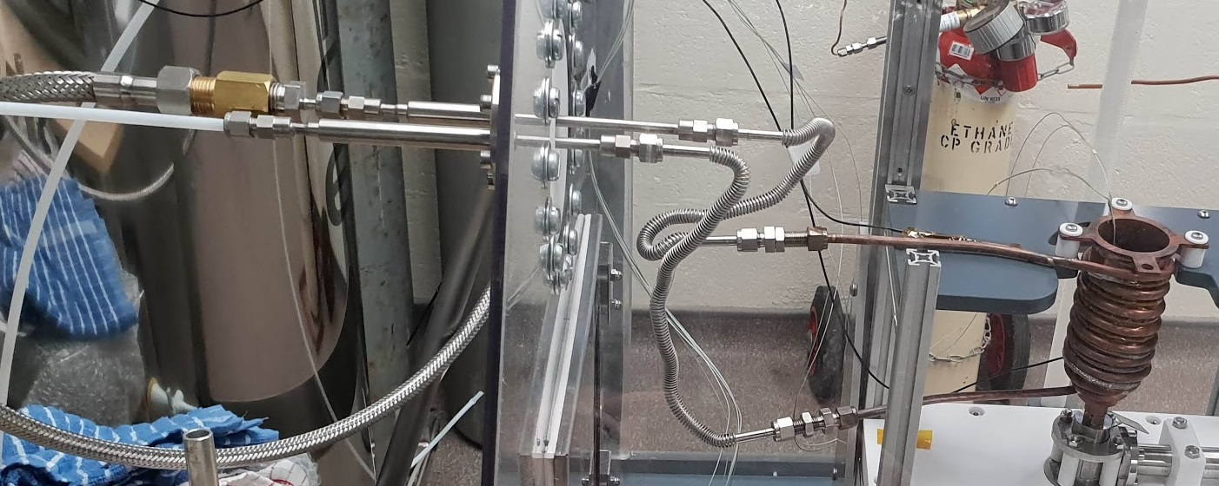
3
4
Inlet Liquid N₂
1
2
Outlet (cold gas)
6
7
5

Slide 2
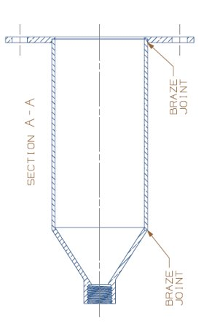

Slide 3
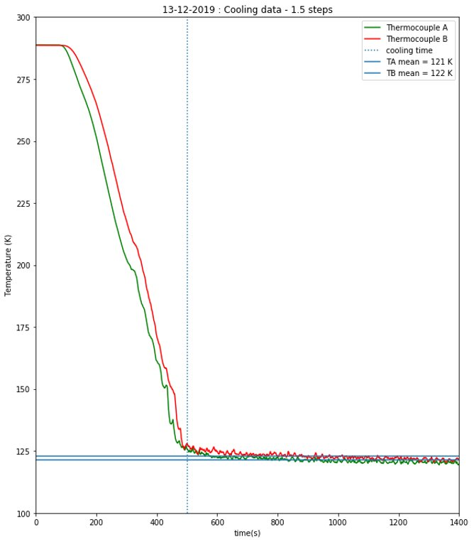
A
B

Slide 4
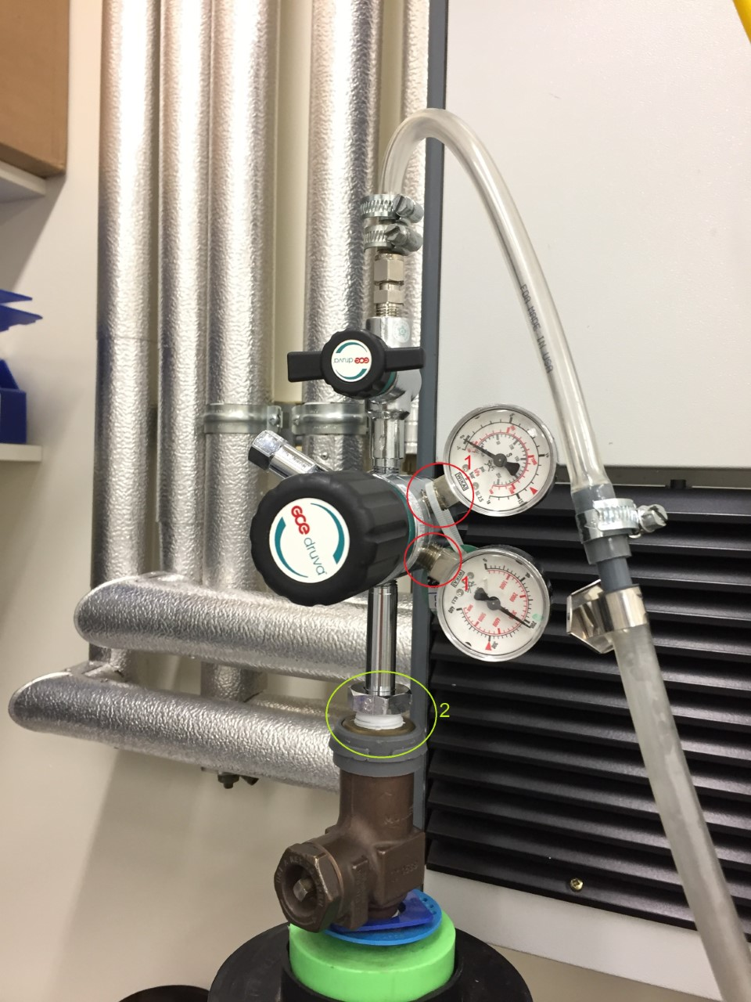
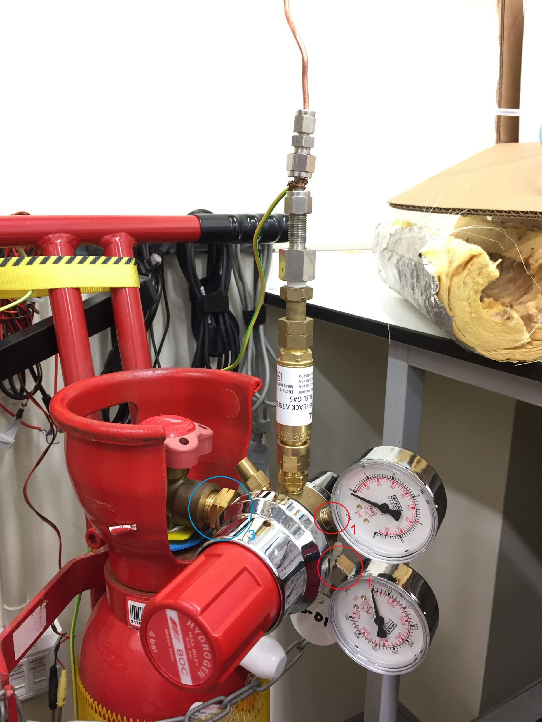
N₂ Regulator
C₂H₆ Regulator
1
2

Slide 5
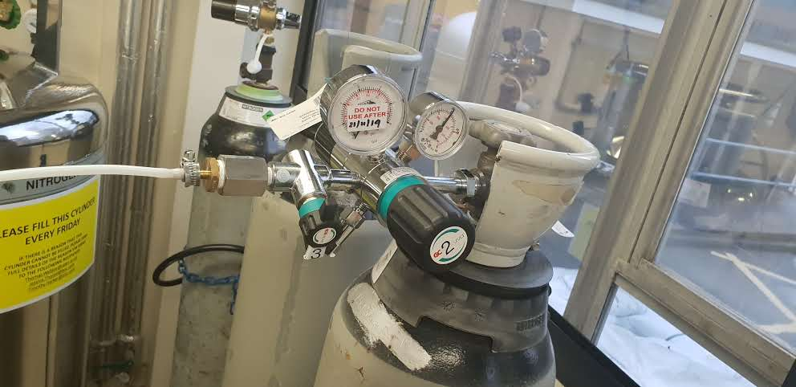
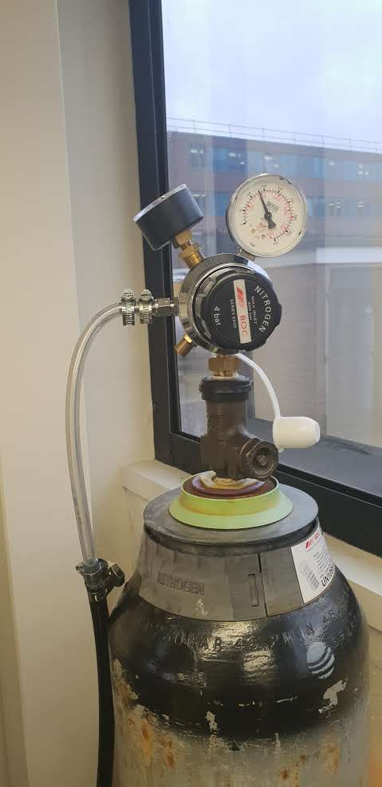
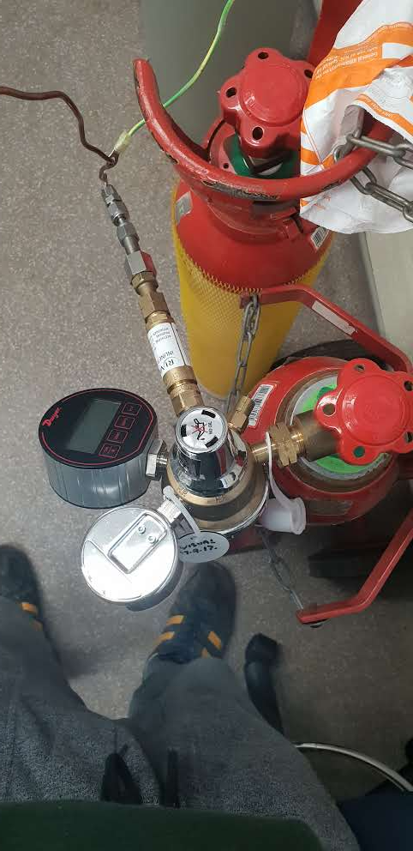
N₂ Regulator (bottle 1)
N₂ Regulator (bottle 2)
C₂H₆ Regulator
1
1
2
BS3 connector
BS4 connector

Slide 6
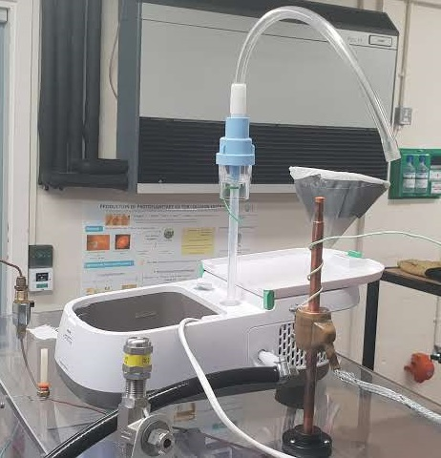
4
5
3
1
6
2

Slide 7
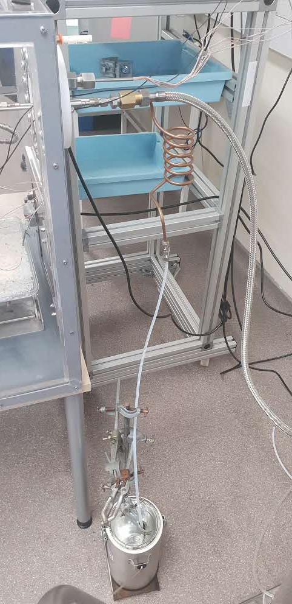

Slide 8
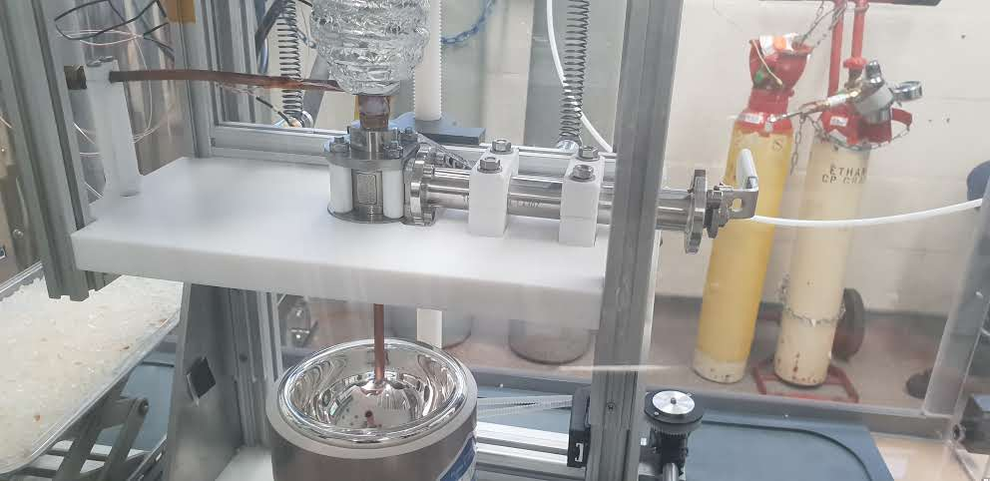
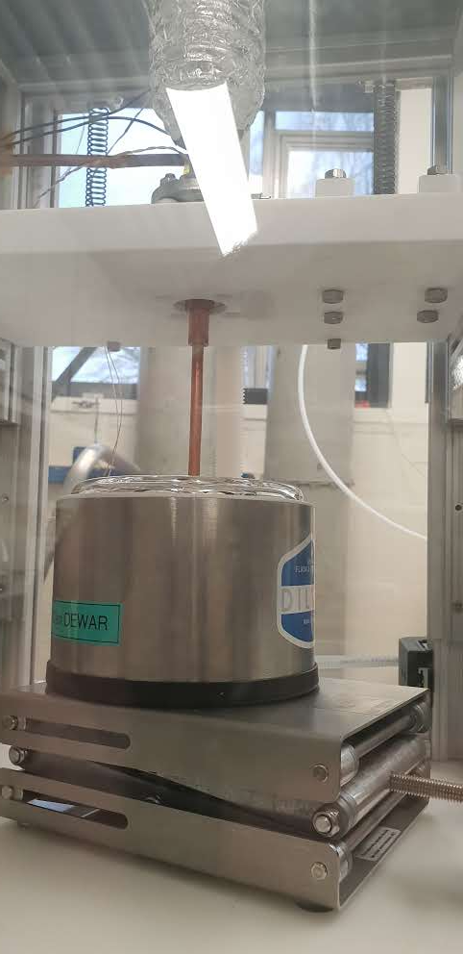
OPEN

Slide 9
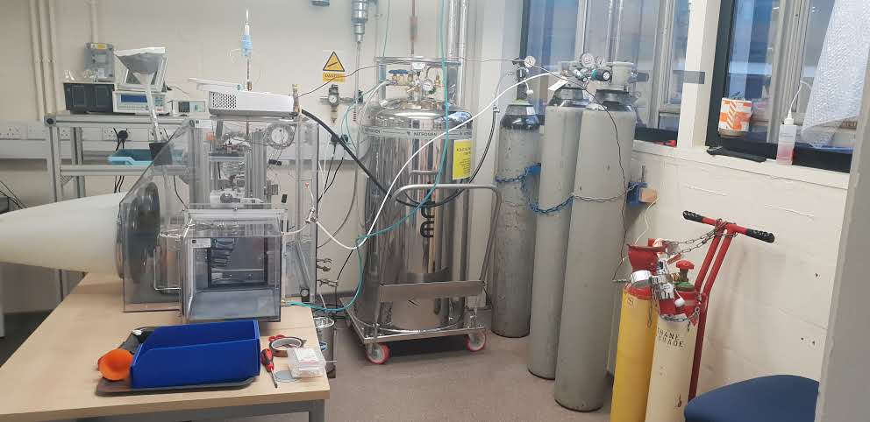
2
3
1
N₂ pressurized
Deware (200L)

Slide 10
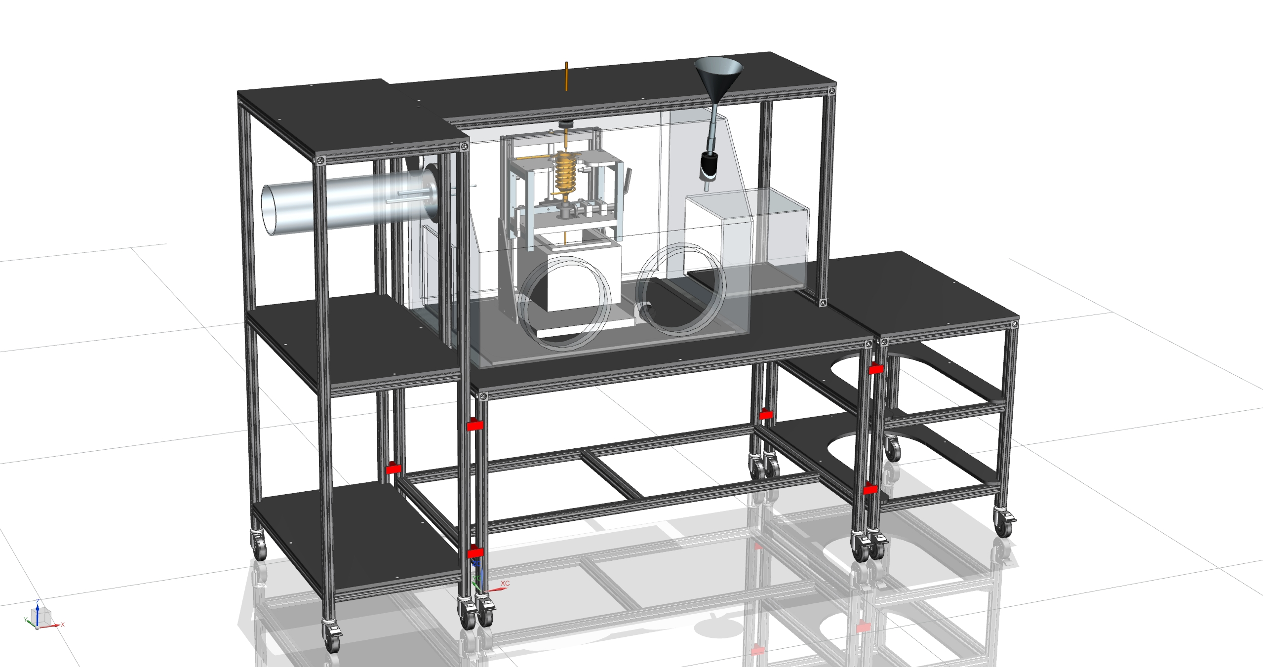
PID 1 & 2
Nozzle
Picolog TC-08
CCR attachment
Preparation area
Computer
Sliding table Cryogenic Dewar

Slide 11
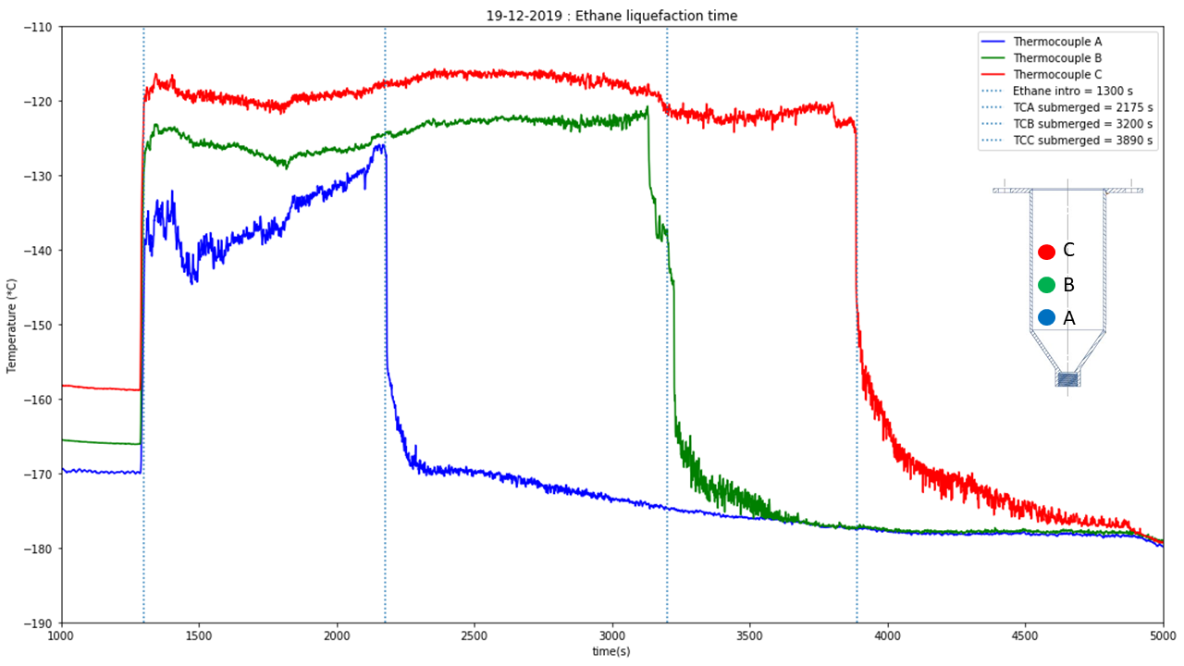

Slide 12
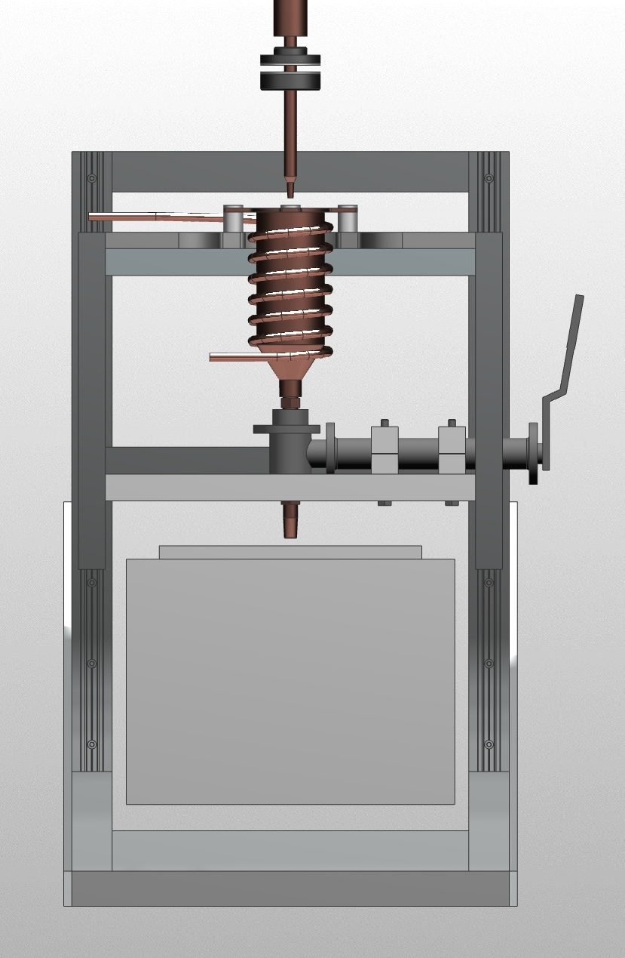
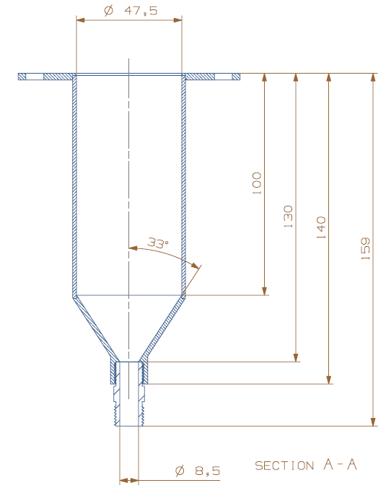
K, Copper block T
T, Nozzle
T, Dewar top
T, Dewar bottom
T, Ethane bottom
T, Ethane top
T, 6kg copper block

Slide 13
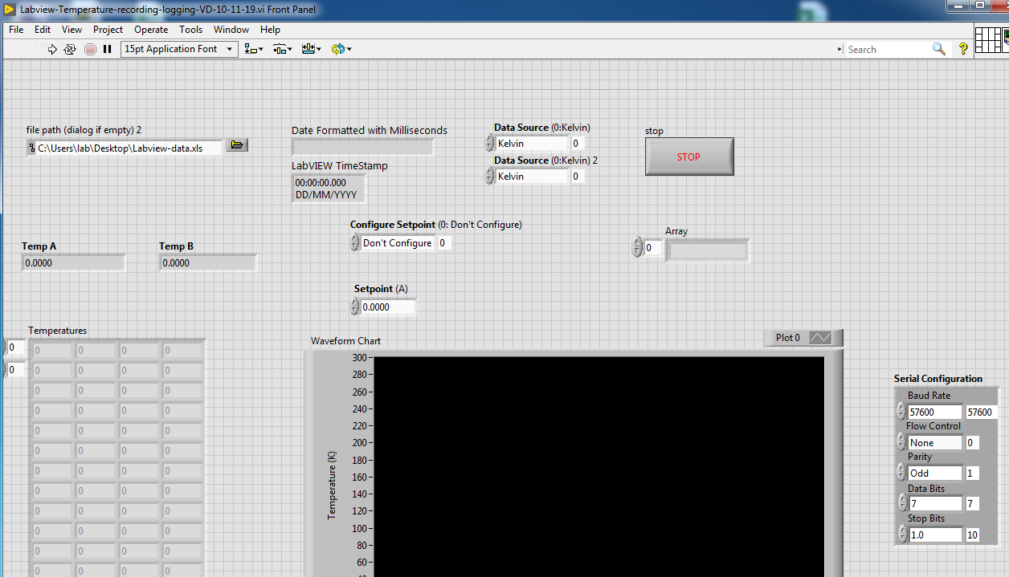
Start Labview T recording
Log file

Slide 14
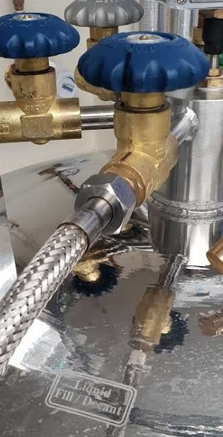
1 step

