Slide 1
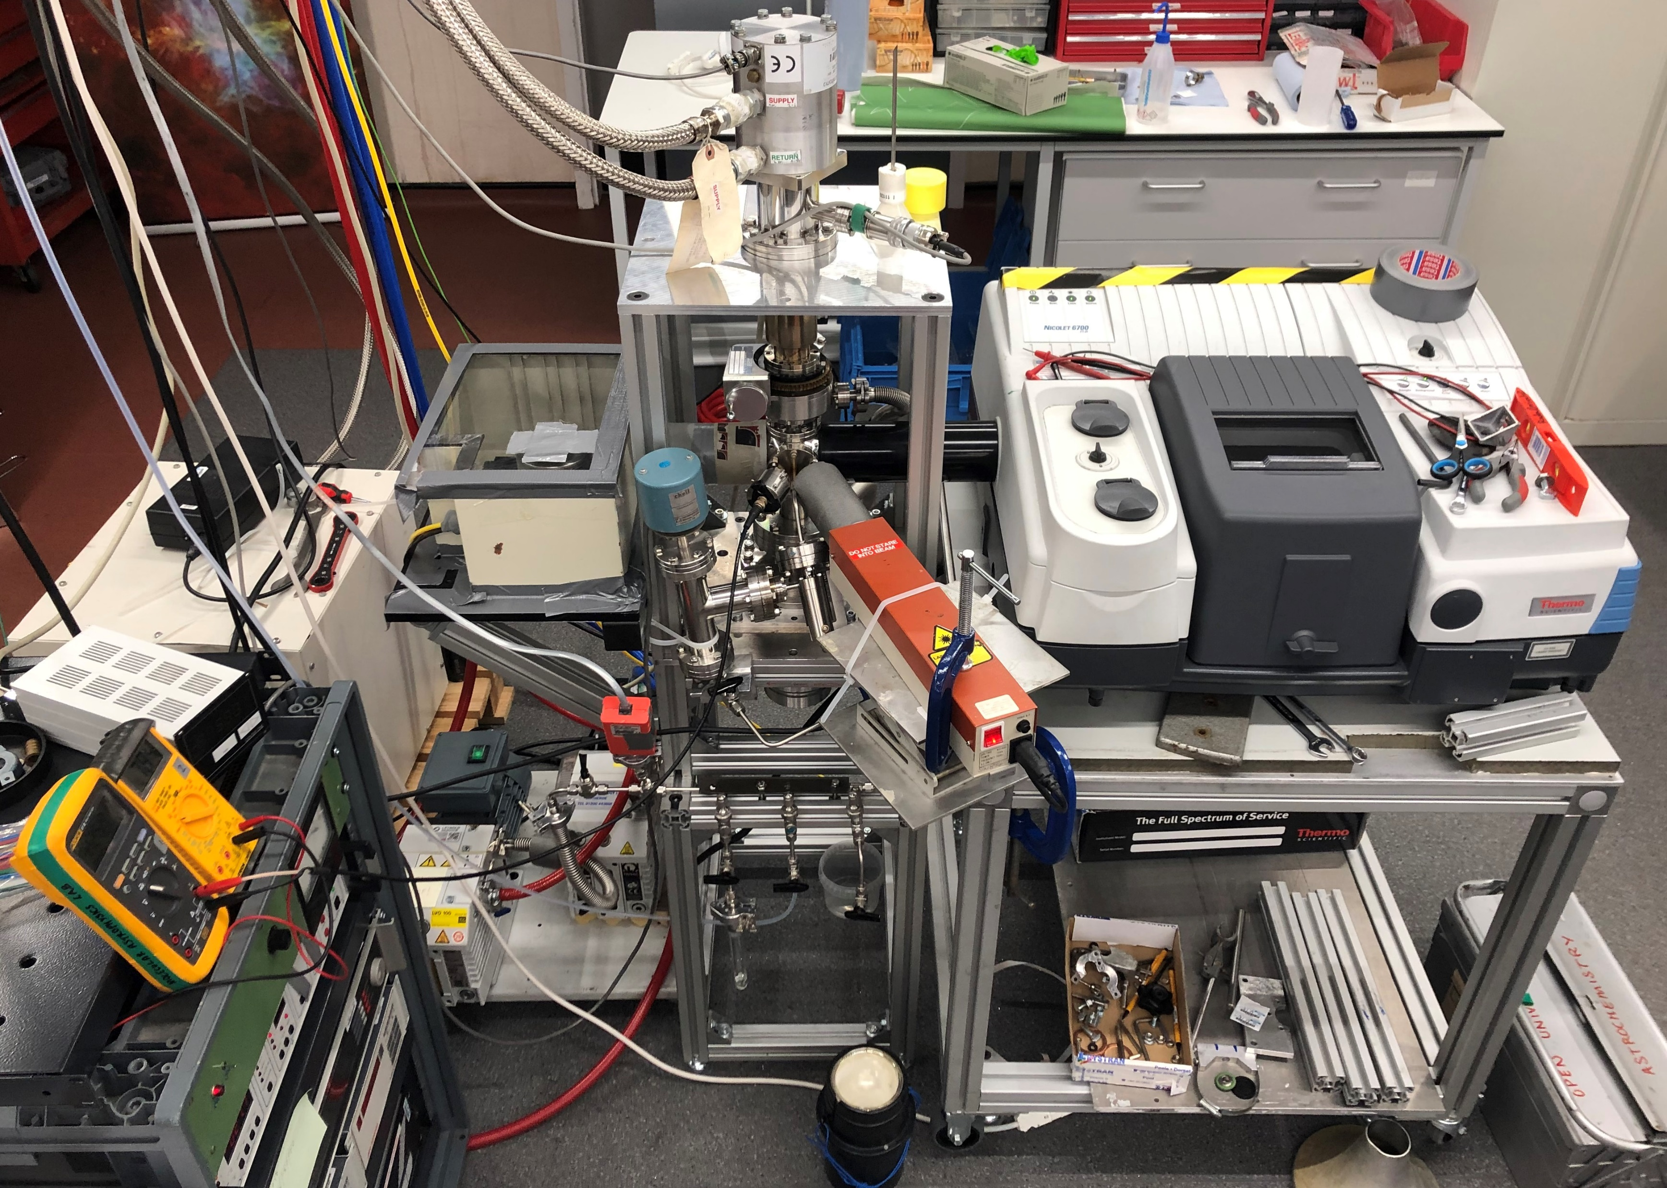
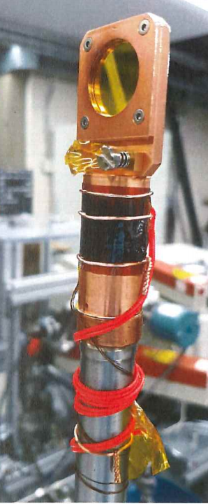
He Close Cycle Refrigerator
Main chamber
Substrate
MCT Detector
IR Spectrometer
Gas mixing chamber
Deposition
Interferometry
Laser
Scan
Absorption
Gas lines

