Slide 1

Guided Tour

Slide 2
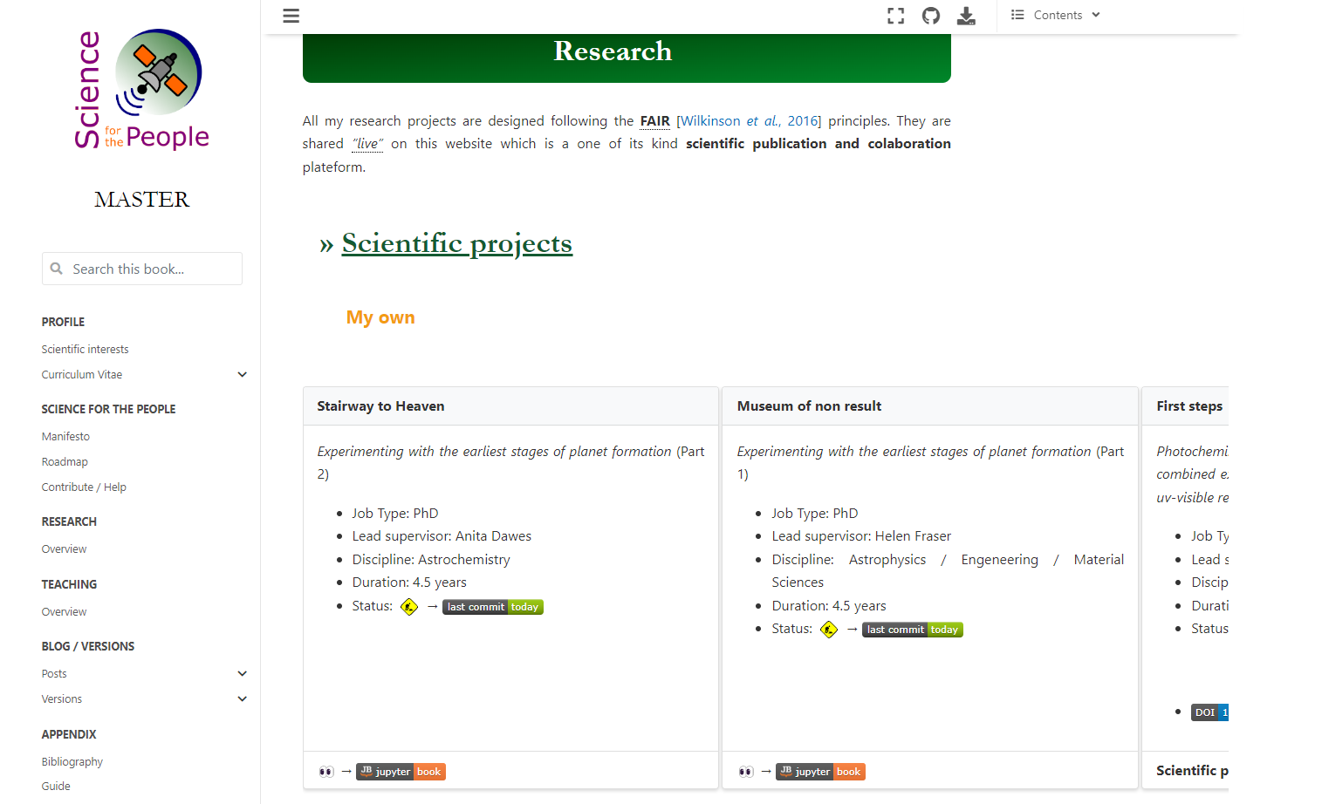
Main menue (site)
pages are clickables

