Slide 1
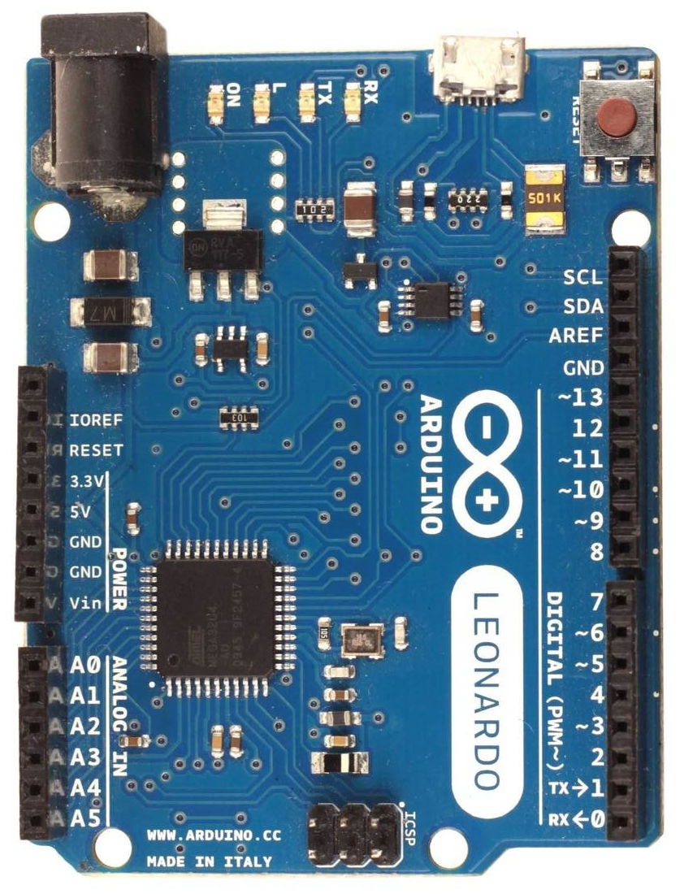
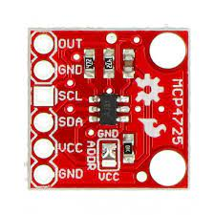
Wiring diagram for external DAC’s (only valid for firmware fw-vXX3, in DAC± mode)
Arduino Leonardo, Micro or ProMicro
20k
Vcc can be provided by
regulated bipolar power supply
use LM7812, LM7912 for ±12V
or LM7815, LM7915 for ±15V
+Vcc
shielded audio grade cable
10k
+
10k
IC1
output ±10V
-
goes to AASD analog input
use of analog optocoupler
is desired but not required
-Vcc
20k
IC1 - can be any audio grade
operational amplifire like
TL072, NE5532 or equivalent
DAC1
0x61
right
DAC0
0x60
left
Arduino MCP4725
5V VDD
GND GND
2 SDA (i²C data)
3 CLK (i²C clock)
DAC0 - ADDR pin to GND
i²C address 0x60 is for left force
DAC1 - ADDR pin to VCC
i²C address 0x61 is for right force
MCP4725
external i²C 12bit DAC

