Slide 1
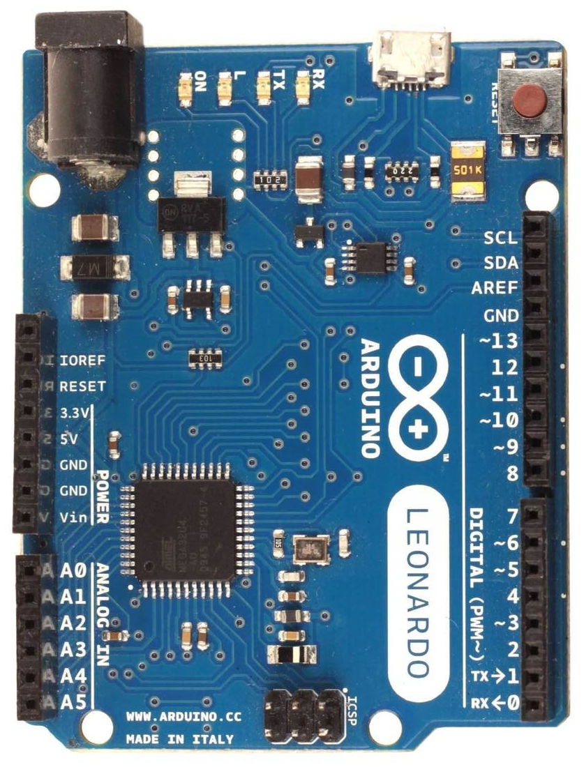

Wiring diagram for analog XY shifter (only valid for firmware with option “f”)
Arduino Leonardo or Micro only
a
b
c
1023
1
3
5
7
10k linear pots
Y
e
neutral gear (no button)
d
A4
A5
2
4
6 (r)
8 (r)
0
X
1023
button0 for
reverse gear
Arduino XY shifter
5V 5V
GND GND
A4 X position
A5 Y position
4 button0 (reverse gear)
in order to activate a reverse gear
you need to press this button and
shift into last gear which
can be 6th or 8th depending
on the shifter configuration

