Slide 1
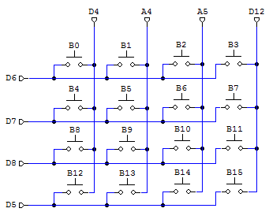
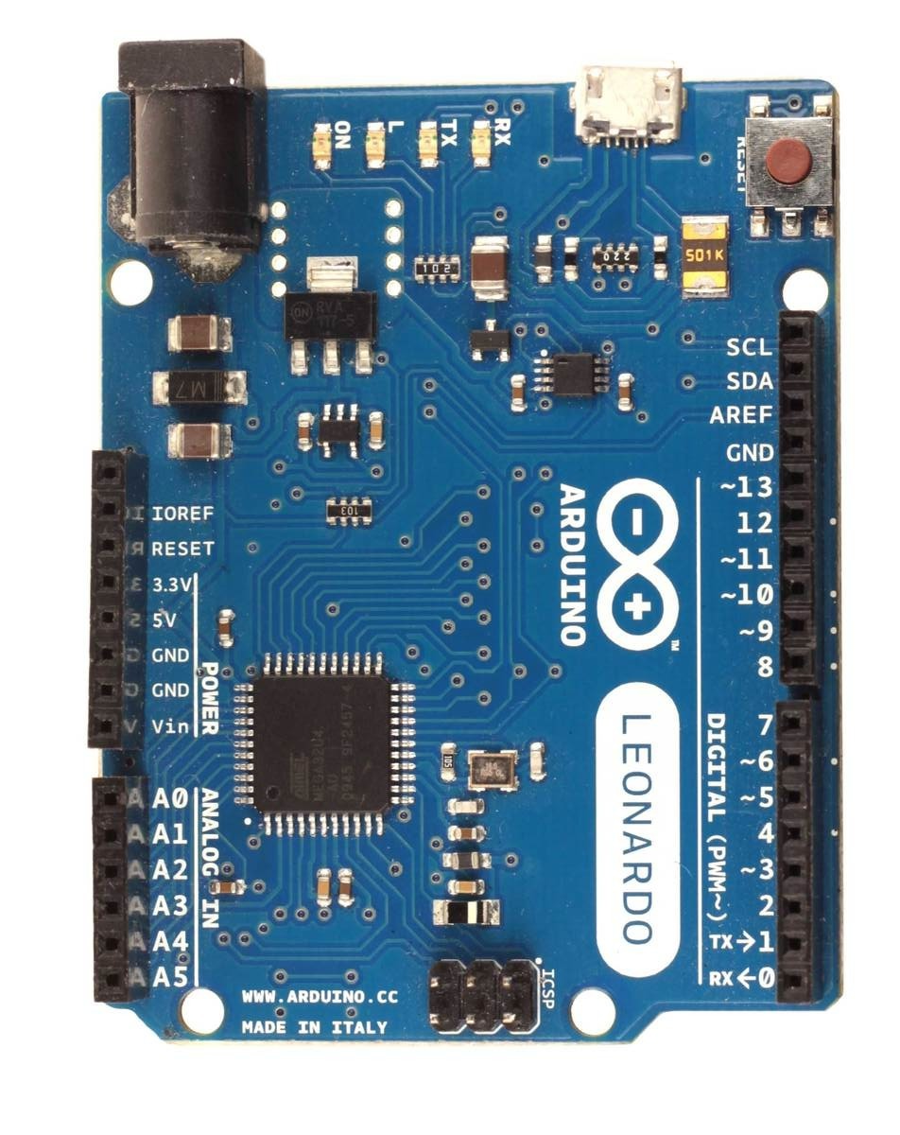
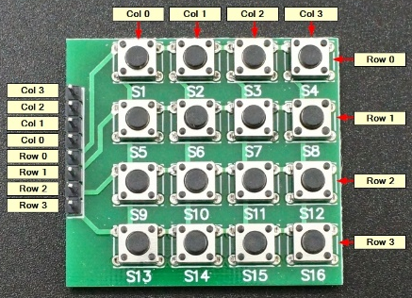
Wiring diagram for 4x4 button matrix (only valid for firmware fw-vXX0 with “t” option)
Arduino Leonardo, Micro or ProMicro
Firmware with “h” option
has hat switch support on
matrix buttons B0-B3:
B0 - up
B1 - right
B2 - down
B3 - left
Matrix pins:
row0 - D6
row1 - D7
row2 - D8
row3 - D5
col0 - D4
col1 - A4
col2 - A5
col3 - D12
Button matrix schematic and PCB

