Slide 1
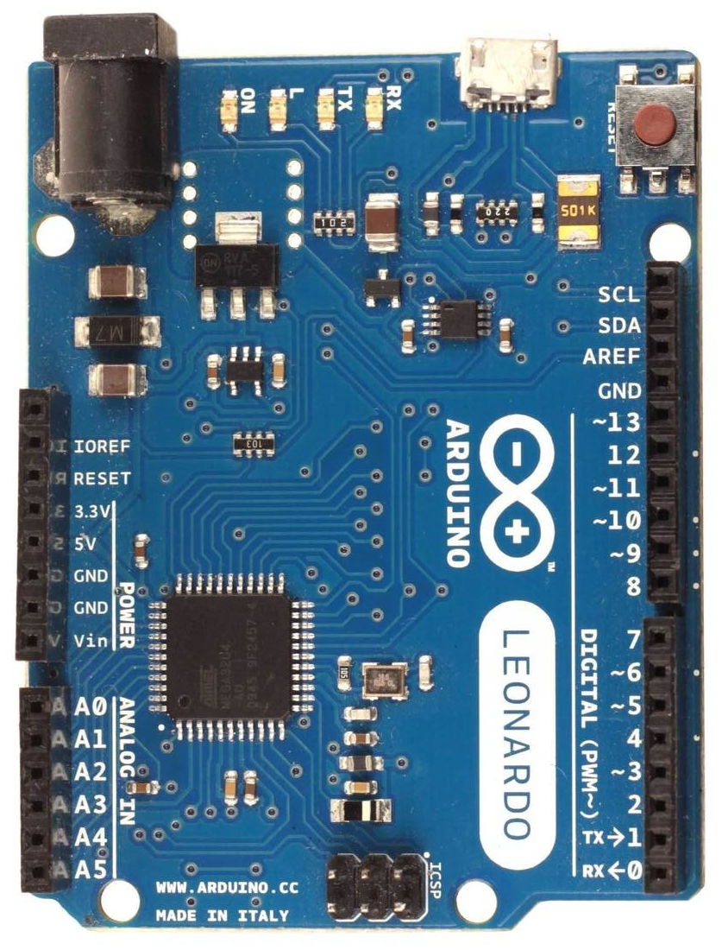
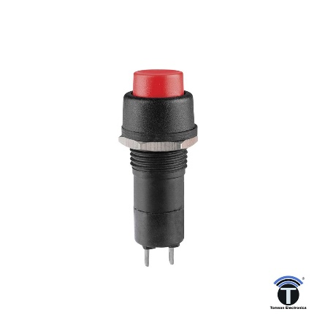
Wiring diagram for optical quadrature encoder and FFB clip LED (valid for all firmware versions)
Arduino Leonardo, Micro or ProMicro
Any 5V optical quadrature encoder
max supported CPR=100k
Arduino Encoder
GND 0V, shield
5V VCC or 5V
TX A+
RX B+
2 Z+ (or re-center switch)
3x 3.3K
5V DC
0V (common)
GND (shield)
OUT A
OUT B
OUT Z
*
Internal 100k pullup resistors are
enabled in firmware, but you may
want to add additional ones in order
to avoid step skipping which manifest
as losing of wheel center over time,
anything between 1K and 4.7K is ok
*
OMRON E6B2-CWZ1X
*
*
220R
Arduino FFB clip LED pin
Leonardo, Micro 13
ProMicro 3 (fw option “m”)
FFB clip LED is not just a simple ON/OFF
it has linearly increasing intensity up to
half brightness between 90-99% of FFB
and a full brightness for 100% of FFB
giving you the ability to easily fine tune
FFB strength and get the most details
FFB clip LED indicator function
100
LED intensity (%)
*
50
wheel re-center switch (fw option “c”)
* not required features/components
0
90
100
FFB (%)
GND

