Slide 1
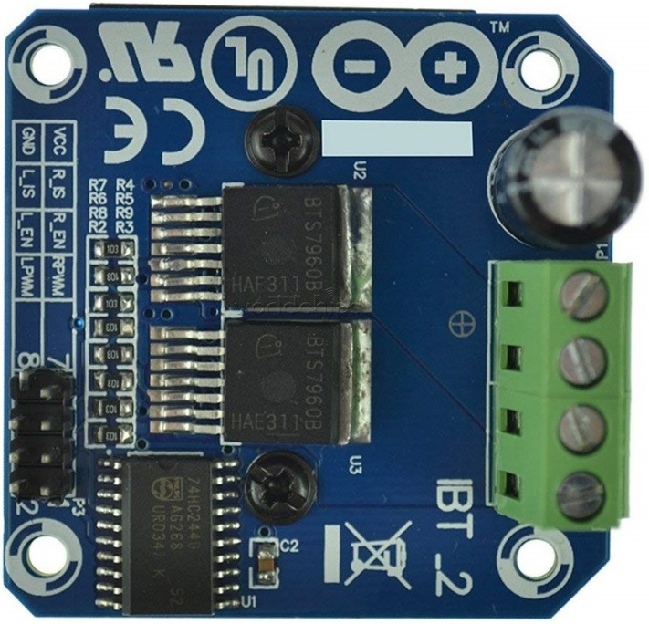
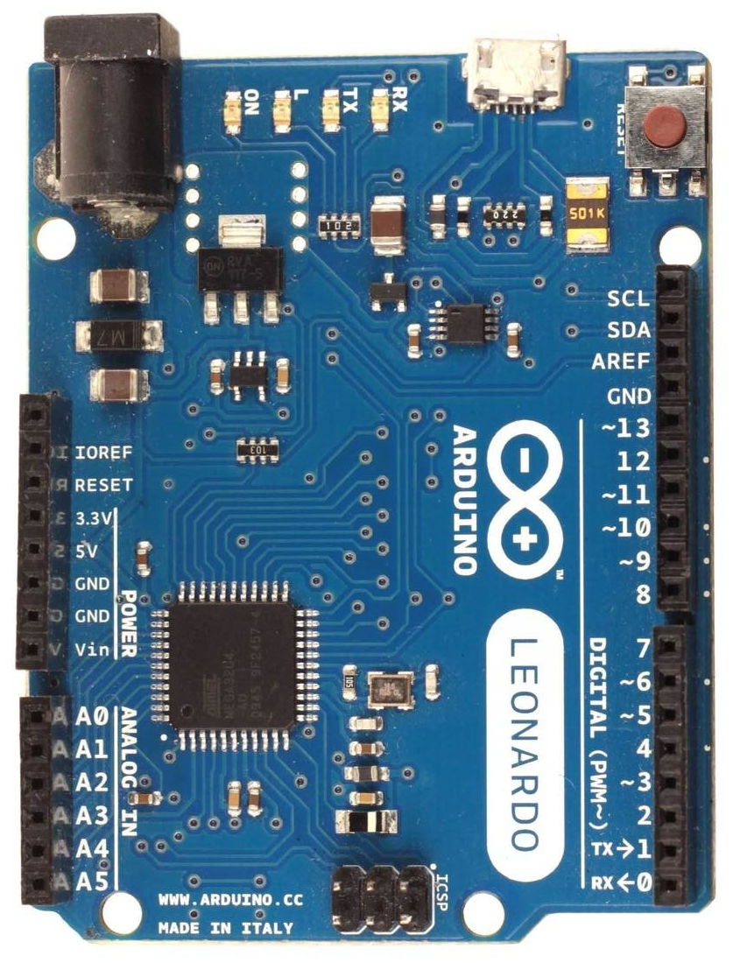
Wiring diagram for H-bridge motor driver (valid for all firmware in PWM± mode, except fw-v183)
Arduino Leonardo, Micro or ProMicro
BTS7960 or any other 2 channel H-bridge
motor driver with PWM inputs
Standard pinouts:
Arduino BTS7960 (pin)
GND GND (8)
5V VCC (7), R_EN (3), L_EN (4)
9 LPWM (2)
10 RPWM (1)
BTS7960 pins:
B+, B- DC power supply input (5.5-27)V
M+, M- DC motor output (max 300W)
R_IS, L_IS are current shunt outputs
that may be used for monitoring
current load at each channel, but you
have to connect a shunt resistor to each
B-
B+
M+
M-
*
If your motor is very hard to turn
by hand when there is no PWM
signal input, then you may
try the wiring trick by shorting
bts pins VCC, R_EN, L_EN
together and leave them floating!
* floating means not connected
anywhere (no voltage on them)
R_IS, L_IS
Vout
(0-5)V -> (0-43)A
1k

