Slide 2
Group Members
Dylan Chu
Junior
Lead Programmer
Undergraduate researcher for Dr. Kuber

Slide 3
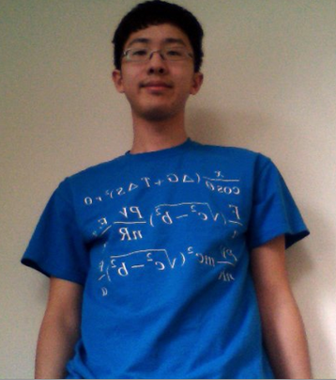
Group Members
Yu-Dean Wang
Junior
Lead Designer
President of UMBC
Anime Society

Slide 4
Imagine this:
Your professor sends you an e-mail
to simply show up at a certain time.
You show up, and get to wait in line.
You’re hoping that you get advised before
he is done advising for the day.

Slide 5
Imagine this:
Your advisor gives you times to meet for advising.
But you aren’t available.
Your advisor isn’t available.
So you have to jump through hoops to register.

Slide 6
The Appointment Advisor

Slide 7
App Development
Started by asking problems in our lives
Then asked a professor
Focused on Student-side
Shared work using GitHub and Meetings

Slide 8
Using the Appointment Advisor
The start screen
Reset removes every filled timeslot

Slide 9
Using the Appointment Advisor
Choosing Professor and Class
Class restricts timeslot availability

Slide 10
Using the Appointment Advisor
Choosing Day
Affects timeslot availability

Slide 11
Using the Appointment Advisor
Choosing Time
Timeslots invisible if unavailable

Slide 12
Using the Appointment Advisor
Results screen

Slide 13
Using the Appointment Advisor
Personal Page
States time, day, and professor

Slide 14
Using the Appointment Advisor
Choosing another appointment time
Previous timeslot entry overwritten, freeing it up.

Slide 15
Most challenging parts were:
Choosing based on day
Saving Timeslot data for user and app

Slide 16
In our next version:
Timeframe: 2 weeks
Large-scale scheduling calendar
Teacher-side implementation
Validation, canceling appointments
Using database to store data

