Slide 1
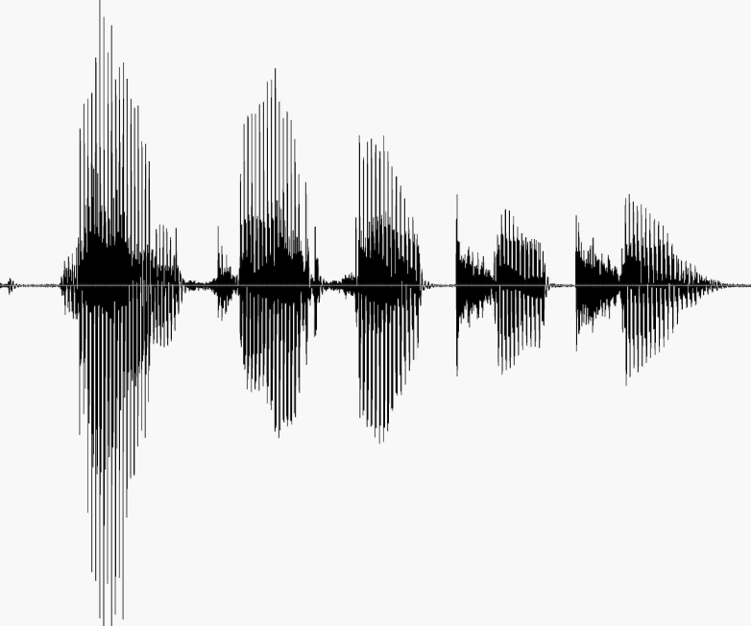
CS 224S / LINGUIST 285 Spoken Language Processing
Andrew Maas
Stanford University
Spring 2017
Lecture 11: Dialogue Acts, Information State, and Markov Decision Processes
Original slides by Dan Jurafsky

Slide 2
Outline
Human dialogue considerations
Information state
Evaluation
Markov decision processes

Slide 3
Linguistics of Human Conversation
Turn-taking
Speech Acts
Grounding

Slide 4
Turn-taking
Dialogue is characterized by turn-taking.
A:
B:
A:
B:
…
So how do speakers know when to take the floor?

Slide 5
Adjacency pairs
Sacks et al. (1974)
Adjacency pairs: current speaker selects next speaker
Question/answer
Greeting/greeting
Compliment/downplayer
Request/grant
Silence inside the pair is meaningful:
A: Is there something bothering you or not?
(1.0)
A: Yes or no?
(1.5)
A: Eh
B: No.

Slide 6
Speech Acts
Austin (1962): An utterance is a kind of action
Clear case: performatives
I name this ship the Titanic
I second that motion
I bet you five dollars it will snow tomorrow
Performative verbs (name, second)
Locutionary (what was said)
Illocutionary (what was meant)
Is there any salt?

Slide 7
5 classes of “speech acts”
Searle (1975)
Assertives: committing the speaker to something’s being the case
(suggesting, putting forward, swearing, boasting, concluding)
Directives: attempts by speaker to get addressee to do something
(asking, ordering, requesting, inviting, advising, begging)
Commissives: Committing speaker to future course of action
(promising, planning, vowing, betting, opposing)
Expressives: expressing psychological state of the speaker about a state of affairs
(thanking, apologizing, welcoming, deploring).
Declarations: changing the world via the utterance
(I resign; You’re fired)

Slide 8
More Illocutionary acts: Grounding
Why do elevator buttons light up?
Clark (1996) (after Norman 1988)
Principle of closure. Agents performing an action require evidence, sufficient for current purposes, that they have succeeded in performing it
What is the linguistic correlate of this?

Slide 9
Grounding
Need to know whether an action succeeded or failed
Dialogue is also an action
a collective action performed by speaker and hearer
Common ground: set of things mutually believed by both speaker and hearer
Need to achieve common ground, so hearer must ground or acknowledge speakers utterance.

Slide 10
How do speakers ground? Clark and Schaefer
Continued attention:
B continues attending to A
Relevant next contribution:
B starts in on next relevant contribution
Acknowledgement:
B nods or says continuer (uh-huh) or assessment (great!)
Demonstration:
B demonstrates understanding A by reformulating A’s contribution, or by collaboratively completing A’s utterance
Display:
B repeats verbatim all or part of A’s presentation

Slide 11
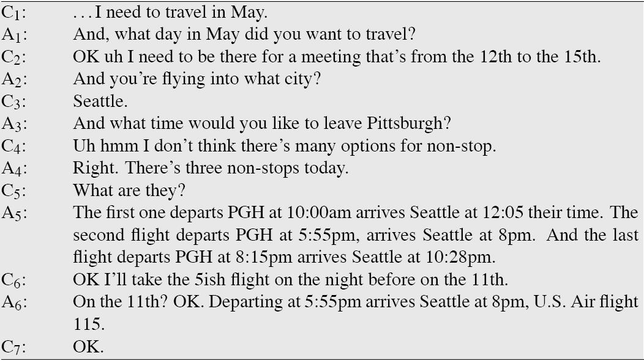
A human-human conversation

Slide 12
Grounding examples
Display:
C: I need to travel in May
A: And, what day in May did you want to travel?
Acknowledgement
C: I want to fly from Boston
A: mm-hmm
C: to Baltimore Washington International

Slide 13
Grounding Examples (2)
Acknowledgement + next relevant contribution
And, what day in May did you want to travel?
And you’re flying into what city?
And what time would you like to leave?
The and indicates to the client that agent has successfully understood answer to the last question.

Slide 14
Grounding negative responses From Cohen et al. (2004)
System: Did you want to review some more of your personal profile?
Caller: No.
System: Okay, what’s next?
System: Did you want to review some more of your personal profile?
Caller: No.
System: What’s next?
Good!
Bad!

Slide 15
Information-State and Dialogue Acts
For more than just form-filling
Need to:
Decide when the user has asked a question, made a proposal, rejected a suggestion
Ground a user’s utterance, ask clarification questions, suggest plans
Need models of interpretation and generation
Speech acts and grounding
More sophisticated representation of dialogue context than just a list of slots

Slide 16
Information-state architecture
Information state
Dialogue act interpreter
Dialogue act generator
Set of update rules
Update dialogue state as acts are interpreted
Generate dialogue acts
Control structure to select which update rules to apply

Slide 17
Information-state

Slide 18
Dialog acts
Also called “conversational moves”
An act with (internal) structure related specifically to its dialogue function
Incorporates ideas of grounding
Incorporates other dialogue and conversational functions that Austin and Searle didn’t seem interested in

Slide 19
Verbmobil task
Two-party scheduling dialogues
Speakers were asked to plan a meeting at some future date
Data used to design conversational agents which would help with this task
(cross-language, translating, scheduling assistant)

Slide 20
Verbmobil Dialogue Acts
THANK thanks
GREET Hello Dan
INTRODUCE It’s me again
BYE Allright, bye
REQUEST-COMMENT How does that look?
SUGGEST June 13th through 17th
REJECT No, Friday I’m booked all day
ACCEPT Saturday sounds fine
REQUEST-SUGGEST What is a good day of the week for you?
INIT I wanted to make an appointment with you
GIVE_REASON Because I have meetings all afternoon
FEEDBACK Okay
DELIBERATE Let me check my calendar here
CONFIRM Okay, that would be wonderful
CLARIFY Okay, do you mean Tuesday the 23rd?

Slide 21
Dialog Act Markup in Several Layers (DAMSL): forward looking function
STATEMENT a claim made by the speaker
INFO-REQUEST a question by the speaker
CHECK a question for confirming information
INFLUENCE-ON-ADDRESSEE (=Searle's directives)
OPEN-OPTION a weak suggestion or listing of options
ACTION-DIRECTIVE an actual command
INFLUENCE-ON-SPEAKER (=Austin's commissives)
OFFER speaker offers to do something
COMMIT speaker is committed to doing something
CONVENTIONAL other
OPENING greetings
CLOSING farewells
THANKING thanking and responding to thanks

Slide 22
DAMSL: backward looking function
AGREEMENT speaker's response to previous proposal
ACCEPT accepting the proposal
ACCEPT-PART accepting some part of the proposal
MAYBE neither accepting nor rejecting the proposal
REJECT-PART rejecting some part of the proposal
REJECT rejecting the proposal
HOLD putting off response, usually via subdialogue
ANSWER answering a question
UNDERSTANDING whether speaker understood previous
SIGNAL-NON-UNDER. speaker didn't understand
SIGNAL-UNDER. speaker did understand
ACK demonstrated via continuer or assessment
REPEAT-REPHRASE demonstrated via repetition or reformulation
COMPLETION demonstrated via collaborative completion

Slide 23
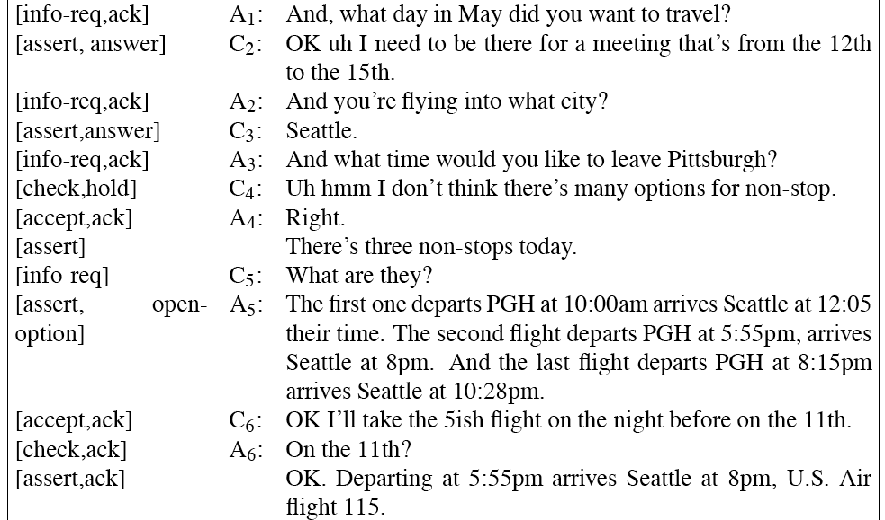
A DAMSL Labeling

Slide 24
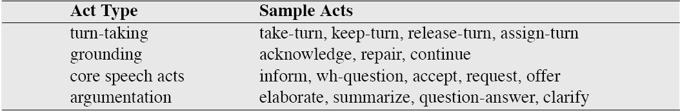
Conversation Acts Traum and Hinkelman (1992)

Slide 25
Generating Dialogue Acts
Two examples
Confirmation
Rejection

Slide 26
Confirmation
Errors: Speech is a pretty errorful channel
Humans use grounding to confirm that they heard correctly
ASR is way worse than humans!
Dialog systems need to do even more grounding and confirmation than humans
Users are confused when system doesn’t give explicit acknowledgement signal.
Stifelman et al. (1993), Yankelovich et al. (1995)

Slide 27
Explicit confirmation
S: Which city do you want to leave from?
U: Baltimore
S: Do you want to leave from Baltimore?
U: Yes

Slide 28
Explicit confirmation
U: I’d like to fly from Denver Colorado to New York City on September 21st in the morning on United Airlines
S: Let’s see then. I have you going from Denver Colorado to New York on September 21st. Is that correct?
U: Yes

Slide 29
Implicit confirmation: display
U: I’d like to travel to Berlin
S: When do you want to travel to Berlin?
U: Hi I’d like to fly to Seattle Tuesday morning
S: Traveling to Seattle on Tuesday, August eleventh in the morning. Your name?

Slide 30
Implicit vs. Explicit
Complementary strengths
Explicit: easier for users to correct systems’s mistakes (can just say “no”)
But explicit is cumbersome and long
Implicit: much more natural, quicker, simpler (if system guesses right).

Slide 31
Implicit and Explicit
Early systems: all-implicit or all-explicit
Modern systems: adaptive
How to decide?
ASR system can give confidence metric.
This expresses how convinced system is of its transcription of the speech
If high confidence, use implicit confirmation
If low confidence, use explicit confirmation

Slide 32
Computing confidence
Simplest: use acoustic log-likelihood of user’s utterance
More features
Prosodic: utterances with longer pauses, F0 excursions, longer durations
Backoff: did we have to backoff in the LM?
Cost of an error: Explicit confirmation before moving money or booking flights

Slide 33
Rejection
“I’m sorry, I didn’t understand that.”
Reject when:
ASR confidence is low
Best interpretation is semantically ill-formed
Might have four-tiered level of confidence:
Below confidence threshhold, reject
Above threshold, explicit confirmation
If even higher, implicit confirmation
Even higher, no confirmation

Slide 34
Automatic Interpretation of Dialogue Acts
How do we automatically identify dialogue acts?
Given an utterance:
Decide whether it is a QUESTION, STATEMENT, SUGGEST, or ACK
Perhaps we can just look at the form of the utterance to decide?

Slide 35
Can we just use the surface syntactic form?
YES-NO-Qs have auxiliary-before-subject syntax:
Will breakfast be served on USAir 1557?
STATEMENTs have declarative syntax:
I don’t care about lunch
COMMANDs have imperative syntax:
Show me flights from Milwaukee to Orlando on Thursday night

Slide 36
Surface form != speech act type
 | Surface form | Speech act
Can I have the rest of your sandwich? | Question | Request
I want the rest of your sandwich | Declarative | Request
Give me your sandwich! | Imperative | Request

Slide 37
Dialogue Act ambiguity
Can you give me a list of the flights from Atlanta to Boston?
This looks like an INFO-REQUEST.
If so, the answer is:
YES.
But really it’s a DIRECTIVE or REQUEST, a polite form of:
Please give me a list of the flights…
What looks like a QUESTION can be a REQUEST

Slide 38
Indirect speech acts
Utterances which use a surface statement to ask a question
Utterances which use a surface question to issue a request

Slide 39
Dialogue Act ambiguity
What looks like a STATEMENT can be a QUESTION:
Us | OPEN-OPTION | I was wanting to make some arrangements for a trip that I’m going to be taking uh to LA uh beginnning of the week after next
Ag | HOLD | OK uh let me pull up your profile and I’ll be right with you here. [pause]
Ag | CHECK | And you said you wanted to travel next week?
Us | ACCEPT | Uh yes.

Slide 40
DA interpretation as statistical classification: Features
Words and Collocations:
Please or would you: good cue for REQUEST
Are you: good cue for INFO-REQUEST
Prosody:
Rising pitch is a good cue for INFO-REQUEST
Loudness/stress can help distinguish yeah/AGREEMENT from yeah/BACKCHANNEL
Conversational Structure
Yeah following a proposal is probably AGREEMENT; yeah following an INFORM probably a BACKCHANNEL

Slide 41
An example of dialogue act detection: Correction Detection
If system misrecognizes an utterance, and either
Rejects
Via confirmation, displays its misunderstanding
Then user has a chance to make a
correction
Repeat themselves
Rephrasing
Saying “no” to the confirmation question.

Slide 42

Corrections
Unfortunately, corrections are harder to recognize than normal sentences!
Swerts et al (2000): corrections misrecognized twice as often (in terms of WER) as non-corrections!!!
Why?
Prosody seems to be largest factor: hyperarticulation
Liz Shriberg example:
“NO, I am DE-PAR-TING from Jacksonville”

Slide 43
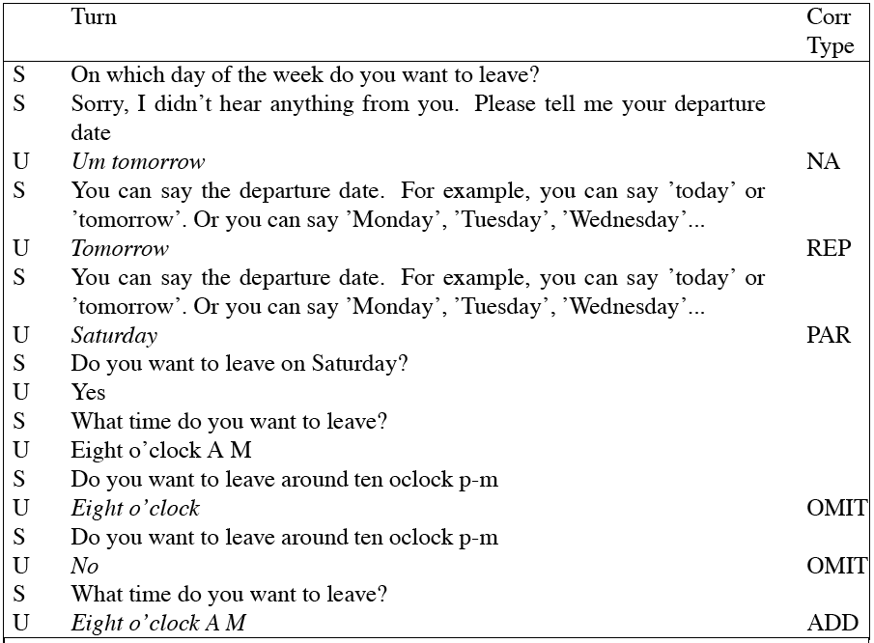
A Labeled dialogue (Swerts et al)

Slide 44
Machine learning to detect user corrections: features
Lexical information (no, correction, I don’t, swear words)
Prosodic indicators of hyperarticulation
increases in F0 range, pause duration, word duration
Length
ASR confidence
LM probability
Various dialogue features (repetition)

Slide 45
Prosodic Features
Shriberg et al. (1998)
Decision tree trained on simple acoustically-based prosodic features
Slope of F0 at the end of the utterance
Average energy at different places in utterance
Various duration measures
All normalized in various ways
These helped distinguish
Statement (S)
Yes-no-question (QY)
Declarative question (QD) (“You’re going to the store?”)
Wh-question (QW)

Slide 46
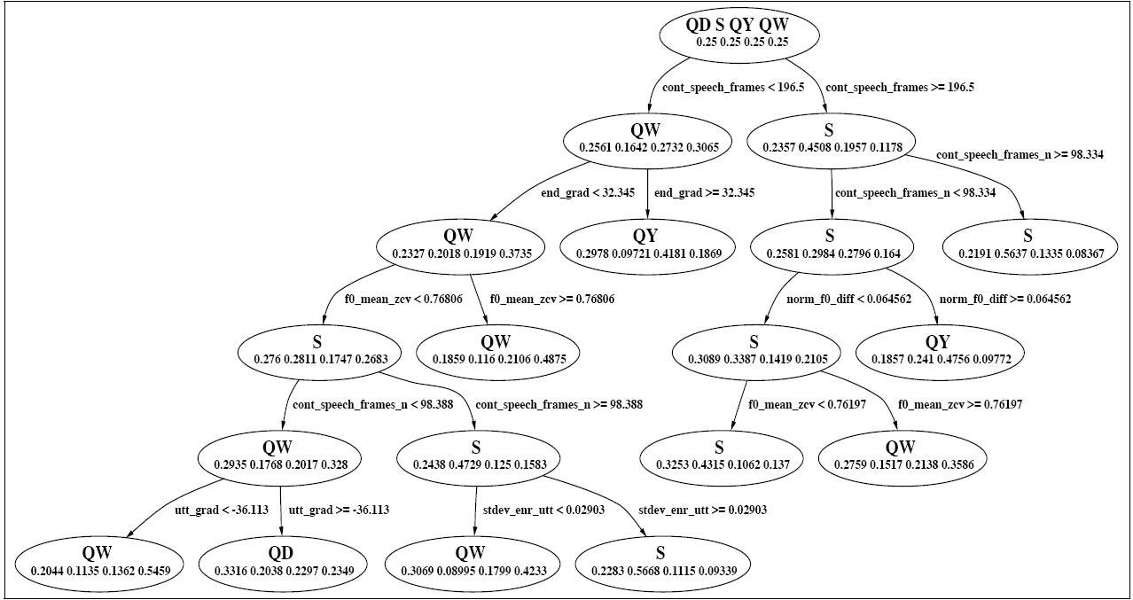
Prosodic Decision Tree for making S/QY/QW/QD decision

Slide 47
Dialogue System Evaluation
Always two kinds of evaluation
Extrinsic: embedded in some external task
Intrinsic: evaluating the component as such
What constitutes success or failure for a dialogue system?

Slide 48
Reasons for Dialogue System Evaluation
A metric to compare systems
can’t improve it if we don’t know where it fails
can’t decide between two systems without a goodness metric
A metric as an input to reinforcement learning:
automatically improve conversational agent performance via learning

Slide 49
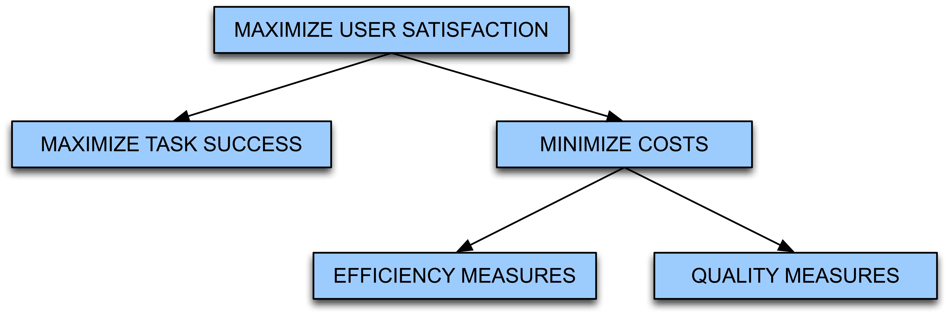
PARADISE evaluation
Maximize Task Success
Minimize Costs
Efficiency Measures
Quality Measures
PARADISE (PARAdigm for Dialogue System Evaluation) (Walker et al. 2000)

Slide 50
Task Success
% of subtasks completed
Correctness of each questions/answer/error msg
Correctness of total solution
Error rate in final slots
Generalization of Slot Error Rate
Users’ perception of whether task was completed

Slide 51
Efficiency Cost
Polifroni et al. (1992), Danieli and Gerbino (1995) Hirschman and Pao (1993)
Total elapsed time in seconds or turns
Number of queries
Turn correction ration: number of system or user turns used solely to correct errors, divided by total number of turns

Slide 52
Quality Cost
# of times ASR system failed to return any sentence
# of ASR rejection prompts
# of times user had to barge-in
# of time-out prompts
Inappropriateness (verbose, ambiguous) of system’s questions, answers, error messages

Slide 53
Concept accuracy:
“Concept accuracy” or “Concept error rate”
% of semantic concepts that the NLU component returns correctly
I want to arrive in Austin at 5:00
DESTCITY: Boston
Time: 5:00
Concept accuracy = 50%
Average this across entire dialogue
“How many of the sentences did the system understand correctly”
Can be used as either quality cost or task success

Slide 54
PARADISE: Regress against user satisfaction

Slide 55
Regressing against user satisfaction
Questionnaire to assign each dialogue a “user satisfaction rating”: this is dependent measure
Set of cost and success factors are independent measures
Use regression to train weights for each factor

Slide 56
Experimental Procedures
Subjects given specified tasks
Spoken dialogues recorded
Cost factors, states, dialog acts automatically logged; ASR accuracy,barge-in hand-labeled
Users specify task solution via web page
Users complete User Satisfaction surveys
Use multiple linear regression to model User Satisfaction as a function of Task Success and Costs; test for significant predictive factors
Slide from Julia Hirschberg

Slide 57
User Satisfaction: Sum of Many Measures
Was the system easy to understand? (TTS Performance)
Did the system understand what you said? (ASR Performance)
Was it easy to find the message/plane/train you wanted? (Task Ease)
Was the pace of interaction with the system appropriate? (Interaction Pace)
Did you know what you could say at each point of the dialog? (User Expertise)
How often was the system sluggish and slow to reply to you? (System Response)
Did the system work the way you expected it to in this conversation? (Expected Behavior)
Do you think you'd use the system regularly in the future? (Future Use)

Slide 58
Performance Functions from Three Systems
ELVIS User Sat.= .21* COMP + .47 * MRS - .15 * ET
TOOT User Sat.= .35* COMP + .45* MRS - .14*ET
ANNIE User Sat.= .33*COMP + .25* MRS -.33* Help
COMP: User perception of task completion (task success)
MRS: Mean (concept) recognition accuracy (cost)
ET: Elapsed time (cost)
Help: Help requests (cost)
Slide from Julia Hirschberg

Slide 59
Evaluation Summary
Best predictors of User Satisfaction:
Perceived task completion
mean recognition score (concept accuracy)
Performance model useful for system development
Making predictions about system modifications
Distinguishing ‘good’ dialogues from ‘bad’ dialogues
As part of a learning model

Slide 60
Now that we have a success metric
Could we use it to help drive learning?
Learn an optimal policy or strategy for how the conversational agent should behave

Slide 61
New Idea: Modeling a dialogue system as a probabilistic agent
A conversational agent can be characterized by:
The current knowledge of the system
Set of states S the agent can be in
Set of actions A the agent can take
A goal G, which implies
A success metric that tells us how well the agent achieved its goal
A way of using this metric to create a strategy or policy π for what action to take in any particular state.

Slide 62
What do we mean by actions A and policies π?
Kinds of decisions a conversational agent needs to make:
When should I ground/confirm/reject/ask for clarification on what the user just said?
When should I ask a directive prompt, when an open prompt?
When should I use user, system, or mixed initiative?

Slide 63
A threshold is already a policy – a human-designed one!
Could we learn what the right action is
Rejection
Explicit confirmation
Implicit confirmation
No confirmation
By learning a policy which,
given various information about the current state,
dynamically chooses the action which maximizes dialogue success

Slide 64
Another strategy decision
Open versus directive prompts
When to do mixed initiative
How we do this optimization?
Markov Decision Processes

Slide 65
Review: Open vs. Directive Prompts
Open prompt
System gives user very few constraints
User can respond how they please:
“How may I help you?” “How may I direct your call?”
Directive prompt
Explicit instructs user how to respond
“Say yes if you accept the call; otherwise, say no”

Slide 66
Review: Restrictive vs. Non-restrictive gramamrs
Restrictive grammar
Language model which strongly constrains the ASR system, based on dialogue state
Non-restrictive grammar
Open language model which is not restricted to a particular dialogue state

Slide 67
Kinds of Initiative
How do I decide which of these initiatives to use at each point in the dialogue?
Grammar | Open Prompt | Directive Prompt
Restrictive | Doesn’t make sense | System Initiative
Non-restrictive | User Initiative | Mixed Initiative

Slide 68
Modeling a dialogue system as a probabilistic agent
A conversational agent can be characterized by:
The current knowledge of the system
A set of states S the agent can be in
a set of actions A the agent can take
A goal G, which implies
A success metric that tells us how well the agent achieved its goal
A way of using this metric to create a strategy or policy π for what action to take in any particular state.

Slide 69
Goals are not enough
Goal: user satisfaction
OK, that’s all very well, but
Many things influence user satisfaction
We don’t know user satisfaction until after the dialogue is done
How do we know, state by state and action by action, what the agent should do?
We need a more helpful metric that can apply to each state

Slide 70
Utility
A utility function
maps a state or state sequence
onto a real number
describing the goodness of that state
I.e. the resulting “happiness” of the agent
Principle of Maximum Expected Utility:
A rational agent should choose an action that maximizes the agent’s expected utility

Slide 71
Maximum Expected Utility
Principle of Maximum Expected Utility:
A rational agent should choose an action that maximizes the agent’s expected utility
Action A has possible outcome states Result_{i}(A)
E: agent’s evidence about current state of world
Before doing A, agent estimates prob of each outcome
P ( Result_{i}(A) | Do(A), E)
Thus can compute expected utility:

Slide 72
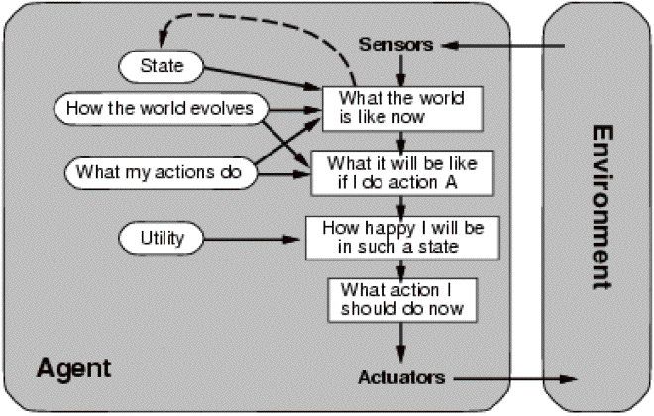
Utility (Russell and Norvig)

Slide 73
Markov Decision Processes
Or MDP
Characterized by:
a set of states S an agent can be in
a set of actions A the agent can take
A reward r(a,s) that the agent receives for taking an action in a state
(+ Some other things I’ll come back to (gamma, state transition probabilities))

Slide 74
What is a state?
In principle, MDP state could include any possible information about dialogue
Complete dialogue history so far
Usually use a much more limited set
Values of slots in current frame
Most recent question asked to user
User’s most recent answer
ASR confidence
etc.

Slide 75
Actions in MDP models of dialogue
Speech acts!
Ask a question
Explicit confirmation
Rejection
Give the user some database information
Tell the user their choices
Do a database query

Slide 76
A brief tutorial example
Levin et al. (2000)
A Day-and-Month dialogue system
Goal: fill in a two-slot frame:
Month: November
Day: 12th
Via the shortest possible interaction with user

Slide 77
State in the Day-and-Month example
Values of the two slots day and month.
Total:
2 special initial state s_{i} and s_{f}.
365 states with a day and month
1 state for leap year
12 states with a month but no day
31 states with a day but no month
411 total states

Slide 78
Actions in the Day-and-Month example
ad: a question asking for the day
am: a question asking for the month
adm: a question asking for the day+month
af: a final action submitting the form and terminating the dialogue

Slide 79
A simple reward function
For this example, let’s use a cost function
A cost function for entire dialogue
Let
N_{i} = number of interactions (duration of dialogue)
N_{e} = number of errors in the obtained values (0-2)
N_{f} = expected distance from goal
(0 for complete date, 1 if either data or month are missing, 2 if both missing)
Then (weighted) cost is:
C = w_{i}×N_{i} + w_{e}×N_{e} + w_{f}×N_{f}

Slide 80
2 possible policies
P_{d}=probability of error in directive prompt
P_{o}=probability of error in open prompt

Slide 81
2 possible policies
Strategy 1 is better than strategy 2 when improved error rate justifies longer interaction:

Slide 82
That was an easy optimization
Only two actions, only tiny # of policies
In general, number of actions, states, policies is quite large
So finding optimal policy π* is harder
We need reinforcement leraning
Back to MDPs:

Slide 83
MDP
We can think of a dialogue as a trajectory in state space
The best policy π* is the one with the greatest expected reward over all trajectories
How to compute a reward for a state sequence?

Slide 84
Reward for a state sequence
One common approach: discounted rewards
Cumulative reward Q of a sequence is discounted sum of utilities of individual states
Discount factor γ between 0 and 1
Makes agent care more about current than future rewards; the more future a reward, the more discounted its value

Slide 85
The Markov assumption
MDP assumes that state transitions are Markovian

Slide 86
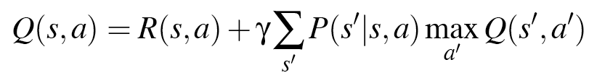
Expected reward for an action
Expected cumulative reward Q(s,a) for taking a particular action from a particular state can be computed by Bellman equation:
Expected cumulative reward for a given state/action pair is:
immediate reward for current state
+ expected discounted utility of all possible next states s’
Weighted by probability of moving to that state s’
And assuming once there we take optimal action a’

Slide 87
What we need for Bellman equation
A model of p(s’|s,a)
Estimate of R(s,a)
How to get these?
If we had labeled training data
P(s’|s,a) = C(s,s’,a)/C(s,a)
If we knew the final reward for whole dialogue R(s₁,a₁,s₂,a₂,…,s_{n})
Given these parameters, can use value iteration algorithm to learn Q values (pushing back reward values over state sequences) and hence best policy

Slide 88
Final reward
What is the final reward for whole dialogue R(s₁,a₁,s₂,a₂,…,s_{n})?
This is what our automatic evaluation metric PARADISE computes:
the general goodness of a whole dialogue!!!!!

Slide 89
How to estimate p(s’|s,a) without labeled data
Have random conversations with real people:
Carefully hand-tune small number of states and policies
Then can build a dialogue system which explores state space by generating a few hundred random conversations with real humans
Set probabilities from this corpus
Have random conversations with simulated people:
Now you can have millions of conversations with simulated people
So you can have a slightly larger state space

Slide 90
An example
Singh, S., D. Litman, M. Kearns, and M. Walker. 2002. Optimizing Dialogue Management with Reinforcement Learning: Experiments with the NJFun System. Journal of AI Research.
NJFun system, people asked questions about recreational activities in New Jersey
Idea of paper: use reinforcement learning to make a small set of optimal policy decisions

Slide 91
Very small # of states and acts
States: specified by values of 8 features
Which slot in frame is being worked on (1-4)
ASR confidence value (0-5)
How many times a current slot question had been asked
Restrictive vs. non-restrictive grammar
Result: 62 states
Actions: each state only 2 possible actions
Asking questions: System versus user initiative
Receiving answers: explicit versus no confirmation.

Slide 92
Ran system with real users
311 conversations
Simple binary reward function
1 if competed task (finding museums, theater, winetasting in NJ area)
0 if not
System learned good dialogue strategy: Roughly
Start with user initiative
Backoff to mixed or system initiative when re-asking for an attribute
Confirm only a lower confidence values

Slide 93
State of the art
Only a few MDP systems were built
Current direction:
Partially observable MDPs (POMDPs)
We don’t REALLY know the user’s state (we only know what we THOUGHT the user said)
So need to take actions based on our BELIEF , i.e., a probability distribution over states rather than the “true state”

