Slide 1
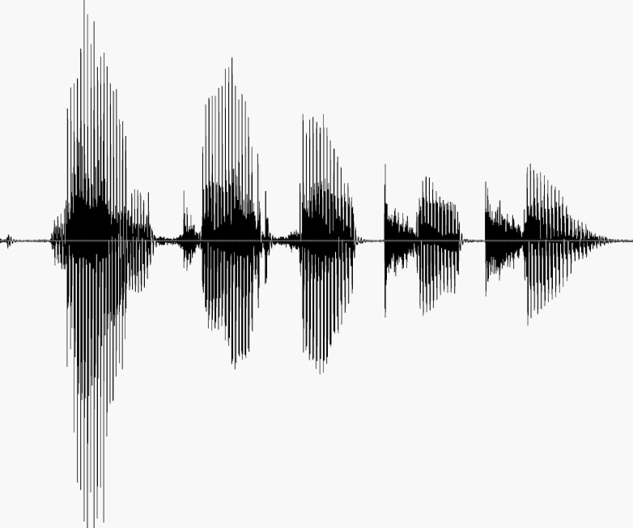
CS 224S / LINGUIST 285 Spoken Language Processing
Andrew Maas
Stanford University
Spring 2017
Lecture 4: ASR: Word Error Rate, Training, Advanced Decoding
Original slides by Dan Jurafsky

Slide 2
Outline for Today
Word error rate (WER) computation
Training
Baum-Welch = EM = Forward Backward
Detailed example in slides appendix
How we train LVCSR systems in practice
Advanced decoding

Slide 3
Administrative items
Homework 1 due by 11:59pm tonight on Gradescope
Homework 2 released tonight (due in 2 weeks)
Project handout released tonight
We will compile and post to piazza project ideas over the next 1-2 weeks
Proposals due May 1
Background survey released today. Complete by Friday (part of class participation grade)

Slide 4
Outline for Today
Word error rate (WER) computation
Training
Baum-Welch = EM = Forward Backward
Detailed example in slides appendix
How we train LVCSR systems in practice
Advanced decoding

Slide 5
Evaluation
How to evaluate the word string output by a speech recognizer?

Slide 6
Word Error Rate
Word Error Rate =
100 (Insertions+Substitutions + Deletions)
Total Word in Correct Transcript
Aligment example:
REF: portable **** PHONE UPSTAIRS last night so
HYP: portable FORM OF STORES last night so
Eval I S S
WER = 100 (1+2+0)/6 = 50%

Slide 7
NIST sctk scoring software: Computing WER with sclite
http://www.nist.gov/speech/tools/
Sclite aligns a hypothesized text (HYP) (from the recognizer) with a correct or reference text (REF) (human transcribed)
id: (2347-b-013)
Scores: (#C #S #D #I) 9 3 1 2
REF: was an engineer SO I i was always with **** **** MEN UM and they
HYP: was an engineer ** AND i was always with THEM THEY ALL THAT and they
Eval: D S I I S S

Slide 8
Sclite output for error analysis
CONFUSION PAIRS Total (972)
With >= 1 occurrances (972)
1: 6 -> (%hesitation) ==> on
2: 6 -> the ==> that
3: 5 -> but ==> that
4: 4 -> a ==> the
5: 4 -> four ==> for
6: 4 -> in ==> and
7: 4 -> there ==> that
8: 3 -> (%hesitation) ==> and
9: 3 -> (%hesitation) ==> the
10: 3 -> (a-) ==> i
11: 3 -> and ==> i
12: 3 -> and ==> in
13: 3 -> are ==> there
14: 3 -> as ==> is
15: 3 -> have ==> that
16: 3 -> is ==> this

Slide 9
Better metrics than WER?
WER has been useful
But should we be more concerned with meaning (“semantic error rate”)?
Good idea, but hard to agree on
Has been applied in dialogue systems, where desired semantic output is more clear

Slide 10
Outline for Today
Word error rate (WER) computation
Training
Baum-Welch = EM = Forward Backward
Detailed example in slides appendix
How we train LVCSR systems in practice
Advanced decoding

Slide 11
HMM for ice cream
A: Transition parameters
B: Observation/Emission parameters

Slide 12
The Learning Problem
Baum-Welch = Forward-Backward Algorithm (Baum 1972)
Is a special case of the EM or Expectation-Maximization algorithm (Dempster, Laird, Rubin)
The algorithm will let us train the transition probabilities A= {a_{ij}} and the emission probabilities B={b_{i}(o_{t})} of the HMM

Slide 13
The Learning Problem
Baum-Welch / EM enables maximum likelihood training of (A,B)
In practice we do not train A
Why?

Slide 14
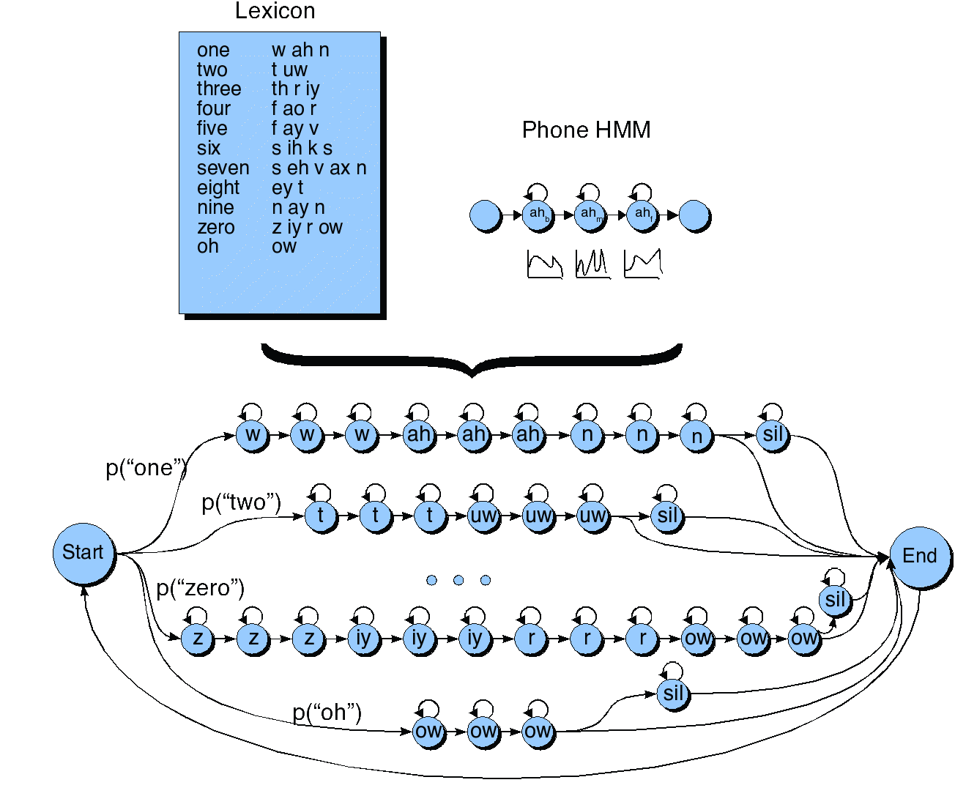
HMM for the digit recognition task

Slide 15
The Learning Problem
Baum-Welch / EM implicitly does “soft assignment” of hidden states when updating observation/emission model parameters
In practice we use “hard assignment” / Viterbi training

Slide 16
Estimating hidden states in training
ah_{f} | 0 | 0.1 | 0.1 | 0.95
ah_{m} | 0 | 0.15 | 0.5 | 0.05
ah_{b} | 1.0 | 0.8 | 0.4 | 0
 | o₁ | o₂ | o₃ | o₄
Updating parameters in EM/Soft Assignment
B_{ahm}~ 0*o₁ + 0.15*o₂ + 0.5*o₃ + 0.05*o₄
Updating parameters with Viterbi/Hard Assignment
B_{ahm}~ o₃

Slide 17
Typical training procedure in LVCSR
Generate a forced alignment with existing model
Viterbi decoding with a very constrained prior (the transcript)
Assigns observations to HMM states
Create new observation models from update alignments
Iteratively repeat the above steps, occasionally introducing a more complex observation model or adding more difficult training examples

Slide 18
Outline for Today
Word error rate (WER) computation
Training
Baum-Welch = EM = Forward Backward
Detailed example in slides appendix
How we train LVCSR systems in practice
Advanced decoding

Slide 19
Advanced Search (= Decoding)
How to weight the AM and LM
Speeding things up: Viterbi beam decoding
Multipass decoding
N-best lists
Lattices
Word graphs
Meshes/confusion networks
Finite State Methods

Slide 20
What we are searching for
Given Acoustic Model (AM) and Language Model (LM):
AM (likelihood)
LM (prior)
(1)

Slide 21
Combining Acoustic and Language Models
We don’t actually use equation (1)
AM underestimates acoustic probability
Why? Bad independence assumptions
Intuition: we compute (independent) AM probability estimates; but if we could look at context, we would assign a much higher probability. So we are underestimating
We do this every 10 ms, but LM only every word.
Besides: AM isn’t a true probability
AM and LM have vastly different dynamic ranges

Slide 22
Language Model Scaling Factor
Solution: add a language model weight (also called language weight LW or language model scaling factor LMSF
Value determined empirically, is positive (why?)
Often in the range 10 +/- 5.
Kaldi uses an acoustic model scaling factor instead, but it achieves the same efffect
= argmax log P(O|W) + LMSF * log P(W)
Notes:
Exponential smoothing is reasonable if you assume that each acoustic model observation is perfectly correlated in time, but the acoustic model assumes conditional independence. Thus the exponential correction term simulates multiplying the language model probabilities an equivalent number of times.

Slide 23
Language Model Scaling Factor
As LMSF is increased:
More deletion errors (since increase penalty for transitioning between words)
Fewer insertion errors
Need wider search beam (since path scores larger)
Less influence of acoustic model observation probabilities
Slide from Bryan Pellom

Slide 24
Word Insertion Penalty
But LM prob P(W) also functions as penalty for inserting words
Intuition: when a uniform language model (every word has an equal probability) is used, LM prob is a 1/V penalty multiplier taken for each word
Each sentence of N words has penalty N/V
If penalty is large (smaller LM prob), decoder will prefer fewer longer words
If penalty is small (larger LM prob), decoder will prefer more shorter words
When tuning LM for balancing AM, side effect of modifying penalty
So we add a separate word insertion penalty to offset

Slide 25
Word Insertion Penalty
Controls trade-off between insertion and deletion errors
As penalty becomes larger (more negative)
More deletion errors
Fewer insertion errors
Acts as a model of effect of length on probability
But probably not a good model (geometric assumption probably bad for short sentences)

Slide 26
Log domain
We do everything in log domain
So final equation:

Slide 27
Speeding things up
Viterbi is O(N²T), where N is total number of HMM states, and T is length
This is too large for real-time search
A ton of work in ASR search is just to make search faster:
Beam search (pruning)
Fast match
Tree-based lexicons

Slide 28
Beam search
Instead of retaining all candidates (cells) at every time frame
Use a threshold T to keep subset:
At each time t
Identify state with lowest cost Dmin
Each state with cost > Dmin+ T is discarded (“pruned”) before moving on to time t+1
Unpruned states are called the active states

Slide 29
Viterbi Beam Search
A:
π_{A}
b_{A}(1)
b_{A}(2)
b_{A}(3)
b_{A}(4)
B:
π _{B}
b_{B}(1)
b_{B}(2)
b_{B}(3)
b_{B}(4)
C:
π _{C}
b_{C}(1)
b_{C}(2)
b_{C}(3)
b_{C}(4)
t=0
t=1
t=2
t=3
t=4

Slide 30
Viterbi Beam search
Most common search algorithm for LVCSR
Time-synchronous
Comparing paths of equal length
Two different word sequences W1 and W2:
We are comparing P(W1|O_{0t}) and P(W2|O_{0t})
Based on same partial observation sequence O_{0t}
So denominator is same, can be ignored
Time-asynchronous search (A*) is harder

Slide 31
Viterbi Beam Search
Empirically, beam size of 5-10% of search space
Thus 90-95% of HMM states don’t have to be considered at each time t
Vast savings in time.

Slide 32
On-line processing
Problem with Viterbi search
Doesn’t return best sequence til final frame
This delay is unreasonable for many applications.
On-line processing
usually smaller delay in determining answer
at cost of always increased processing time.

Slide 33
On-line processing
At every time interval I (e.g. 1000 msec or 100 frames):
At current time tcurr, for each active state qtcurr, find best path P(qtcurr) that goes from from t0 to tcurr (using backtrace (ψ))
Compare set of best paths P and find last time tmatch at which all paths P have the same state value at that time
If tmatch exists {
Output result from t0 to tmatch
Reset/Remove ψ values until tmatch
Set t0 to tmatch+1
}
Efficiency depends on interval I, beam threshold, and how well the observations match the HMM.

Slide 34
On-line processing
Example (Interval = 4 frames):
At time 4, all best paths for all states A, B, and C have state B in common at time 2. So, tmatch = 2.
Now output states BB for times 1 and 2, because no matter what happens in the future, this will not change. Set t0 to 3
best sequence
A:
δ₁(A)
δ₂(A)
δ₃(A)
δ₄(A)
BBAA
B:
δ₁(B)
δ₂(B)
δ₃(B)
δ₄(B)
BBBB
C:
δ₁(C)
δ₂(C)
δ₃(C)
δ₄(C)
BBBC
t=1
t=2
t=3
t=4
t₀=1
t_{curr}=4

Slide 35
On-line processing
Interval=4
best sequence
A:
δ₃(A)
δ₄(A)
δ₅(A)
δ₆(A)
δ₇(A)
δ₈(A)
BBABBA
Now t_{match} = 7, so output from t=3 to t=7: BBABB, then set t₀ to 8.
If T=8, then output state with best δ₈, for example C. Final result (obtained piece-by-piece) is then BBBBABBC
B:
δ₃(B)
δ₄(B)
δ₅(B)
δ₆(B)
δ₇(B)
δ₈(B)
BBABBB
C:
δ₃(C)
δ₄(C)
δ₅(C)
δ₆(C)
δ₇(C)
δ₈(C)
BBABBC
t=3
t=4
t=5
t=6
t=7
t=8
t₀=3
t_{curr}=8

Slide 36
Problems with Viterbi
It’s hard to integrate sophisticated knowledge sources
Trigram grammars
Parser-based or Neural Network LM
long-distance dependencies that violate dynamic programming assumptions
Knowledge that isn’t left-to-right
Following words can help predict preceding words
Solutions
Return multiple hypotheses and use smart knowledge to rescore them
Use a different search algorithm, A* Decoding (=Stack decoding)

Slide 37
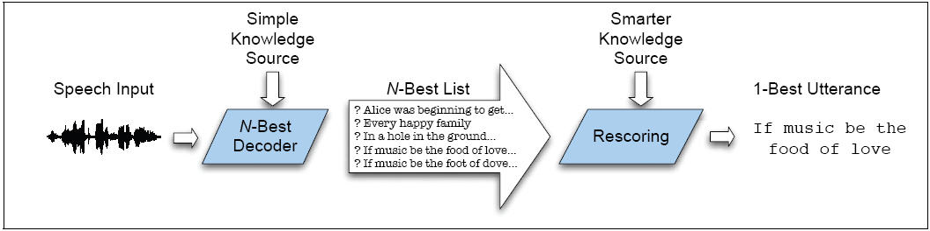
Multipass Search

Slide 38
Ways to represent multiple hypotheses
N-best list
Instead of single best sentence (word string), return ordered list of N sentence hypotheses
Word lattice
Compact representation of word hypotheses and their times and scores
Word graph
FSA representation of lattice in which times are represented by topology

Slide 39


Another Problem with Viterbi
The forward probability of observation given word string
The Viterbi algorithm makes the “Viterbi Approximation”
Approximates P(O|W)
with P(O|best state sequence)

Slide 40
Solving the best-path-not-best-words problem
Viterbi returns best path (state sequence) not best word sequence
Best path can be very different than best word string if words have many possible pronunciations
Two solutions
Modify Viterbi to sum over different paths that share the same word string.
Do this as part of N-best computation
Compute N-best word strings, not N-best phone paths
Use a different decoding algorithm (A*) that computes true Forward probability.

Slide 41
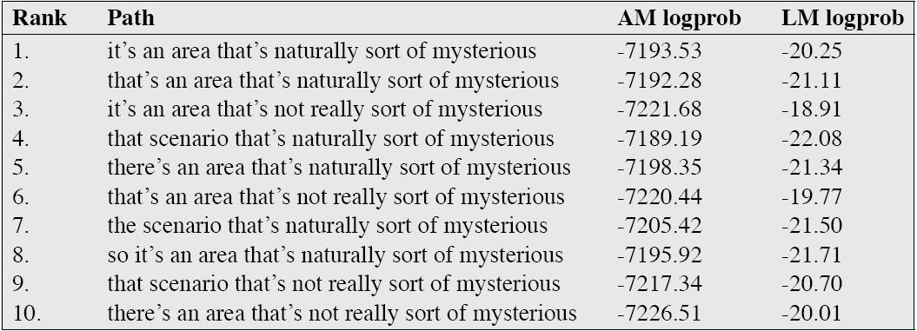
Sample N-best list

Slide 42
N-best lists
Again, we don’t want the N-best paths
That would be trivial
Store N values in each state cell in Viterbi trellis instead of 1 value
But:
Most of the N-best paths will have the same word string
Useless!!!
It turns out that a factor of N is too much to pay

Slide 43
Computing N-best lists
In the worst case, an admissible algorithm for finding the N most likely hypotheses is exponential in the length of the utterance.
S. Young. 1984. “Generating Multiple Solutions from Connected Word DP Recognition Algorithms”. Proc. of the Institute of Acoustics, 6:4, 351-354.
For example, if AM and LM score were nearly identical for all word sequences, we must consider all permutations of word sequences for whole sentence (all with the same scores).
But of course if this is true, can’t do ASR at all!

Slide 44
Computing N-best lists
Instead, various non-admissible algorithms:
(Viterbi) Exact N-best
(Viterbi) Word Dependent N-best
And one admissible
A* N-best

Slide 45
Exact N-best for time-synchronous Viterbi
Due to Schwartz and Chow; also called “sentence-dependent N-best”
Idea: each state stores multiple paths
Idea: maintain separate records for paths with distinct word histories
History: whole word sequence up to current time t and word w
When 2 or more paths come to the same state at the same time, merge paths w/same history and sum their probabilities.
i.e. compute the forward probability within words
Otherwise, retain only N-best paths for each state

Slide 46
Exact N-best for time-synchronous Viterbi
Efficiency:
Typical HMM state has 2 or 3 predecessor states within word HMM
So for each time frame and state, need to compare/merge 2 or 3 sets of N paths into N new paths.
At end of search, N paths in final state of trellis give N-best word sequences
Complexity is O(N)
Still too slow for practical systems
N is 100 to 1000
More efficient versions: word-dependent N-best

Slide 47
Word-dependent (‘bigram’) N-best
Intuition:
Instead of each state merging all paths from start of sentence
We merge all paths that share the same previous word
Details:
This will require us to do a more complex traceback at the end of sentence to generate the N-best list

Slide 48
Word-dependent (‘bigram’) N-best
At each state preserve total probability for each of k << N previous words
K is 3 to 6; N is 100 to 1000
At end of each word, record score for each previous word hypothesis and name of previous word
So each word ending we store “alternatives”
But, like normal Viterbi, pass on just the best hypothesis
At end of sentence, do a traceback
Follow backpointers to get 1-best
But as we follow pointers, put on a queue the alternate words ending at same point
On next iteration, pop next best

Slide 49
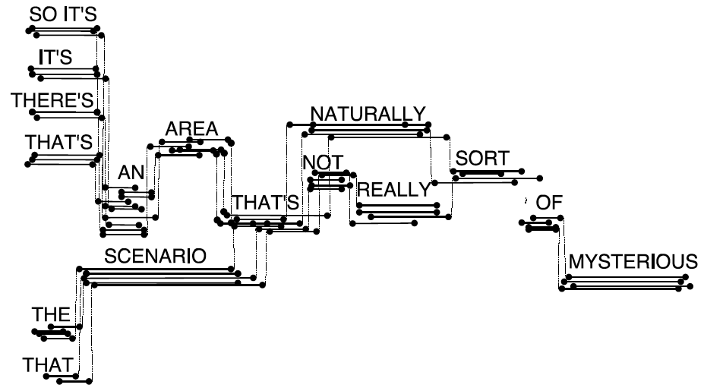
Word Lattice
Each arc annotated with AM and LM logprobs

Slide 50
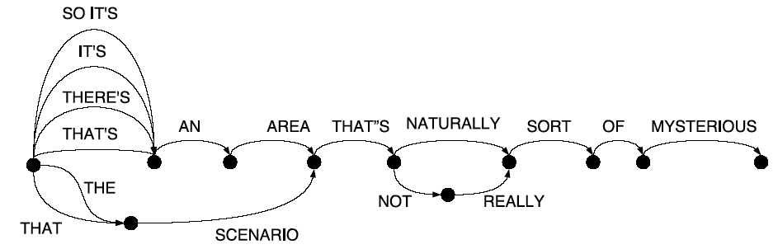
Word Graph
Timing information removed
Overlapping copies of words merged
AM information removed
Result is a WFST
Natural extension to N-gram language model

Slide 51
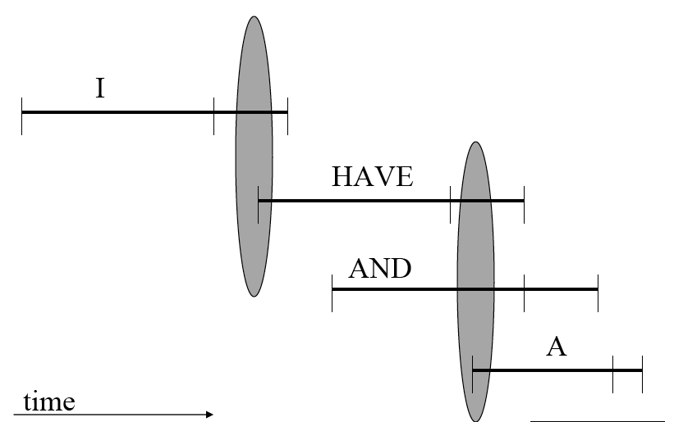
Converting word lattice to word graph
Word lattice can have range of possible end frames for word
Create an edge from (w_{i},t_{i}) to (w_{j},t_{j}) if t_{j-1} is one of the end-times of w_{i}
Slide from Bryan Pellom

Slide 52
Lattices
Some researchers are careful to distinguish between word graphs and word lattices
But we’ll follow convention in using “lattice” to mean both word graphs and word lattices.
Two facts about lattices:
Density: the number of word hypotheses or word arcs per uttered word
Lattice error rate (also called “lower bound error rate”): the lowest word error rate for any word sequence in lattice
Lattice error rate is the “oracle” error rate, the best possible error rate you could get from rescoring the lattice.
We can use this as an upper bound

Slide 53

Posterior lattices
We don’t actually compute posteriors:
Why do we want posteriors?
Without a posterior, we can choose best hypothesis, but we can’t know how good it is!
In order to compute posterior, need to
Normalize over all different word hypothesis at a time
Align all the hypotheses, sum over all paths passing through word

Slide 54
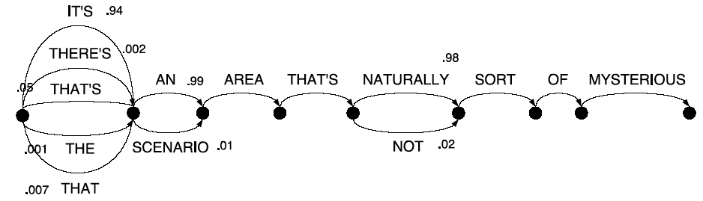
Mesh = Sausage = pinched lattice

Slide 55
Summary: one-pass vs. multipass
Potential problems with multipass
Can’t use for real-time (need end of sentence)
(But can keep successive passes really fast)
Each pass can introduce inadmissible pruning
(But one-pass does the same w/beam pruning and fastmatch)
Why multipass
Very expensive KSs. (NL parsing, higher-order n-gram, etc.)
Spoken language understanding: N-best perfect interface
Research: N-best list very powerful offline tools for algorithm development
N-best lists needed for discriminant training (MMIE, MCE) to get rival hypotheses

Slide 56
Weighted Finite State Transducers for ASR
The modern paradigm for ASR decoding
Used by Kaldi
Weighted finite state automaton that transduces an input sequence to an output sequence
Mohri, Mehryar, Fernando Pereira, and Michael Riley. "Speech recognition with weighted finite-state transducers." In Springer Handbook of Speech Processing, pp. 559-584. Springer Berlin Heidelberg, 2008.
http://www.cs.nyu.edu/~mohri/pub/hbka.pdf

Slide 57
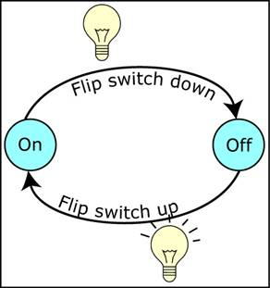
Simple State Machine
Notes:
Image source: http://www.ai-junkie.com/architecture/state_driven/tut_state1.html

Slide 58
Weighted Finite State Acceptors

Slide 59
Weighted Finite State Transducers

Slide 60
WFST Algorithms
Composition: combine transducers at different levels.
If G is a finite state grammar and P is a pronunciation dictionary, P ◦ G transduces a phone string to word strings allowed by the grammar
Determinization: Ensures each state has no more than one output transition for a given input label
Minimization: transforms a transducer to an equivalent transducer with the fewest possible states and transitions
slide from Steve Renals

Slide 61
WFST-based decoding in Kaldi: HCLG
Represent the following components as WFSTs:
H: HMM structure
C: Phonetic context dependency
L: Lexicon (Pronunciation dictionary)
G: Grammar (Language model)
The decoding network is defined by their composition:
H◦C◦L◦G
Successively determinize and combine the component transducers, then minimize the final network
slide from Steve Renals

Slide 62
G (Language model)

Slide 63
L (Pronunciation dictionary)

Slide 64
G o L

Slide 65
min(det(L o G))

Slide 66
Advanced Search (= Decoding)
How to weight the AM and LM
Speeding things up: Viterbi beam decoding
Multipass decoding
N-best lists
Lattices
Word graphs
Meshes/confusion networks
Finite State Methods
For a more thorough introduction to WFST decoding in Kaldi:
http://danielpovey.com/files/Lecture4.pdf

Slide 67
Appendix: Baum-Welch Training

Slide 68
Input to Baum-Welch
O unlabeled sequence of observations
Q vocabulary of hidden states
For ice-cream task
O = {1,3,2,…,}
Q = {H,C}

Slide 69
Starting out with Observable Markov Models
How to train?
Run the model on observation sequence O.
Since it’s not hidden, we know which states we went through, hence which transitions and observations were used.
Given that information, training:
B = {b_{k}(o_{t})}: Since every state can only generate one observation symbol, observation likelihoods B are all 1.0
A = {a_{ij}}:

Slide 70
Extending Intuition to HMMs
For HMM, cannot compute these counts directly from observed sequences
Baum-Welch intuitions:
Iteratively estimate the counts.
Start with an estimate for a_{ij} and b_{k}, iteratively improve the estimates
Get estimated probabilities by:
computing the forward probability for an observation
dividing that probability mass among all the different paths that contributed to this forward probability

Slide 71
The Backward algorithm
We define the backward probability as follows:
This is the probability of generating partial observations O_{t+1T} from time t+1 to the end, given that the HMM is in state i at time t and of course given Φ.

Slide 72
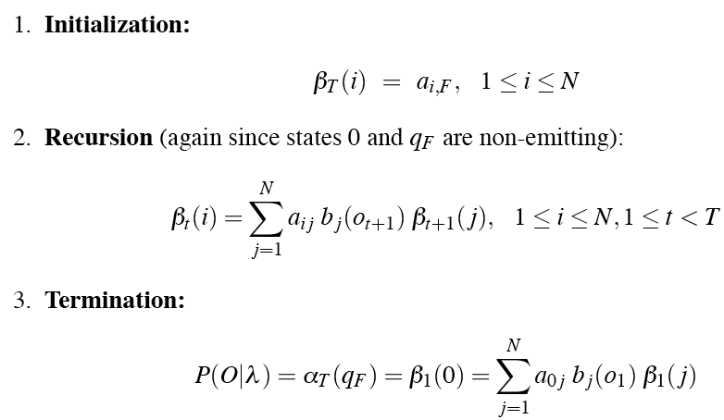
The Backward algorithm
We compute backward prob by induction:
q₀
/

Slide 73
Inductive step of the backward algorithm
Computation of β_{t}(i) by weighted sum of all successive values βt+1

Slide 74
Intuition for re-estimation of aij
We will estimate â_{ij} via this intuition:
Numerator intuition:
Assume we had some estimate of probability that a given transition i→j was taken at time t in observation sequence.
If we knew this probability for each time t, we could sum over all t to get expected value (count) for i→j.

Slide 75
Re-estimation of aij
Let ξ_{t} be the probability of being in state i at time t and state j at time t+1, given O_{1..T} and model Φ:
We can compute ξ from not-quite-ξ, which is:

Slide 76
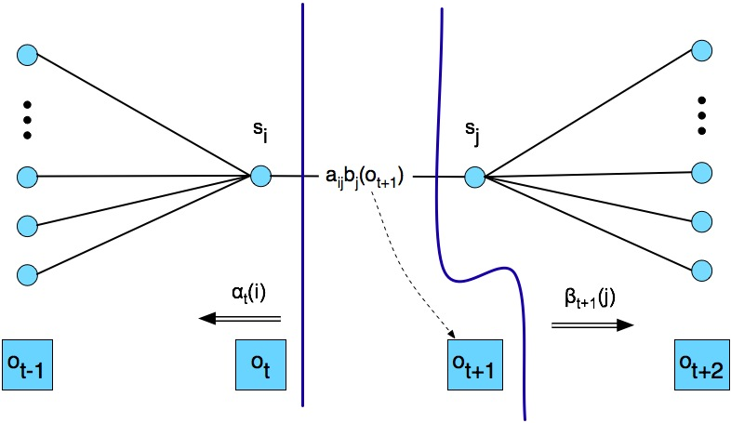
Computing not-quite-ξ

Slide 77
From not-quite-ξ to ξ
We want:
We’ve got:
Which we compute as follows:

Slide 78

From not-quite-ξ to ξ
We want:
We’ve got:
Since:
We need:

Slide 79
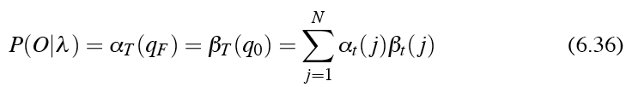

From not-quite-ξ to ξ

Slide 80

From ξ to a_{ij}
The expected number of transitions from state i to state j is the sum over all t of ξ
The total expected number of transitions out of state i is the sum over all transitions out of state i
Final formula for reestimated a_{ij}:

Slide 81
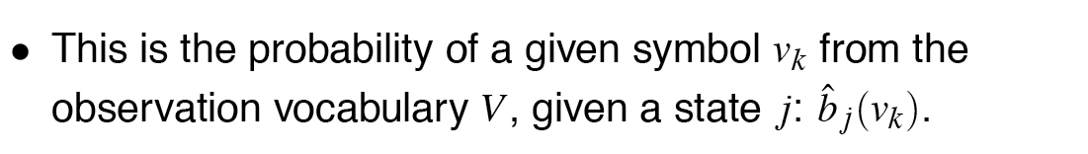



Re-estimating the observation likelihood b
We’ll need to know γ_{t}(j): the probability of being in state j at time t:

Slide 82
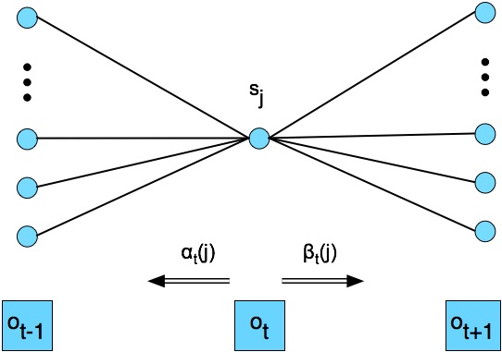

Computing γ

Slide 83
Summary
The ratio between the expected number of transitions from state i to j and the expected number of all transitions from state i
The ratio between the expected number of times the observation data emitted from state j is v_{k}, and the expected number of times any observation is emitted from state j

Slide 84
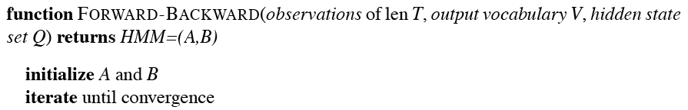
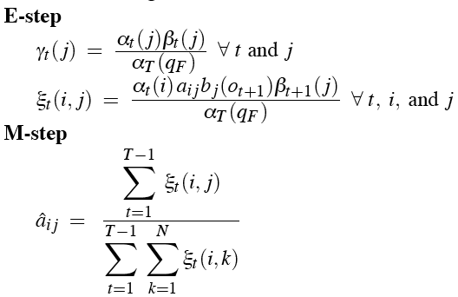
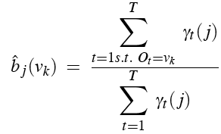

The Forward-Backward Algorithm

Slide 85
Summary: Forward-Backward Algorithm
Intialize Φ=(A,B)
Compute α, β, ξ
Estimate new Φ’=(A,B)
Replace Φ with Φ’
If not converged go to 2

Slide 86
Applying FB to speech: Caveats
Network structure of HMM is always created by hand
no algorithm for double-induction of optimal structure and probabilities has been able to beat simple hand-built structures.
Always Bakis network = links go forward in time
Subcase of Bakis net: beads-on-string net:
Baum-Welch only guaranteed to return local max, rather than global optimum
At the end, we through away A and only keep B

