Slide 1
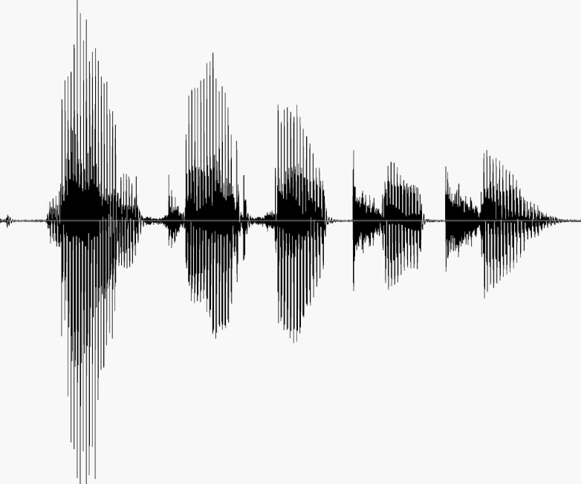
CS 224S / LINGUIST 285 Spoken Language Processing
Andrew Maas
Stanford University
Spring 2017
Lecture 6: Course Project Introduction and Deep Learning Preliminaries

Slide 2
Outline for Today
Course projects
What makes for a successful project
Leveraging existing tools
Project archetypes and considerations
Discussion
Deep learning preliminaries

Slide 3
Silence models for HMM-GMM
SIL is a phoneme to a recognizer
Always inserted at start and end of utterance
Corrupting silence with bad forced alignments can break recognizer training (silence eats everything)
The sound of silence
Turns out to be difficult to model!
Silence GMM models must capture lots of noise artifacts, breathing, laughing (depending on data transcription standards)
Microphones in the wild with background noise make SIL/non-speech even more difficult
Special models for silence transition since we often stay there a long time

Slide 4
Course project goals
A substantial piece of work related to topics specific to this course
A successful project
Results in most of a conference paper submission if academically oriented
A portfolio item / work sample for job interviews related to ML, NLP, or SLP
Reflects deeper understanding of SLP technology than simply applying existing API’s for ASR, voice commands, etc.
No midterm or final exam to allow more focus on projects

Slide 5
A successful project
Course-relevant topic. Proposed experiments or system address a challenging, unsolved SLP problem
Proposes and executes a sensible approach informed by previous related work
Performs error analysis to understand what aspects of the system are good/bad
Adapts system or introduces new hypotheses/components based on initial error analysis
Goes beyond simply combining existing components / tools to solve a standard problem

Slide 6
Complexity and focus
SLP systems are some of the most complex in AI
Example: A simple voice command system contains:
Speech recognizer (Language model, pronunciation lexicon, acoustic model, decoder, lots of training options)
Intent/command slot filling (some combination of lexicon, rules, and ML to handle variation)
Get a complete baseline system working by milestone
Focus on a subset of all areas to make a bigger contribution there. APIs/tools are a great choice for areas not directly relevant to your focus

Slide 7
Balancing scale and depth
Working on “real” scale datasets/problems is a plus…
But don’t let scale distract from getting to the meat of your technical contribution
Example:
Comparing some neural architectures for end-to-end speech recognition
Case 1: Use WSJ. Medium sized corpus, read speech. SOTA error rates ~3%
Case 2: Use Switchboard: Large, conversational corpus. SOTA error rates ~15%
Case 2 stronger overall if you run the same experiments / error analysis. Don’t let scale prevent “thoughtful loops”

Slide 8
Thoughtful loops
A single loop:
Try something reasonable
Perform relatively detailed error analysis using what we know from the course
Propose a modification / new experiment based on what you find
Try it!
Repeat above
A successful project does this at least once
Scale introduces risk of overly slow loops
Ablative analysis or oracle experiments are a great way to guide what system component to work on

Slide 9
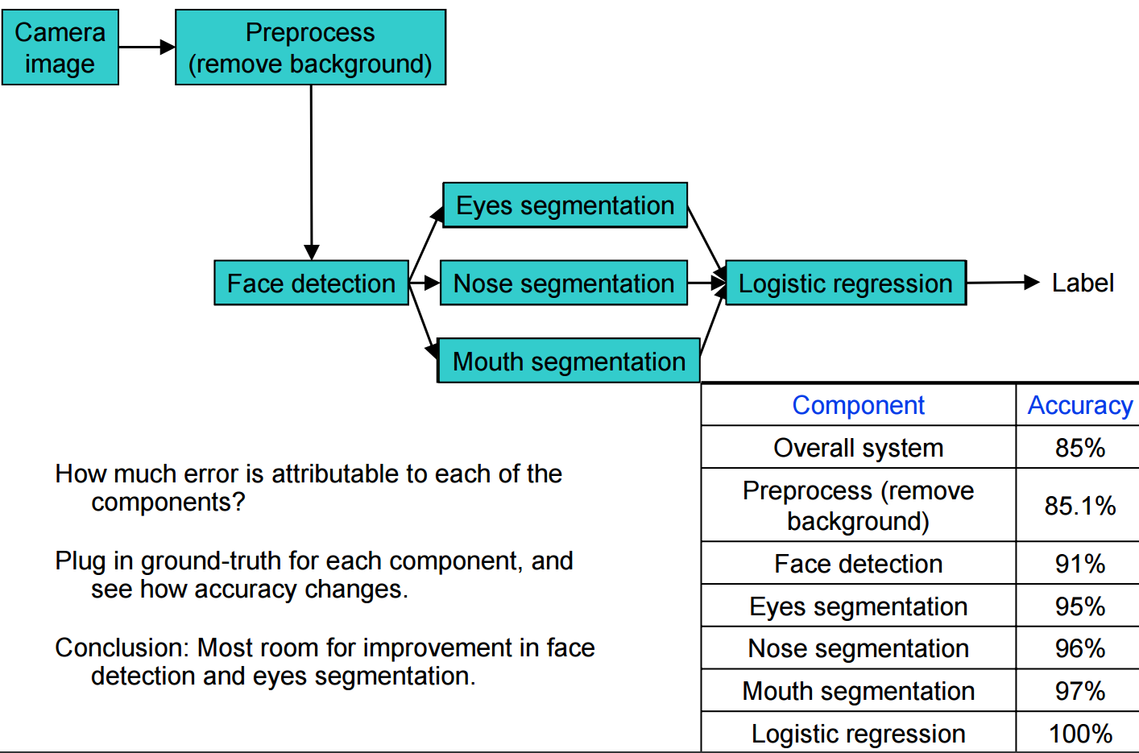
Oracle experiments
Slide from Andrew Ng’s CS229 lecture on applying ML
http://cs229.stanford.edu/materials/ML-advice.pdf

Slide 10
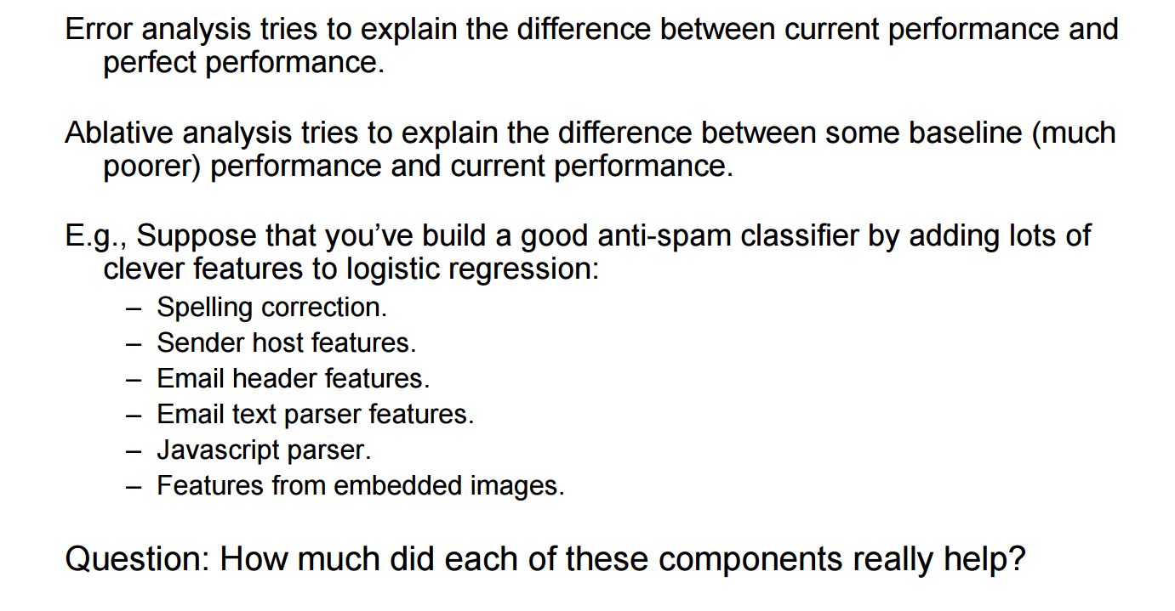
Ablation experiments
Slide from Andrew Ng’s CS229 lecture on applying ML
http://cs229.stanford.edu/materials/ML-advice.pdf

Slide 11
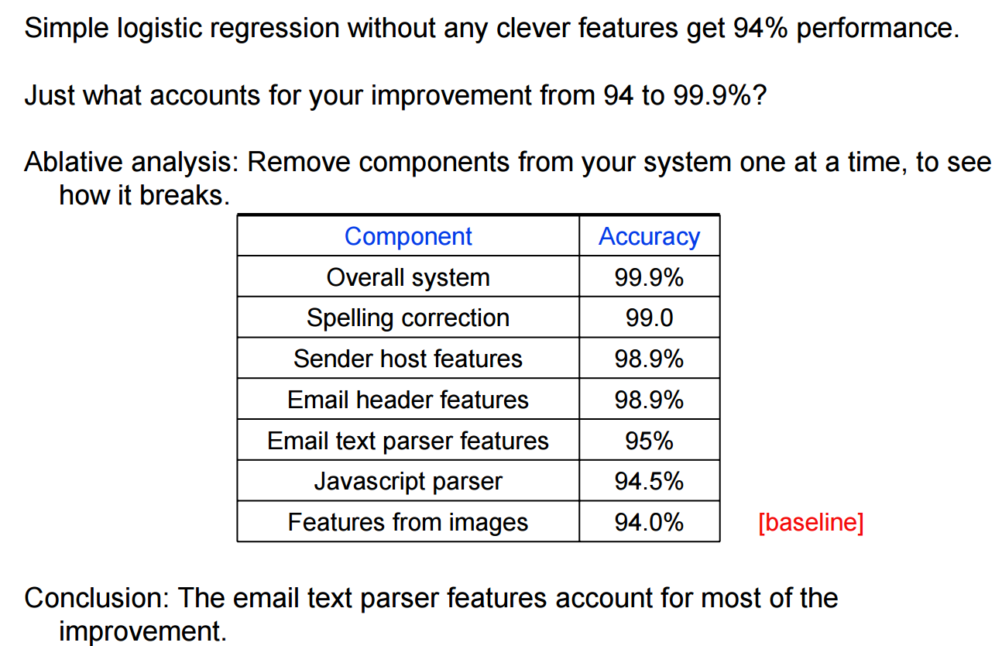
Ablation experiments
Slide from Andrew Ng’s CS229 lecture on applying ML
http://cs229.stanford.edu/materials/ML-advice.pdf

Slide 12
Pitfalls in project planning
Data!
What dataset will you use for your task?
If you need to collect data, why? Understand that a project with a lot of required data collection creates high risk of not being able to execute enough loops
Do you really need to collect data? Really?
Overly complex baseline system
Relying on external tools to the point that connecting them becomes the entire effort and makes innovation hard
Off-topic. Could this be a CS 229 project instead?

Slide 13
Deliverables
All projects
Proposal: What task, dataset, evaluation metrics and approach outline?
Milestone: Have you gotten your data and built a baseline for your task?
Final paper: Methods, results, related work, conclusions. Should read like aconference paper
Audio/Visual material
Include links to audio samples for TTS. Screen capture videos for dialog interactions (spoken dialog especially)
Much easier to understand your contribution this way than leave us to guess. Even if it doesn’t quite work.
Available on laptop at poster session (live demo!)

Slide 14
Leveraging existing tools
Free to use any tool, but realize using the Google speech API does not constitute ‘building a recognizer’
Ensure the tool does not prevent trying the algorithmic modifications of interest (e.g. can’t do acoustic model research on speech API’s)
Projects that combine existing tools in a straightforward way should be avoided
Conversely, almost every project can and should use some form of tool:
Tensorflow, speech API, language model toolkit, Kaldi, etc.
Use tools to focus on your project hypotheses

Slide 15
Error analysis with tools
Project writeup / presentation should be able to explain:
What goal does this tool achieve for our system?
Is the tool a source of errors? (e.g. oracle error rate for a speech API)
How could this tool be modified / replaced to improve the system? (maybe it is perfect and that’s okay)
As with any component, important to isolate sources of errors
Work with tools in a way that reflects your deeper understanding of what they do internally (e.g. n-best lists)

Slide 16
Sample of tools and APIs
Speech APIs: Google, IBM, Microsoft all have options
Varying levels of customization and conveying n-best
Speech synthesis APIs: same as speech + Festival
Slack or Facebook for text dialog interfaces
Slack allows downloading of historical data which could help train systems
Howdy.ai / botkit for integration
Intent recognition APIs
Wit.ai, API.ai. Amazon Alexa

Slide 17
Sample project archetypes

Slide 18
Speech recognition research
Benchmark corpus (WSJ, Switchboard, noisy ASR on CHIME)
Baseline system in Kaldi. State of the art known
Template very amenable to publication in speech or machine learning conferences
Can be very difficult to improve on state of the art. The best systems have a lot of heuristics that might not be in Kaldi
Systems can be cumbersome to train
Lots of algorithmic variations to try
Successful projects do not need to improve on best existing results

Slide 19
Speech synthesis
Blizzard challenge provides training data and systems for comparison
Evaluation is difficult. No single metric
Matching state of the art can be very tedious signal processing
Open realm of experiments to try, especially working to be expressive or improve prosody
Relatively large systems without the convenience of a tool like Kaldi

Slide 20
Extracting affect from speech
Beyond transcription, understanding emotion, accent, or mental state (intoxication, depression, Parkinson’s etc.)
Very dataset dependent. How will you access labeled data to train a system?
Can’t be just a classifier. Need to use insights from this course or combine with speech recognition
Should be spoken rather than just written text

Slide 21
Dialog systems
Build a dialog system for a task that interests you (bartender, medical guidance, chess)
Must be multi-turn. Not just voice commands or single slot intent recognizers
Evaluation is difficult, likely will have to collect any training data yourself
Don’t over-invest in knowledge engineering
Lots of room to be creative and design interactions to hide system limitations
More difficult to publish smaller scale systems, but make for great demos / portfolio items

Slide 22
Deep learning approaches
Active area of research for every area of SLP
Beware:
Do you have enough training data compared to the most similar paper to your approach?
Do you have enough compute power?
How long will a single model take to train? Think about your time to complete one ‘loop’
Ensure you are doing SLP experiments not just tuning neural nets for a dataset
Hot area for academic publications at the moment

Slide 23
Summary
Have fun
Build something you’re proud of
Project ideas posted to Piazza by Friday and more through next week

Slide 24
Discussion/Questions

Slide 25
Outline for Today
Course projects
What makes for a successful project
Leveraging existing tools
Project archetypes and considerations
Discussion
Deep learning preliminaries

Slide 26



Neural Network Basics: Single Unit
Logistic regression as a “neuron”
x₁
w₁
w₂
Σ
Output
x₂
w₃
x₃
b
+1
Slides from Awni Hannun (CS221 Autumn 2013)
Notes:
-note f can be any activation function not just sigmoid, including tanh and rectified linear functions

Slide 27
Single Hidden Layer Neural Network
Stack many logistic units to create a Neural Network
x₁
w₁₁
w₂₁
a₁
x₂
a₂
x₃
+1
+1
Layer 2 /
hidden layer
Layer 1 / Input
Layer 3 / output
Slides from Awni Hannun (CS221 Autumn 2013)

Slide 28
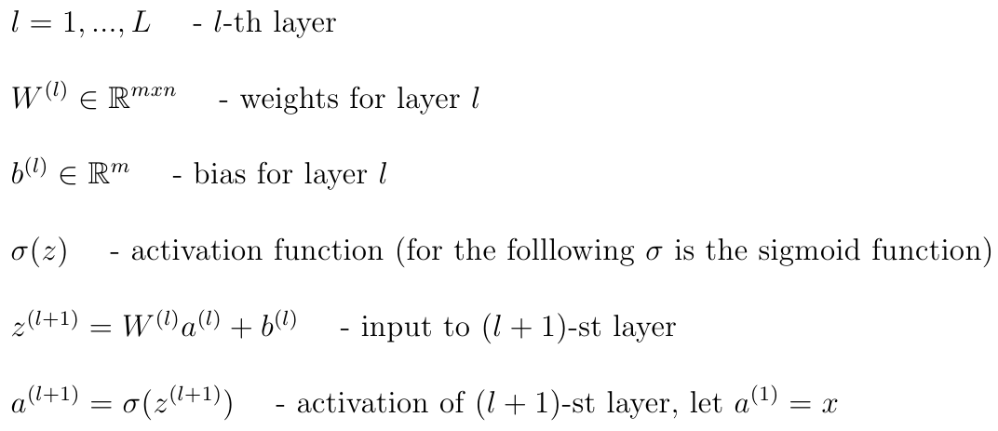
Notation
Slides from Awni Hannun (CS221 Autumn 2013)

Slide 29

Forward Propagation
x₁
w₁₁
w₂₁
x₂
x₃
+1
+1
Slides from Awni Hannun (CS221 Autumn 2013)

Slide 30

Forward Propagation
x₁
x₂
x₃
+1
+1
Layer 2 /
hidden layer
Layer 1 / Input
Layer 3 / output
Slides from Awni Hannun (CS221 Autumn 2013)

Slide 31


Forward Propagation with Many Hidden Layers
. . .
. . .
+1
+1
Layer l
Layer l+1
Slides from Awni Hannun (CS221 Autumn 2013)

Slide 32

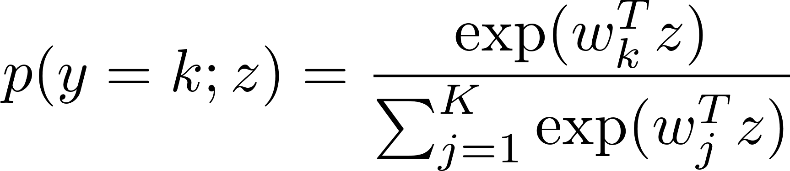
Forward Propagation as a Single Function
Gives us a single non-linear function of the input
But what about multi-class outputs?
Replace output unit for your needs
“Softmax” output unit instead of sigmoid
Slides from Awni Hannun (CS221 Autumn 2013)

Slide 33
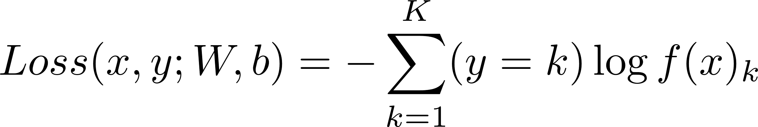
Objective Function for Learning
Supervised learning, minimize our classification errors
Standard choice: Cross entropy loss function
Straightforward extension of logistic loss for binary
This is a frame-wise loss. We use a label for each frame from a forced alignment
Other loss functions possible. Can get deeper integration with the HMM or word error rate

Slide 34
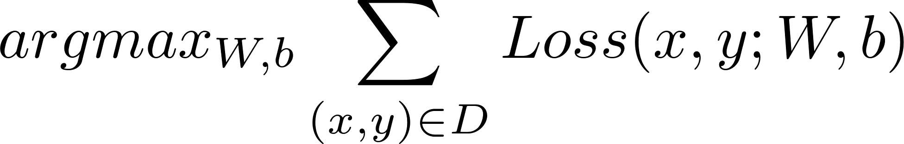
The Learning Problem
Find the optimal network weights
How do we do this in practice?
Non-convex
Gradient-based optimization
Simplest is stochastic gradient descent (SGD)
Many choices exist. Area of active research

Slide 35


Computing Gradients: Backpropagation
Backpropagation
Algorithm to compute the derivative of the loss function with respect to the parameters of the network
Slides from Awni Hannun (CS221 Autumn 2013)

Slide 36


Chain Rule
Recall our NN as a single function:
x
g
f
Slides from Awni Hannun (CS221 Autumn 2013)
Notes:
Regular chain rule

Slide 37

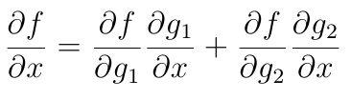
Chain Rule
g₁
x
f
g₂
Slides from Awni Hannun (CS221 Autumn 2013)
Notes:
Regular chain rule

Slide 38
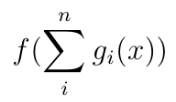
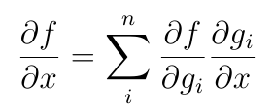
Chain Rule
g₁
x
f
. . .
g_{n}
Slides from Awni Hannun (CS221 Autumn 2013)
Notes:
Regular chain rule

Slide 39


Backpropagation
Idea: apply chain rule recursively
x
w₁
f₁
w₂
f₂
w₃
f₃
δ⁽³⁾
δ⁽²⁾
Slides from Awni Hannun (CS221 Autumn 2013)
Notes:
Regular chain rule

Slide 40
Backpropagation
x₁
x₂
δ⁽³⁾
Loss
x₃
+1
+1
Slides from Awni Hannun (CS221 Autumn 2013)
Notes:
Backprop intuition

Slide 41
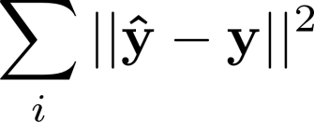






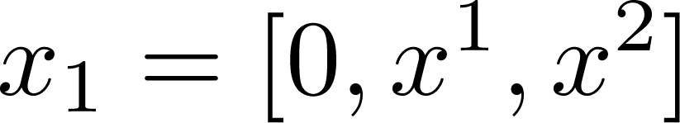
Neural network with regression loss
Minimize
Output Layer
Hidden Layer
Noisy Input

Slide 42




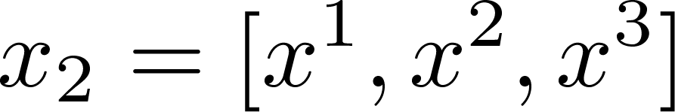
Recurrent Network
Output Layer
Hidden Layer
Noisy Input

Slide 43



Deep Recurrent Network
Output Layer
Hidden Layer
Hidden Layer
Noisy Input

Slide 44
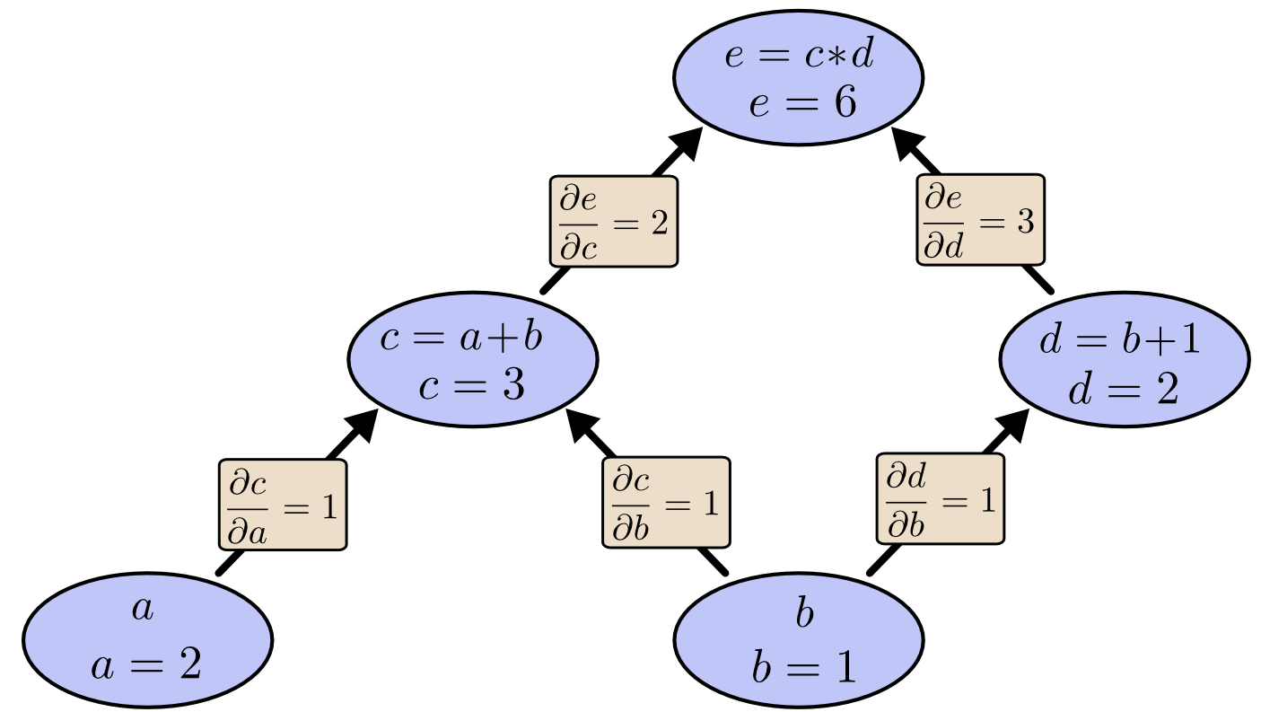
Compute graphs

