Slide 1
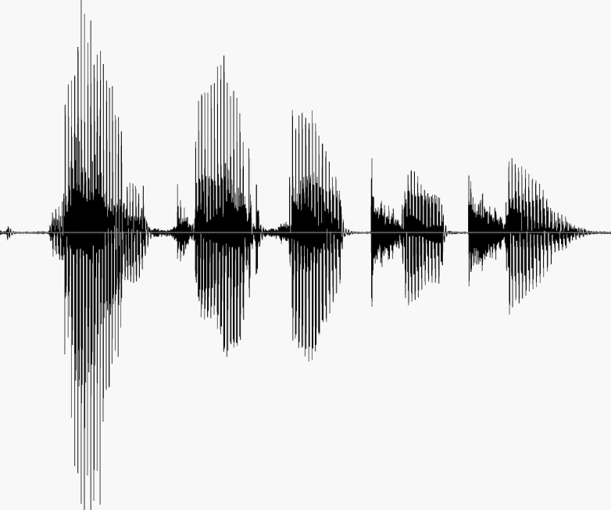
CS 224S / LINGUIST 285 Spoken Language Processing
Andrew Maas
Stanford University
Spring 2017
Lecture 8: End-to-end neural network speech recognition

Slide 2
Outline
ASR discussion thus far
Connectionist temporal classification (CTC)
Lexicon-free CTC
Scaling up end-to-end neural approaches
Alternative end-to-end approaches
HW3 discussion

Slide 3
Noisy channel model
likelihood
prior

Slide 4
The noisy channel model
Ignoring the denominator leaves us with two factors: P(Source) and P(Signal|Source)

Slide 5
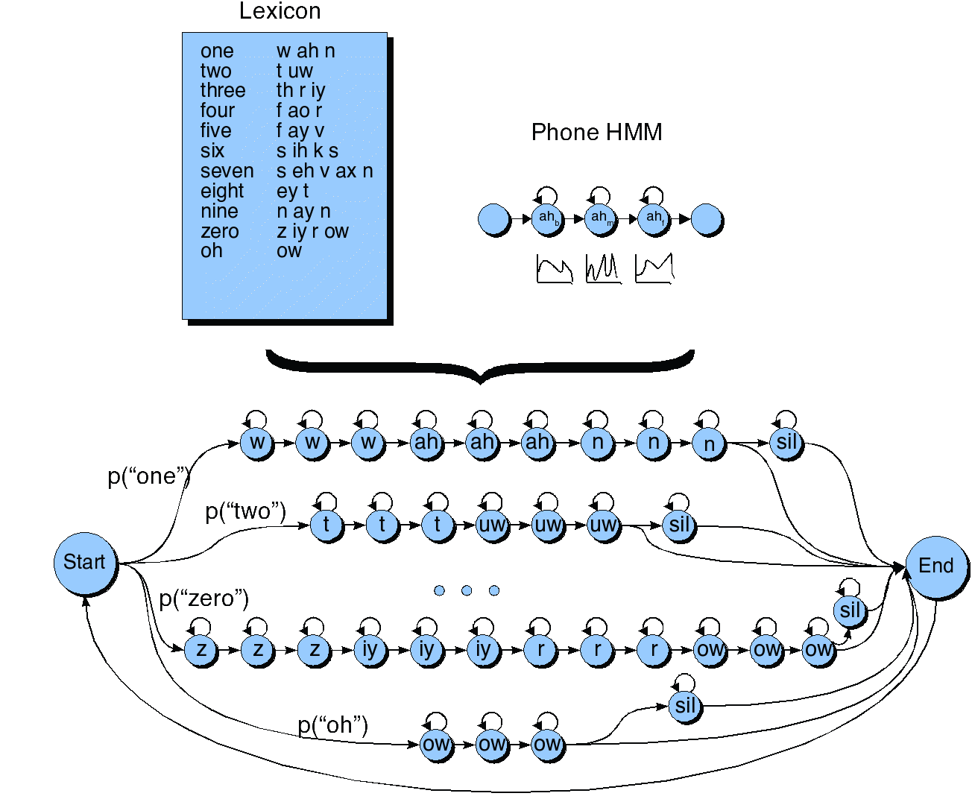
HMM for the digit recognition task

Slide 6
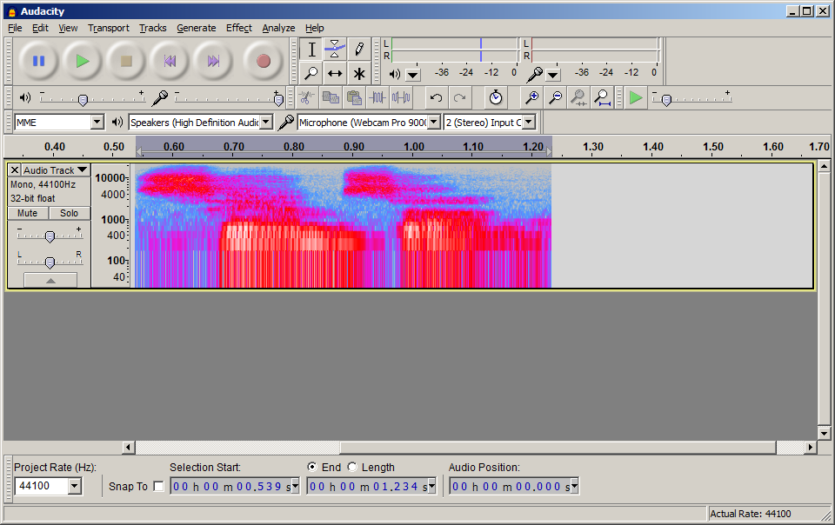
Acoustic Modeling with GMMs
Transcription:
Pronunciation:
Sub-phones :
Hidden Markov Model (HMM):
Acoustic Model:
Audio Input:
Samson
S – AE – M – S –AH – N
942 – 6 – 37 – 8006 – 4422 …
942
942
6
GMM models:
P(x|s)
x: input features
s: HMM state
Features
Features
Features
Notes:
This is a generative model, meaning we need to understand all of how an HMM state ‘creates’ input features x

Slide 7
DNN Hybrid Acoustic Models
Transcription:
Pronunciation:
Sub-phones :
Hidden Markov Model (HMM):
Acoustic Model:
Audio Input:
Samson
S – AE – M – S –AH – N
942 – 6 – 37 – 8006 – 4422 …
942
942
6
P(s|x₁)
P(s|x₂)
P(s|x₃)
Use a DNN to approximate:
P(s|x)
Apply Bayes’ Rule:
P(x|s) = P(s|x) * P(x) / P(s)
DNN * Constant / State prior
Features (x₁)
Features (x₂)
Features (x₃)

Slide 8
Framework + Isolated Training Limitations
(Maas, Qi, Xie, Hannun, Lengerich, Jurafsky, & Ng. 2017)

Slide 9
Recurrent DNN Hybrid Acoustic Models
Transcription:
Pronunciation:
Sub-phones :
Hidden Markov Model (HMM):
Acoustic Model:
Audio Input:
Samson
S – AE – M – S –AH – N
942 – 6 – 37 – 8006 – 4422 …
942
942
6
P(s|x₁)
P(s|x₂)
P(s|x₃)
Features (x₁)
Features (x₂)
Features (x₃)

Slide 10






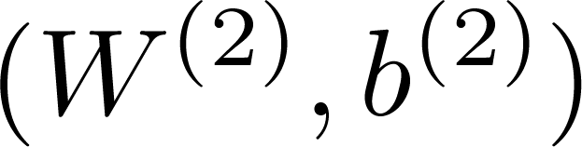




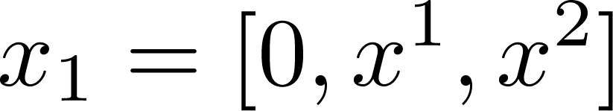
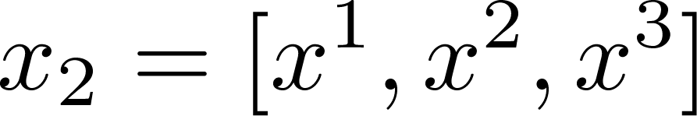

Deep Recurrent Network
Output Layer
Hidden Layer
Hidden Layer
Input

Slide 11
HMM-Free Recognition
Transcription:
Pronunciation:
Sub-phones :
Hidden Markov Model (HMM):
Acoustic Model:
Audio Input:
Samson
S – AE – M – S –AH – N
942 – 6 – 37 – 8006 – 4422 …
942
942
6
P(s|x₁)
P(s|x₂)
P(s|x₃)
Features (x₁)
Features (x₂)
Features (x₃)
(Graves & Jaitly. 2014)

Slide 12
HMM-Free Recognition
Transcription:
Characters:
Collapsing function:
Acoustic Model:
Audio Input:
Samson
SAMSON
SS___AA_M_S___O___NNNN
S
S
_
P(a|x₁)
P(a|x₂)
P(a|x₃)
Use a DNN to approximate:
P(a|x)
The distribution over characters
Features (x₁)
Features (x₂)
Features (x₃)
(Graves & Jaitly. 2014)

Slide 13
Example Results (WSJ)
YET A REHBILITATION CRU IS ONHAND IN THE BUILDING LOOGGING BRICKS PLASTER AND BLUEPRINS FOUR FORTY TWO NEW BETIN EPARTMENTS
YET A REHABILITATION CREW IS ON HAND IN THE BUILDING LUGGING BRICKS PLASTER AND BLUEPRINTS FOR FORTY TWO NEW BEDROOM APARTMENTS
THIS PARCLE GUNA COME BACK ON THIS ILAND SOM DAY SOO
THE SPARKLE GONNA COME BACK ON THIS ISLAND SOMEDAY SOON
TRADE REPRESENTIGD JUIDER WARANTS THAT THE U S WONT BACKCOFF ITS PUSH FOR TRADE BARIOR REDUCTIONS
TRADE REPRESENTATIVE YEUTTER WARNS THAT THE U S WONT BACK OFF ITS PUSH FOR TRADE BARRIER REDUCTIONS
TREASURY SECRETARY BAGER AT ROHIE WOS IN AUGGRAL PRESSED FOUR ARISE IN THE VALUE OF KOREAS CURRENCY
TREASURY SECRETARY BAKER AT ROH TAE WOOS INAUGURAL PRESSED FOR A RISE IN THE VALUE OF KOREAS CURRENCY

Slide 14
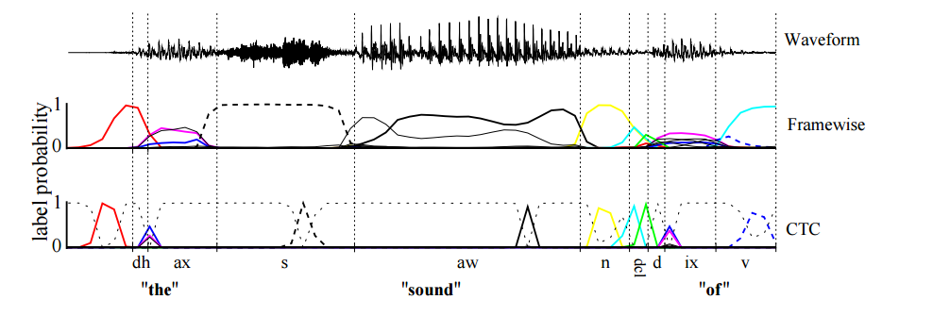
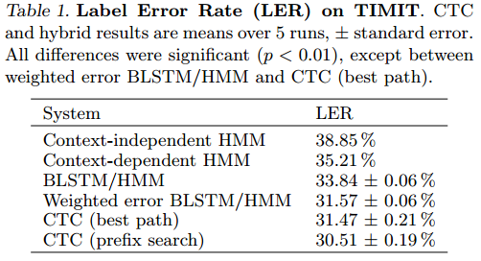
Earlier work on CTC with phonemes
(Graves, Fernández, Gomez, & Schmidhuber. 2006)

Slide 15
Decoding with a Language Model
Lexicon
[a, …, zebra]
Language
Model
p(“yeah” | “oh”)
Character
Probabilities
__oo_h__y_e_aa_h
(Hannun, Maas, Jurafsky, & Ng. 2014)

Slide 16
Loss functions and architecture
What function to fit
Loss function
HMM-DNN uses independent per-frame classification with force alignment hard labels
CTC independent per-frame but cleverly allows for multiple possible labelings
How do we approximate that function
Neural network architecture
HMM-DNN typically fine with just DNN
CTC needs recurrent NN

Slide 17
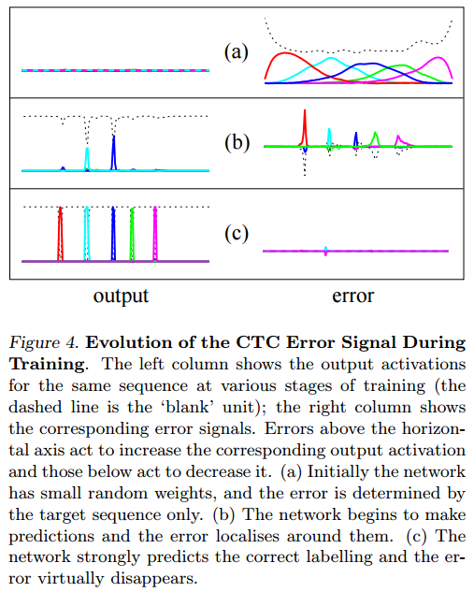
CTC loss during training
(Graves, Fernández, Gomez, & Schmidhuber. 2006)

Slide 18
Recurrence Matters!
S
S
_
P(a|x₁)
P(a|x₂)
P(a|x₃)
Architecture | CER
DNN | 22
+ recurrence | 13
+ bi-directional recurrence | 10
Features (x₁)
Features (x₂)
Features (x₃)
(Hannun, Maas, Jurafsky, & Ng. 2014)

Slide 19
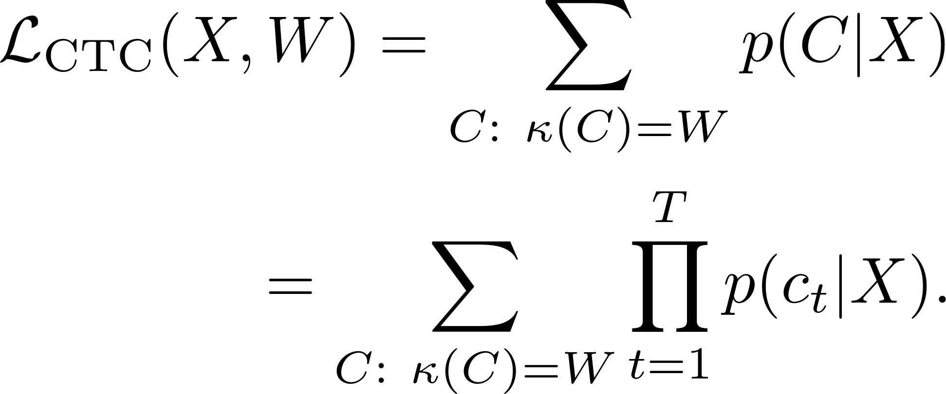
CTC Loss Function
Maximum log likelihood training of transcript
Intuition: Alignments are unknown so integrate over all possible time-character alignments
Example: W = “hi”, T = 3 possible C such that K(C) = W: hhi, hii, _hi, h_i, hi_
(Graves & Jaitly. 2014)

Slide 20



CTC Objective Function
Labels at each time index are conditionally independent (like HMMs)
Sum over all time-level labelings consistent with the output label.
Output label: AB
Time-level labelings: AB, _AB, A_B, … _A_B_
Final objective maximizes probability of true labels:
(Graves & Jaitly, ICML 2014)

Slide 21
Collapsing Example
Per-frame argmax:
____________________________________________________________________________________________________yy__ee_________tt_ ____________________________________________a_____ _rr__e________hh__________b___ii_______lll__i_____tt______aa______tt_______iio__n___ ___cc_____rrr_u_____________________ ________ii___ss ______________o__________nn_____________hhh_a___________________nnddd ________________i__n___ __thh_e_____ __________________________________________bb_uuii_______lllldd____ii____nng_____ ___________________________________l___o___o_g__g___ii____nng______ ____b___rr_ii________ck__s__________________________________________p___ll__a________sstt_________eerr__ ______a___nnd_ ___b___lll_uu____ee__pp___r___i________nnss_ ________________f______oou____________rrr________ _____________f_____oo__rrr__tt_y____ _____t____www_oo__________ ____nn___ew___________________ ______________________________________________________b___e_______t__________i____n___ ____e________pp_____aa___rr___tt____mm_ee___nnntss _____________________________________________________________________________________________________________________________________
After collapsing:
yet a rehbilitation cru is onhand in the building loogging bricks plaster and blueprins four forty two new betin epartments
Reference:
yet a rehabilitation crew is on hand in the building lugging bricks plaster and blueprints for forty two new bedroom apartments
(Hannun, Maas, Jurafsky, & Ng. 2014)

Slide 22
Rethinking Decoding
Out of Vocabulary Words
syriza
bae
abo--
Lexicon
[a, …, zebra]
sof--
schmidhuber
Language
Model
p(“yeah” | “oh”)
Character
Language
Model
p(h | o,h, ,y,e,a,)
Character
Probabilities
Character
Probabilities
__oo_h__y_e_aa_h
__oo_h__y_e_aa_h
(Maas*, Xie*, Jurafsky, & Ng. 2015)

Slide 23
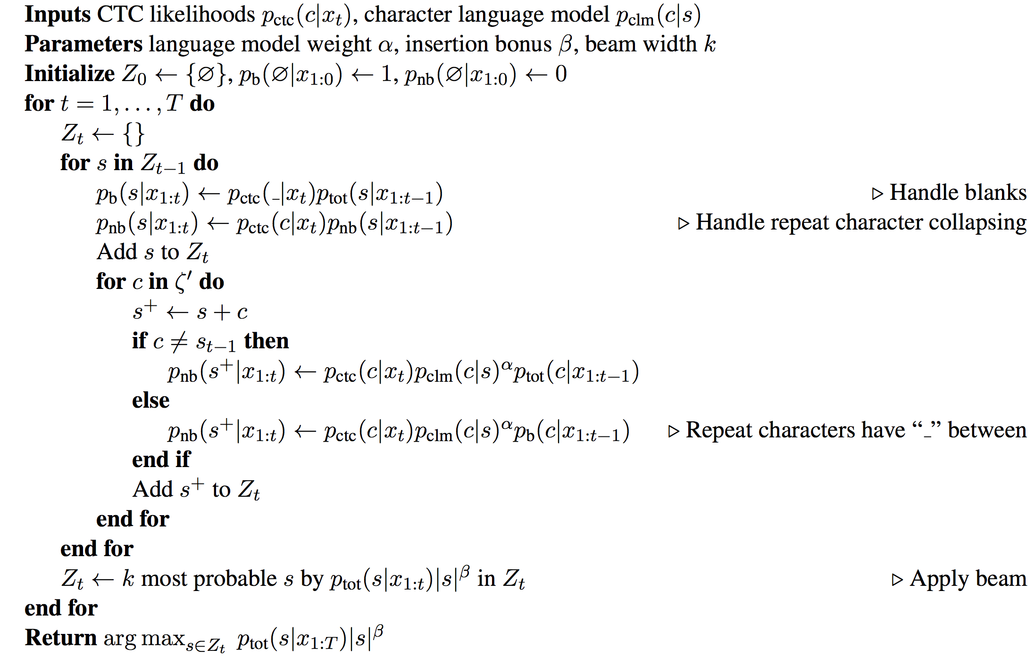
Beam Search Decoding

Slide 24
Lexicon-Free & HMM-Free on Switchboard
(Maas*, Xie*, Jurafsky, & Ng. 2015)
Notes:
This is the first time that anyone has done well on Switchboard with just 2 neural networks and a very simple beam search decoding
Our system has 10x fewer lines of code than the HMM-GMM baseline

Slide 25
Example Results (Switchboard) ~19% CER
i i don'tknow i don't know what the rain force have to do with it but you know their chop a those down af the tr minusrat everyday
i- i don't kn- i don't know what the rain forests have to do with it but you know they're chopping those down at a tremendous rate everyday
come home and get back in to regular cloos aga
come home and get back into regular clothes again
i guess down't here u we just recently move to texas so my wor op has change quite a bit muh we ook from colorado were and i have a cloveful of sweatterso tuth
i guess down here uh we just recently moved to texas so my wardrobe has changed quite a bit um we moved from colorado where and i have a closet full of sweaters that
i don't know whether state lit state hood whold itprove there a conomy i don't i don't know that to that the actove being a state
i don't know whether state woul- statehood would improve their economy i don't i don't know that the ve- the act of being a state
(Maas*, Xie*, Jurafsky, & Ng. 2015)

Slide 26
Comparing CLMs
All NN models have 5M total parameters
(Maas*, Xie*, Jurafsky, & Ng. 2015)

Slide 27
Transcribing Out of Vocabulary Words
Truth: yeah i went into the i do not know what you think of fidelity but
HMM-GMM: yeah when the i don’t know what you think of fidel it even them
CTC-CLM: yeah i went to i don’t know what you think of fidelity but um
Truth: no no speaking of weather do you carry a altimeter slash barometer
HMM-GMM: no i’m not all being the weather do you uh carry a uh helped emitters last brahms her
CTC-CLM: no no beating of whether do you uh carry a uh a time or less barometer
Truth: i would ima- well yeah it is i know you are able to stay home with them
HMM-GMM: i would amount well yeah it is i know um you’re able to stay home with them
CTC-CLM: i would ima- well yeah it is i know uh you’re able to stay home with them
(Maas*, Xie*, Jurafsky, & Ng. 2015)

Slide 28
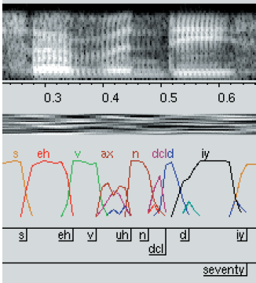
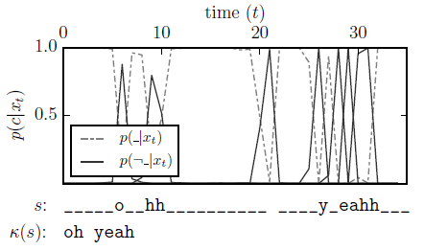
Comparing Alignments
HMM-GMM phone probabilities
CTC character probabilities
(HMM slide from Dan Ellis)
Notes:
CTC is a test utterance with no LM
Dan Ellis slides:
http://www.cs.ubc.ca/~murphyk/Software/HMM/E6820-L10-ASR-seq.pdf

Slide 29
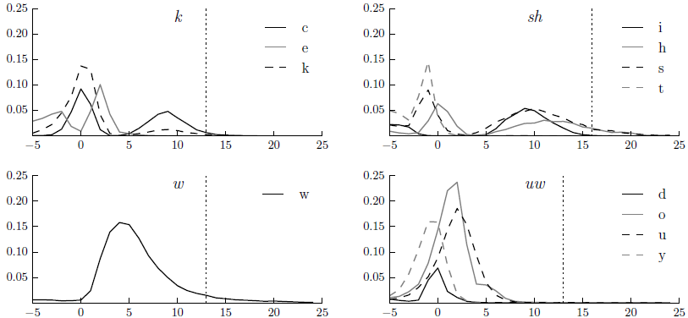
Learning Phonemes and Timing
Take all phone segments from HMM-GMM alignments (k)
Align all segments to start at the same time = 0
Compute the average CTC character probabilities during the segment (c, e, k)
Vertical line shows median end time of phone segment from HMM-GMM alignments

Slide 30
Learning Phonemes and Timing
(Maas*, Xie*, Jurafsky, & Ng. 2015)

Slide 31
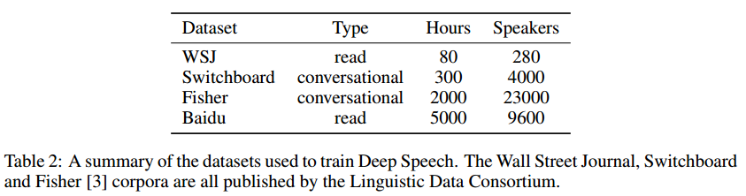
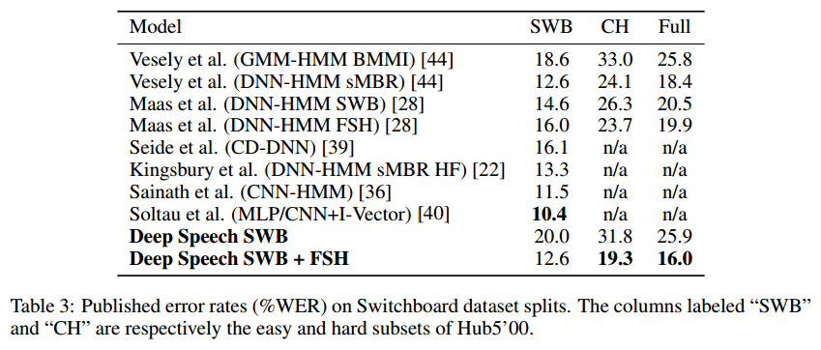
Scaling end to end models: Baidu deep speech
(Hannun et al. 2014)

Slide 32
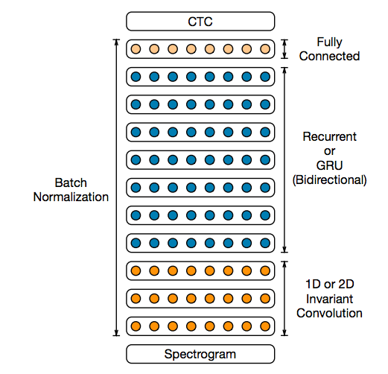
Deep Speech – Deep RNN
Slides from Awni Hannun

Slide 33
Deep Speech – Batch Norm for RNNs
Normalize
Normalize
Slides from Awni Hannun

Slide 34
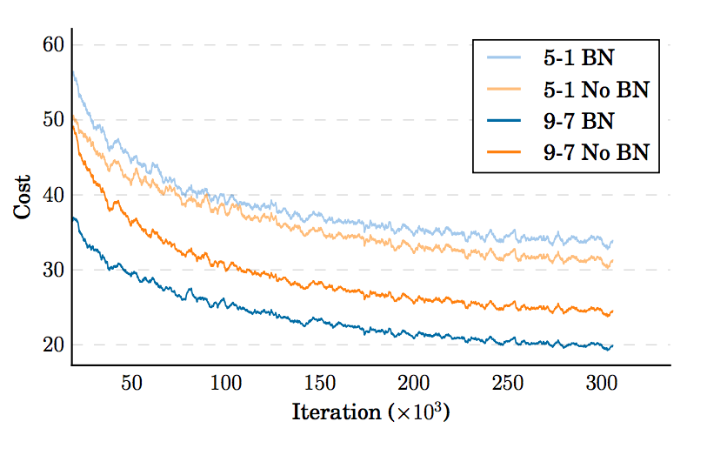
Deep Speech – Batch Norm for RNNs
Slides from Awni Hannun

Slide 35
Deep Speech - Hours of speech data
Language | Hours
English | 12,000
Mandarin | 10,000
Where does the data come from?
Public benchmarks (English)
Internal manually labelled data (English and Mandarin)
Captioned videos (English and Mandarin)
Slides from Awni Hannun

Slide 36
Deep Speech - Captioned Video Data Pipeline
Download publicly available video + captions.
Align caption to video with CTC Model
Segment at regions of silence
Use simple classifier to throw out very noisy samples.
Slides from Awni Hannun

Slide 37
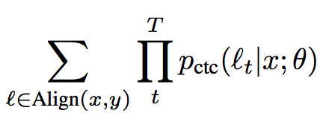
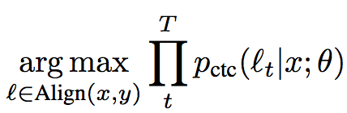
Deep Speech - Captioned Video Data Pipeline
Align with a model trained with CTC?
Slides from Awni Hannun

Slide 38
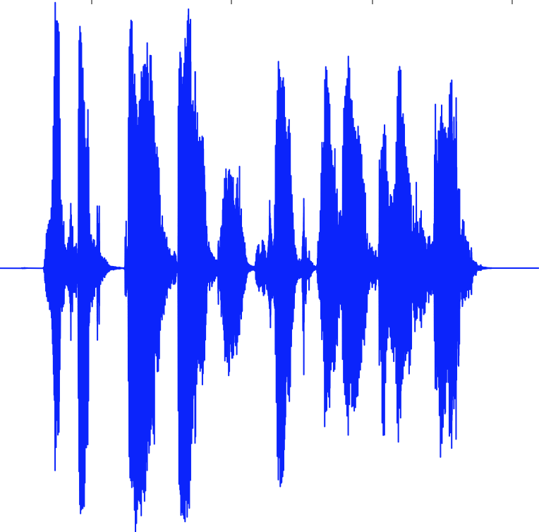
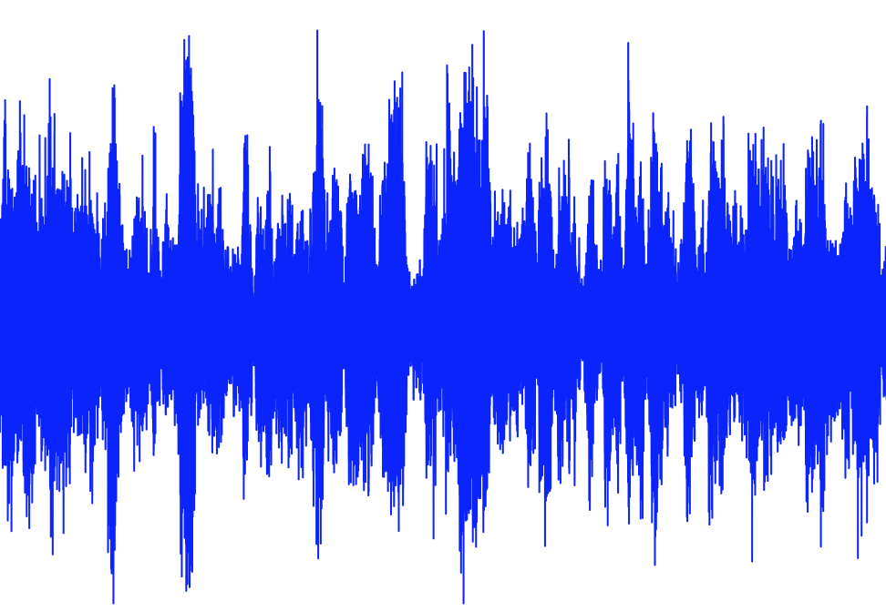
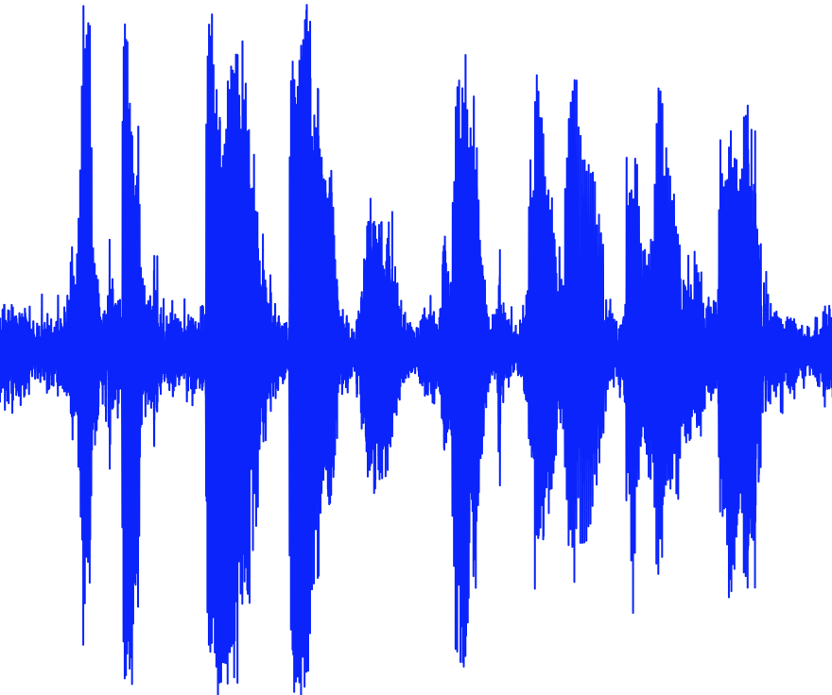
Deep Speech - Even more data!
Augmentation: noise synthesis, reverb, time-stretching, pitch-shifting,...
Speech
Noise
Noisy Speech
Slides from Awni Hannun

Slide 39
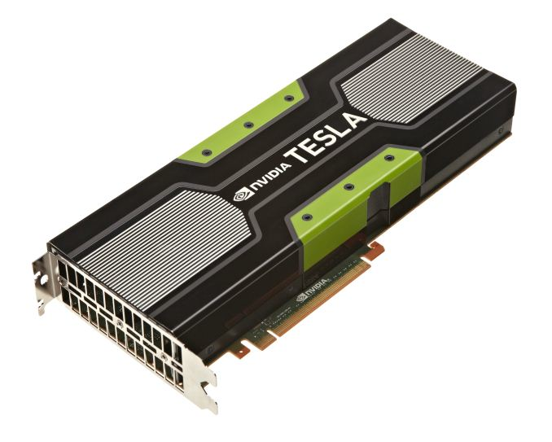
Deep Speech – Data Parallel GPU Scaling
Model 1
Model 2
Share weight updates each iteration
InfiniBand
Model 3
Model 4
Slides from Awni Hannun
Notes:
-when 1 gpu isn’t enough, lots of gpus

Slide 40
Deep Speech – Data Parallel GPU Scaling
Custom Ring Reduce avoids extraneous copies to CPU memory.
# GPUs | OpenMPI All-reduce (s)* | Custom All-reduce (s)* | Factor Speedup
4 | 55359 | 2587 | 21.4
8 | 48881 | 2470 | 19.8
16 | 21562 | 1393 | 15.5
*Measures time spent in all-reduce for a single epoch.
Slides from Awni Hannun
Notes:
custom MPI algorithm and description

Slide 41
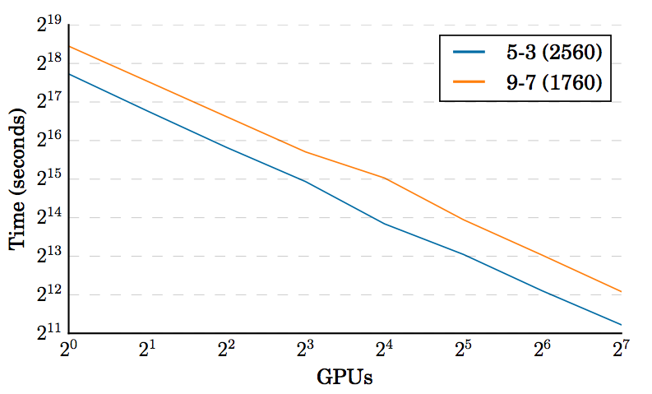
Deep Speech – Data Parallel GPU Scaling
Slides from Awni Hannun
Notes:
custom MPI algorithm and description

Slide 42
Deep Speech – Some results
Architecture | English (WER) | Mandarin (WER)
5-layer 1-RNN | 13.55 | 15.41
5-layer 3-RNN | 11.61 | 11.85
5-layer 3-RNN + BatchNorm | 10.56 | 9.39
9-layer 7-RNN + BatchNorm + Frequency Convolution | 9.52 | 7.93
Slides from Awni Hannun

Slide 43
Deep Speech – Deployment
Bi-directional models give almost 10% relative boost … but we can’t deploy them.
ASR latencies for voice search <50ms
For 3 second audio would need to decode 60x faster than realtime!
Slides from Awni Hannun

Slide 44
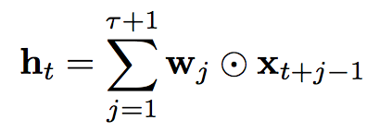
Deep Speech – Lookahead convolution
Slides from Awni Hannun

Slide 45
Deep Speech – Lookahead convolution
For a lookahead of 20 time-steps (about 800ms in the future)
Model | English (WER) | Chinese (WER)
Forward only | 18.8 | 15.7
Forward + Lookahead (+50k params) | 16.8 | 13.5
Bidirectional (+12M params) | 15.4 | 12.8
Slides from Awni Hannun
Notes:
custom MPI algorithm and description

Slide 46
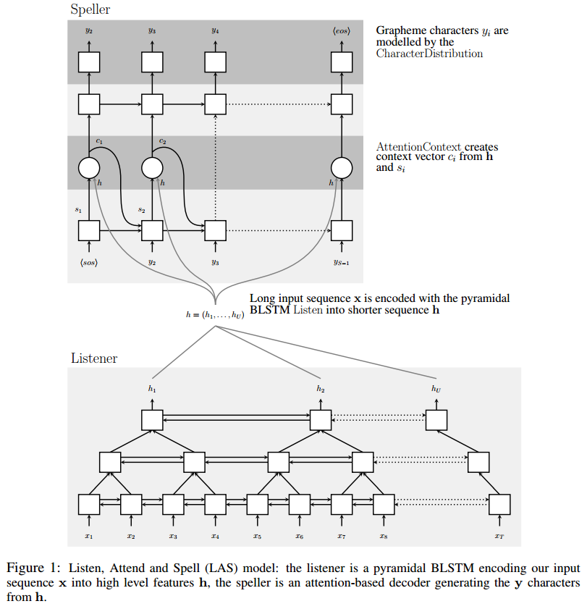
Listen, Attend, and Spell
(Chan, Jaitly, Le, & Vinyals. 2015)

Slide 47
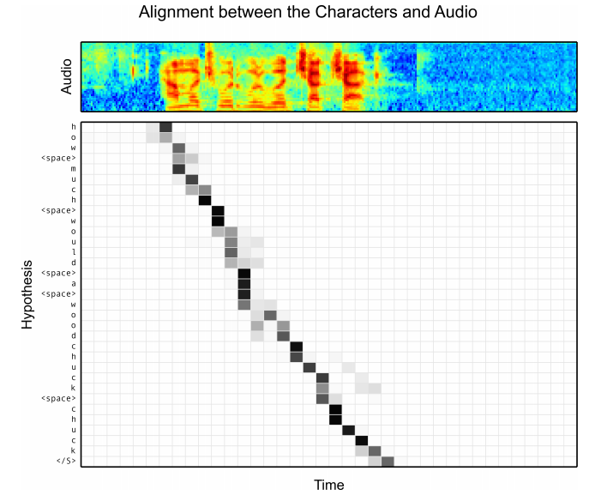
Listen, Attend, and Spell
(Chan, Jaitly, Le, & Vinyals. 2015)

Slide 48
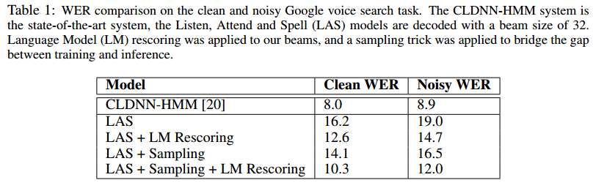
Listen, Attend, and Spell
(Chan, Jaitly, Le, & Vinyals. 2015)

Slide 49

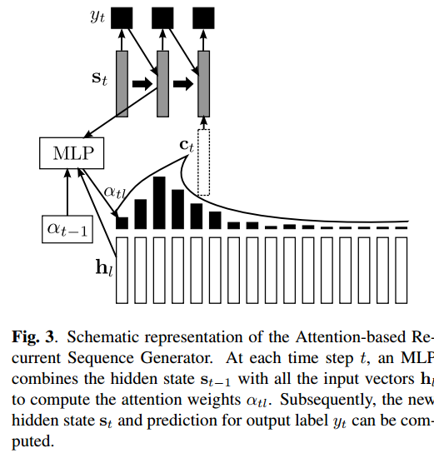
Attention-based sequence generation
Maximum likelihood conditional language model given the audio
(Bahdanau et al. 2016)

