Slide 1
CS 224S: TensorFlow Tutorial
Lecture and Live Demo
Pujun Bhatnagar
Rishabh Bhargava

Slide 2
Intro to Deep Learning Frameworks
Scales machine learning code
Computes gradients!
Standardizes machine learning applications for sharing
Zoo of Deep Learning frameworks available with different advantages, paradigms, levels of abstraction, programming languages, etc
Interface with GPUs for parallel processing
In some ways, rightfully gives Deep Learning its name as a separate practice

Slide 3
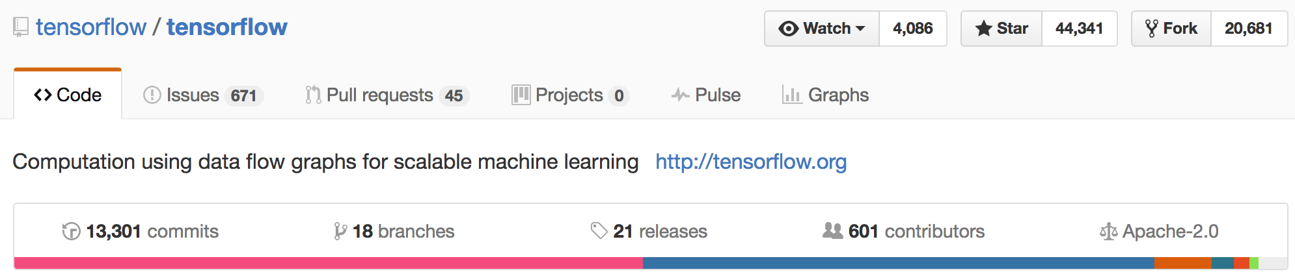
What is TensorFlow?
Open source software library for numerical computation using data flow graphs
Originally developed by Google Brain Team to conduct machine learning research
“Tensorflow is an interface for expressing machine learning algorithms, and an implementation for executing such algorithms”

Slide 4
Programming model
Big idea: express a numeric computation as a graph.
Graph nodes are operations which have any number of inputs and outputs
Graph edges are tensors which flow between nodes
Notes:
I’m going to introduce the main ideas of tensorflow as well as its mechanics
Biggest idea to understanding TensorFlow is that computation in this environment is expressed as a graph.
One important idea to get out of this presentation: Backbone to any tensorflow program is a graph
Nodes in the graph represent operations, which takes tensors as inputs and outputs a new tensor.
Edges are the tensors which flow between nodes. You can think of tensors as n-dimensional arrays.
The advantage of using flow graphs as your framework is that it allows you to build complex models in terms of smaller operations in the graph, which makes gradient calculations simple. You’ll be very very grateful for this in large projects!
Another way of thinking about a TensorFlow graph is that each node is a function whose value can be computed in runtime.

Slide 5
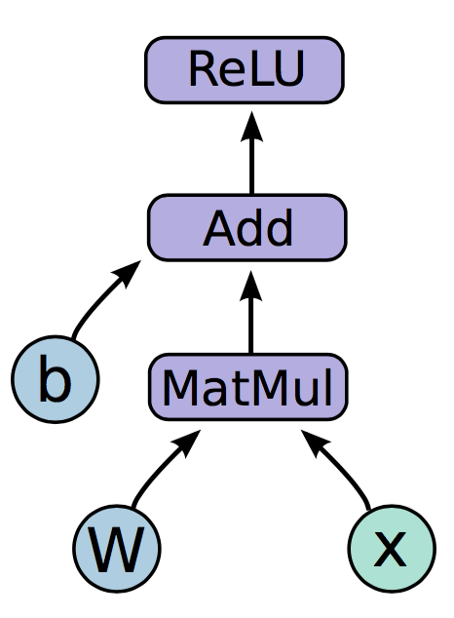
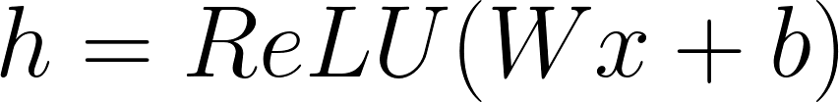
Programming model
Notes:
Neural network with one hidden layer
The function we are computing is on the left. Relu is an activation function that takes the max of 0 and your input, applies a nonlinearity to your network.
The graph on the right is how this function would look like in a tensorflow graph.
Let us break down the nodes in the graph into three types

Slide 6
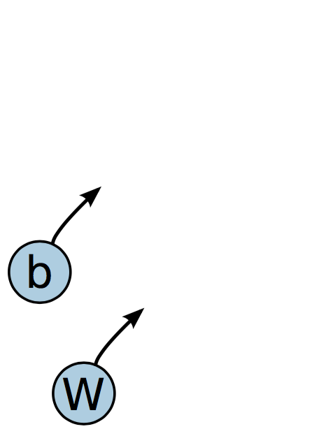
Programming model
Variables are stateful nodes which output their current value.
State is retained across multiple executions of a graph
(mostly parameters)
Notes:
We have two variables in this graph, the bias and W matrix.
What we mean by saying that variables are stateful is that they retain their current value over multiple executions, and it’s easy to restore saved values to variables.
Variables have a number of other useful features. They can be saved to disk during and after training, and gradient updates will by default apply over all the variables in your graph
Variables are still operations (nodes = operations!). When you run a variable you get the value of its state.
The variables in your graph are going to be your parameters

Slide 7
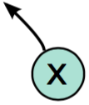
Programming model
Placeholders are nodes whose value is fed in at execution time
(inputs, labels, …)
Notes:
The second important node type is placeholders. If you have inputs into your network that depend on some external data, you want to be able to build your graph without depending on any real values yet, as those are passed in at run time.
Placeholders, unlike variables that have initial assignment, expect as arguments a data type and a shape of a tensor.
Inputs, labels

Slide 8
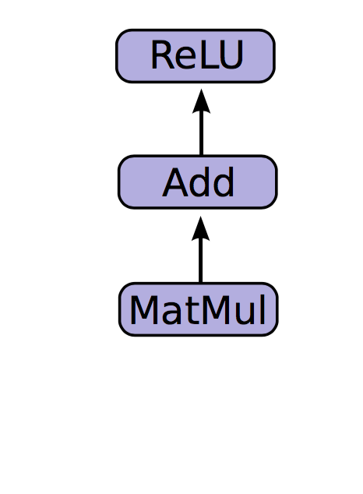
Programming model
Mathematical operations:
MatMul: Multiply two matrix values.
Add: Add elementwise (with broadcasting).
ReLU: Activate with elementwise rectified linear function.
Notes:
The other nodes are mathematical operations that you are familiar with. Matmul, addition, and relu are all operations in your graph that combine your inputs and parameters to produce new nodes.

Slide 9
In code,
import tensorflow as tf b = tf.Variable(tf.zeros((100,))) W = tf.Variable(tf.random_uniform((784, 100), -1, 1)) x = tf.placeholder(tf.float32, (100, 784))
h = tf.nn.relu(tf.matmul(x, W) + b)
Create weights, including initialization W ~ Uniform(-1, 1); b = 0
Create input placeholder x m * 784 input matrix
Build flow graph
Notes:
So let us actually look at how this is implemented in code.
[Explain]
The key thing to remember about symbolic programming language is that, up to what what we have written here, no data is actually being computed. X is just a placeholder for data. The graph merely defines a function.
You cannot print out h and get it’s value, ‘h’ represents a node in the graph

Slide 10
But where is the graph?
New nodes are automatically built into the underlying graph!
tf.get_default_graph().get_operations():
random_uniform/sub
random_uniform/mul
random_uniform
Variable_1
Variable_1/Assign
Variable_1/read
Placeholder
MatMul
add
Relu == h
h refers to an op!
zeros/shape
zeros/Const
zeros
Variable
Variable/Assign
Variable/read
random_uniform/shape
random_uniform/min
random_uniform/max
random_uniform/RandomUniform
Notes:
This is where it becomes apparent that tensorflow is another level of abstraction above the python program, that these operations are what define your computations

Slide 11
How do we run it?
CPU
So far we have defined a graph.
We can deploy this graph with a session: a binding to a particular execution context (e.g. CPU, GPU)
GPU
Notes:
Google is developing their own integrated circuit to process tensorflow graphs orders of magnitude more quickly.
A session is an environment that supports the execution of all the operations in your graph.
Tensor processing units, used in AlphaGo match.

Slide 12
Getting output
import numpy as np import tensorflow as tf b = tf.Variable(tf.zeros((100,)))
W = tf.Variable(tf.random_uniform((784, 100),
-1, 1))
x = tf.placeholder(tf.float32, (100, 784))
h = tf.nn.relu(tf.matmul(x, W) + b)
sess.run(fetches, feeds)
Fetches: List of graph nodes. Return the outputs of these nodes.
Feeds: Dictionary mapping from graph nodes to concrete values. Specifies the value of each graph node given in the dictionary.
sess = tf.Session() sess.run(tf.initialize_all_variables()) sess.run(h, {x: np.random.random(100, 784)})
Notes:
Way we get output is to build a session object, and then to call run on that session with two arguments: fetches and feeds.
Fetches represent the list of graph nodes, ie operations, and returns the outputs of these nodes.
Feeds are dictionary maps of graph nodes to values. This is where you fill in your placeholder values. Nodes that depend on placeholders cannot run if its value is not fed.
First build a session object. It might seem strange that we don’t have as an input to this session object any graph items, but that is because every time we define these operations they are added to the underlying default graph.
An important concept of Tensorflow is lazy evaluation, evaluation of the graph only happens at session.run. It’s a tf.assign operation.

Slide 13
So what have we covered so far?
We first built a graph using variables and placeholders
We then deployed the graph onto a session, which is the execution environment
Next we will see how to train the model

Slide 14
How do we define the loss?
Use placeholder for labels
Build loss node using labels and prediction
prediction = tf.nn.softmax(...) #Output of neural network
label = tf.placeholder(tf.float32, [100, 10])
cross_entropy = -tf.reduce_sum(label * tf.log(prediction), axis=1)
Notes:
The first thing we need to do to train is to build a loss node. We use placeholders for labels since these are values that are fed in at runtime. And like of the other machine learning frameworks, this means that we would first go ahead and define the loss and then also see the placeholder

Slide 15
How do we compute Gradients?
train_step = tf.train.GradientDescentOptimizer(0.5).minimize(cross_entropy)
tf.train.GradientDescentOptimizer is an Optimizer object
tf.train.GradientDescentOptimizer(lr).minimize(cross_entropy) adds optimization operation to computation graph
TensorFlow graph nodes have attached gradient operations
Gradient with respect to parameters computed with backpropagation
...automatically
Notes:
The next thing we have to do is compute gradients. The way this is done in tensorflow is by creating an optimizer object that has methods to compute various optimization algorithms, in this case gradient descent.
GradientDescentOptimizer is a subclass of the general Optimizer class
The next thing we do is build an optimization operation that is appended to our computation graph by calling on the function “minimize” that takes as an argument the node we are trying to minimize.
Remember, this minimize operation, called train_step above, when you call it, actually applies gradient updates to your variables.
It combines calls of two other tensorflow functions: compute gradients and apply gradients.

Slide 16
Creating the train_step op
prediction = tf.nn.softmax(...)
label = tf.placeholder(tf.float32, [None, 10])
cross_entropy = tf.reduce_mean(-tf.reduce_sum(label * tf.log(prediction), reduction_indices=[1]))
train_step = tf.train.GradientDescentOptimizer(0.5).minimize(cross_entropy)
Notes:
If we introduce the code line from the previous slide, we add an optimization node to the graph.
Evaluating at runtime this “train_step” python variable will automatically apply gradients to all of the variables in our graph.

Slide 17
Training the Model
sess.run(train_step, feeds)
Create Session
Build training schedule
Run train_step
sess = tf.Session() sess.run(tf.initialize_all_variables())
for i in range(1000):
batch_x, batch_label = data.next_batch()
sess.run(train_step, feed_dict={x: batch_x,
label: batch_label}
Notes:
Now that we’ve created the train_step node, let us look at how we can train it.
The only thing we have left to do is figure out how to create some sort of iterating training schedule that feeds in data, labels, and trains our model by applying gradients to the variables.

Slide 18
Variable sharing: naive way
variables_dict = { "weights": tf.Variable(tf.random_normal([782, 100]), name="weights") "biases": tf.Variable(tf.zeros([100]), name="biases") }
Not good for encapsulation!
Notes:
One naive way to do this is to define your shared variables at the top of your program and then use those python variables in your model.
But this breaks encapsulation! The code that builds the graph should always document the names, types, and shapes of your variables in its block, and this information is lost. When the code changes you also get bad things with changing variable names, as well as inconsitencies.

Slide 19
What’s in a Name?
tf.variable_scope() provides simple name-spacing to avoid clashes
tf.get_variable() creates/accesses variables from within a variable scope
with tf.variable_scope("foo"): v = tf.get_variable("v", shape=[1]) # v.name == "foo/v:0"
with tf.variable_scope("foo", reuse=True): v1 = tf.get_variable("v") # Shared variable found!
with tf.variable_scope("foo", reuse=False): v1 = tf.get_variable("v") # CRASH foo/v:0 already exists!
Notes:
TensorFlow introduces something called variable scope that provides a simple name-spacing scheme to avoid clashes and to help in sharing variables.
What variable scope allows you to do is to easily share named variables when you construct a graph.
Program will crash telling you that foo slash v : 0 already exists.

Slide 20
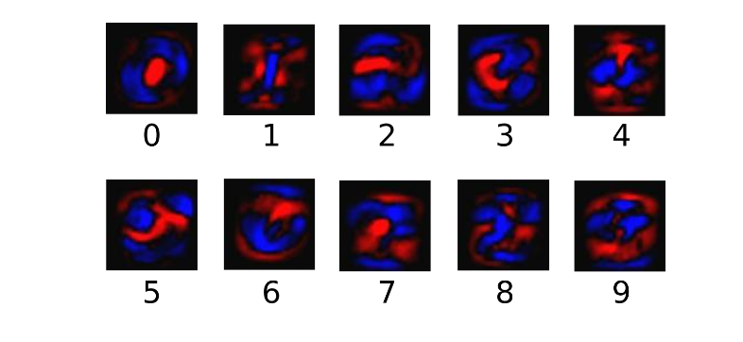
Live Demo: Learning the MNIST dataset

Slide 21
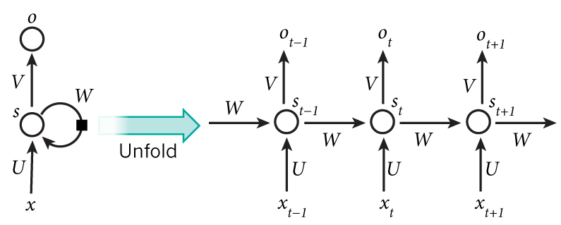
RNNs
Cell types:
Vanilla
LSTM
GRU
http://www.wildml.com/2015/09/recurrent-neural-networks-tutorial-part-1-introduction-to-rnns/
Notes:
Basic structure of RNNs; input, state, output. Unrolled.

Slide 22
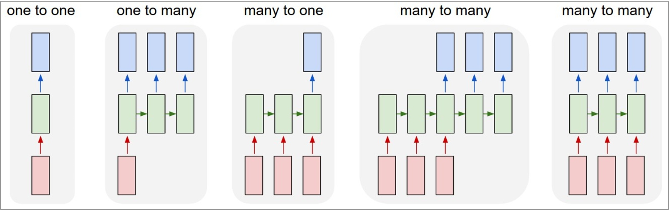
RNN sequences
http://karpathy.github.io/2015/05/21/rnn-effectiveness/
Notes:
We don’t know how many is ‘many’.

Slide 23
RNN + Tensorflow
Most calculations are performed on a per-batch basis
RNNs expects tensors of shape [B, T, ..] as input, where B is batch size, T is length in time of each input.
What if each sequence is not the same length T?
Solution: Batching and Padding

Slide 24
Batching and Padding
Imagine one of your sequences is of length 1000, but the average sequence length is 20.
Pad all sequences to length 1000 -- huge waste of memory and time!
Make batches of size 32, and pad all examples in the batch to maximum sequence length in batch. Only one batch suffers!
Padding: Appending 0’s to shorter sequences in a batch to make them equal length.
Dynamically unroll the RNN (example on next slide)

Slide 25
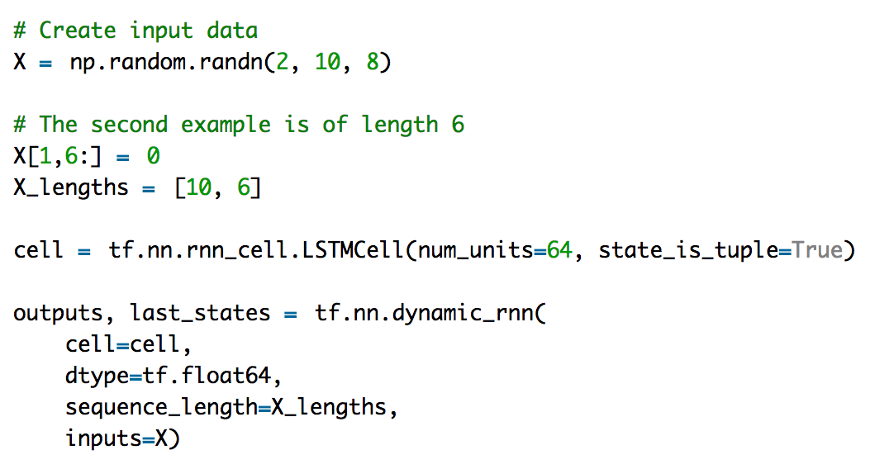
dynamic_rnn
http://www.wildml.com/2016/08/rnns-in-tensorflow-a-practical-guide-and-undocumented-features/
Notes:
Dynamic allows for batches of variable size + faster.

Slide 26
In Summary:
Build a graph
Feedforward / Prediction
Optimization (gradients and train_step operation)
Initialize a session
Train with session.run(train_step, feed_dict)

Slide 27
Questions?

Slide 28
Acknowledgments
Barak Oshri, Nishith Khandwala, CS224N CAs last quarter
Jon Gauthier, Natural Language Processing Group, Symbolic Systems
Bharath Ramsundar, PhD Student, Drug Discovery Research
Chip Huyen, Undergraduate, teaching CS20SI: TensorFlow for Deep Learning Research last quarter

Slide 29
Live Demo: Tackling MNIST using Tensorflow
Insert link to the ipython notebook
Link to the github repo: https://github.com/pbhatnagar3/cs224s-tensorflow-tutorial

