Slide 1
Osteoarthritis Treatment Analysis Using Machine Learning
Comprehensive Data Analytics Approach to Healthcare Decision Making
Name:NTWARI Deus
ID:25048
Course: INSY 8413 - Introduction to Big Data Analytics
Instructor: Eric Maniraguha
Date: July 26, 2025
Institution: Faculty of Information Technology

Slide 2
Agenda
🎯 Project Introduction
- Problem Statement & Objectives
- Dataset Overview
🔬 Methodology
- Data Preprocessing & Analysis
- Machine Learning Approach
📊 Results
- Key Findings & Insights
- Dashboard Demonstration
💡 Recommendations
- Clinical Applications
- Treatment Guidelines
🚀 Future Work
- Enhancements & Extensions

Slide 3
Problem Statement
Research Question:
"Can we identify distinct patient clusters based on treatment response patterns and rank osteoarthritis treatments by effectiveness using machine learning?"
Objectives:
✅ Analyze 28 different osteoarthritis treatments
✅ Identify patient response patterns through clustering
✅ Rank treatments by effectiveness
✅ Provide evidence-based recommendations
✅ Create interactive dashboard for healthcare professionals

Slide 4
Dataset Overview
Source: Osteoarthritis Clinical Studies Database
Sample Size: 341
Treatment Types: 28 distinct interventions
Key Variables: Pain scores, follow-up time, sample sizes, study metadata
Data Quality: Comprehensive preprocessing with outlier removal

Slide 5
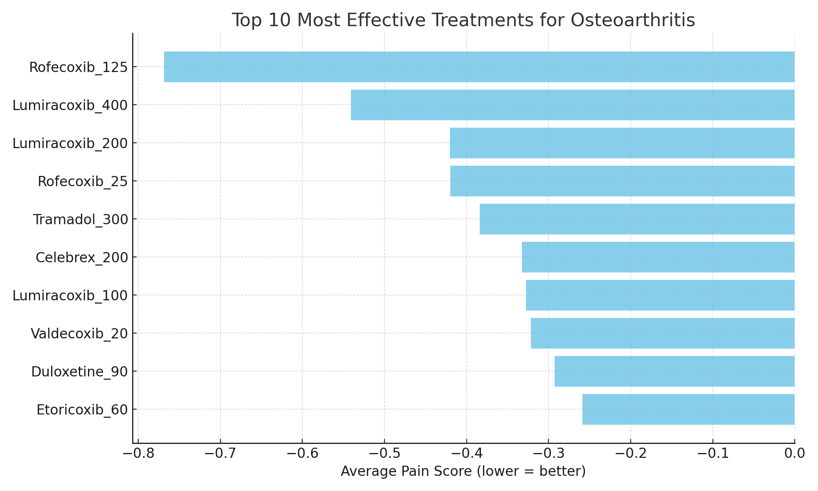
Top 10 Treatment Effectiveness Rankings

Slide 6
Methodology - Clustering Approach
Algorithm: K-Means Clustering
- Optimal Clusters: 3 (determined via Elbow Method)
- Evaluation Metric: Silhouette Score
- Silhouette Score: 0.341
Preprocessing Steps:
- StandardScaler applied to key numeric features
- PCA used for 2D visualization
- Features: Pain score (y), Sample size (N), Follow-up time, Standard error

Slide 7
Results - Clustering Analysis
Cluster-wise Summary:
🔹 Cluster 0:
- Patients: 169
- Avg Pain Score: -0.66
- Avg Follow-Up Time: 0.38
- Best Treatment: Oxycodone_44
🔹 Cluster 1:
- Patients: 113
- Avg Pain Score: 1.09
- Avg Follow-Up Time: -0.68
- Best Treatment: Duloxetine_90
🔹 Cluster 2:
- Patients: 59
- Avg Pain Score: -0.20
- Avg Follow-Up Time: 0.20
- Best Treatment: Lumiracoxib_400

Slide 8
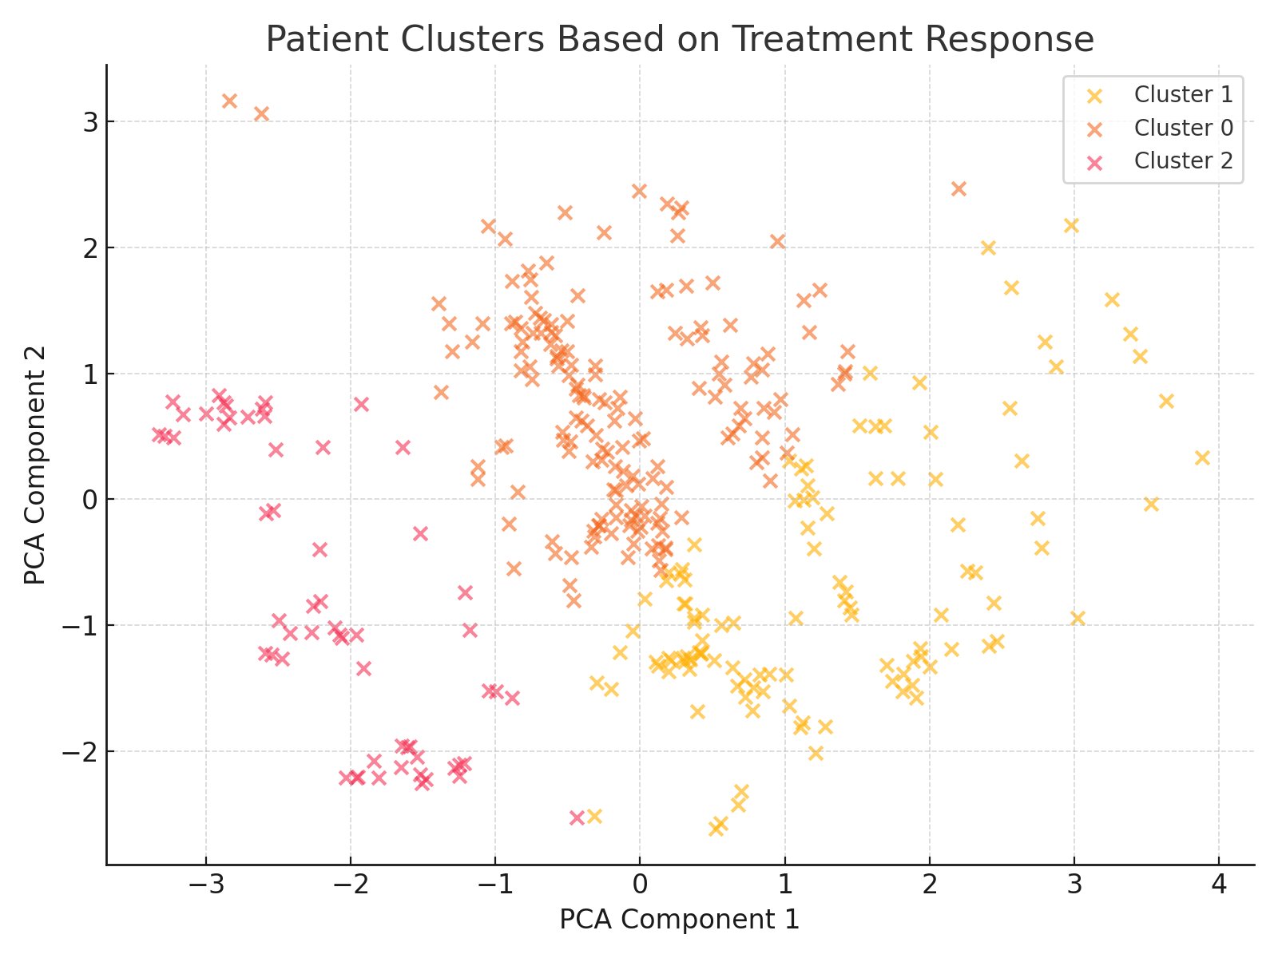
Patient Clusters - PCA Visualization

