Slide 1
Osteoarthritis Treatment Analysis Using Machine Learning
Comprehensive Data Analytics Approach to Healthcare Decision Making
Student: [Your Name]
Course: INSY 8413 - Introduction to Big Data Analytics
Instructor: Eric Maniraguha
Date: July 26, 2025
Institution: Faculty of Information Technology

Slide 2
Agenda
🎯 Project Introduction
- Problem Statement & Objectives
- Dataset Overview
🔬 Methodology
- Data Preprocessing & Clustering
- ML-based Treatment Ranking
📊 Results
- Cluster Summaries
- Treatment Insights
💡 Recommendations & Deployment
🚀 Future Enhancements

Slide 3
Problem Statement & Objectives
"Can we identify patient clusters based on treatment response patterns and rank osteoarthritis treatments by effectiveness using machine learning?"
Project Goals:
✅ Analyze 28 treatment interventions
✅ Apply clustering to segment patients
✅ Rank treatments by outcome
✅ Create decision-support tools

Slide 4
Dataset Summary
📌 Source: Osteoarthritis Clinical Studies
📊 Patients: 341
🔢 Treatments: 28 types
🔍 Key Features:
- `y`: Pain score (lower is better)
- `N`: Sample size
- `time_wk`: Follow-up duration
- `se`: Standard error
🧼 Preprocessing: Missing value removal, outlier detection, standardization

Slide 5
Clustering Methodology
✅ Algorithm: K-Means (k=3)
📈 Metric: Silhouette Score = 0.341
🔢 Features Used: Pain Score, Follow-Up, Sample Size, SE
⚙️ Preprocessing:
- StandardScaler for normalization
- PCA for 2D Visualization

Slide 6
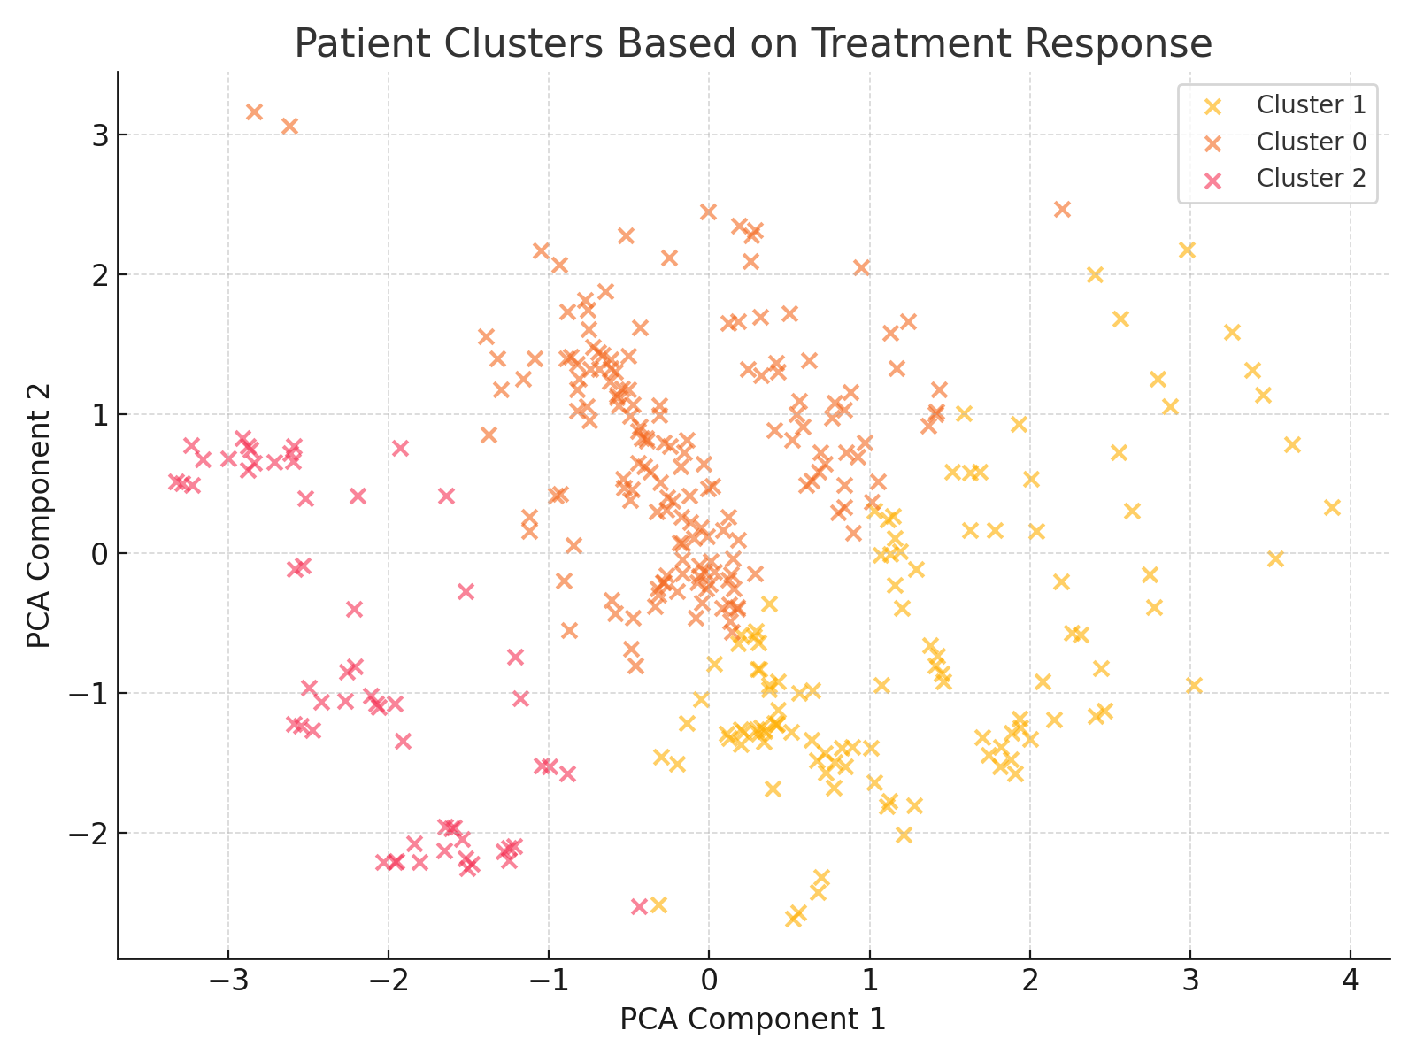
Clustering Results
🧬 Cluster Summary:
🔹 Cluster 0
- Patients: 169
- Avg Pain Score: -0.66
- Follow-up: 0.38 weeks
- Best Treatment: Oxycodone_44
🔹 Cluster 1
- Patients: 113
- Avg Pain Score: 1.09
- Follow-up: -0.68 weeks
- Best Treatment: Duloxetine_90
🔹 Cluster 2
- Patients: 59
- Avg Pain Score: -0.20
- Follow-up: 0.20 weeks
- Best Treatment: Lumiracoxib_400

Slide 7
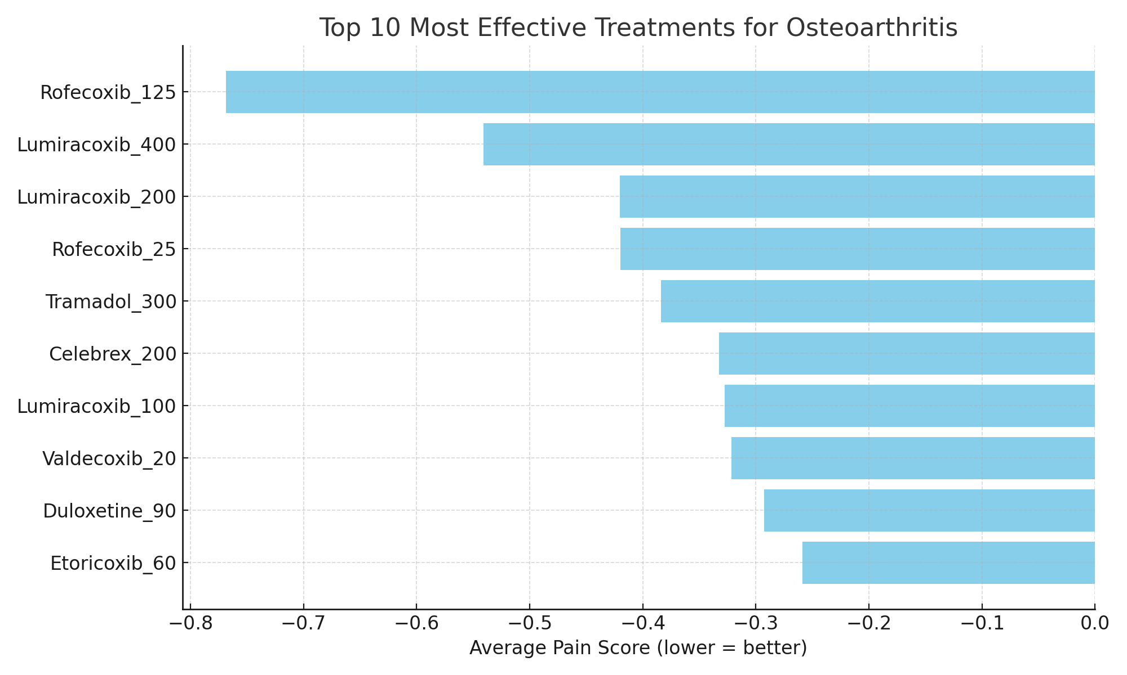
Top 10 Treatment Rankings

Slide 8
Clinical & Administrative Recommendations
🏥 Clinical Recommendations:
1. Use cluster-specific treatment plans
2. Prioritize top-performing treatments
3. Integrate dashboard for decision support
📋 Admin Guidelines:
1. Optimize resource allocation
2. Update clinical protocols
3. Track outcomes using dashboard

Slide 9
Conclusion & Final Thoughts
✅ Analyzed 28 osteoarthritis treatments
✅ Identified 3 patient clusters with distinct responses
✅ Developed a ranking system based on pain reduction
✅ Created visual decision-support tools
"Machine learning enables smarter, data-driven healthcare."

