Slide 1



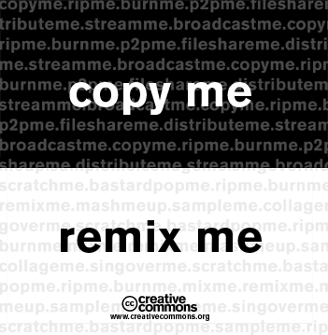



Image Examples: Misc Image Types | PptxGenJS
Type: GIF (animated)
Type: GIF
Type: PNG (base64)
Hyperlink Image
(legacy PPT only animates in slide show)
Type: JPG
Type: PNG
Type: SVG
Notes:
API Docs: https://gitbrent.github.io/PptxGenJS/docs/api-images.html

Slide 2


Image Examples: Image Sizing/Rounding | PptxGenJS
Sizing: Orig `w:6, h:2.7`
Rounding: `rounding:true`
Sizing: `contain, w:3`
Sizing: `cover, w:3, h:2`
Sizing: `crop, w:3, h:2`
Notes:
API Docs: https://gitbrent.github.io/PptxGenJS/docs/api-images.html

Slide 3
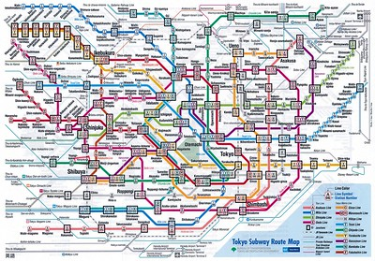
Image Examples: Image Rotation | PptxGenJS
Rotate: `rotate:45`, `rotate:180`, `rotate:315`
Notes:
API Docs: https://gitbrent.github.io/PptxGenJS/docs/api-images.html

Slide 4
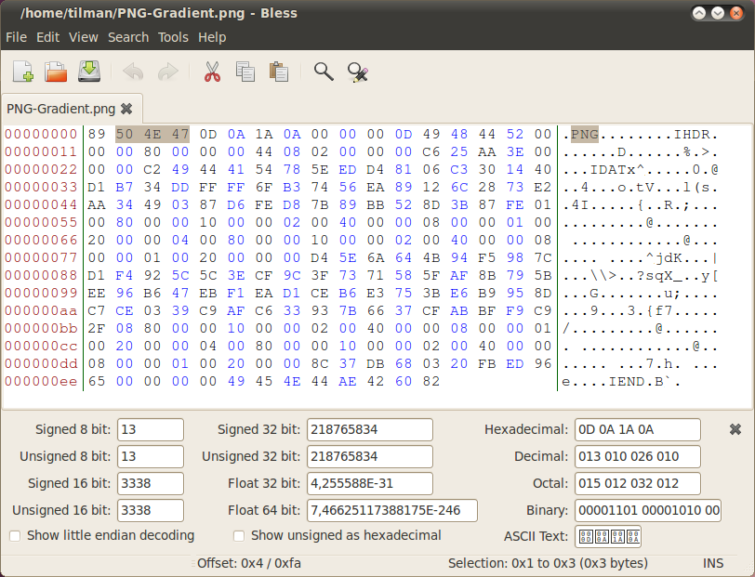
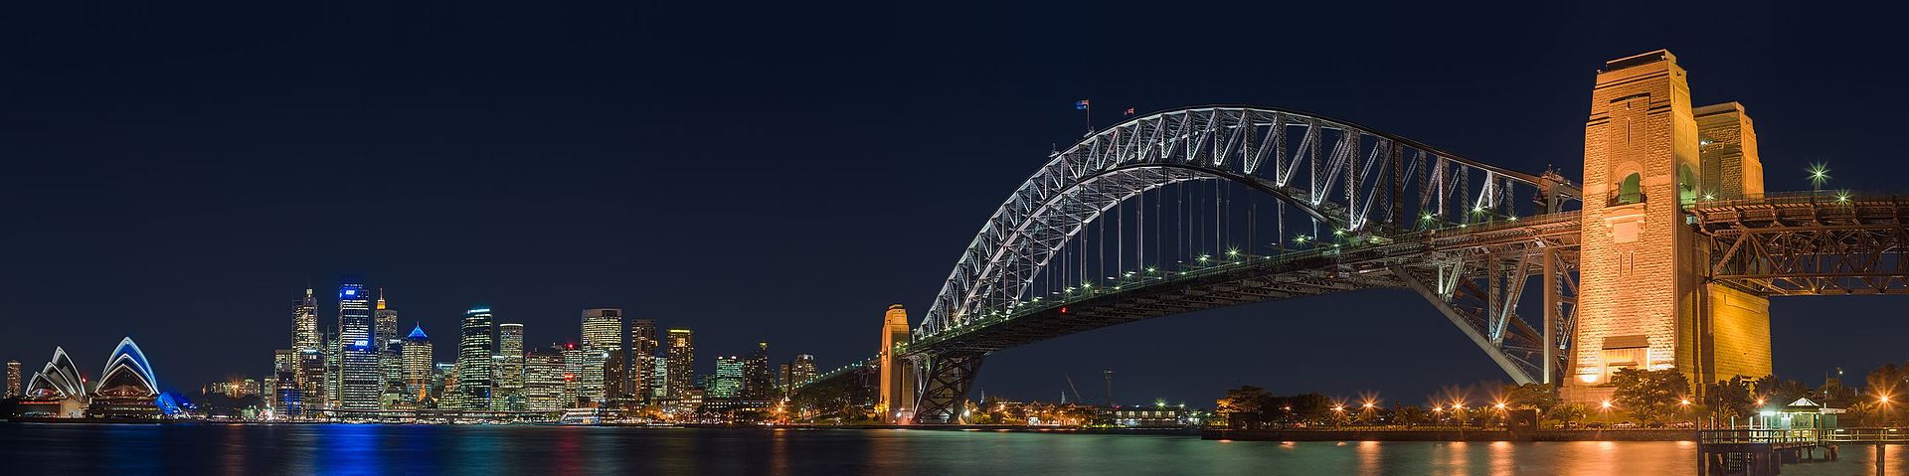
Image Examples: Image URLs | PptxGenJS
path:"https://raw.githubusercontent.com/gitbrent/PptxGenJS/master/demos/common/images/cc_logo.jpg"
path:"https://raw.githubusercontent.com/gitbrent/PptxGenJS/master/demos/common/images/png-gradient-hex.png"
path:"/common/images/cc_license_comp.png"
// Test: URL variables, plus more than one ".jpg"
path:"https://raw.githubusercontent.com/gitbrent/PptxGenJS/master/demos/common/images/sydney_harbour_bridge_night.jpg?op=paramTest&ampersandTest&fileType=.jpg"
Notes:
API Docs: https://gitbrent.github.io/PptxGenJS/docs/api-images.html

