Slide 1






Slide 2
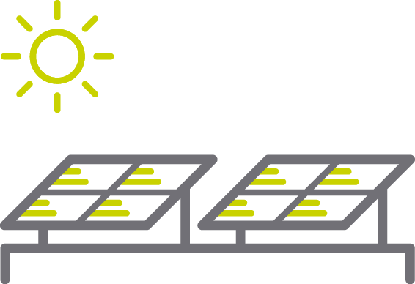
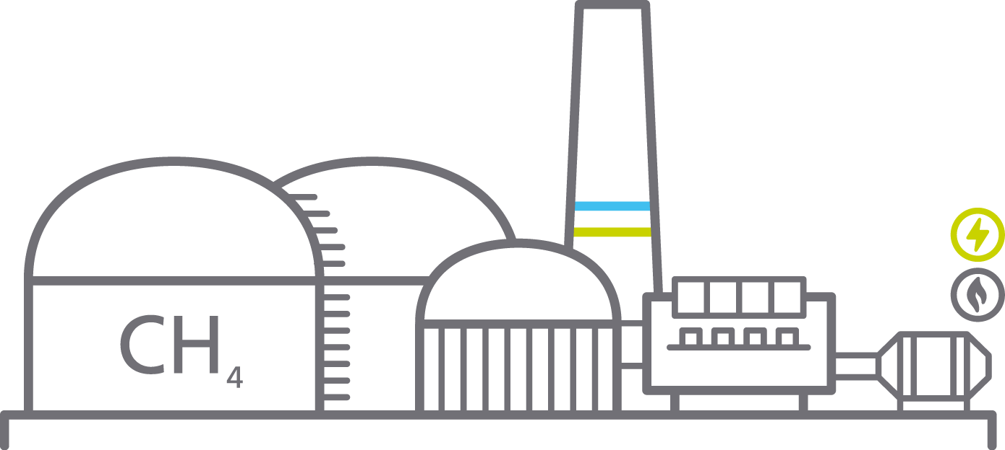



Erneuerbare Energien

Slide 3
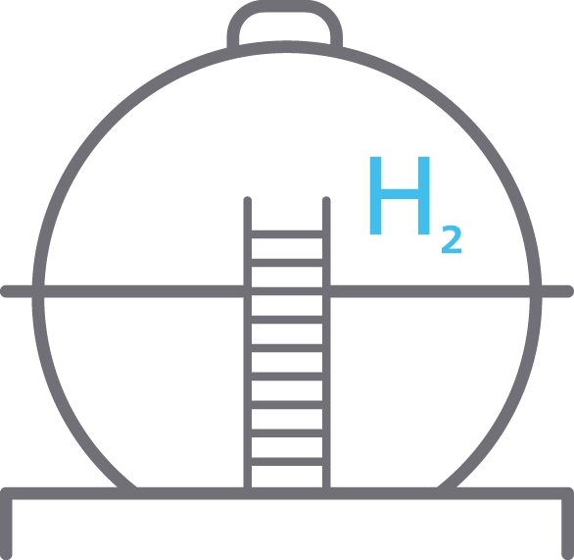

UGS
Decentral
Storage

Slide 4
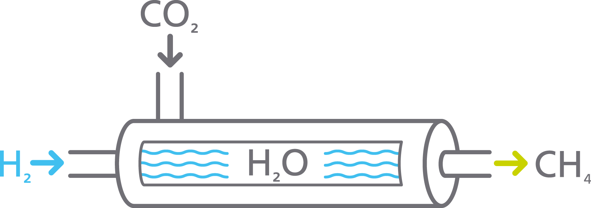
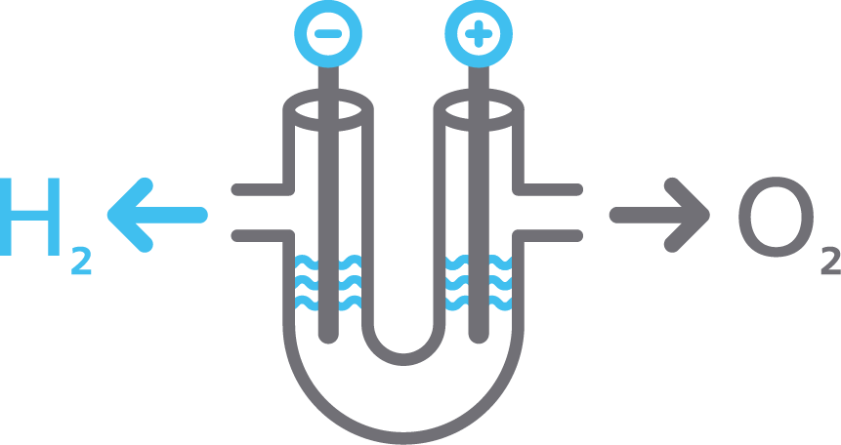
Methanation

Slide 5



Slide 6




Quarters
Mobility
Chem. Industry
Refinery

