Slide 1
Real-Time Currency and Gold Price
Tracker with DevOps Integration

Slide 2
OUTLINE OF PROJECT
Containerized Python application for scraping real-time currency exchange rates and gold prices.
Converts scraped data into USD and stores it for analysis.
Deployed using Docker and orchestrated with Kubernetes.
Utilizes mounted volumes for data persistence across deployments.
Exports key metrics to Prometheus, including exchange rates and scrape times.
Provides real-time visualization and trend analysis via Grafana dashboards.

Slide 3
KEY FEATURES
Web Scraping: Extracts live currency and gold price data from online sources using BeautifulSoup.
Currency Conversion: Converts currency values to USD for comparison across countries.
Data Storage: Stores historical data in a persistent volume to track price changes over time.
Containerization: Uses Docker for consistent deployment across environments.
Kubernetes Orchestration: Manages the deployment, scaling, and operation of containers using Minikube.
Monitoring & Visualization: Prometheus scrapes metrics, and Grafana visualizes currency and gold price trends.

Slide 4
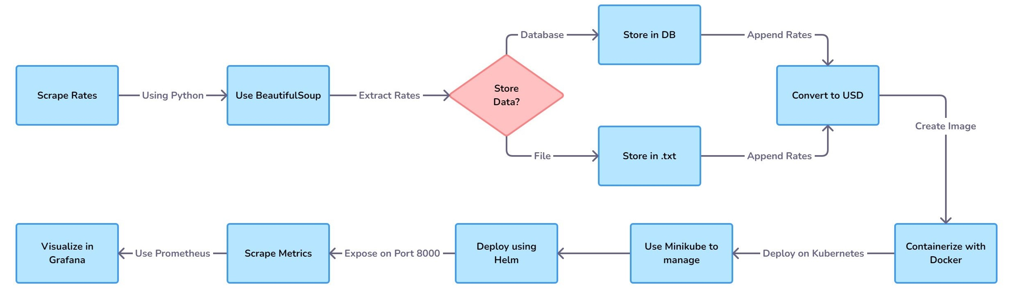
FLOWCHART

Slide 5
TECHSTACK AND USE-CASE
Languages/Tools: Python, Docker, Kubernetes, Prometheus, Grafana
Platform: Docker Desktop, Minikube, PyCharm
Version Control: GitHub (Dev-1775/GoldPriceDevOps)
USE-CASE: Track and visualize real-time gold prices and currency exchange rates to identify trends and insights over time, suitable for financial analysis and investment decisions.

Slide 6
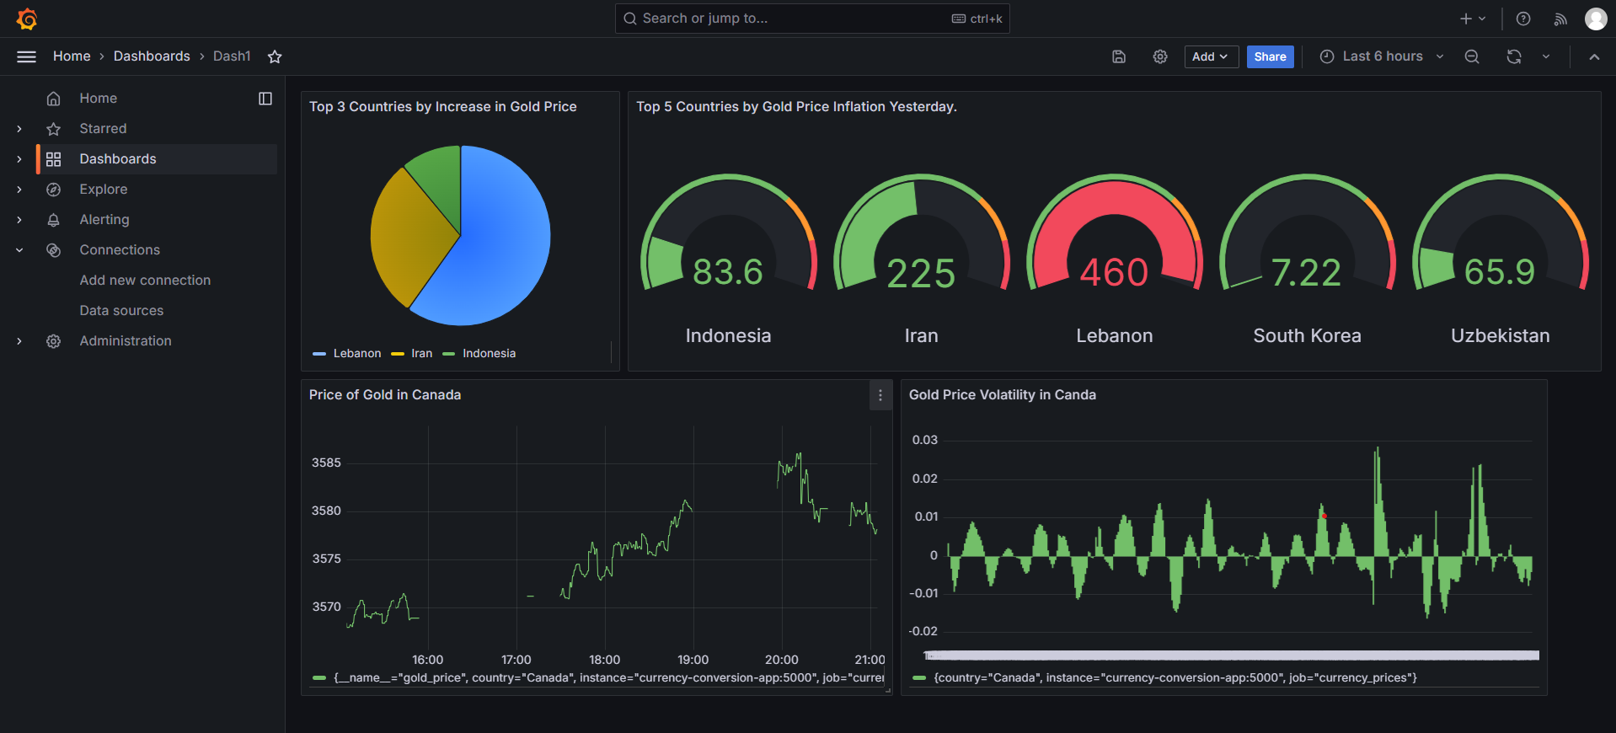
GRAFANA DASHBOARD

Slide 7
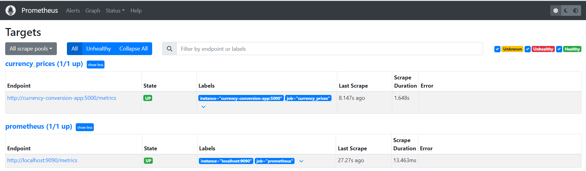
PROMETHEUS PODS

Slide 8
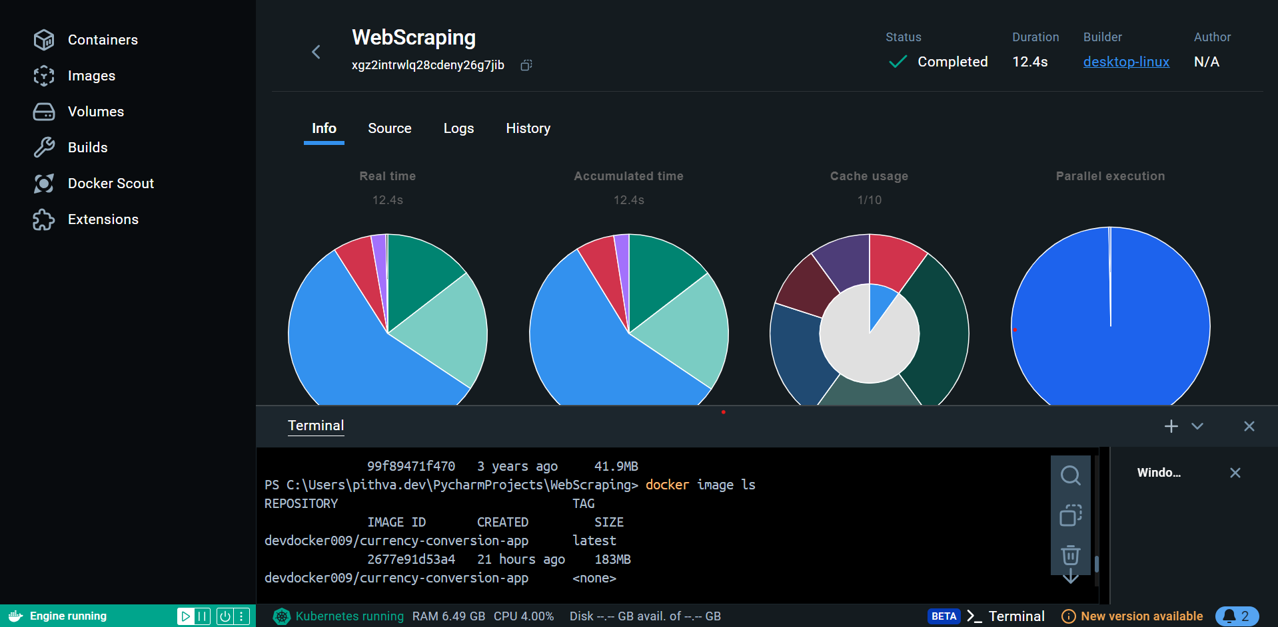
DOCKER DESKTOP

