Slide 1
Pinecone
Introduction

Slide 2
What is pinecone
Pinecone is the vector database for machine learning applications. Build vector-based personalization, ranking, and search systems that are accurate, fast, and scalable. Use simple APIs with zero maintenance.
In this embeddings of documents or content are stored and retrieve embedding by cosine similarity.

Slide 3
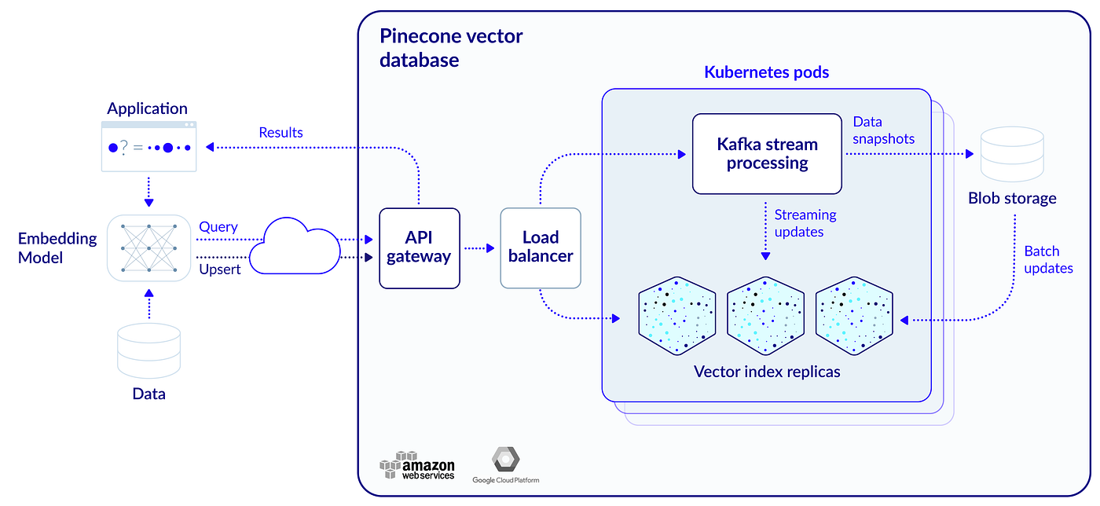
How it work?

Slide 4
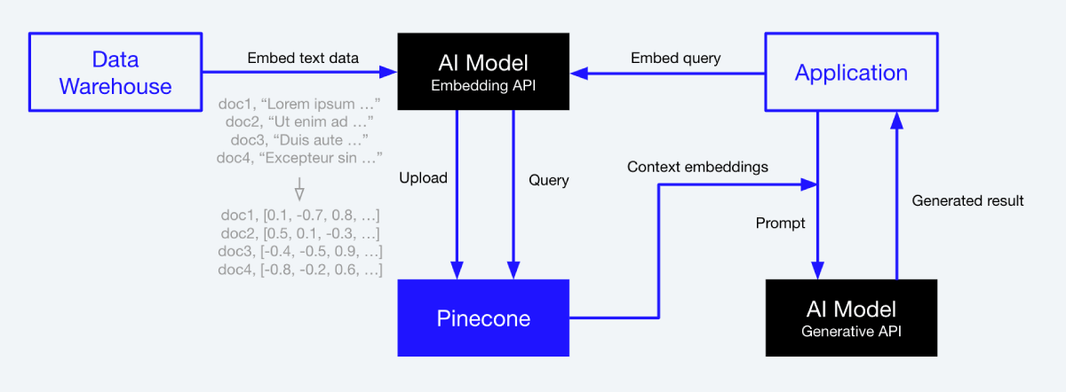
For chatbot

Slide 5
Important llibraries to convert document to embeddings
For langchain:!pip install --upgrade langchain openai -q
For embeddings:!pip install sentence_transformers -q
Other :!pip install unstructured -q
!pip install unstructured[local-inference] -q
!pip install detectron2@git+https://github.com/facebookresearch/detectron2.git@v0.6#egg=detectron2 -q
!apt-get install poppler-utils

Slide 6
Load directory in which are saved in of readable extension
from langchain.document_loaders import DirectoryLoader
directory = '/content/data/'
def load_docs(directory):
loader = DirectoryLoader(directory)
documents = loader.load()
return documents
documents = load_docs(directory)

Slide 7
Split document into chunks
from langchain.text_splitter import RecursiveCharacterTextSplitter
def split_docs(documents,chunk_size=500,chunk_overlap=20):
text_splitter = RecursiveCharacterTextSplitter(chunk_size=chunk_size, chunk_overlap=chunk_overlap)
docs = text_splitter.split_documents(documents)
return docs
docs = split_docs(documents)
print(len(documents))

Slide 8
Embeddings and Initialize Pinecone
pinecone
from langchain.embeddings import SentenceTransformerEmbeddings
embeddings = SentenceTransformerEmbeddings(model_name="all-MiniLM-L6-v2")
import pinecone
from langchain.vectorstores import Pinecone
pinecone.init(
api_key="0f0a35be-e8ea-4068-9876-0017b4e4c2cb",
environment="us-west1-gcp-free"
)
index_name = "longchain-chatbot"
index = Pinecone.from_documents(docs, embeddings, index_name=index_name)

Slide 9
Search query in vector DB
query = "famous places in Los Angeles?"
query_result = embeddings.embed_query(query)
index.query(query_result, top_k=4, include_metadata=True)
In this we can see that query is written then query is converted into embeddings now index.query will search nearest or similar embeddings related to query.

Slide 10
Thank You

