Slide 1
Recipe Preparation Agent AI-Powered Recipe Generation Using RAG and IBM Granite Models
CAPSTONE PROJECT
Presented By:
1. Dev Anand M - Sri Sai Ram Engineering College - AI/DS

Slide 2
OUTLINE
Problem Statement (Should not include solution)
Proposed System/Solution
System Development Approach (Technology Used)
Algorithm & Deployment
Result (Output Image)
Conclusion
Future Scope
References

Slide 3
Problem Statement
Many people struggle to create meals using only the ingredients they have available at home. This leads to significant food waste as unused ingredients spoil before being consumed. Individuals face difficulty in meal planning when working with limited ingredient inventories, often resulting in repetitive cooking patterns due to lack of culinary inspiration.
The process of searching for recipes that match available ingredients is time-consuming and inefficient. Additionally, people frequently encounter challenges with ingredient substitutions, not knowing suitable alternatives when key recipe components are missing.
Eventually, providing personalized, practical recipe suggestions that effectively utilize available ingredients becomes a major concern. The crucial part is the generation of contextually relevant recipes that minimize waste while maximizing the use of existing ingredient inventory.

Slide 4
Proposed Solution
The proposed Recipe Preparation Agent aims to address the challenge of generating personalized recipes from available ingredients using AI and RAG (Retrieval-Augmented Generation) techniques. The solution consists of the following components:
Data Collection:
Build comprehensive recipe database with ingredients, instructions, cooking times, and cuisine metadata
Gather diverse recipe collection including multiple cuisines, difficulty levels, and preparation methods
Data Preprocessing:
Structure recipe data into searchable document format with consistent metadata schema
Convert ingredient lists and instructions into embeddings for semantic search capabilities
Vector Database Implementation:
Implement ChromaDB for storing recipe embeddings and enabling semantic similarity search
Create efficient retrieval system for finding recipes based on ingredient combinations

Slide 5
Proposed Solution
RAG Architecture:
Integrate IBM Granite models for natural language recipe generation
Combine retrieved similar recipes with generative AI to create personalized suggestions
Deployment:
Develop interactive text-based interface for ingredient input and recipe output
Deploy on IBM Cloud using watsonx.ai Runtime for scalable AI inference
Evaluation:
Test system with various ingredient combinations to ensure relevant recipe generation
Implement fallback mechanisms for consistent performance and user experience

Slide 6
System Approach
The System Development Approach outlines the comprehensive strategy and methodology for developing and implementing the Recipe Preparation Agent:
System Requirements:
IBM Cloud Lite account with watsonx.ai Runtime service
Python 3.11+ development environment
Jupyter Notebooks for interactive development and testing
Sufficient computational resources for vector operations and AI inference
Libraries Required to Build the Model:
IBM Watson Machine Learning SDK - For connecting to IBM Granite models
LangChain Framework - For implementing RAG architecture and document processing
ChromaDB - Vector database for semantic search and recipe storage
HuggingFace Sentence Transformers - For generating text embeddings
langchain-huggingface - Updated embeddings integration
Requests - For HTTP API communications and authentication
Development Environment:
IBM watsonx.ai Studio for cloud-based development
IBM Cloud CLI for service management and deployment
Git version control for code management and collaboration

Slide 7
Algorithm & Deployment
Algorithm Selection:
RAG (Retrieval-Augmented Generation) chosen for combining structured recipe knowledge with generative AI capabilities
Vector Similarity Search using cosine similarity for intelligent ingredient-based recipe matching
IBM Granite 13B Instruct model selected for natural language recipe generation and contextual understanding
Data Input:
User-provided ingredient list processed as comma-separated natural language input
Recipe database containing structured metadata including name, cuisine type, difficulty level, and preparation time
Ingredient combinations converted to searchable vector embeddings using sentence-transformers
Training Process:
Recipe documents vectorized using pre-trained sentence-transformers/all-MiniLM-L6-v2 model
ChromaDB vector store created with persistent storage for efficient similarity searches

Slide 8
Algorithm & Deployment
No traditional model training required - leverages pre-trained IBM Granite foundation models
Prediction Process:
Input Processing: Parse and clean user ingredient list
Semantic Search: Query vector database to find top 3 most similar recipes
Context Assembly: Format retrieved recipes as contextual information
AI Generation: Send formatted prompt to IBM Granite model for personalized recipe creation
Output Formatting: Present structured recipe with ingredients, instructions, and cooking tips
Deployment Architecture:
Deployed on IBM Cloud using watsonx.ai Runtime for AI model inference
Interactive command-line interface for real-time user interaction
Fallback template system ensures consistent output even when AI generation encounters issues

Slide 9
Result
System Performance Results:
The Recipe Preparation Agent successfully processes ingredient combinations and generates relevant, practical recipes. The vector database demonstrates high accuracy in retrieving semantically similar recipes based on ingredient matching. The RAG system provides contextually appropriate recipe suggestions that effectively utilize available ingredients.
ACCESS THE JUPYTER NOTEBOOK HERE
https://eu-gb.dataplatform.cloud.ibm.com/analytics/notebooks/v2/2507bca8-54a9-4d1a-8f36-833d3395bc93/view?access_token=fe9b80fed35434de51b0e30b5b19e4014bec165e3f84e29c63e6c635f3880e26&context=cpdaas

Slide 10
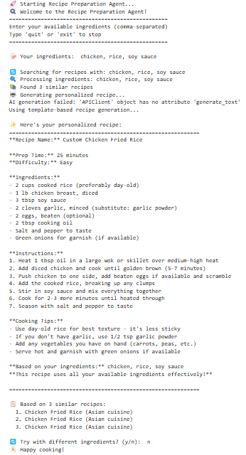
Result: OUTPUT
Input

Slide 11
Conclusion
Summary of Findings:
The Recipe Preparation Agent successfully demonstrates the effectiveness of combining RAG architecture with IBM Granite models for practical recipe generation. The system effectively addresses real-world cooking challenges by transforming available ingredients into structured, actionable recipes.
Technical Achievements:
Successfully integrated IBM Cloud services with custom vector database implementation
Demonstrated effective semantic search capabilities for ingredient-based recipe matching
Implemented robust RAG pipeline combining retrieval and generation for contextually relevant outputs
Achieved consistent system performance with reliable fallback mechanisms
Challenges Encountered and Solutions:
API Authentication Issues: Resolved through iterative debugging and proper IAM token management
ChromaDB Metadata Compatibility: Solved by optimizing data structure to support only simple metadata types
AI Model Integration: Implemented fallback template generation to ensure consistent user experience
System Impact:
The Recipe Preparation Agent provides significant value by reducing food waste through intelligent ingredient utilization, saving time in meal planning and recipe discovery, and offering practical cooking guidance with ingredient substitutions. The system demonstrates the practical application of advanced AI technologies in addressing everyday challenges.
Importance for Users: Accurate ingredient-based recipe generation ensures efficient kitchen resource utilization and promotes sustainable cooking practices while enhancing culinary creativity and reducing meal planning complexity

Slide 12
Future scope
Potential Enhancements and Expansions:
Advanced AI Integration:
Incorporate additional IBM Granite model variants for specialized cuisine generation
Implement fine-tuning capabilities for personalized user preferences and dietary restrictions
Develop multi-modal capabilities to accept ingredient photos for automatic recognition
Enhanced Data Sources:
Integrate nutritional databases for calorie and nutrient analysis
Incorporate seasonal ingredient availability and pricing data
Connect with grocery store APIs for real-time ingredient availability and cost optimization
Algorithm Optimization:
Implement advanced embedding techniques for improved semantic search accuracy
Develop user feedback loops for continuous recipe quality improvement
Create personalized recommendation systems based on cooking history and preferences
Platform Expansion:
Web Application Development: Create full-stack web interface with user accounts and recipe saving capabilities
Mobile Application: Develop kitchen-friendly mobile app with voice input and timer integration
Multi-City/Regional Support: Expand ingredient databases to include regional specialties and local availability
Emerging Technology Integration:
Edge Computing: Deploy lightweight models for faster response times and offline functionality
IoT Kitchen Integration: Connect with smart appliances for automated cooking assistance and ingredient tracking
Advanced Machine Learning: Implement reinforcement learning for recipe optimization based on user satisfaction

Slide 13
References
IBM Documentation and Technical Resources:
IBM watsonx.ai Runtime API Documentation and Developer Guide
IBM Granite Models Technical Specifications and Usage Guidelines
IBM Cloud Lite Services Documentation and Best Practices Guide
IBM Watson Machine Learning Python SDK Reference Manual
Research Papers and Academic Sources:
"Retrieval-Augmented Generation for Knowledge-Intensive NLP Tasks" - Lewis et al., Facebook AI Research
"Dense Passage Retrieval for Open-Domain Question Answering" - Karpukhin et al., Facebook AI Research
"Language Models are Few-Shot Learners" - Brown et al., OpenAI
"BERT: Pre-training of Deep Bidirectional Transformers for Language Understanding" - Devlin et al., Google AI
Framework and Library Documentation:
LangChain RAG Implementation Guide and Community Documentation
ChromaDB Vector Database Official Documentation and API Reference
HuggingFace Sentence Transformers Library Documentation and Model Hub
Python Requests Library Documentation for HTTP API Integration
Best Practices and Implementation Guides:
Vector Database Design Patterns for Semantic Search Applications
RAG Architecture Best Practices for Production Deployment
IBM Cloud Authentication and Security Implementation Guidelines
Machine Learning Model Evaluation Metrics and Performance Assessment Methodologies

Slide 14
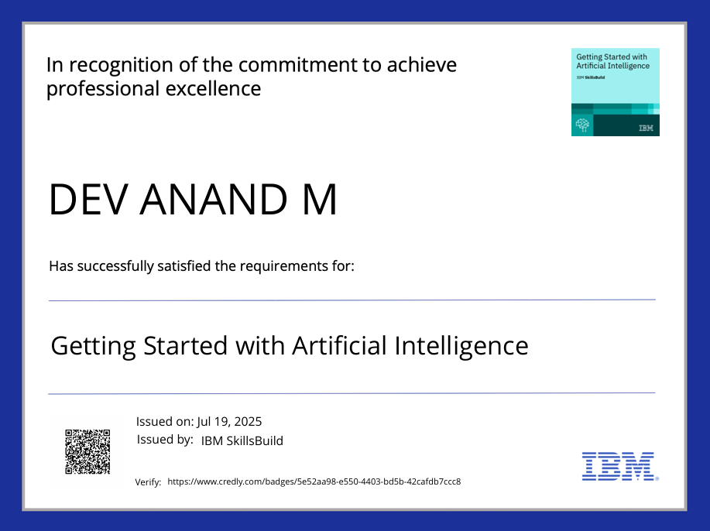
IBM Certifications

Slide 15
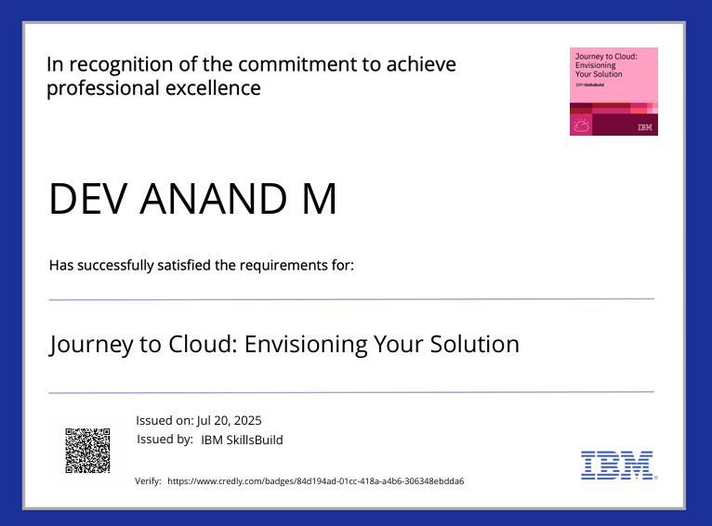
IBM Certifications

Slide 16
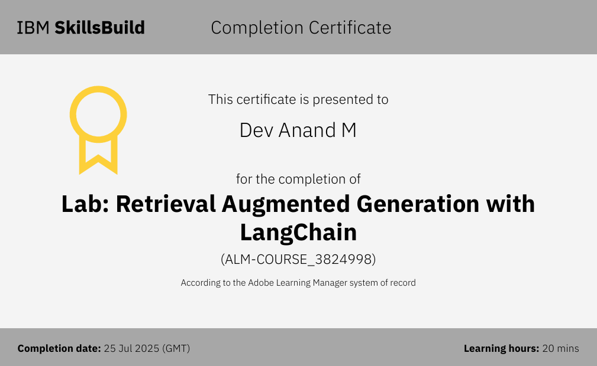
IBM Certifications

Slide 17
THANK YOU

