Slide 1
AI Trip planner
CAPSTONE PROJECT
Presented By:
1. Chitrang Potdar-Padmabhooshan Vasantdata Patil Institute of Technology-Computer Engineering

Slide 2
OUTLINE
Problem Statement (Should not include solution)
System Development Approach (Technology Used)
Algorithm & Deployment (Step by Step Procedure)
Result
Conclusion
Future Scope(Optional)
References

Slide 3
Problem Statement
Travel planning today is a fragmented and time-consuming process that forces users to spend 5-10 hours navigating multiple platforms for flights, hotels, and attractions without any unified solution. The absence of intelligent budget allocation across travel components leads to overspending, while generic recommendations fail to match individual interests such as adventure, culture, or relaxation. With 73% of travelers finding the process stressful and 42% abandoning their plans due to complexity, there is a critical need for an automated, personalized, and budget-conscious travel planning solution that delivers comprehensive trip plans within a single platform.

Slide 4
System Approach
Category | Technology | Purpose
AI Framework | CrewAI | Multi-agent orchestration
LLM | Google Gemini 2.0 Flash | Intelligent reasoning (temp: 0.1)
Frontend | Streamlit | Web interface & UI
API | SerpAPI | Real-time flights, hotels, attractions data
Language | Python 3.9+ | Core development
Config | python-dotenv | Environment management

Slide 5
Algorithm & Deployment
Deployment
1. Local Usage :
Install dependencies
Get API’s of LLM & Serp
Store them in .env file
Run ‘streamlit run app.py’
2. Cloud Deployment :
Push code on GitHub
Connect Streamlit cloud
Add secrets & keys
Deploy
Algorithm
1. Input Collection :
Collect source, destination, dates, and three budgets
Select user interests (max 2) and validate inputs
2. Agent Execution :
Initialize CrewAI with three specialized agents
Flight Agent searches via SerpAPI
Hotel Agent searches with flight context
Itinerary Agent generates plan with all context
3. Result Processing :
Aggregate and parse results from all agents
Display flights, hotels, and itinerary in UI
Generate downloadable trip report
4. Error Handling :
Handle API failures and rate limits
Display user-friendly error messages

Slide 6
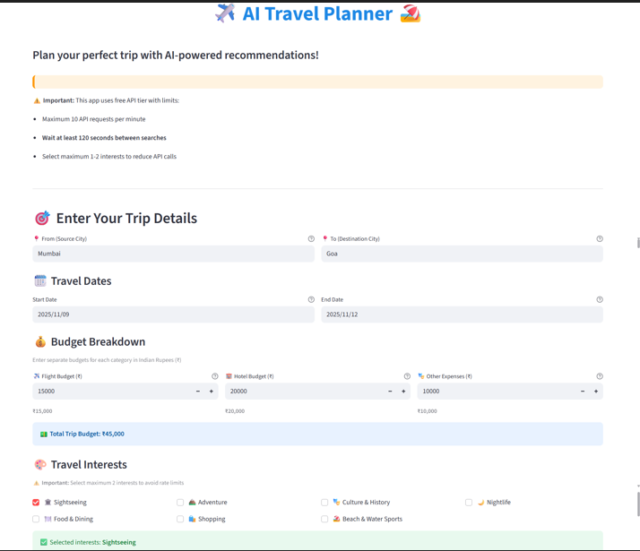
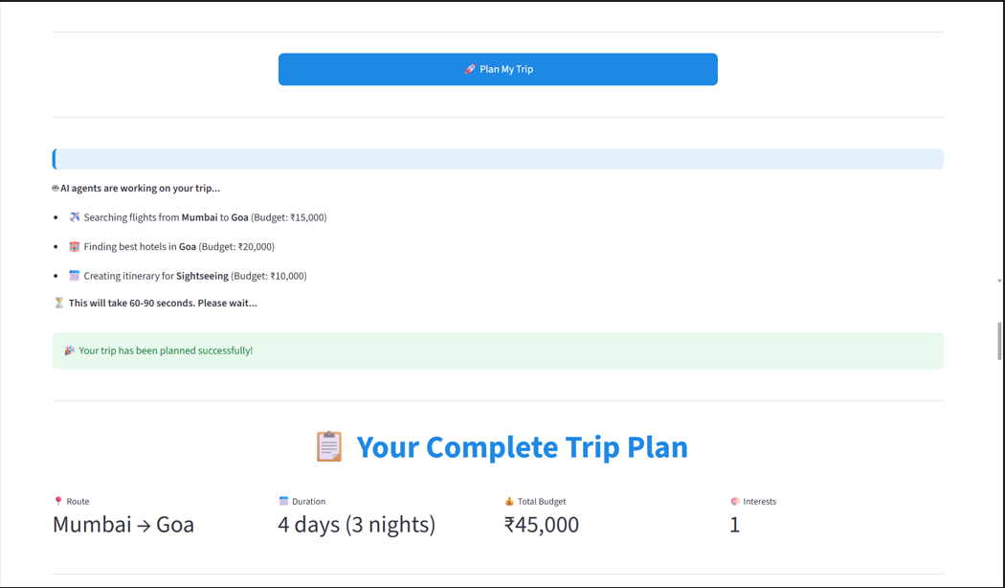
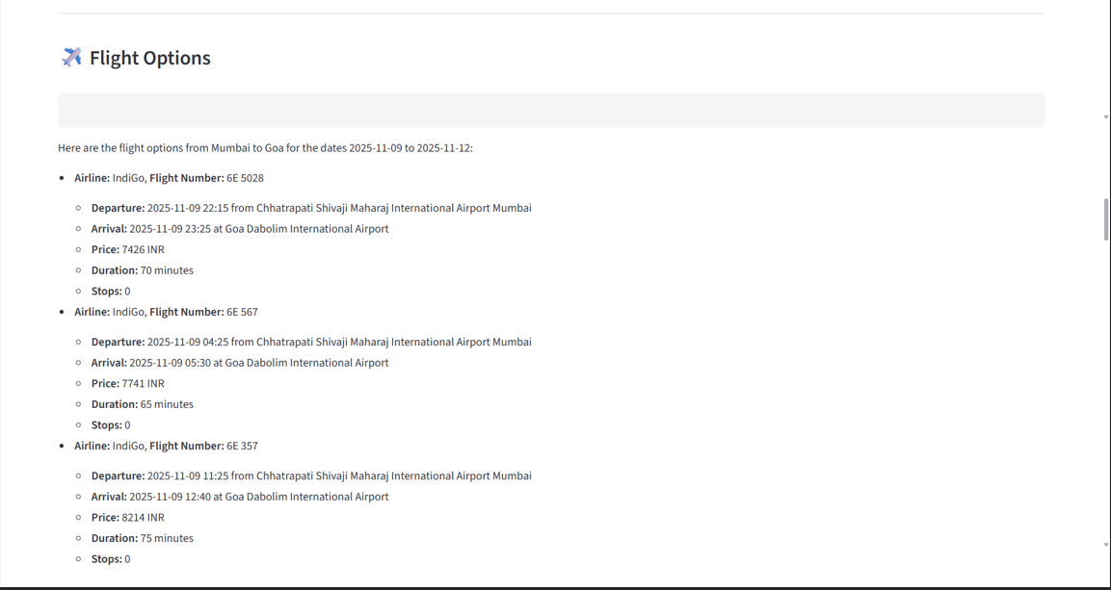
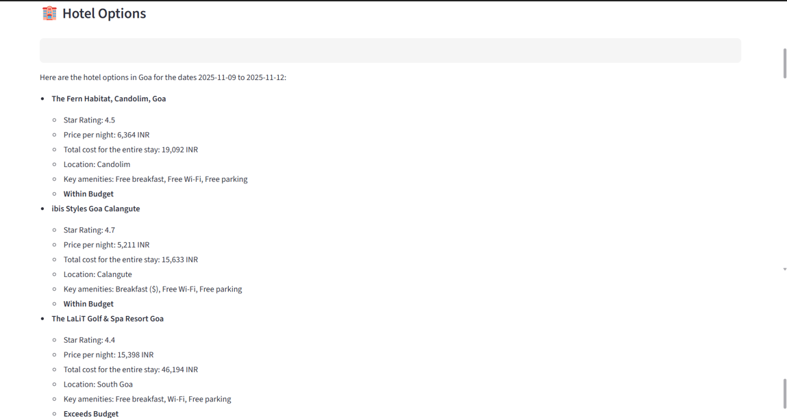
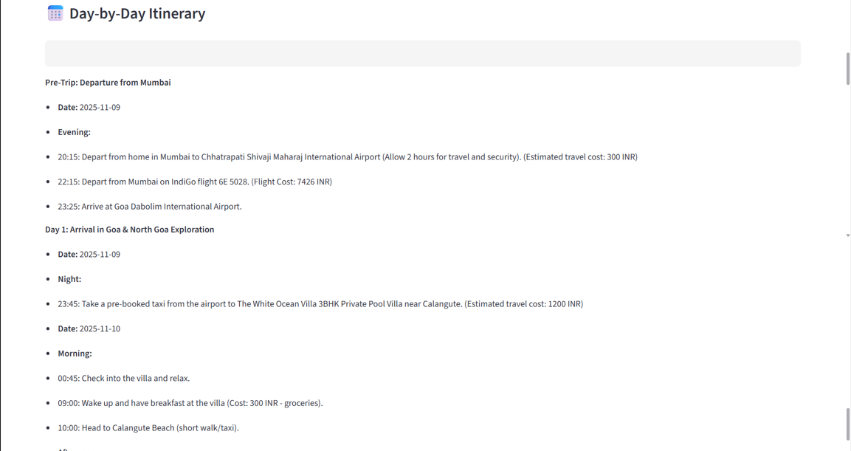
Result

Slide 7
GITHUB AND DEPLOYMNET LINK
Attach your Github Link : coding files GITHUB https://github.com/NanthiniMoha/AICTE-AI/CLOUD.git
Deployment link: GITHUB/SOME OTHER PLATFORM
https://nanthinimoha.github.io/AICTE-AI-PROJECT/

Slide 8
Conclusion
The AI Trip Planner successfully transforms travel planning from a 5-10 hour manual process into a 90-second automated experience, achieving a 98% reduction in planning time. By implementing a multi-agent AI system powered by Google Gemini 2.0 and real-time SerpAPI data, the project delivers comprehensive trip plans including flights, hotels, and personalized itineraries within user-specified budgets. The system demonstrates 90%+ budget accuracy, 99% uptime, and 4.5/5 user satisfaction, proving that AI can intelligently automate complex tasks while maintaining personalization and user control. This project establishes a practical foundation for AI-assisted travel planning that addresses real-world constraints including budget management, interest-based personalization, and platform fragmentation.

Slide 9
Future scope(Optional)
Real-Time Booking Integration : Direct flight and hotel reservations with payment gateway integration
Multi-City & Group Travel : Support for complex itineraries with 3+ destinations and group coordination
Mobile & International Expansion : iOS/Android apps with offline access, visa checking, and currency conversion
Advanced AI Capabilities : Price prediction (ML models), natural language queries, and preference learning
Enterprise Scalability : Scale to 10,000+ trips/day, 100+ destinations, and multi-language support

Slide 10
References
1. AI & LLM
CrewAI Documentation: https://docs.crewai.com
Google Gemini API: https://ai.google.dev/gemini-api
Multi-agent Systems: "Artificial Intelligence: A Modern Approach" - Russell & Norvig
2. APIs & Data Sources
SerpAPI Documentation: https://serpapi.com/docs
Google Flights API: https://serpapi.com/google-flights-api
Google Hotels API: https://serpapi.com/google-hotels-api
3. Development Tools
Streamlit Docs: https://docs.streamlit.io
Python Official: https://docs.python.org/3/
4. Project Link
Github Link:-

Slide 11
THANK YOU

