Slide 1
PROJECT: EVENT CALENDAR
Name: myEvent Calendar

Slide 2
Event Calendar?
An event calendar is a design pattern that allows the user to select a date.
The dates are not presented as a traditional list that a user scrolls through, or as input fields where the user enters numbers, but rather as a visual representation of a monthly calendar.
This makes the process for selecting a date faster.

Slide 3
PURPOSE
Allows user to create events.
Allows user to view events.
Allows user to update added events.
Allows user to delete events.
Alert user when the event occurs.

Slide 4
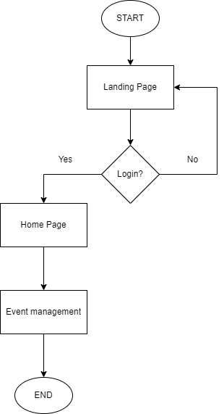
Fig: Flowchart of Event Calendar

Slide 5
EXPEXTED OUTCOME
Users can view the site without being logged in.
Users are allowed to manage events only after they login. They can create, read, update and delete their events.
Event alert will be sent to users through email.

