Slide 1
Customer Survey

Slide 2
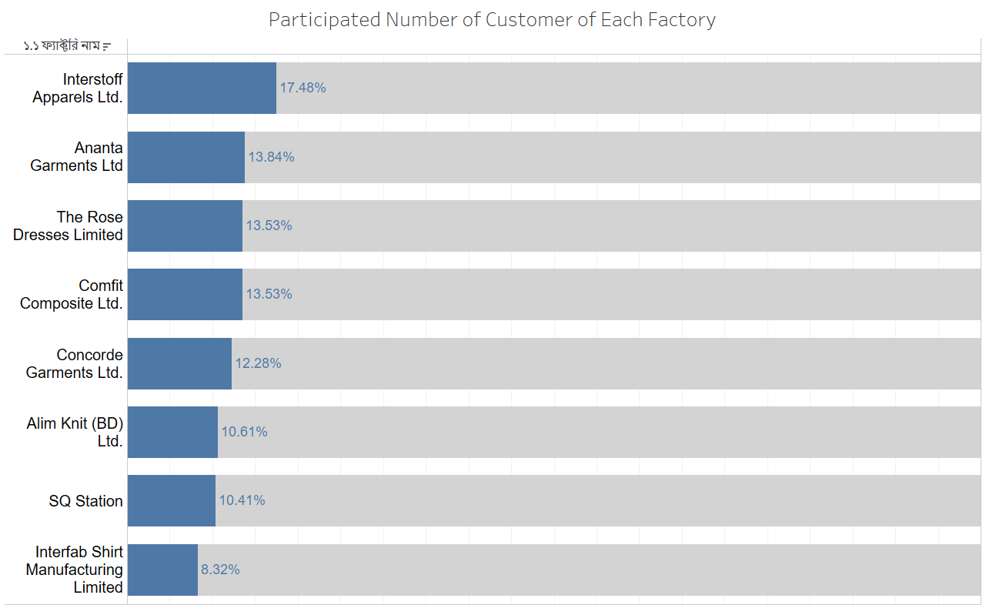
Contribution of People
Let's dive into the data first for a better understanding of the concept.
We have eight factories with diverse participants.
In this presentation, we will examine their choices and preferences regarding Apon Bazar. Without further delay, let's embark on the journey of exploring customer preferences

Slide 3
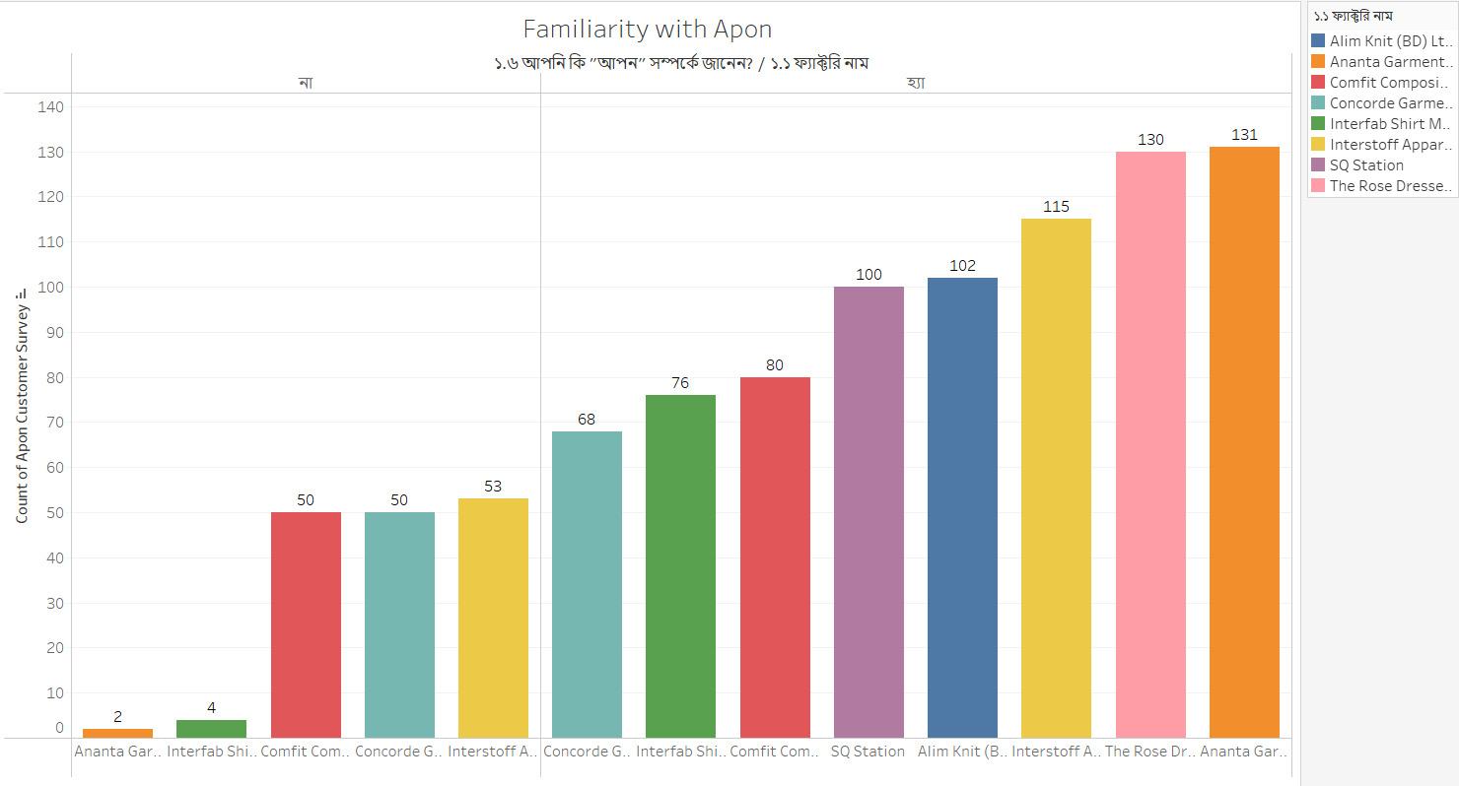
Familiarity
Firstly, we aim to assess the participants' familiarity with Apon Bazar.
To gauge their awareness, we will utilize a chart to distinguish those who are acquainted with us and those who are not. Upon reviewing data from each factory, it is evident that the majority of individuals from Ananta Garments are aware of Apon Bazar.
Conversely, the highest number of participants without knowledge about Apon Bazar comes from Interestoff Garments

Slide 4
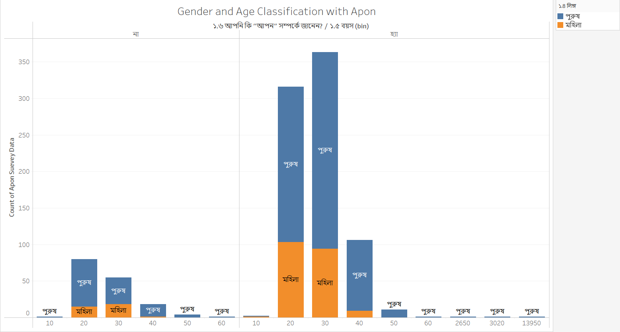
Gender with Ages
Now, let's explore the ratio of gender and ages among those who are familiar with Apon Bazar. In this section, we aim to interpret the knowledge levels of each participant based on their gender and age.
Upon reviewing the chart, it becomes evident that males in the age range of 20-30 possess a better understanding of Apon Bazar

Slide 5
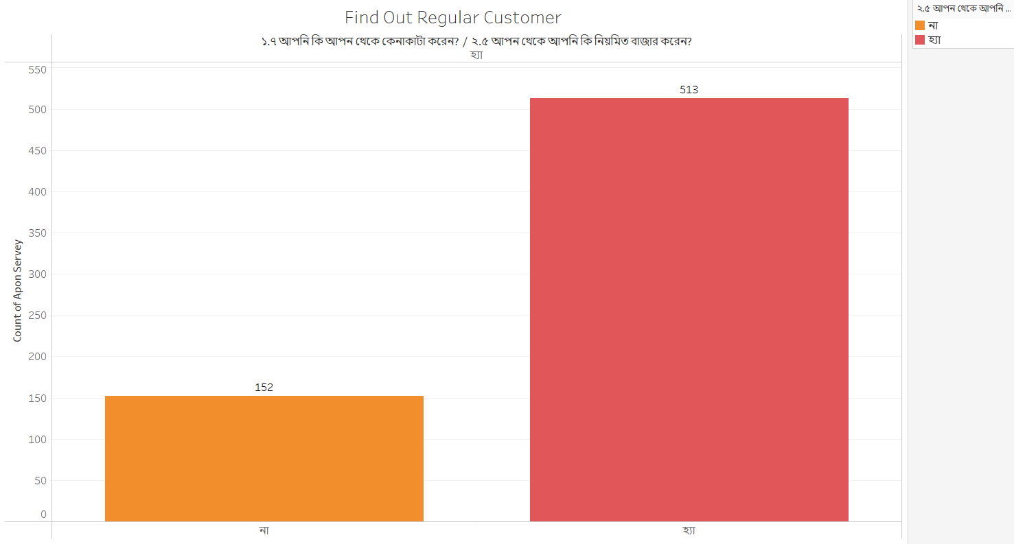
Conditional Statement
Checking amount of percentage where people buy product regularly and irregularly.

Slide 6
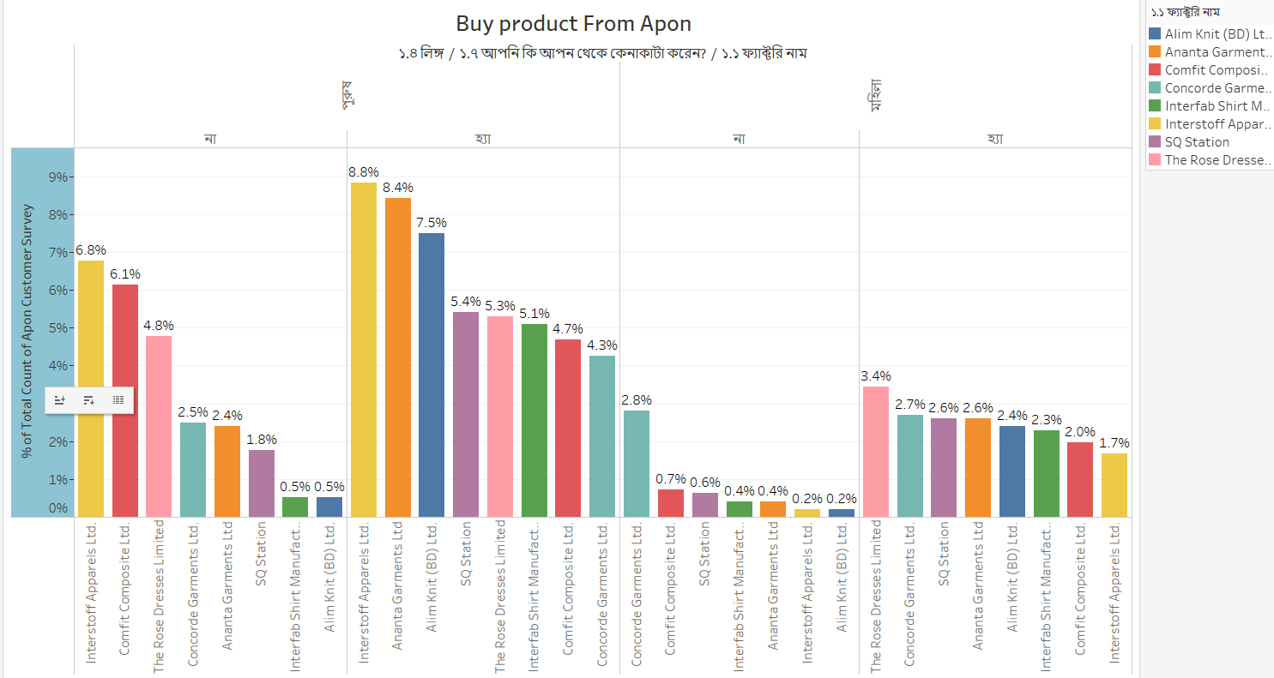
Buying Percentage
We have already gathered information on familiarity, contribution, and various other parameters. Now, let's shift our focus to the chart depicting individuals from different factories who have experience buying products from Apon Bazar.
In this analysis, we aim to concentrate on specific factories and genders where efforts can be maximized to enhance sales and promote familiarity with Apon Bazar.

Slide 7
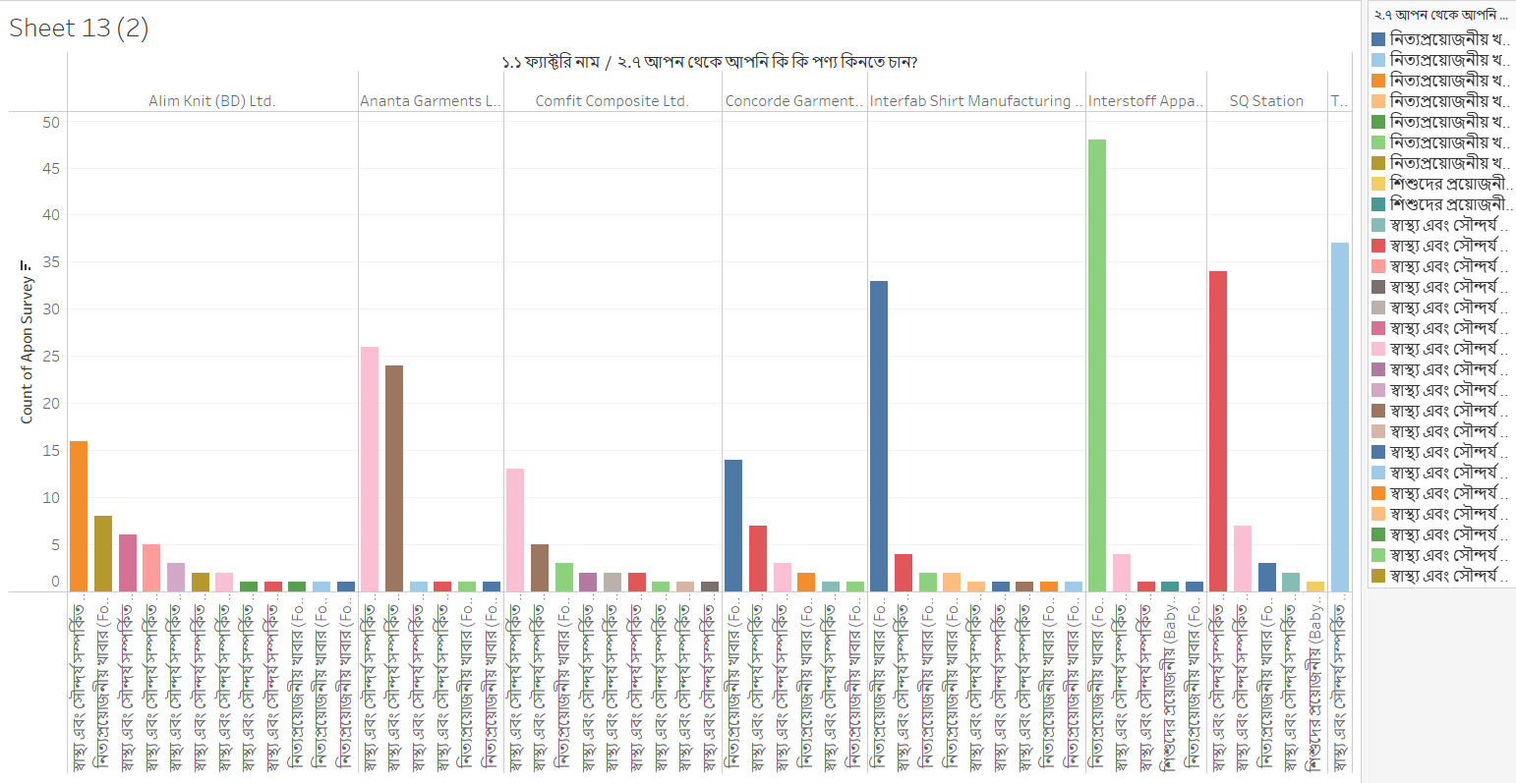
Types of Product
Find out which area of Apon Branch need which types of Product based on their customer preferences.

Slide 8
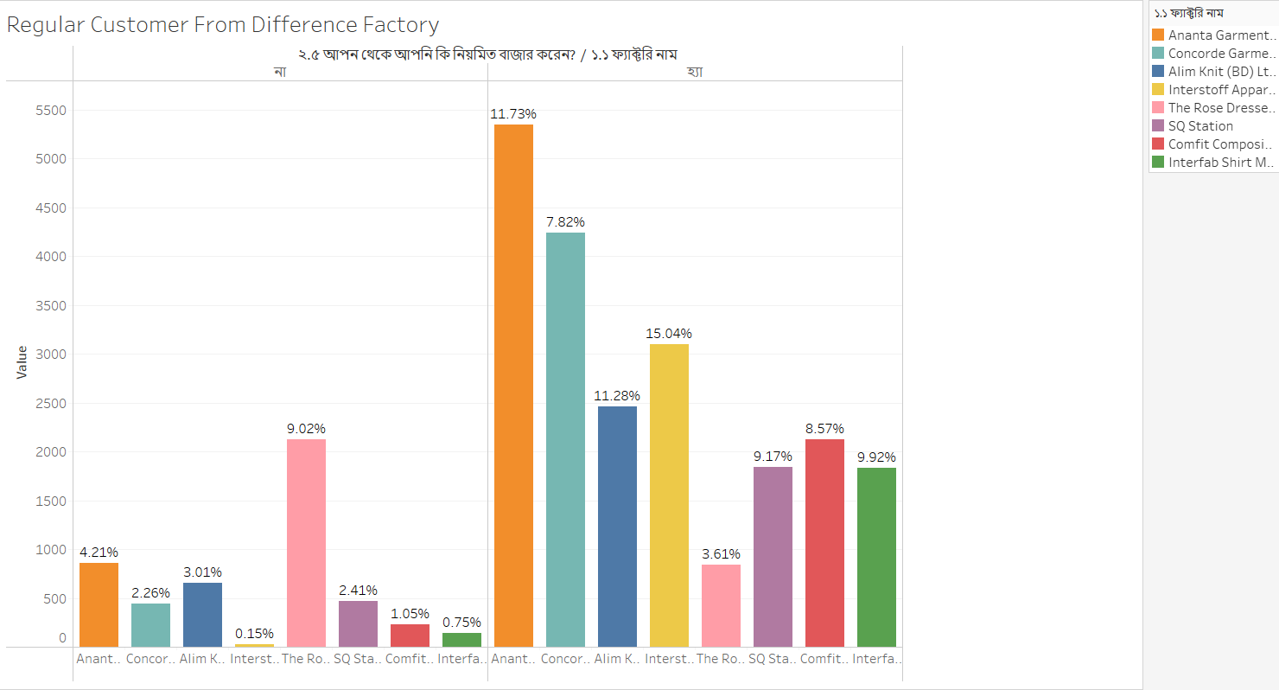
Regularity on Buying Product
Catch out the garments where Apon Bazar doing very well based on their regular product sells

Slide 9
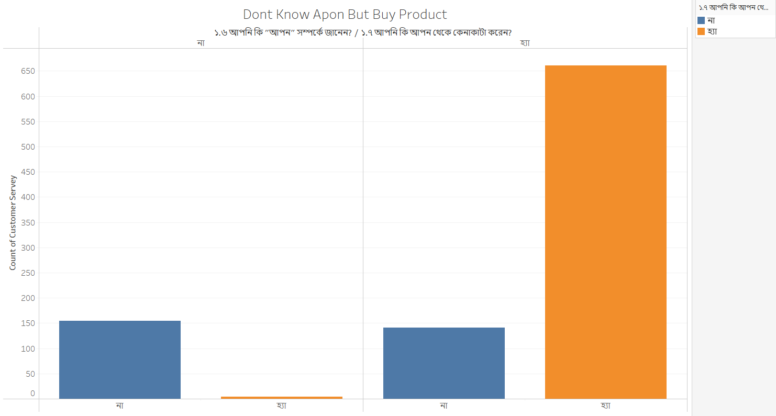
Interesting Finding
Feeling a bit monotonous, isn't it? Interestingly, I've come across a noteworthy observation. While many customers are aware of Apon Bazar, some choose not to make a purchase.
On the flip side, there are those who both know about it and make purchases. Surprisingly, there are also individuals who, despite making a purchase, are not acquainted with Apon Bazar. Quite a mix of customer behaviors, wouldn't you say

Slide 10
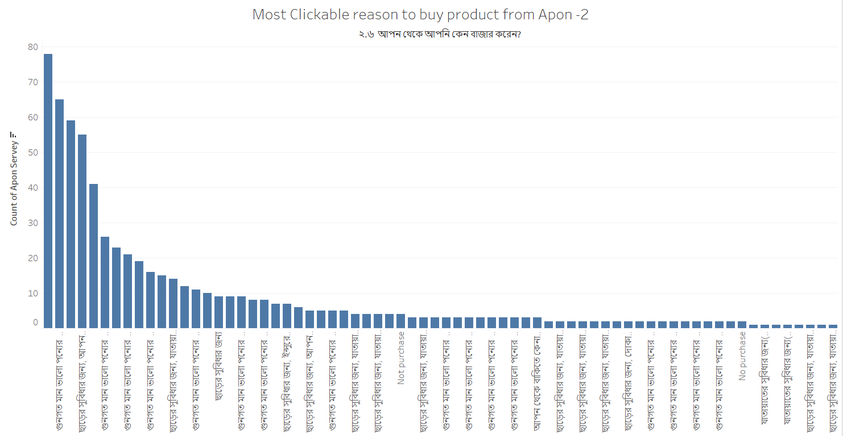
Advantage-1
As we conclude our examination of various criteria, let's delve into the reasons why people choose to buy products from Apon Shop.
And what's the winning combination? Well, you guessed it right – the magic lies in the combination of discounts and quality. These factors emerge as the key drivers for securing sales in the competitive markets of the factories.

Slide 11
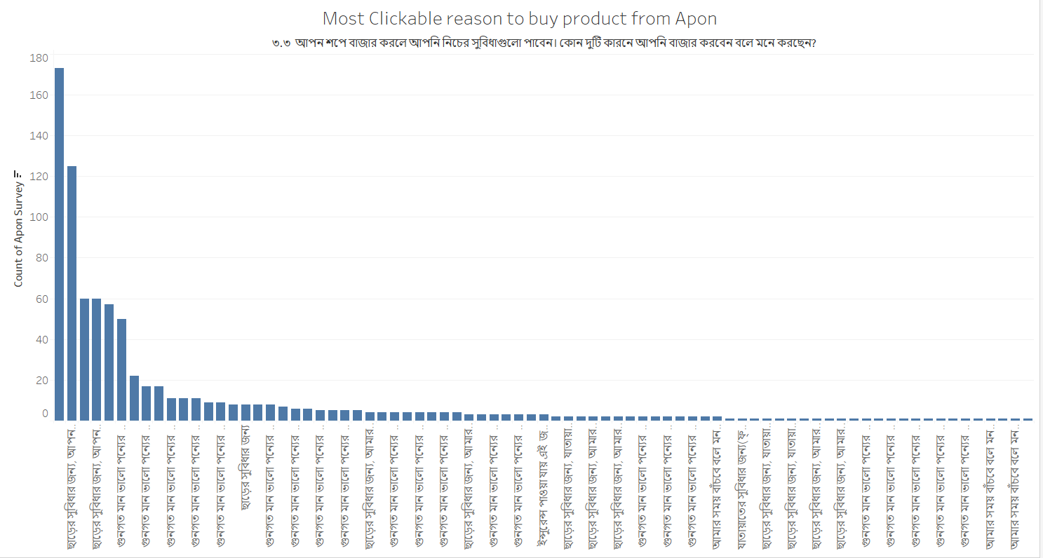
Advantage-2
We've emphasized that quality and discounts are pivotal for Apon Bazar. Drawing insights from our existing customers, it appears that our new customers are enticed by our trustworthy service and high-quality products coupled with attractive discounts.
These factors stand out as the primary reasons behind their choice to opt for our services

Slide 12
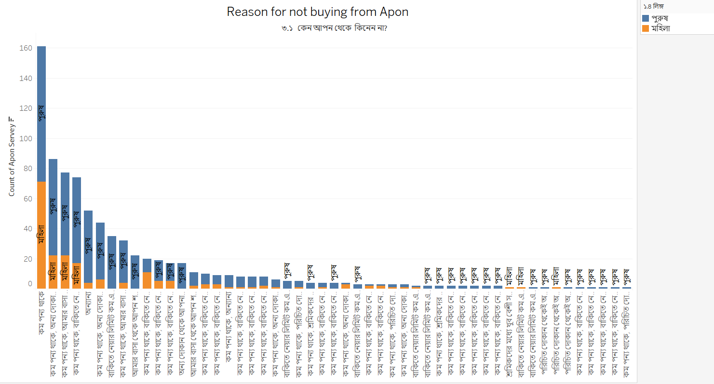
Negative Response
As we approach the final page of our survey results, we've identified reasons why participants choose not to buy products from Apon Bazar.
The factors include product shortages, credit limitations, long distances from participants, and various other considerations. These insights provide valuable information for refining our services and addressing customer concerns.

Slide 13
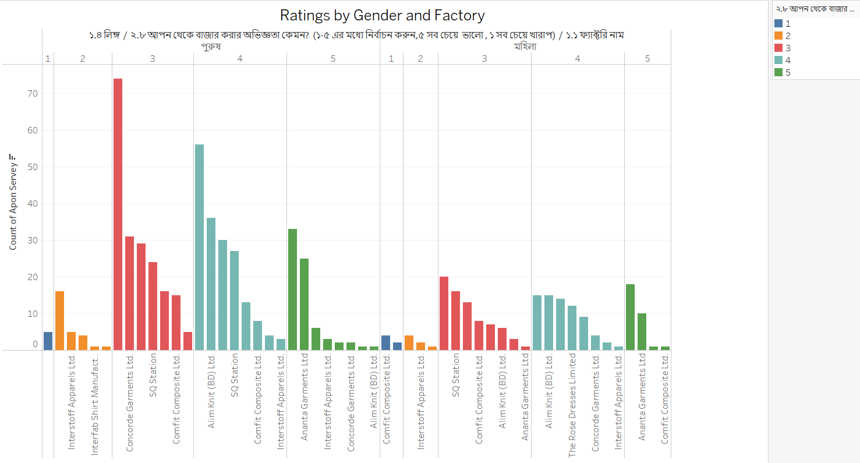
Survey result
Participants had the opportunity to vote based on their experiences with Apon Bazar, and interestingly, females provided more favorable votes than males.
However, the overall results indicate that Apon Bazar's performance hasn't met the expected standards. There's a long journey ahead to achieve better sales, offer top-notch service, and maintain competitive pricing, all of which are crucial for enhancing any business

Slide 14
Conclusion
In conclusion, my survey has provided valuable insights into the dynamics of customer engagement with Apon Bazar. While I have identified strengths, such as the appeal of quality products and discounts, there are clear areas for improvement, including addressing product shortages, credit limitations, and the need to minimize distances for customers. The voting pattern suggests that there is work to be done to enhance the overall customer experience, especially among male participants. Recognizing the challenges, it is evident that Apon Bazar has significant potential for growth. Authority should committed to undertaking the necessary steps to refine services, improve customer satisfaction, and pave the way for a successful future. With a focus on providing the best service, competitive pricing, and continuous innovation, Apon Bazar is poised for a journey towards better sales and becoming a benchmark in the industry. I appreciate the feedback and trust of our customers and look forward to implementing positive changes on this exciting path ahead.

