Slide 1
Phishing Awareness Module
Here is where your presentation begins

Slide 2
CONTENTS OF THIS TEMPLATE
FONTS | This presentation uses standard fonts for compatibility. No installation required.
USED AND ALTERNATIVE RESOURCES | Educational content on phishing from real-world scenarios, internal training materials, and open sources
THANKS SLIDE | This module was created for awareness and training purposes. Please retain credit for original authors.
COLORS | All the colors used in this presentation
ICONS AND INFOGRAPHIC RESOURCES | Simple bullet icons and formatting used to keep the message clear and distraction-free.
EDITABLE PRESENTATION THEME | You can edit the master slides easily.

Slide 3
TABLE OF CONTENTS
01
02
03
04
SECTION
SECTION
SECTION
SECTION

Slide 4

BEFORE WE BEGIN
Do you know what helps you make your point clear?
Lists like this one:
They're simple and easy to follow
Help organize important cybersecurity concepts
Reinforce what to remember
(like spotting phishing scams!)
Let’s dive in and learn how to stay safe from phishing attacks!

Slide 5
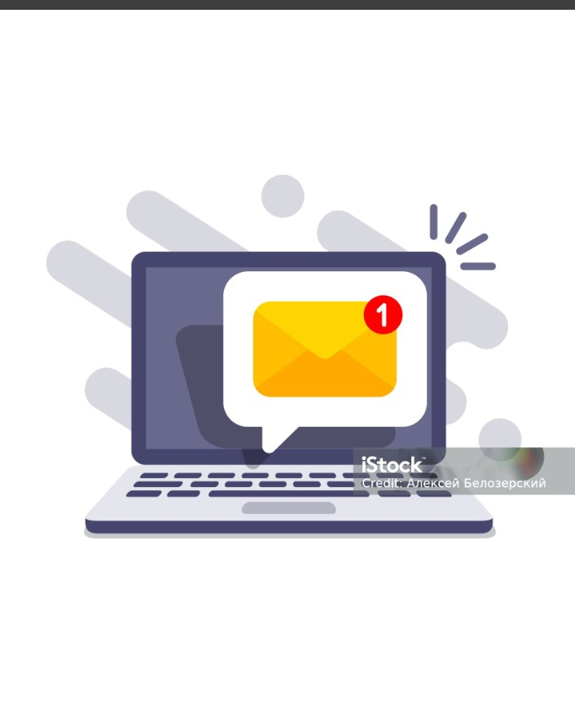
01
Understanding Phishing

Slide 6
Understanding Phishing
1)Definition
~> Phishing is a type of cyber attack where attackers trick people into giving away sensitive information.
2)Purpose of Phishing
~> Steal login credentials, credit card numbers, or confidential company data.
~> Distribute malware or gain unauthorized access to systems.
3) How It Works ~>The attacker sends a fake message that looks like it’s from a trusted source.
~> The message usually contains a link to a fake website or an attachment with malware.
4) Why It’s Effective
~> Phishing relies on human error, not system flaws.

Slide 7
Common Delivery Methods of Phishing
1) Email Phishing: ~> Fake emails trick users into clicking links or downloading harmful attachments.
2)Smishing: ~> Phishing messages sent via SMS to steal personal or banking details.
3) Vishing: ~> Scam calls pretending to be officials, asking for sensitive information.
4) Fake Websites: ~> Look-alike sites steal login credentials when victims enter their details.

Slide 8
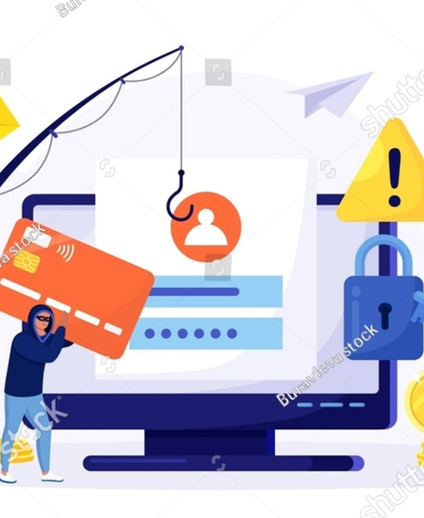
02
Recognizing Phishing Attempts

Slide 9
How to Spot a Phishing Attempt”
1) Check the Sender’s Email Address ~> Look closely—attackers often mimic real addresses with small changes.
2)Watch for Spelling and Grammar Mistakes ~> Poor language is a common red flag in phishing emails.
3) Beware of Urgent or Threatening Language ~> Phrases like “Act Now!” or “Account Suspended!” are common phishing tactics.
4) Hover Over Links Before Clicking ~> This reveals the true destination—fake URLs are often disguised.

Slide 10
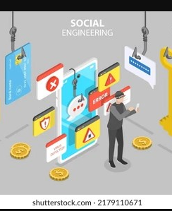
03
Social Engineering Tactics

Slide 11
Common Social Engineering Tactics:
1) Impersonation Attackers pose as someone trusted — like IT staff, managers, or service providers — to gain access or sensitive data.
2) Urgency and Fear ~> They create panic (e.g., “Your account will be locked!”) to make victims act quickly without thinking.
3) Pretexting ~> Attackers invent a convincing story (or “pretext”) to extract information — like pretending to be from HR requesting personal info.
4) Baiting ~> Victims are tempted with something desirable — like free software or a prize — but clicking gives attackers access or installs malware.
5) Tailgating (Physical Social Engineering) ~> In physical settings, attackers follow authorized users into secure areas without badges or proper access.

Slide 12
Tips to Defend Against It:
~> Verify requests through a second trusted communication channel.
~> Enable multi-factor authentication on all your accounts.
~> Avoid oversharing personal info on social media.
~> Don’t let urgency pressure you into acting without thinking.
~> Always lock your screen when leaving your device unattended.
~> Stay informed with regular security awareness training.
~> Never plug in unknown or found USB devices.
~> Report any suspicious emails, calls, or activity immediately.

Slide 13
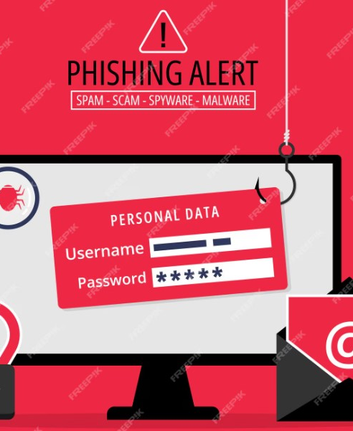
04
Preventing Phishing Attacks

Slide 14
Preventing Phishing Attacks
~> Think before clicking links or opening attachments in emails.
~> Verify the sender’s identity, especially for unusual requests.
~> Use strong, unique passwords and change them regularly.
~> Enable multi-factor authentication (MFA) for extra security.
~> Keep software, browsers, and antivirus programs updated.
~> Avoid sharing sensitive info over email, phone, or text.
~> Report suspicious messages to your IT or security team.
~> Educate yourself and your team with regular training.

Slide 15
Providing best practices and tips to avoid falling victim.
1) Think Before You Click ~> Avoid clicking on suspicious links or pop-ups, especially in unsolicited emails.
2) Verify the Source ~> Always double-check the sender’s email address and website URL.
3) Enable Multi-Factor Authentication (MFA) ~> Add an extra layer of protection to your accounts with MFA.
4) Keep Software Updated ~> Install security updates regularly to patch vulnerabilities in your system.
5) Use Strong, Unique Passwords ~> Avoid using the same password across multiple accounts; use a password
manager.

Slide 16
Real-World Examples of Phishing Attacks
1) Fake Bank Email Scam ~> You get an email that looks exactly like your bank’s official message saying, “Urgent: Your account will be locked unless you verify your information.” The email includes a link to a fake website designed to steal your login details.
2) SMS Phishing (Smishing) ~> You receive a text message saying, “Your package delivery is delayed. Click here to reschedule.” The link takes you to a fraudulent site that asks for your credit card info.
3) Voice Phishing (Vishing) ~> A caller pretends to be from the IRS threatening legal action unless you pay immediately. They pressure you to provide your Social Security number and bank details.
4) Social Media Phishing ~> You get a direct message on Instagram from what looks like a friend asking for help and a loan because they’re stuck overseas. The account is actually hacked.

Slide 17
quizzes for better engagement
1) Is it safe to click links in unsolicited emails asking for personal info? A) Yes B) No
Answer: B) No
2) What should you do if an email claims urgent account problems but looks suspicious? A) Ignore it B) Click the link immediately C) Verify on the official website
Answer: C) Verify on the official website
3) What is the safest action if you get an email asking to verify your bank account by clicking a link? A) Click the link B) Ignore the email C) Visit the bank’s official website directly D) Reply to ask if it’s real
Answer: C) Visit the bank’s official website directly

Slide 18
4) Which is a common sign of phishing emails? A) Personalized greeting from a known contact B) Poor grammar and urgent requests for info C) Emails with only images D) Emails never asking for any action
Answer: B) Poor grammar and urgent requests for info
5) Which is NOT a good way to prevent phishing? A) Using two-factor authentication B) Updating software regularly C) Sharing passwords with trusted people D) Being cautious with unsolicited emails
Answer: C) Sharing passwords with trusted people

Slide 19
"The biggest threat to cybersecurity isn’t technology — it’s human behavior."

Slide 20
🛡️ Thank You!
Stay alert. Stay safe. Avoid the bait think before you click!
📧 Questions or Feedback? Feel free to reach out.

