Slide 1

RevStox: Engineering Stock Market Intelligence
Presented By :
Hariprasath

Slide 2
Project Overview & Objectives
Project Objective
Key Highlights
Build a scalable backend to retrieve, analyze, and manage historical stock data.
Java application with a layered architecture (Model, DAO, Service, Controller).
Facilitate data-driven investment decisions through robust analytics.
SQL database for powerful analytics and efficient data storage.
CSV data ingestion and on-demand querying capabilities.
RevStox provides a robust backend platform for querying and analyzing historical stock data, supporting both data import from CSV and advanced analytical metrics.

Slide 3

Why RevStox?
Existing solutions often fall short:
Investors and analysts often struggle with raw, unstructured stock market data.
Tools like Excel are too simplistic for deep analysis, while high-end APIs are either overly complex, expensive, or proprietary.
Overly complex, expensive, or proprietary (e.g., premium financial APIs).
Too simplistic for serious analysis (e.g., Excel).

Slide 4




Core Functionalities
Data Management
Price Analytics
Import & manage CSV data with robust validation and storage.
Query stock prices by symbol and date, calculate volatility, and price gaps.
Volume Trends
Advanced Metrics
Analyze daily changes, VWAP (Volume-Weighted Average Price), and turnover.
Compute moving averages (7, 30, 90 days), comparative metrics, and stock rankings.

Slide 5
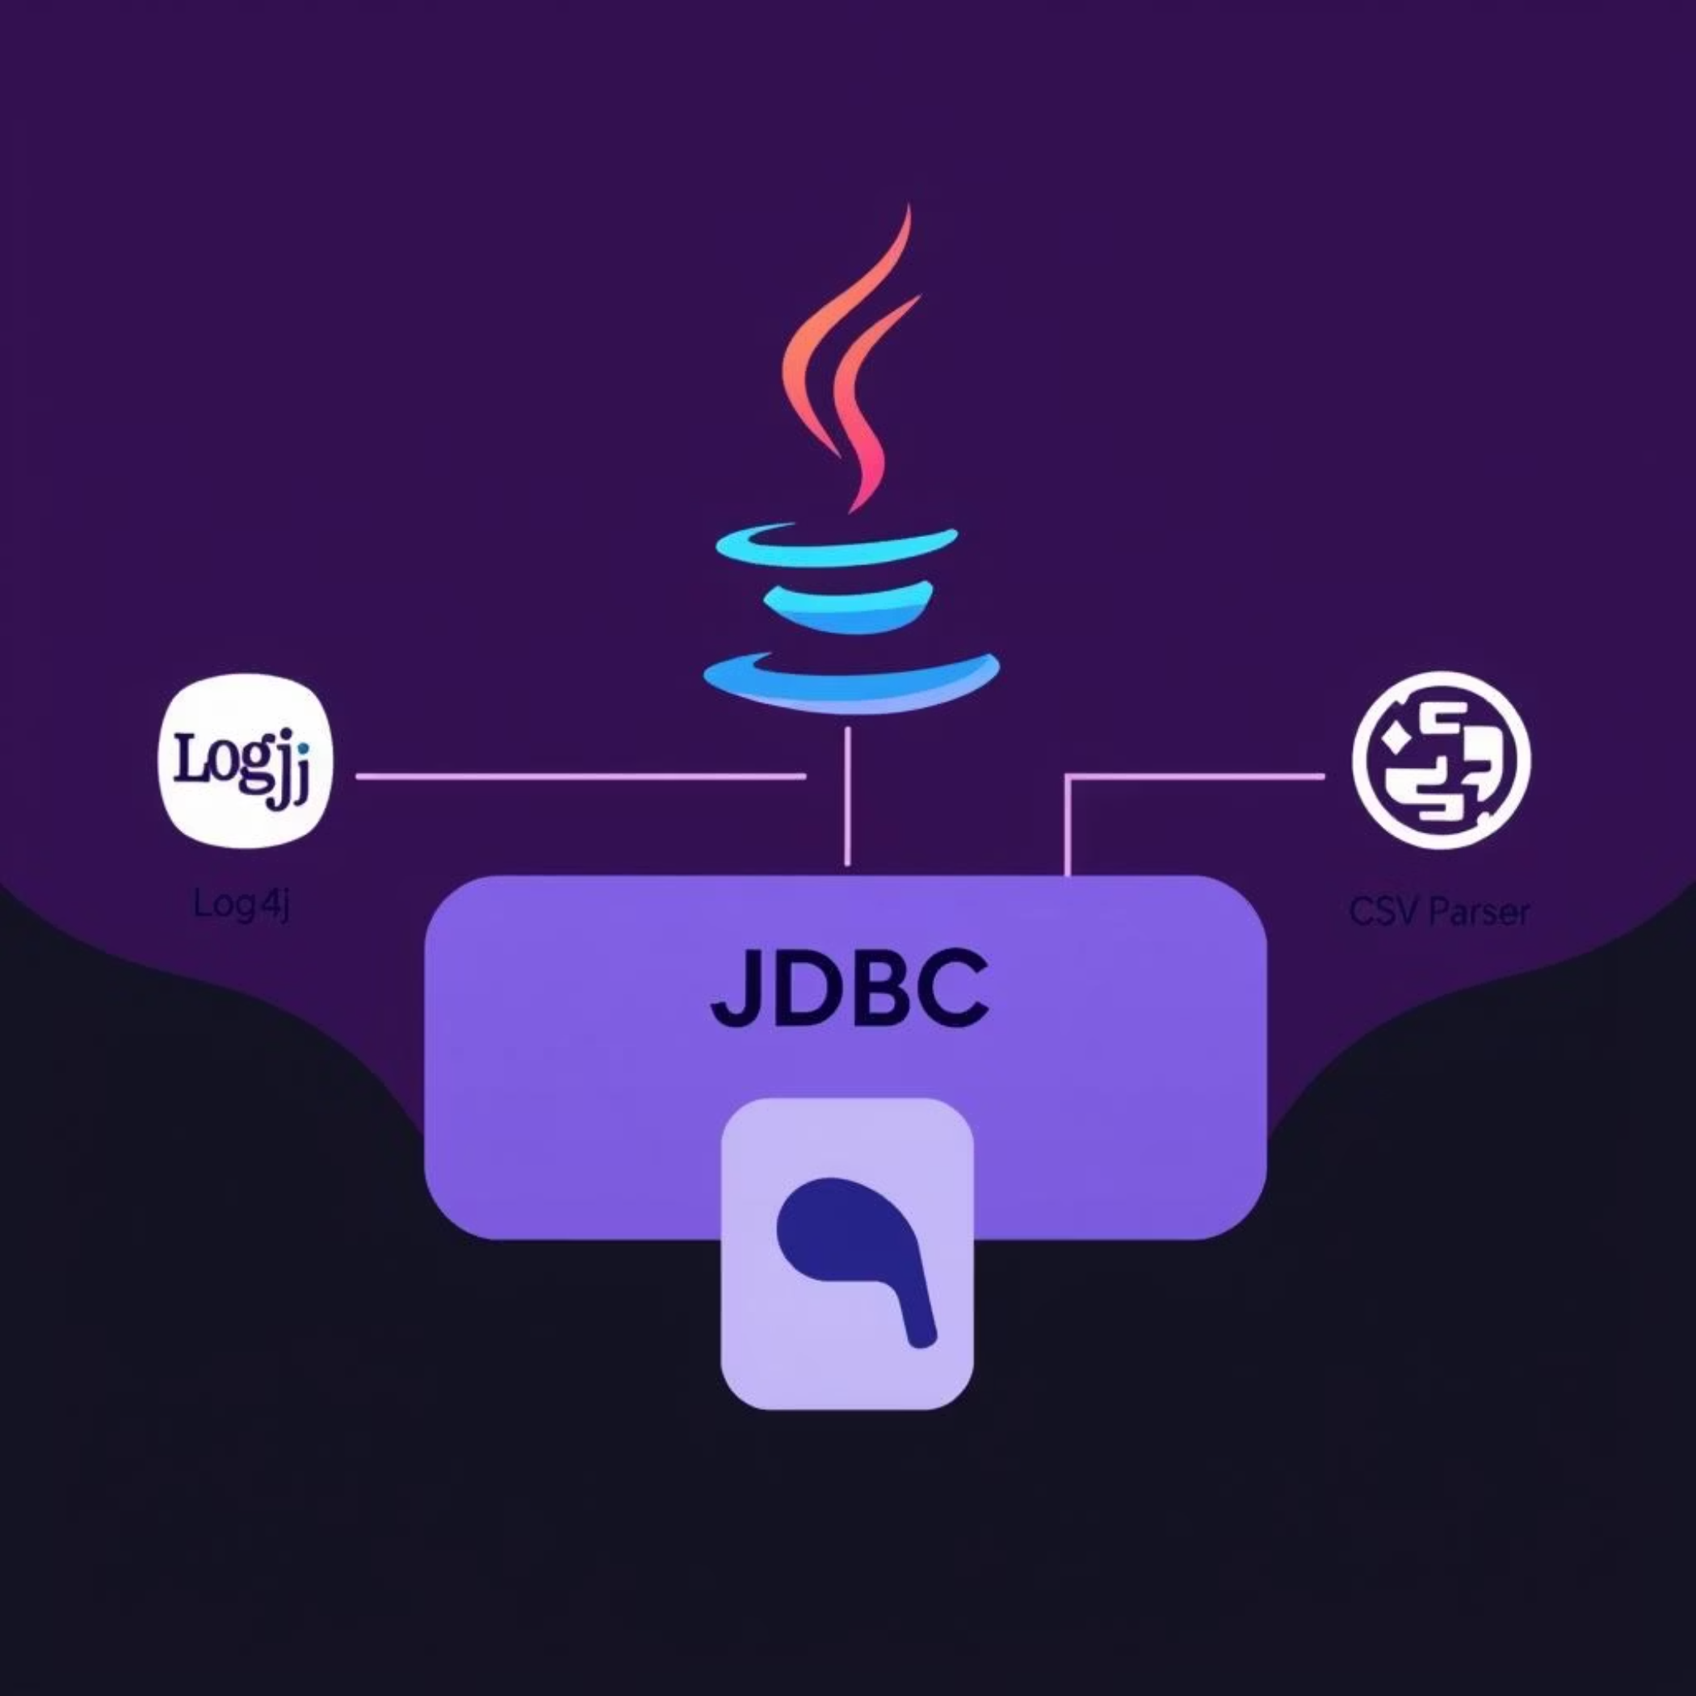
RevStox Tech Stack
The RevStox platform is built on a foundation of industry-standard, high-performance technologies:
Java: Core application logic, ensuring scalability and robust performance.
MySQL: Relational database for efficient data storage and complex queries.
JDBC: Standard Java API for database connectivity, enabling seamless interaction with MySQL.
Logger: Flexible logging framework for detailed traceability and debugging.
CSV Parser: Dedicated library for efficient and accurate data ingestion from CSV files.

Slide 6






Application Architecture
RevStox employs a well-defined layered architecture, promoting modularity, maintainability, and scalability. This design ensures clear separation of concerns, making the system easier to develop, test, and extend.
Controller
Service
DAO
Model
Database

Slide 7






Real-World Use Cases
RevStox empowers investors and analysts with specific, actionable insights, facilitating informed decision-making through precise data retrieval and complex comparative analysis.
Historical Price Retrieval
Price Gap Analysis
Volatility Ranking
Retrieve precise Infosys stock prices for any given period, e.g., Jan 2023.
Accurately calculate price gaps for specific stocks like Reliance.
Rank the top 5 stocks by their volatility over a defined period.
Comparative Analysis
VWAP Tracking
Compare HDFC vs. ICICI on 30-day moving averages.
Track Volume Weighted Average Price (VWAP) for TCS over time.

Slide 8
Thank You

