Slide 1
Convolutional Neural Networks

Slide 2
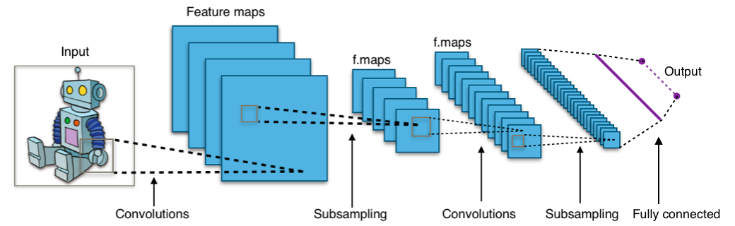
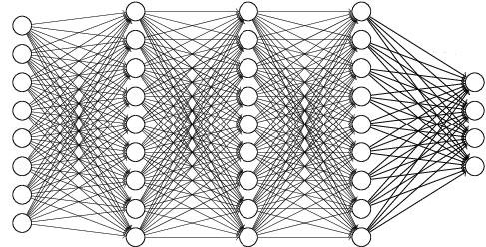
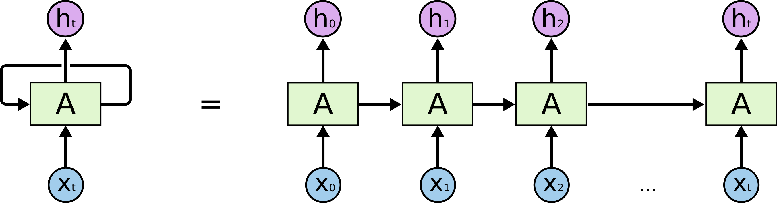
Convolutional Neural Network
Type of Deep Neural Network
Dense Network (=Fully-connected Neural Network)
Convolutional Neural Network
Recurrent Neural Network
…
<Convolutional Neural Network>
<Dense Network>
<Recurrent Neural Network>

Slide 3
Convolutional Neural Network
What is the Convolutional Neural Network?
Consists of Convolution, Pooling layers

Slide 4
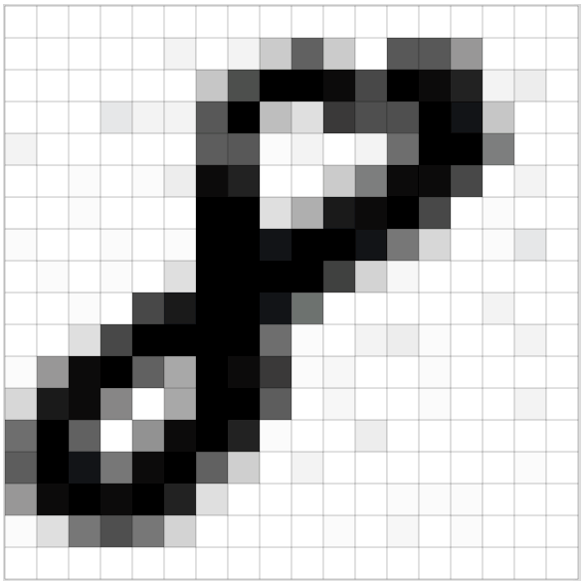
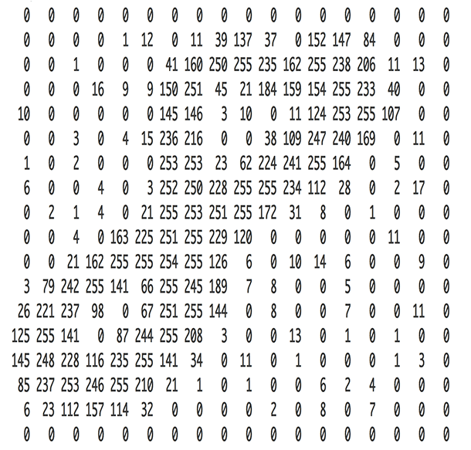
Image data
How to perceive on computer

Slide 5
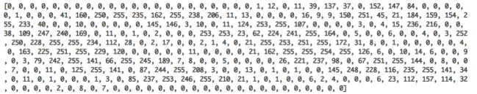
Image data
How to perceive on computer
DNN(Dense Neural network)
CNN(Convolutional Neural network)

Slide 6
Convolution
https://github.com/vdumoulin/conv_arithmetic
Summary (1)
Padding=0, Strides=1
Padding=1 , Strides=1
Padding=0, Strides=2
Padding=1, Strides=2

Slide 7
Convolution
Summary (2)
https://medium.com/@phidaouss/convolutional-neural-networks-cnn-or-convnets-d7c688b0a207

Slide 8
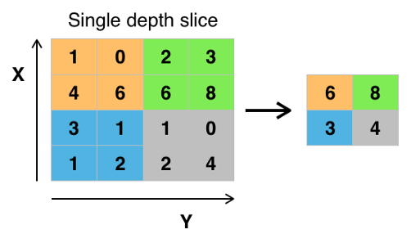
Pooling
Summary (1)
MAX pooling
Sride=2, Kernel_size=2
https://medium.com/@phidaouss/convolutional-neural-networks-cnn-or-convnets-d7c688b0a207

Slide 9
Pooling
Summary (2)
Average pooling
Sride=2, Kernel_size=2
2.75
4.75
1.75
1.75
https://medium.com/@phidaouss/convolutional-neural-networks-cnn-or-convnets-d7c688b0a207

Slide 10
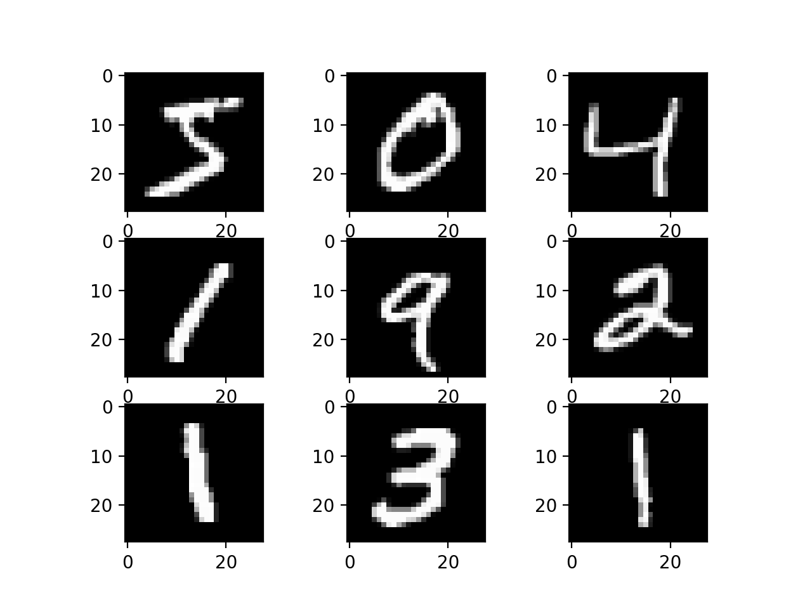
CNN for MNIST
MNIST Dataset
MNIST is handwritten digit images
It contains training set of 60,000 examples and a test set of 10,000 examples
Each example is a 28x28 grayscale image, associated with a label from 10 classes.

Slide 11
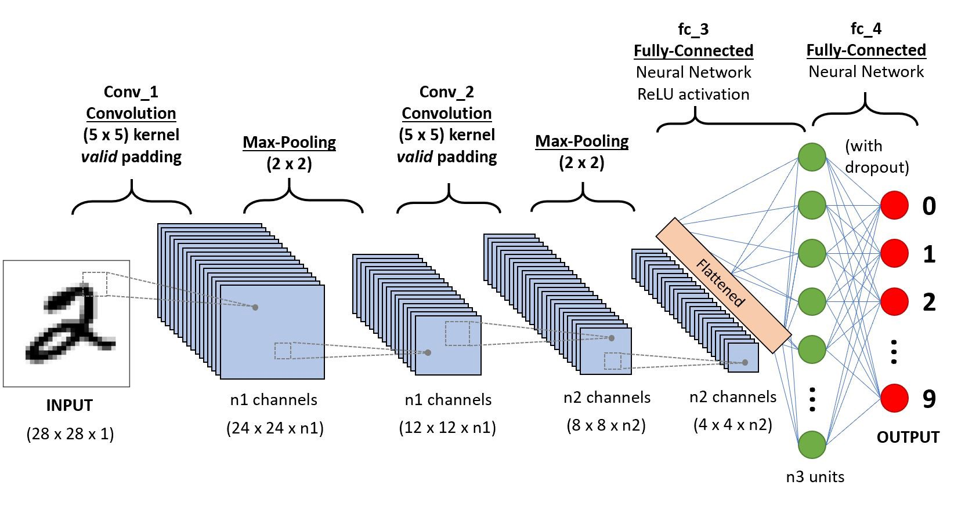
CNN for MNIST
CNN Architecture
10 channels
(10x24x24)
10 channels
(10x12x12)
20channels
(20x8x8)
20 channels
(20x4x4)
(1x28x28)
50

Slide 12
CNN for MNIST
Preparation
USE_CUDA = torch.cuda.is_available() DEVICE = torch.device("cuda" if USE_CUDA else "cpu")
Select device to use (GPU or CPU)
If GPU can be used, use GPU
else, use CPU
import torch import torch.nn as nn import torch.optim as optim import torch.nn.functional as F from torchvision import transforms, datasets USE_CUDA = torch.cuda.is_available() DEVICE = torch.device("cuda" if USE_CUDA else "cpu")

Slide 13
CNN for MNIST
Setup data
Transforms : Normalize data
transform = transforms.Compose([ transforms.ToTensor(), transforms.Normalize(mean=(0.5,), std=(0.1,)) ])
trainset = datasets.MNIST( root='./.data/', train=True, download=False, transform=transform ) testset = datasets.MNIST( root='./.data/', train=False, download=False, transform=transform )

Slide 14
CNN for MNIST
Setup for mini-batch
Divide by each batch of data
Data Shuffling
BATCH_SIZE = 64 train_loader = torch.utils.data.DataLoader( dataset=trainset, batch_size=BATCH_SIZE, shuffle=True, ) test_loader = torch.utils.data.DataLoader( dataset=testset, batch_size=BATCH_SIZE, shuffle=True, )

Slide 15
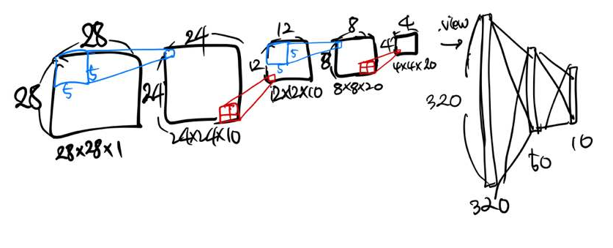
CNN for MNIST
Setup Network
nn.Linear(x, y) = x_dim -> y_dim (node)
nn.Conv2d(x, y) = x_dim -> y_dim (channel)
class Net(nn.Module): def __init__(self): super(Net, self).__init__() self.conv1 = nn.Conv2d(1, 10, kernel_size=5) self.conv2 = nn.Conv2d(10, 20, kernel_size=5) self.fc1 = nn.Linear(320, 50) self.fc2 = nn.Linear(50, 10) def forward(self, x): x = F.relu(F.max_pool2d(self.conv1(x), 2)) x = F.relu(F.max_pool2d(self.conv2(x), 2)) x = x.view(-1, 320) x = F.relu(self.fc1(x)) x = F.dropout(x, training=self.training) x = self.fc2(x) return F.log_softmax(x, dim=1)

Slide 16
CNN for MNIST
Model and Optimizer
Net.to(DEVICE)
.to(): function sends the parameters of the model to the specified location.
DEVICE = GPU or CPU (defined it before)
Stochastic Gradient Descent (SGD)
Parameters to learn
Learning rate – Hyper Parameter
model = Net().to(DEVICE) optimizer = optim.SGD(model.parameters(), lr=0.01)

Slide 17
CNN for MNIST
Setup for training
def train(model, train_loader, optimizer, epoch): model.train() for batch_idx, (data, target) in enumerate(train_loader): data, target = data.to(DEVICE), target.to(DEVICE) optimizer.zero_grad() output = model(data) loss = F.cross_entropy(output, target) loss.backward() optimizer.step() if batch_idx % 200 == 0: print('Train Epoch: {} [{}/{} ({:.0f}%)]\tLoss: {:.6f}'.format( epoch, batch_idx * len(data), len(train_loader.dataset), 100. * batch_idx / len(train_loader), loss.item()))

Slide 18
CNN for MNIST
Setup for evaluation
def evaluate(model, test_loader): model.eval() test_loss = 0 correct = 0 with torch.no_grad(): for data, target in test_loader: data, target = data.to(DEVICE), target.to(DEVICE) output = model(data) test_loss += F.cross_entropy(output, target, reduction='sum').item() pred = output.max(1, keepdim=True)[1] correct += pred.eq(target.view_as(pred)).sum().item() test_loss /= len(test_loader.dataset) test_accuracy = 100. * correct / len(test_loader.dataset) return test_loss, test_accuracy

Slide 19
CNN for MNIST
Run!
EPOCHS= 30 for epoch in range(1, EPOCHS + 1): train(model, train_loader, optimizer, epoch) if epoch % 10 == 0: test_loss, test_accuracy = evaluate(model, test_loader) print('[{}] Test Loss: {:.4f}, Accuracy: {:.2f}%'.format( epoch, test_loss, test_accuracy))
[10] Test Loss: 0.4043, Accuracy: 96.98%
[20] Test Loss: 0.3592, Accuracy: 97.22%
[30] Test Loss: 0.3326, Accuracy: 98.47%

Slide 20
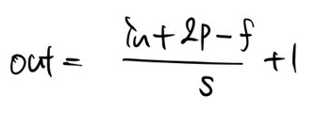
CNN for MNIST
Convolution Layer
Conv2d
Filter: 5x5x10, 5x5x20
Default: Strides: 1, Padding: 0
class Net(nn.Module): def __init__(self): super(Net, self).__init__() self.conv1 = nn.Conv2d(1, 10, kernel_size=5) self.conv2 = nn.Conv2d(10, 20, kernel_size=5) self.fc1 = nn.Linear(320, 50) self.fc2 = nn.Linear(50, 10)

Slide 21
Add Convolution and Pooling Layer
CNN의 channel, kernel size, stride, padding 을 변경해서 자신만의 CNN 구조를 만들어보자!
class Net(nn.Module): def __init__(self): super(Net, self).__init__() self.conv1 = nn.Conv2d(1, 10, kernel_size=5, stride=1, padding=0) self.conv2 = nn.Conv2d(10, 20, kernel_size=5, stride=1, padding=0) self.fc1 = nn.Linear(???, ???) self.fc2 = nn.Linear(???, 10)

Slide 22
Add Dropout and Batch Normalization
Convolution Dropout, Batch Normalization 을 추가하여 성능을 비교해보자!
class Net(nn.Module):
def __init__(self):
super(Net, self).__init__()
self.conv1 = nn.Conv2d(1, 10, kernel_size=5)
self.conv2 = nn.Conv2d(10, 20, kernel_size=5) self.bc1 = nn.BatchNorm2d(10)
self.bc2 = nn.BatchNorm2d(20) self.fc1 = nn.Linear(320, 50)
self.fc2 = nn.Linear(50, 10) self.conv_drop = nn.Dropout2d(p=0.2) def forward(self, x):
…
return x

Slide 23
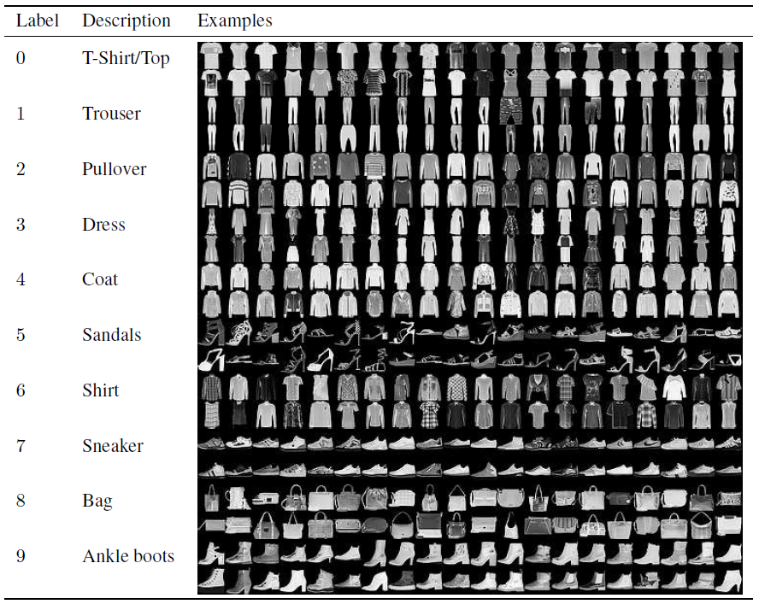

Fahsion MNIST
Fashion MNIST Dataset
Fashion-MNIST is a dataset of Zalando's article images
It contains training set of 60,000 examples and a test set of 10,000 examples
Each example is a 28x28 grayscale image, associated with a label from 10 classes.

Slide 24
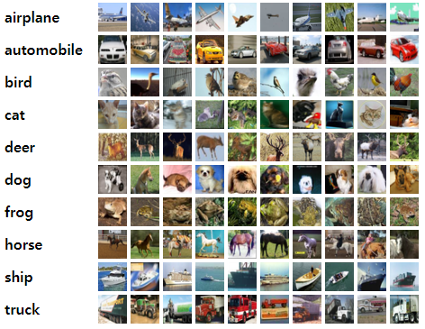
Cifar-10
Cifar-10 Dataset
Subsets of the 80 million tiny images dataset that is commonly used for training various image processing systems and machine learning
It consists of 60,000 32x32 color images in 10 classes, with 6,000 images per class. There are 50,000 training images and 10,000 test images.
<Sample images from Cifar-10 dataset>

Slide 25
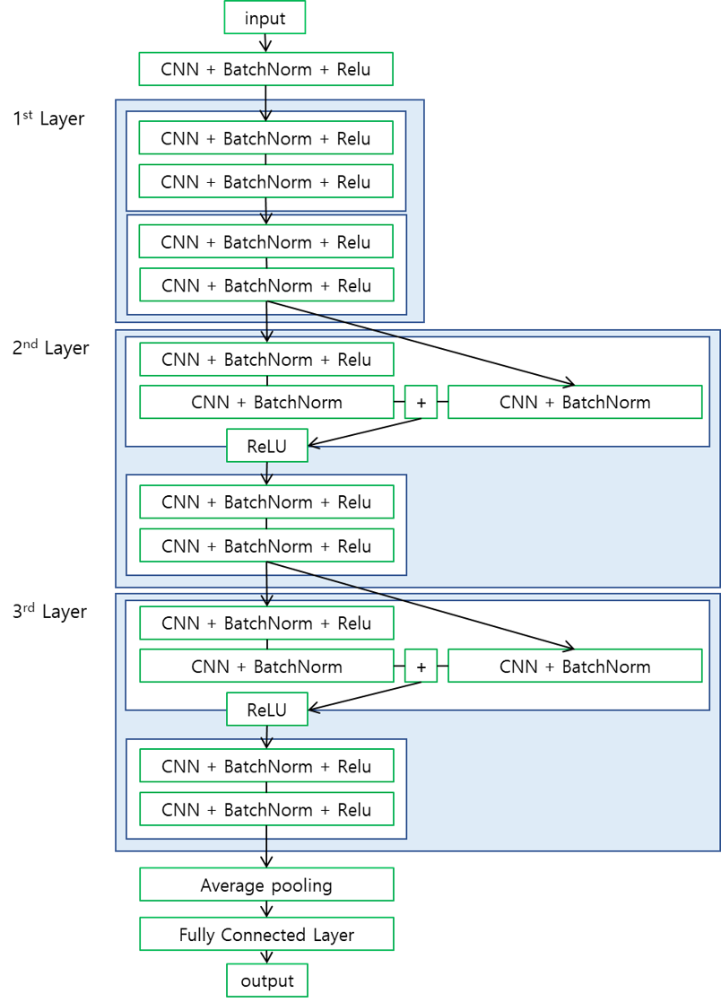
Try to make ResNet
Res Network

Slide 26
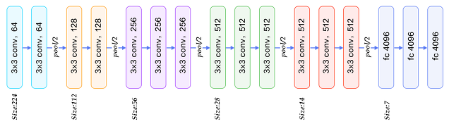
Try to make VGG Net
VGG Network

Slide 27
Pytorch Net
nn.Sequential()
class Net(nn.Module): def __init__(self): super(Net, self).__init__() self.conv1 = make_Sequential(
1, 10, 5, 2, 2, 0.5) self.conv2 = make_Sequential(
10, 20, 5, 2, 2, 0.5) self.fc = nn.Sequential( nn.Linear(320, 50), nn.ReLU(), nn.Dropout(0.5), nn.Linear(50, 10), ) def forward(self, x): x = self.conv1(x) x = self.conv2(x) x = x.view(-1, 320) x = self.fc(x) return F.log_softmax(x, dim=1) def make_Sequential(in_ch, out_ch,
conv_k, pool_k, pool_s, dropout_p): return nn.Sequential( nn.Conv2d(in_ch, out_ch,
kernel_size=conv_k), nn.MaxPool2d(kernel_size=pool_k,
stride=pool_s), nn.ReLU(), nn.Dropout2d(dropout_p), )
class Net(nn.Module): def __init__(self): super(Net, self).__init__() self.conv1 = nn.Sequential( nn.Conv2d(1, 10, kernel_size=5), nn.MaxPool2d(kernel_size=2, stride=2), nn.ReLU(), nn.Dropout2d(0.5), ) self.conv2 = nn.Sequential( nn.Conv2d(10, 20, kernel_size=5), nn.MaxPool2d(kernel_size=2, stride=2), nn.ReLU(), nn.Dropout2d(0.5), ) self.fc = nn.Sequential( nn.Linear(320, 50), nn.ReLU(), nn.Dropout(0.5), nn.Linear(50, 10), ) def forward(self, x): x = self.conv1(x) x = self.conv2(x) x = x.view(-1, 320) x = self.fc(x) return F.log_softmax(x, dim=1)

