Slide 1
Recurrent Neural Networks

Slide 2
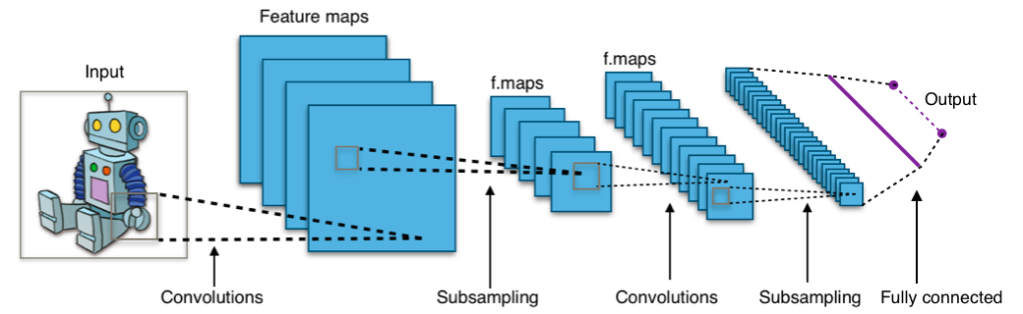
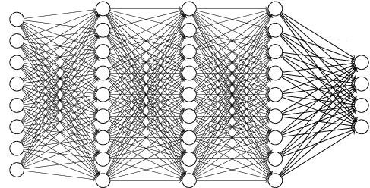
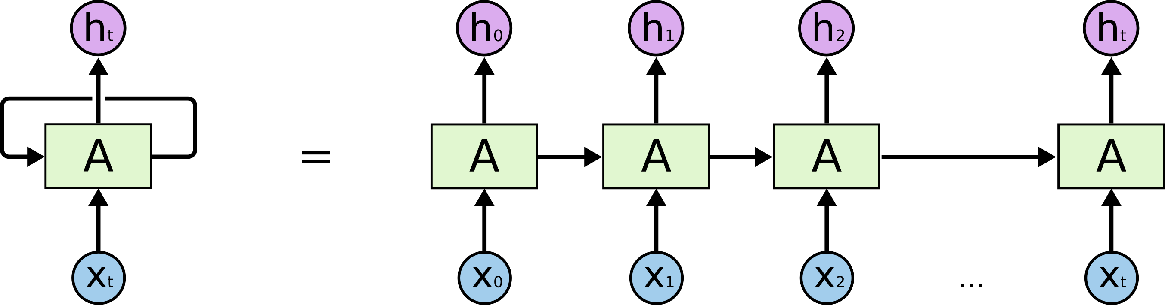
Recurrent Neural Network
Type of Deep Neural Network
Dense Network (=Fully-connected Neural Network)
Convolutional Neural Network
Recurrent Neural Network
…
<Convolutional Neural Network>
<Dense Network>
<Recurrent Neural Network>

Slide 3
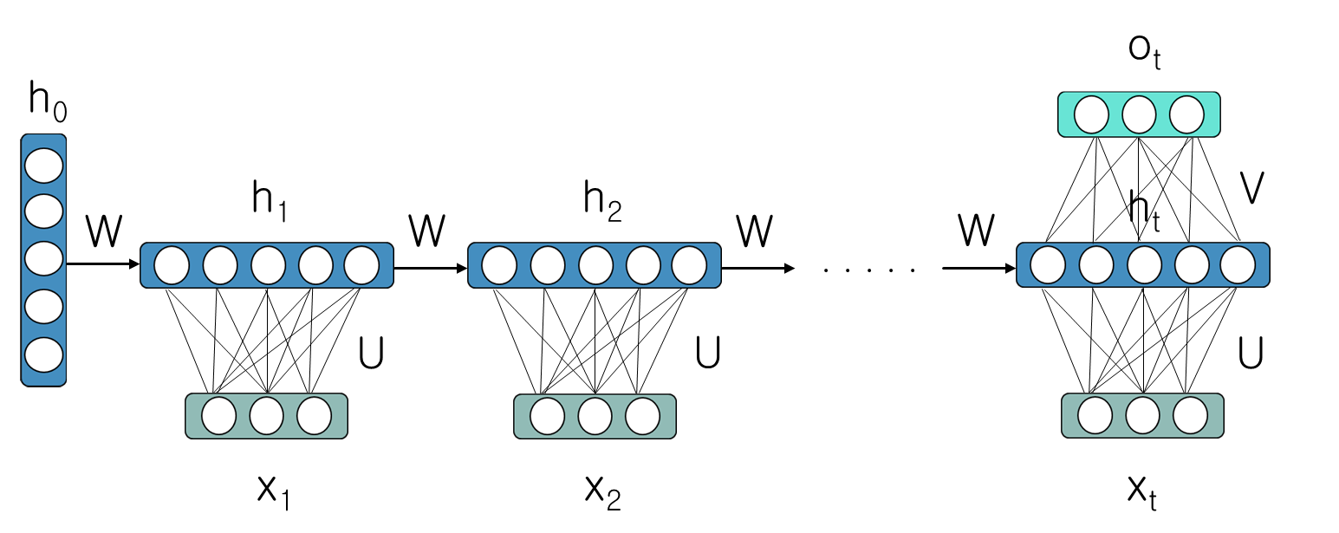
Recurrent Neural Network
What is the Recurrent Neural Network?
$$h_{t}=tanh\left(Ux_{t}+Wh_{t−1}\right)$$
$$\left.o_{t}=Softmax(Vh_{t}\right)$$

Slide 4
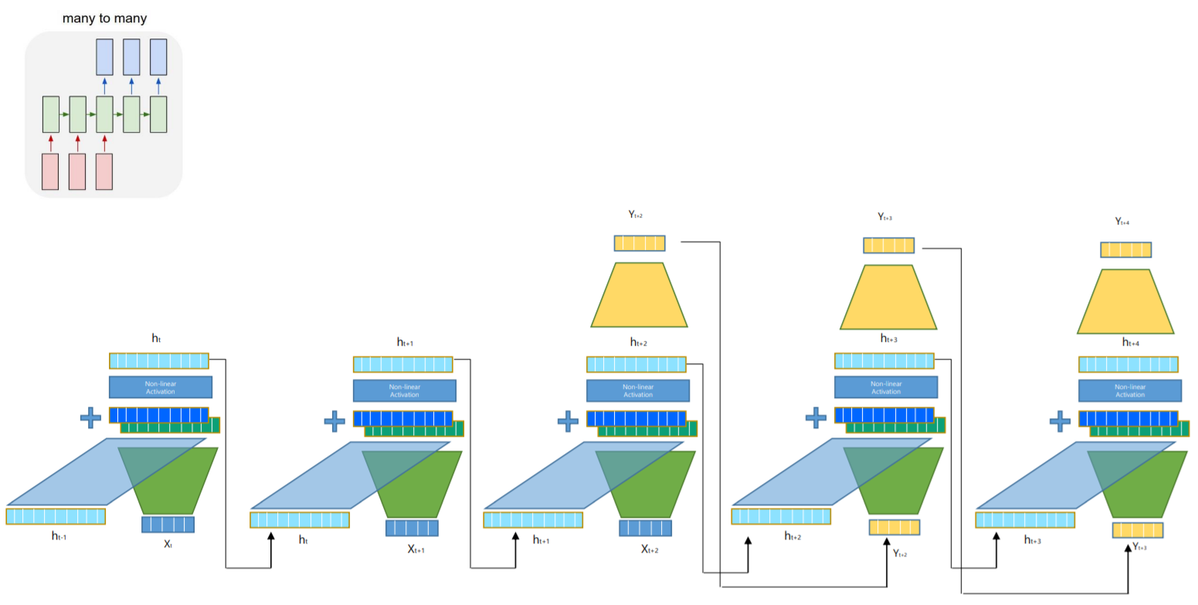

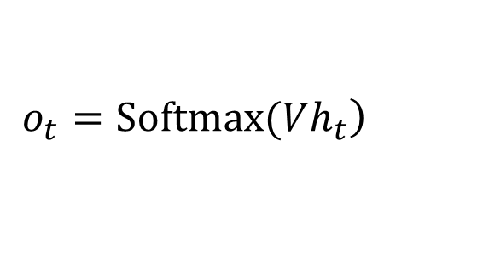
Recurrent Neural Network
$$h_{t}=tanh\left(Ux_{t}+Wh_{t−1}\right)$$
$$\left.o_{t}=Softmax(Vh_{t}\right)$$

Slide 5
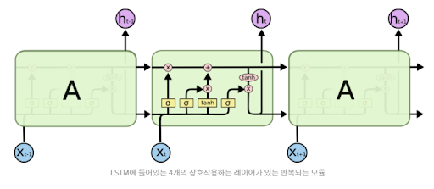
Recurrent Neural Network
LSTM
cell gate, input gate, output gate, forget gate

Slide 6
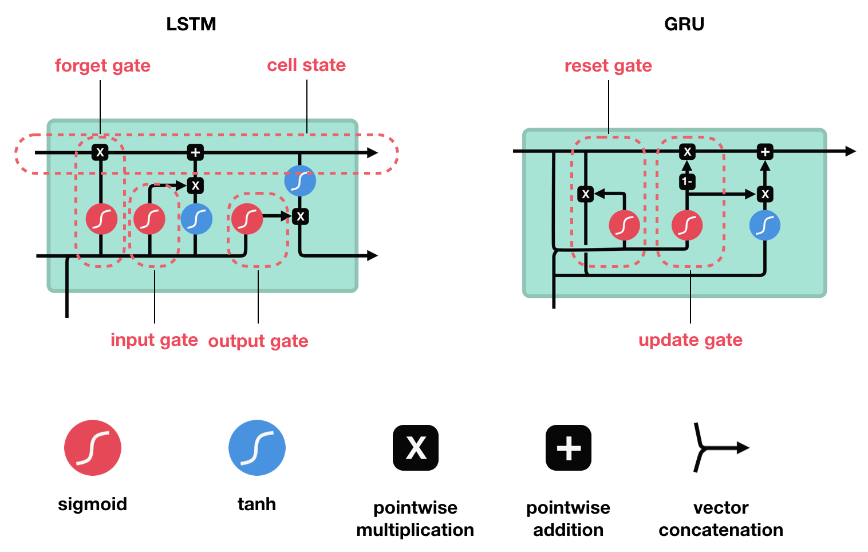
Recurrent Neural Network
GRU
Update & Reset gate

Slide 7
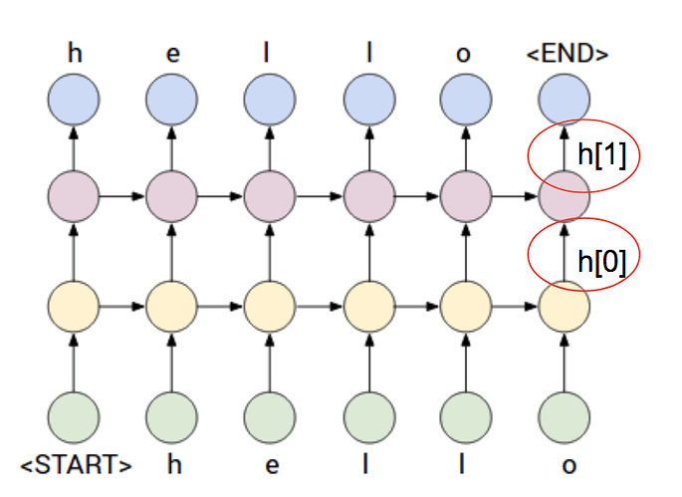
Recurrent Neural Network
Stacked RNN
rnn = torch.nn.RNN(dic_size, hidden_size, batch_first=True, num_layers=2)

Slide 8
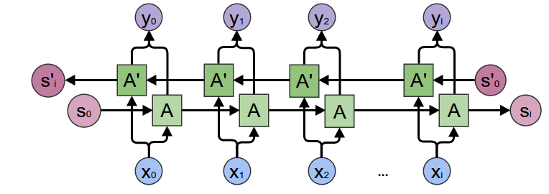
Recurrent Neural Network
Bidirectional LSTM
rnn = torch.nn.RNN(dic_size, hidden_size, batch_first=True, bidirectional=True)

Slide 9
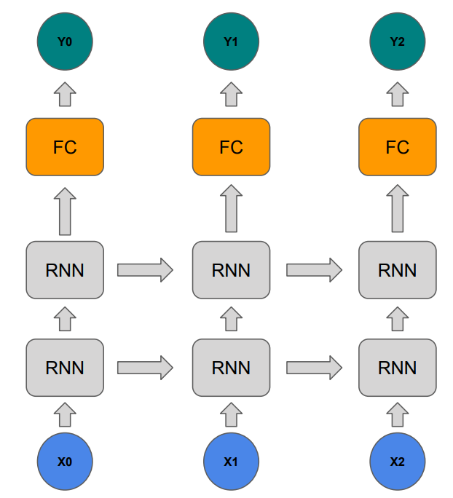
Practice1
RNN + FC

Slide 10
Practice1
RNN + FC
rnn = torch.nn.RNN(dic_size, hidden_size, batch_first=True)
FC = torch.nn.Linear(hidden_size, dic_size)

Slide 11
Practice2
Language Model
0 if you wan -> f you want
1 f you want -> you want
2 you want -> you want t
3 you want t -> ou want to
4 ou want to -> u want to
5 u want to -> want to b
6 want to b -> want to bu
7 want to bu -> ant to bui
8 ant to bui -> nt to buil
9 nt to buil -> t to build
10 t to build -> to build
11 to build -> to build a
12 to build a -> o build a
13 o build a -> build a s
14 build a s -> build a sh
15 build a sh -> uild a shi
16 uild a shi -> ild a ship

Slide 12
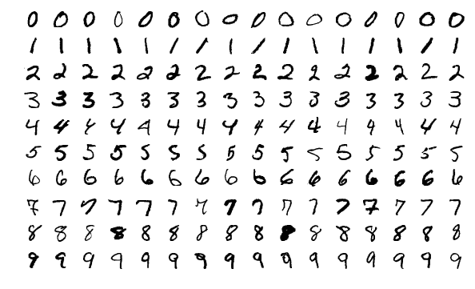
RNN for MNIST
MNIST Dataset
Large data of handwritten digits that is commonly used for training various image processing systems and machine learning
It contains 60,000 training images and 10,000 testing images (28 X 28 pixel)

Slide 13
RNN for MNIST

Slide 14
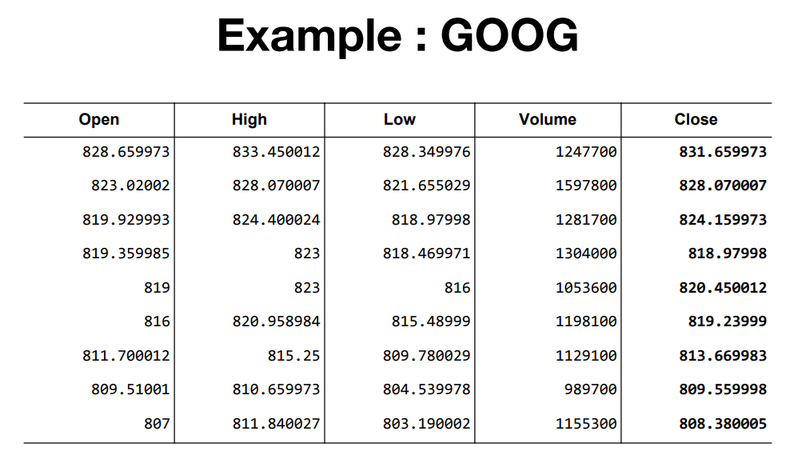
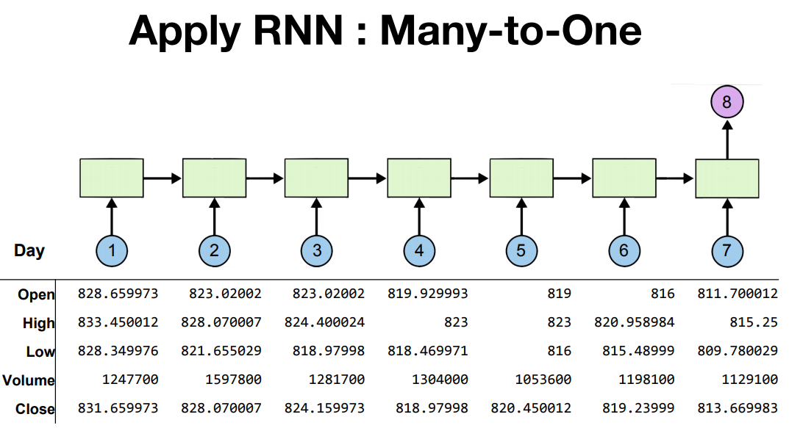
Stock Prediction

Slide 15
Stock Prediction
Data Preprocessing (1)
%matplotlib inline import torch import torch.optim as optim import numpy as np import matplotlib.pyplot as plt

Slide 16
Stock Prediction 문제1
Q. Min-max scaler를 구현하시오
(x-min(x))/(max(x)-min(x))
# scaling function for input data def minmax_scaler(data):
return ??

Slide 17
Stock Prediction
Data Preprocessing (2)
# make dataset to input def build_dataset(time_series, seq_length): dataX = [] dataY = [] for i in range(0, len(time_series) - seq_length): _x = time_series[i:i + seq_length, :] _y = time_series[i + seq_length, [-1]] # Next close price #print(_x, "->", _y) dataX.append(_x) dataY.append(_y) return np.array(dataX), np.array(dataY) # hyper parameters seq_length = 7 data_dim = 5 hidden_dim = 10 output_dim = 1 learning_rate = 0.01 iterations = 500

Slide 18
Data Preprocessing
Data Preprocessing (3)
# load data xy = np.loadtxt("stock.csv", delimiter=",") xy = xy[::-1] # reverse order # split train-test set train_size = int(len(xy) * 0.7) train_set = xy[0:train_size] test_set = xy[train_size - seq_length:] # scaling data train_set = minmax_scaler(train_set) test_set = minmax_scaler(test_set) # make train-test dataset to input trainX, trainY = build_dataset(train_set, seq_length) testX, testY = build_dataset(test_set, seq_length)
trainX_tensor = torch.FloatTensor(trainX)
trainY_tensor = torch.FloatTensor(trainY)
testX_tensor = torch.FloatTensor(testX)
testY_tensor = torch.FloatTensor(testY)

Slide 19
Stock Prediction 문제2
Q. LSTM과 layer로 이뤄진 다음 Net을 구현하시오
class Net(torch.nn.Module): ####Implement this code#### ########################### net = Net(data_dim, hidden_dim, output_dim, 1)

Slide 20
Stock Prediction 문제3
Q. 다음 학습 과정을 구현하시오
# loss & optimizer setting criterion = torch.nn.MSELoss() optimizer = optim.Adam(net.parameters(), lr=learning_rate)
# start training for i in range(iterations): ####Implement this code#### ###########################
# Visualization
plt.plot(testY) plt.plot(net(testX_tensor).data.numpy()) plt.legend(['original', 'prediction']) plt.show()

Slide 21
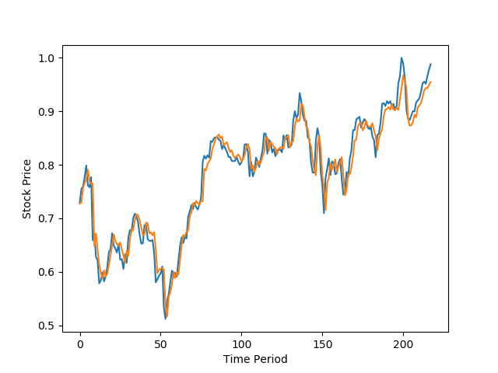
Stock Prediction

Slide 22
Seq2Seq

Slide 23
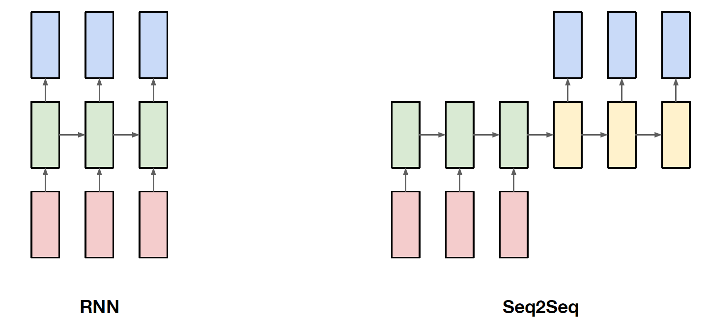
Seq2Seq

Slide 24
Pytorch Summary
Torch reference
https://pytorch.org/tutorials/beginner/blitz/neural_networks_tutorial.html

