Slide 1

Lecture 16 Pipeline Hazards
Guest Lecture by
Mahesh

Slide 2
Today’s Lecture
Recap: 5-stage Pipeline Design
Pipeline hazards
Structural hazards
Data hazards and data dependence analysis

Slide 3
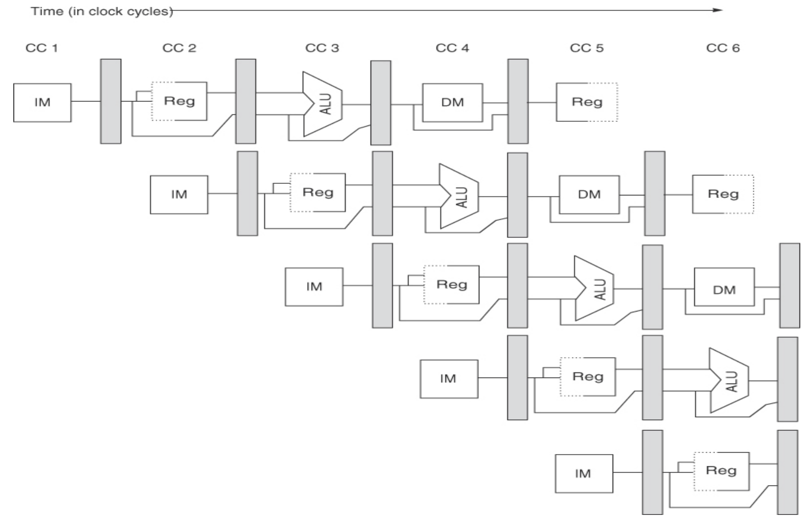
Recap: 5-stage Pipeline Design
lw $1, 6($2)
L2
L3
L4
L5
add $3, $5, $0
L2
L3
L4
L5
sw $4, 8($6)
L2
L3
L4
L5
L2
L3
L4
L2
L3

Slide 4
Issues/Conflicts with Pipelining
Unified memory accessed for instruction and data in the same cycle
Registers are read and written in the same cycle
R-Type instructions can’t skip the DM stage, else conflict for WB
Consuming instruction may have to wait for the producer
Branch target is known only at the end of its execution – what do you do in the meantime?

Slide 5
Issues/Conflicts with Pipelining: Branching
beq $1, $2, 1000
L2
L3
L4
L5
add $3, $5, $0
L2
L3
L4
L5
sub $4, $8, $6
L2
L3
L4
L5
and $7, $3, $5
L2
L3
L4
sw $7, 2($3)
L2
L3

Slide 6
Pipeline Hazards
Structural Hazards: Multiple instructions contend for the same resource.
Data Hazards: A dependent instruction cannot proceed because it needs a value that hasn’t been produced yet.
Control Hazards: The next instruction cannot be fetched because the outcome of an earlier branch is unknown.

Slide 7
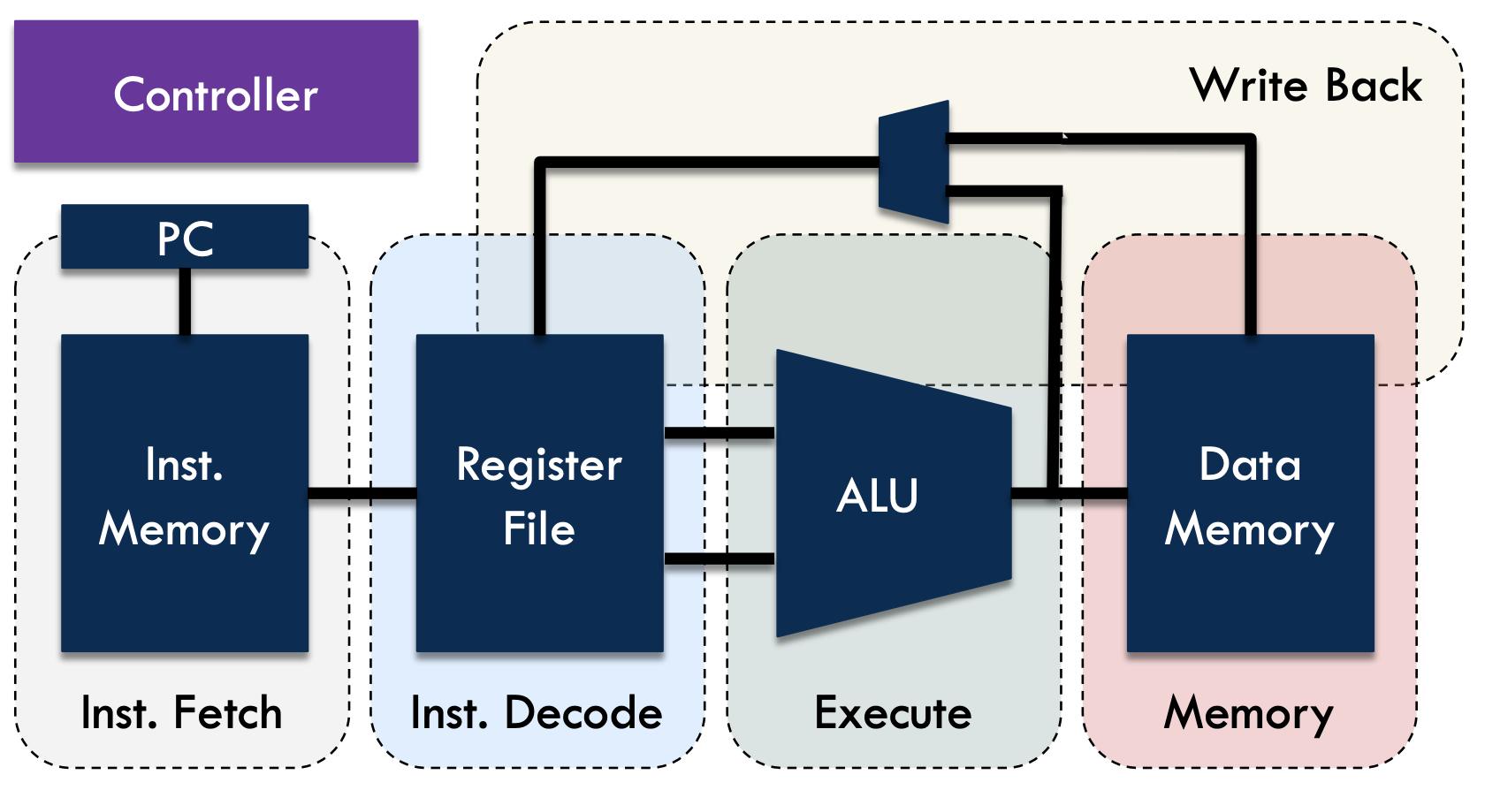
Structural Hazards

Slide 8
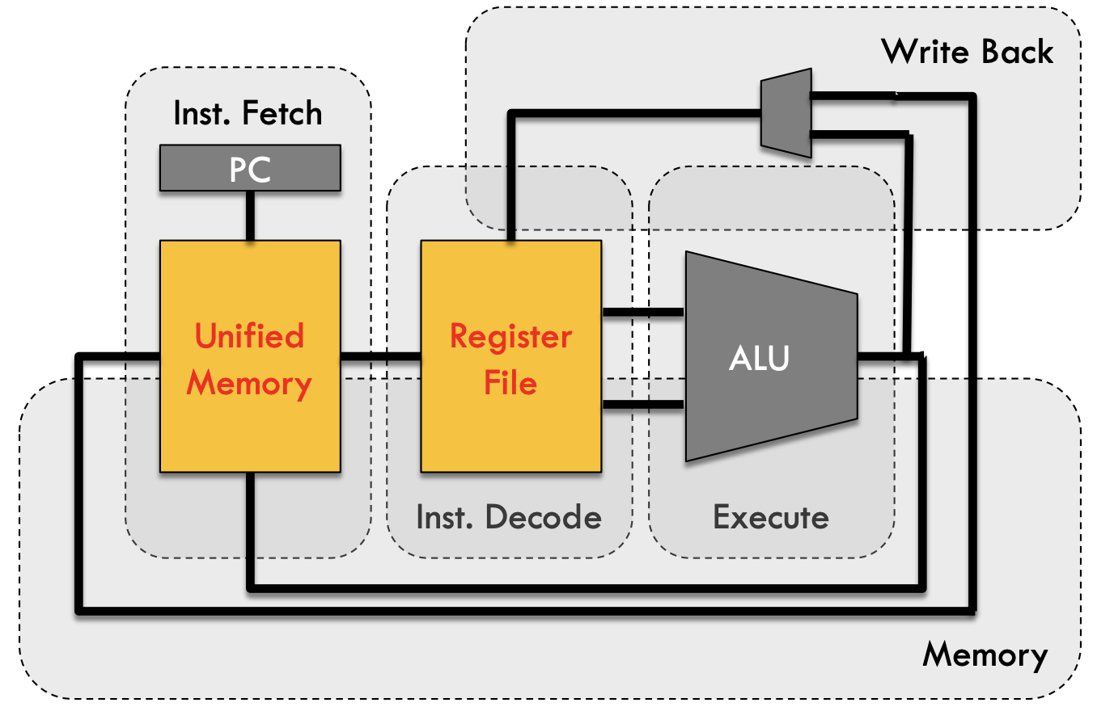
Structural Hazards
Unified memory and register file

Slide 9
Structural Hazards
Unified memory for instruction and data
lw $1, 6($2)
L2
L3
L4
L5
lw $3, 4($8)
L2
L3
L4
L5
sub $6, $5, $4
L2
L3
L4
L5
add $0, $7, $9
L2
L3
L4
L2
L3

Slide 10
Structural Hazards
Unified memory for instruction and data
lw $1, 6($2)
L2
L3
L4
L5
lw $3, 4($8)
L2
L3
L4
L5
sub $6, $5, $4
L2
L3
L4
L5
add $0, $7, $9
L2
L3
L4
L2
L3
Separate Instruction and Data Memories

Slide 11
Structural Hazards
Unified memory for instruction and data
Register file with shared read/write access port
lw $1, 6($2)
L2
L3
L4
L5
lw $3, 4($8)
L2
L3
L4
L5
sub $6, $5, $4
L2
L3
L4
L5
add $0, $7, $9
L2
L3
L4
L2
L3

Slide 12
Structural Hazards
Unified memory for instruction and data
Register file with shared read/write access port
lw $1, 6($2)
L2
L3
L4
L5
lw $3, 4($8)
L2
L3
L4
L5
sub $6, $5, $4
L2
L3
L4
L5
add $0, $7, $9
L2
L3
L4
L2
L3
Register access in half cycles

Slide 13
Data Hazards
An instruction produces a value in a given pipeline stage.
A subsequent instruction consumes that value in a pipeline stage.
The consumer may have to be delayed so that the time of consumption is later than the time of production.

Slide 14
Data Hazards
add $r3, $r1, $r2
L2
L3
L4
L5
add $r5, $r3, $r4
L2
L3
L4
L5
sub $r7, $r8, $r9
L2
L3
L4
L5
L2
L3
L4
L2
L3

Slide 15
Data Hazards
add $r3, $r1, $r2
L2
L3
L4
L5
add $r5, $r3, $r4
L2
L3
L4
L5
sub $r7, $r8, $r9
L2
L3
L4
L5
L2
L3
L4
L2
L3

Slide 16
Handling Data Hazards: Stalling
add $r3, $r1, $r2
L2
L3
L4
L5
nop
L2
L3
L4
L5
nop
L2
L3
L4
L5
add $r5, $r3, $r4
L2
L3
L4
sub $r7, $r8, $r9
L2
L3

Slide 17
Handling Data Hazards: Stalling
I1:
add $r3, $r1, $r2
L2
L3
L4
L5
I2:
add $r5, $r3, $r4
L2
L3
L4
L5
I3:
sub $r7, $r8, $r9
L2
L3
L4
L5
L2
L3
L4
L2
L3

Slide 18
Handling Data Hazards: Stalling
add $r3, $r1, $r2
L2
L3
L4
L5
nop
L2
L3
L4
L5
nop
L2
L3
L4
L5
add $r5, $r3, $r4
L2
L3
L4
sub $r7, $r8, $r9
L2
L3
Can we do better?

Slide 19
Handling Data Hazards: Forwarding/Bypassing
I1:
add $r3, $r1, $r2
L2
L3
L4
L5
I2:
add $r5, $r3, $r4
L2
L3
L4
L5
L2
L3
L4
L5
L2
L3
L4
L2
L3

Slide 20
Handling Data Hazards: Forwarding/Bypassing
I1:
add $r3, $r1, $r2
L2
L3
L4
L5
I2:
add $r5, $r3, $r4
L2
L3
L4
L5
I3:
sub $r7, $r3, $r9
L2
L3
L4
L5
I4:
add $r0, $r3, $r8
L2
L3
L4
L2
L3

Slide 21
ALU With Forwarding
L3
MUX
input 1
L4
L5
output
ALU
L3
MUX
input 2
L4
L5

Slide 22
Forwarding/Bypassing With Loads
I1:
lw $r1, 8($r2)
L2
L3
L4
L5
I2:
lw $r4, 8($r1)
L2
L3
L4
L5
L2
L3
L4
L5
L2
L3
L4
L2
L3

Slide 23
Forwarding/Bypassing With Loads
I1:
lw $r1, 8($r2)
L2
L3
L4
L5
nop
L2
L3
L4
L5
I2:
lw $r4, 8($r1)
L2
L3
L4
L5
L2
L3
L4
Load Delay Slot
L2
L3

Slide 24
Forwarding/Bypassing With Loads
I1:
lw $r1, 8($r2)
L2
L3
L4
L5
I2:
lw $r1, 8($r3)
L2
L3
L4
L5
L2
L3
L4
L5
L2
L3
L4
L2
L3

Slide 25
Forwarding/Bypassing With Loads
I1:
lw $r3, 8($r2)
L2
L3
L4
L5
I2:
lw $r1, 8($r3)
L2
L3
L4
L5
L2
L3
L4
L5
L2
L3
L4
L2
L3

Slide 26
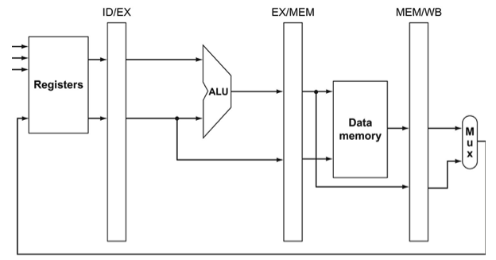
Forwarding Unit
L3
L4
L5
Without Bypassing

Slide 27
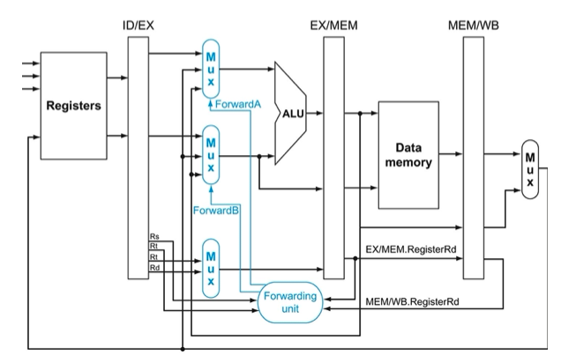
Forwarding Unit
L3
L4
L5
With Bypassing

Slide 28
Exercise: Identify all Data Hazards and Resolve Them
I1:
add $r3, $r1, $r2
CC 7
CC 8
CC 9
L2
L3
L4
L5
I2:
and $r5, $r3, $r4
L2
L3
L4
L5
I3:
add $r2, $r6, $r3
L2
L3
L4
L5
I4:
lw $r6, 8($r3)
L2
L3
L4
L5
L3
L4
I5:
sw $r6, 4($r2)
L2
L3
L4
L5
L2
L3
L4

Slide 29
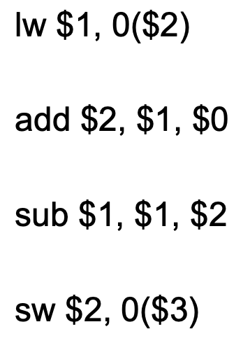
Detecting Data Hazards
Data Dependence Types

Slide 30
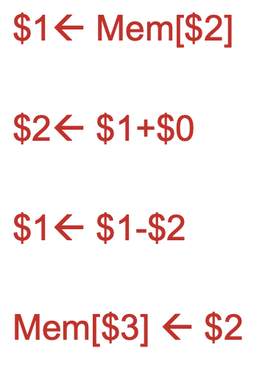
Detecting Data Hazards
Data Dependence Types

Slide 31
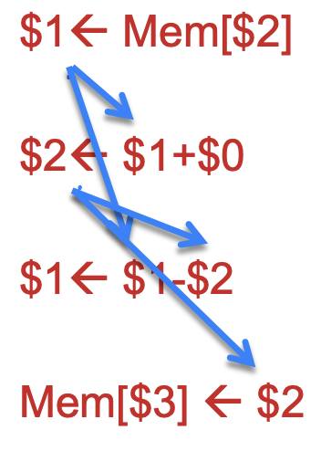
Detecting Data Hazards
Data Dependence Types
Read-After-Write (RAW)

Slide 32
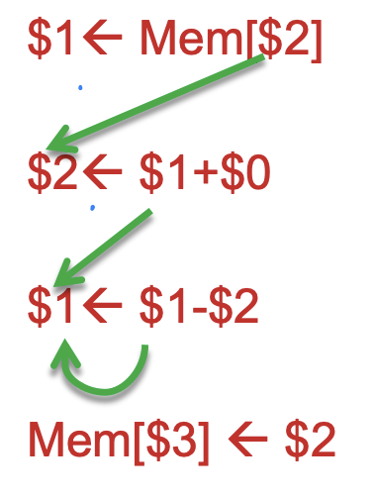
Detecting Data Hazards
Data Dependence Types
Write-After-Read (WAR)

Slide 33
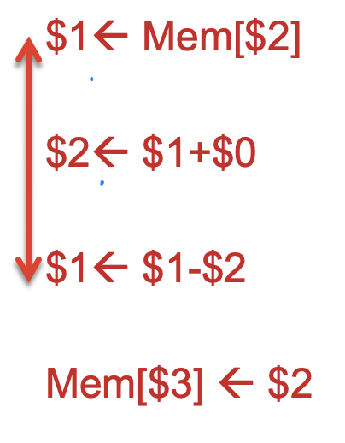
Detecting Data Hazards
Data Dependence Types
Write-After-Write (WAW)

Slide 34
Exercise: Identify Data Hazards
lw $7, 0($1)
sub $1, $4, $6
add $5, $5, $1
sw $1, 0($7)
add $4, $1, $2
lw $5, 0($1)

Slide 35

Exercise: Identify Data Hazards
lw $7, 0($1)
sub $1, $4, $6
add $5, $5, $1
sw $1, 0($7)
add $4, $1, $2
lw $5, 0($1)
$7 $←$ Mem[$1]
$1 $=$ $4 $−$ $6
$5 $=$ $5 $+$ $1
Mem[$7] $←$ $1
$4 $=$ $1 $+$ $2
$5 $←$ Mem[$1]

Slide 36



Exercise: Identify Data Hazards
10 HAZARDS
RAW
WAR
WAW
$7 $←$ Mem[$1]
$1 $=$ $4 $−$ $6
$5 $=$ $5 $+$ $1
Mem[$7] $←$ $1
$4 $=$ $1 $+$ $2
$5 $←$ Mem[$1]
$7 $←$ Mem[$1]
$1 $=$ $4 $−$ $6
$5 $=$ $5 $+$ $1
Mem[$7] $←$ $1
$4 $=$ $1 $+$ $2
$5 $←$ Mem[$1]
$7 $←$ Mem[$1]
$1 $=$ $4 $−$ $6
$5 $=$ $5 $+$ $1
Mem[$7] $←$ $1
$4 $=$ $1 $+$ $2
$5 $←$ Mem[$1]
5 Hazards
4 Hazards
1 Hazard

Slide 37

Thank you!!!
maheshl@cs.utah.edu

