Slide 1

Lecture 15 Introduction to Pipelining
Guest Lecture by
Mahesh

Slide 2
$ whoami
I’m Mahesh, a PhD student in Computer Science @ the U.
What I do now….
I research optimizing compilers for high-performance machine learning.
What I want to do in the future….
Become a Professor and teach CS to students like you!

Slide 3
Today’s Lecture
Recap Single-cycle CPU
Multicycle CPU
Pipelined Architecture
Effects of Pipelining

Slide 4
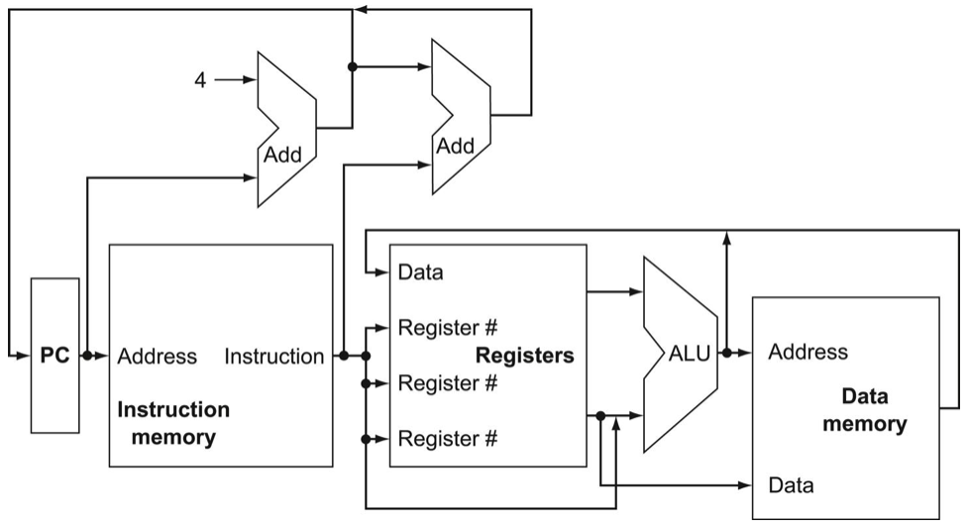
Recap: Single-cycle Processor
View from 30,000 feet

Slide 5
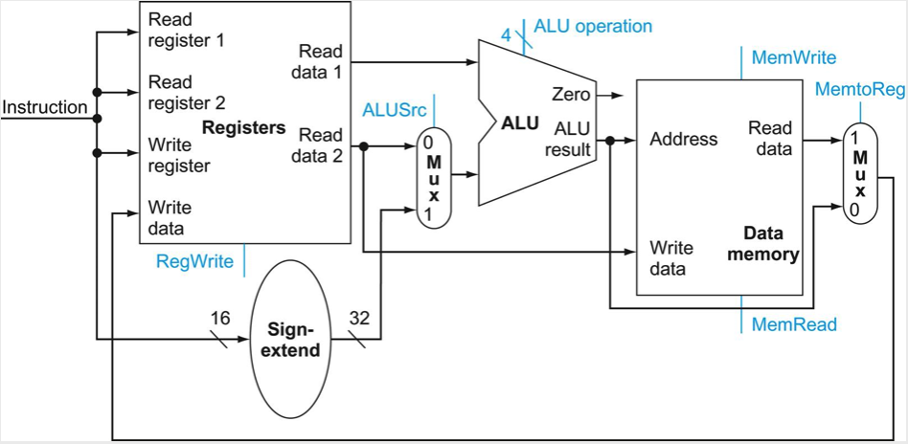
Recap: Single-cycle Processor
View from 10,000 feet

Slide 6
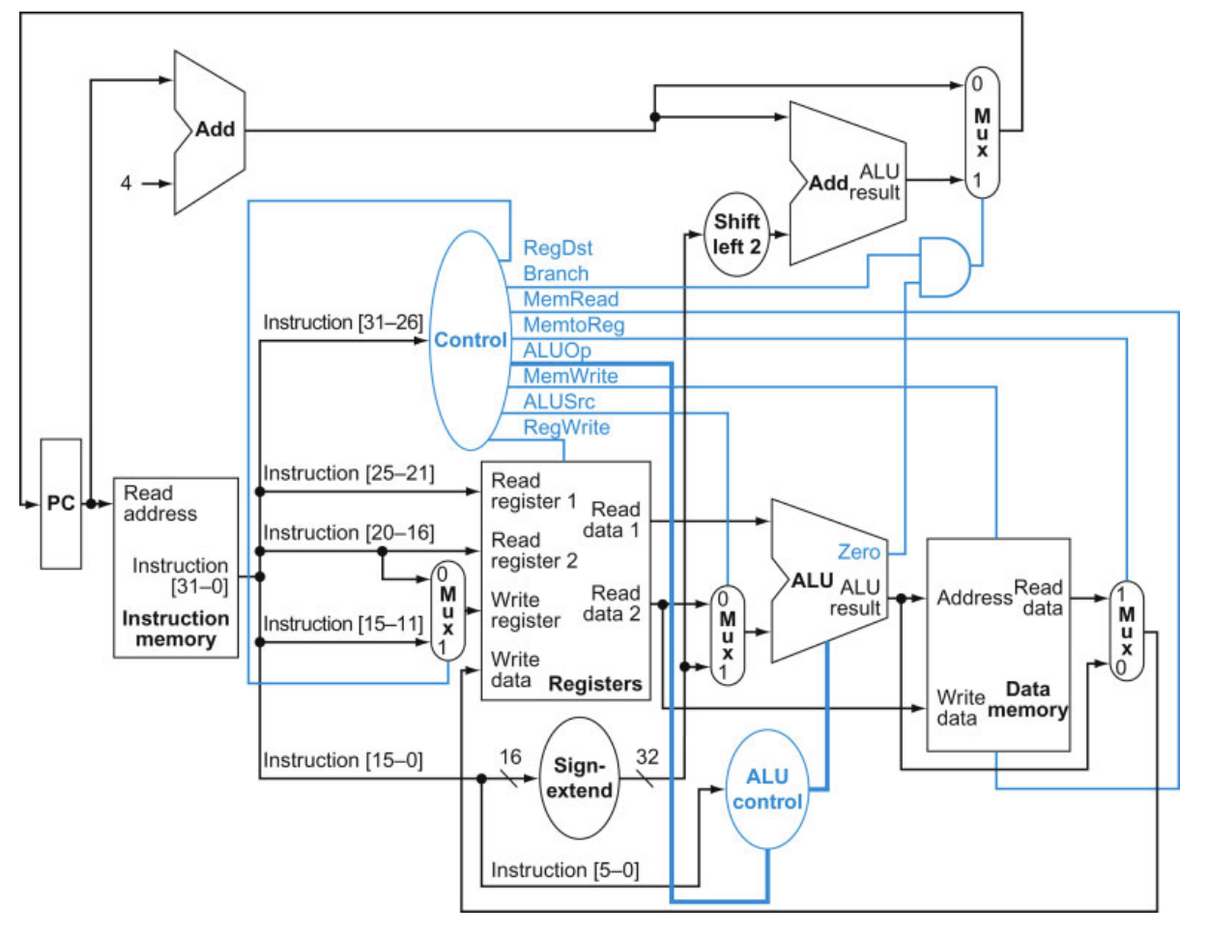
Recap: Single-cycle Processor
View from 5,000 feet
CL
IM
RF
ALU
Program Counter
DM

Slide 7
Recap: Single-cycle Processor
R-Type Instruction
add $1, $2, $3
$2
$3
$1
31:26
25:21
20:16
15:11
10:6
5:0
0 | rs | rt | rd | shamt | funct
op
Source
Registers
Destination
Register
Shift
Amount
Function
Code

Slide 8
Recap: Single-cycle Processor
R-Type Instruction
add $1, $2, $3
$2
$3
$1
31:26
25:21
20:16
15:11
10:6
5:0
0 | rs | rt | rd | shamt | funct
op
Source
Registers
Destination
Register
Shift
Amount
Function
Code
$2
$2
$3
$3

Slide 9
Recap: Single-cycle Processor
I-Type Instruction
beq $1, $2, 1000
1
$1
$2
31:26
25:21
20:16
15:0
4 | rs | rt | offset
op
Source Registers

Slide 10
Recap: Single-cycle Processor
I-Type Instruction
beq $1, $2, 1000
1
$1
$2
1
31:26
25:21
20:16
15:0
4 | rs | rt | offset
op
Source Registers
$1
$1
$2
$2

Slide 11
Recap: Single-cycle Processor
I-Type Instruction
beq $1, $2, 1000
1
$1
$2
1
31:26
25:21
20:16
15:0
4 | rs | rt | offset
op
Source Registers

Slide 12
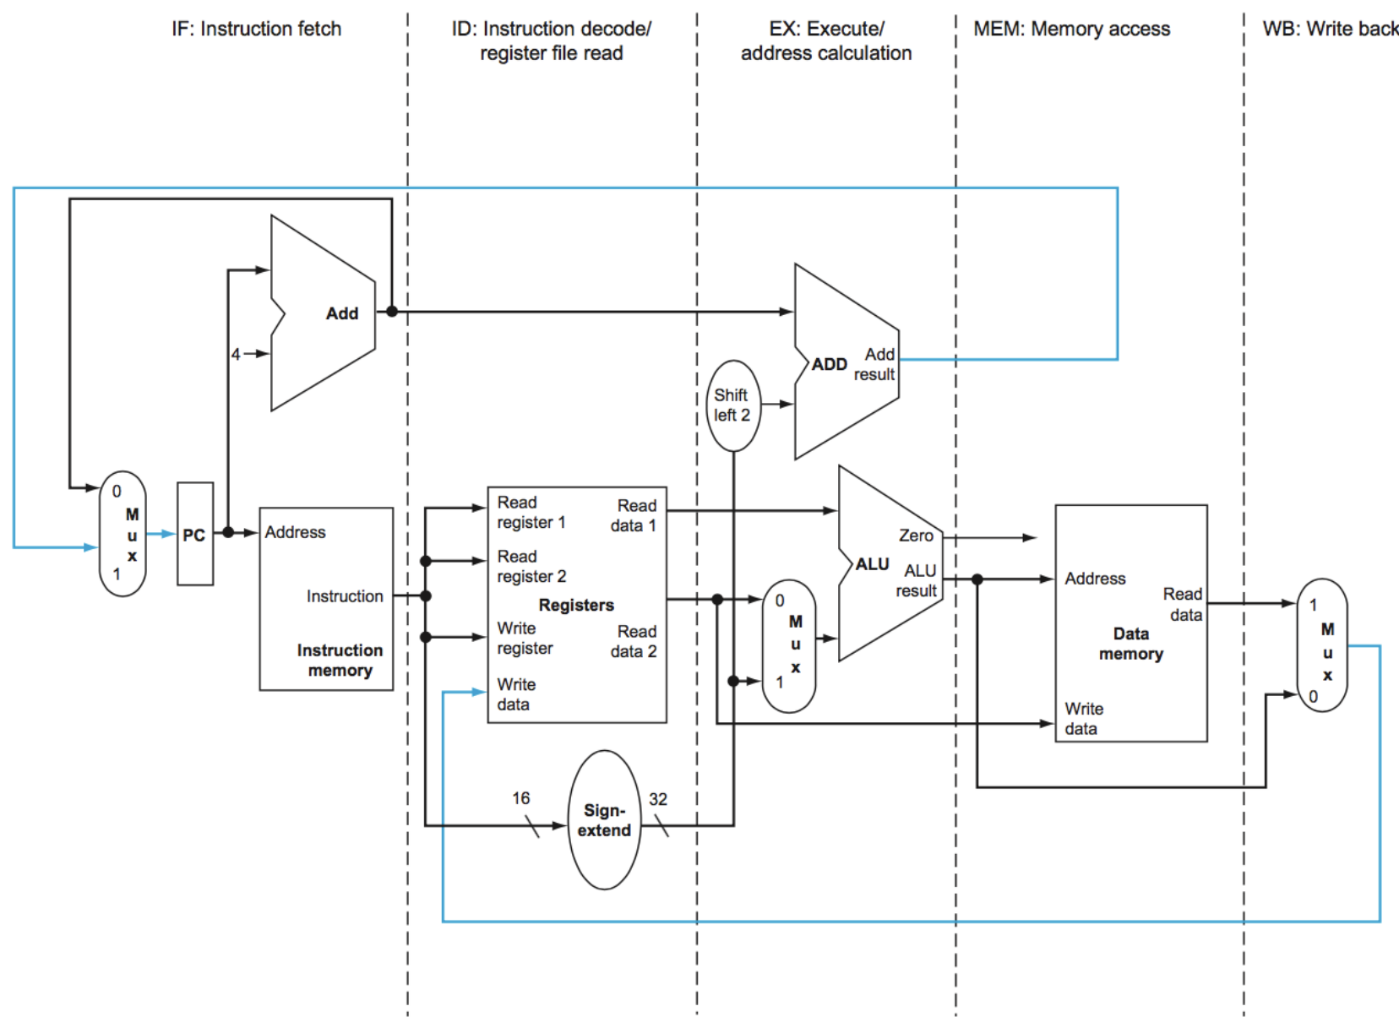
Processing Instructions
A sequence of processing tasks per instruction
IF: Instruction Fetch
ID: Instruction Decode
Register File Read
EX: Execute/
Address Calculation
MEM:
Memory Access
WB:
Write Back

Slide 13
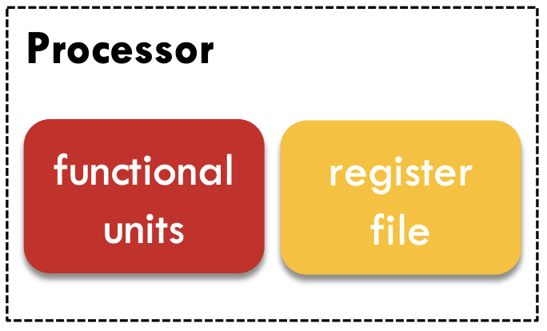

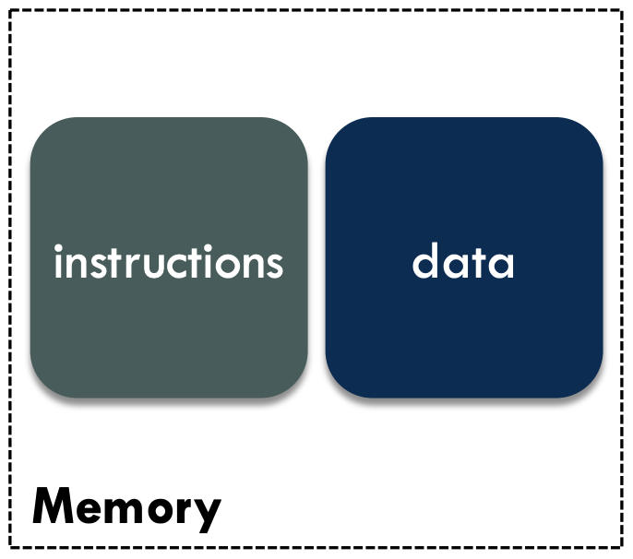
Processing Instructions
Every instruction may require multiple processing steps:
IF: Instruction Fetch
ID: Instruction Decode
Register Read (RR)
EXE: Execute Instructions
MEM: Memory Access
WB: Register Write Back
Control
ALU
load/store

Slide 14
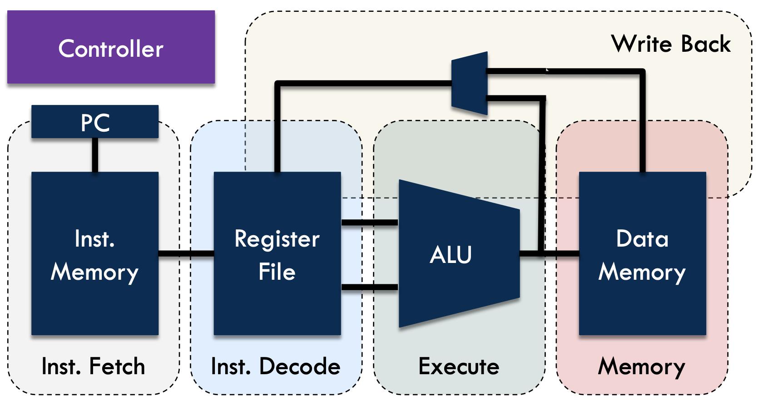
Single-cycle Architecture
Critical path
Includes all of the processing steps
Determines clock cycle time
lw $1, 8($2)

Slide 15
Single-cycle CPU Performance
Example Program:
What is the CPU time for a Cycle Time of 6 ns?
CT = 6 ns; CPU Time = ?
lw $1, 8($2)
add $4, $2, $3
sub $5, $1, $4
and $6, $1, $4
mul $7, $5, $6
Time

Slide 16

Single-cycle CPU Performance
Example Program:
What is the CPU time for a Cycle Time of 6 ns?
CT = 6 ns; CPU Time = 5 x 6 ns= 30 ns
$$CPU Time=IC×CPI×CT$$
lw $1, 8($2)
add $4, $2, $3
sub $5, $1, $4
and $6, $1, $4
mul $7, $5, $6
How to improve?
Locality Optimization
Amdahl’s Law
Common Case Fast
Reuse Idle Resources
Time

Slide 17
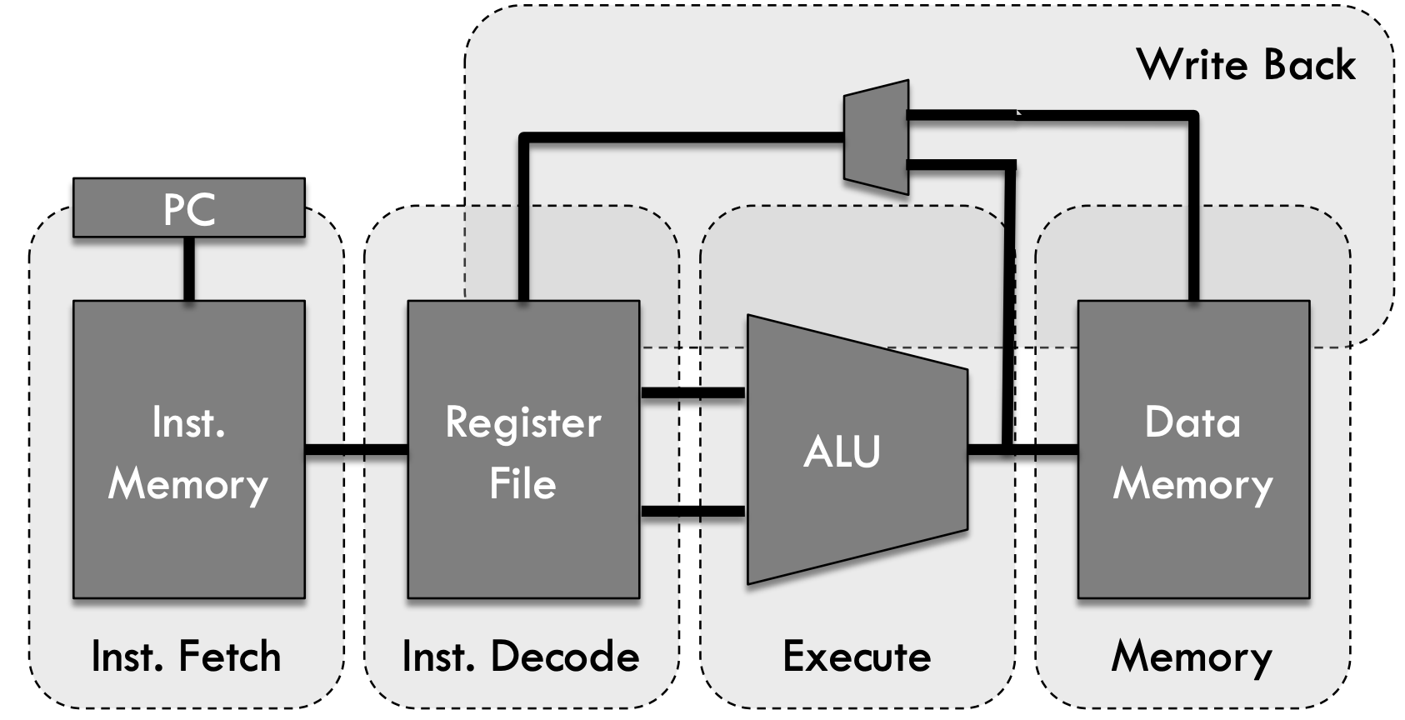
Reusing Idle Resources
Each processing step finishes in a fraction of a cycle.
Idle resources can be reused for processing

Slide 18
Reusing Idle Resources
Each processing step finishes in a fraction of a cycle.
Idle resources can be reused for processing

Slide 19
Reusing Idle Resources
Each processing step finishes in a fraction of a cycle.
Idle resources can be reused for processing

Slide 20
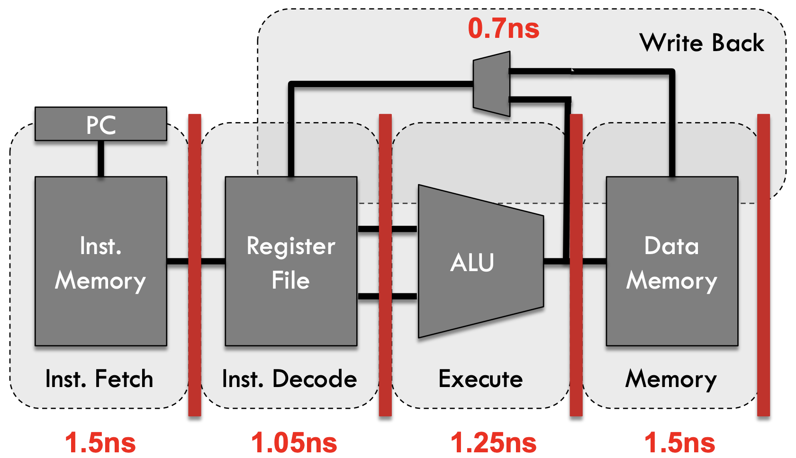
Multi-stage Circuit
Each processing step finishes in a fraction of a cycle.
Idle resources can be reused for processing

Slide 21
Analogy: Car Assembly Line
A
B
C
D
E
Car 1
Car 2
Jobs
Car 3
Car 4
Car 5
Time

Slide 22
Analogy: Car Assembly Line
A
B
C
D
E
Car 1
A
B
C
D
E
Car 2
A
B
C
D
E
Jobs
Car 3
A
B
C
D
E
Car 4
A
B
C
D
E
Car 5
Time

Slide 23
Analogy: Car Assembly Line
A
B
C
D
E
Pipelined
Car 1
A
B
C
D
E
Car 2
A
B
C
D
E
Jobs
Car 3
A
B
C
D
E
Car 4
A
B
C
D
E
Car 5
Time

Slide 24
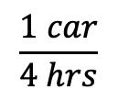



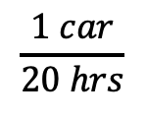
Car Assembly Line With Pipelining
$$20 hrs$$
Unpipelined
$$Throughput=$$
$$\frac{1 car}{20 hrs}$$
Jobs
Time
$$4 hrs$$
Pipelined
$$\frac{1 car}{4 hrs}$$
$$Throughput=$$
Jobs
Time

Slide 25


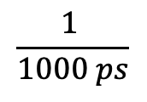



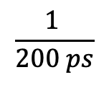





Pipelined Processor
lw $1, 8($2)
add $4, $2, $3
sub $5, $1, $4
and $6, $1, $4
mul $7, $5, $6
$$1000 ps$$
$$Throughput=$$
$$\frac{1 }{1000 ps}$$
$$=1 BIPS$$
Unpipelined
$$CPI=$$
$$1$$
Time
$$200 ps$$
$$\frac{1 }{200 ps}$$
lw $1, 8($2)
add $4, $2, $3
sub $5, $1, $4
and $6, $1, $4
mul $7, $5, $6
Pipelined
$$Throughput=$$
$$=5 BIPS$$
$$CPI=$$
$$1$$
Time

Slide 26
Recall: Single-cycle CPU Performance
Example Program:
What is the CPU time for a Cycle Time of 6 ns?
CT = 6 ns; CPU Time = 5 x 6 ns = 30 ns
lw $1, 8($2)
add $4, $2, $3
sub $5, $1, $4
and $6, $1, $4
mul $7, $5, $6
Time

Slide 27
Pipelined CPU Performance
Example Program:
What is the CPU time for a Cycle Time of 1.5 ns?
CT = 1.5 ns; CPU Time =
9 x 1.5 ns = 13.5 ns
lw $1, 8($2)
add $4, $2, $3
sub $5, $1, $4
and $6, $1, $4
mul $7, $5, $6
Time

Slide 28
Performance Impacts of Pipelining
Does it take shorter to finish each individual job?

Slide 29
Performance Impacts of Pipelining
Does it take shorter to finish each individual job?
No, it takes the same or even more time depending on CT

Slide 30
Performance Impacts of Pipelining
Does it take longer to finish each individual job?
No, it takes the same or even more time depending on CT
Does it take shorter to finish a series of jobs?

Slide 31
Performance Impacts of Pipelining
Does it take shorter to finish each individual job?
No, it takes the same or even more time depending on CT
Does it take shorter to finish a series of jobs?
Yes, the throughput has increased by using a 5-stage pipeline

Slide 32
Performance Impacts of Pipelining
Does it take shorter to finish each individual job?
No, it takes the same or even more time depending on CT
Does it take shorter to finish a series of jobs?
Yes, the throughput has increased by using a 5-stage pipeline
What assumptions were made while answering these questions?

Slide 33
Performance Impacts of Pipelining
Does it take shorter to finish each individual job?
No, it takes the same or even more time depending on CT
Does it take shorter to finish a series of jobs?
Yes, the throughput has increased by using a 5-stage pipeline
What assumptions were made while answering these questions?
No data dependencies

Slide 34
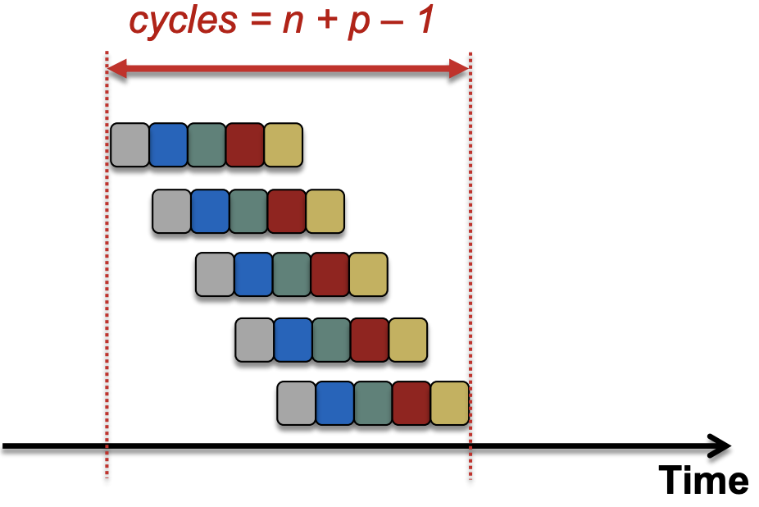

Performance Impacts of Pipelining
Stall cycles to resolve data dependencies
$$n=\# instructions, p=\# pipeline stages$$
Ideal Pipelining

Slide 35
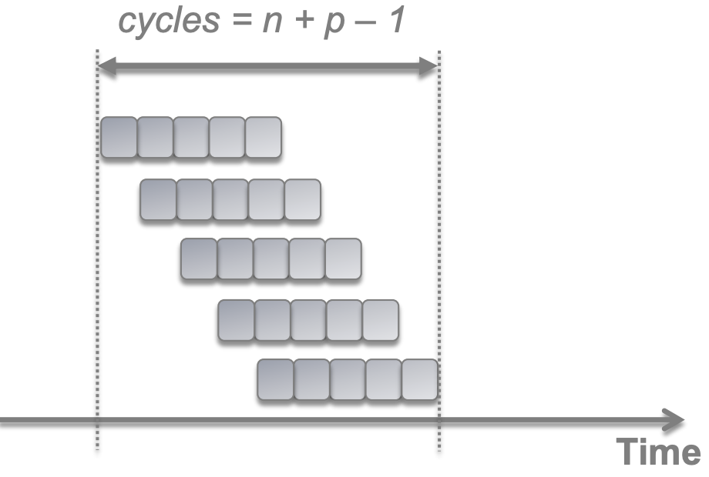
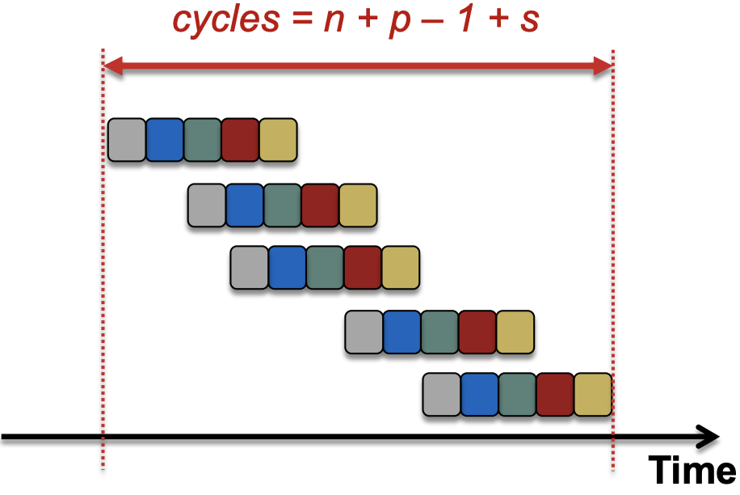

Performance Impacts of Pipelining
Stall cycles to resolve data dependencies
$$n=\# instructions, p=\# pipeline stages, s=\#stall cycles$$
Ideal Pipelining
Real Pipelining

Slide 36
Performance Impacts of Pipelining
Does it take shorter to finish each individual job?
No, it takes the same or even more time depending on CT
Does it take shorter to finish a series of jobs?
Yes, the throughput has increased by using a 5-stage pipeline
What assumptions were made while answering these questions?
No data dependencies

Slide 37
Performance Impacts of Pipelining
Latch overhead in pipelining

Slide 38
Performance Impacts of Pipelining
Does it take shorter to finish each individual job?
No, it takes the same or even more time depending on CT
Does it take shorter to finish a series of jobs?
Yes, the throughput has increased by using a 5-stage pipeline
What assumptions were made while answering these questions?
No data dependencies
No latch overhead

Slide 39
Performance Impacts of Pipelining
Does it take shorter to finish each individual job?
No, it takes the same or even more time depending on CT
Does it take shorter to finish a series of jobs?
Yes, the throughput has increased by using a 5-stage pipeline
What assumptions were made while answering these questions?
No data dependencies
No latch overhead
Is a 50-stage pipeline better than a 5-stage pipeline?
20-30
stages
Performance
Power
# of stages
# of stages

Slide 40
Performance Impacts of Pipelining
Does it take shorter to finish each individual job?
No, it takes the same or even more time depending on CT
Does it take shorter to finish a series of jobs?
Yes, the throughput has increased by using a 5-stage pipeline
What assumptions were made while answering these questions?
No data dependencies
No latch overhead
Is a 50-stage pipeline better than a 5-stage pipeline?
No, performance degrades with more stages due to latch overhead and data dependencies

Slide 41
Quantitative Effects of Pipelining
As a result of pipelining:
Time in ns per instruction goes up
Each instruction takes more cycles to execute
But…average CPI remains roughly the same
Clock speed goes up
Total execution time goes down, resulting in lower average time per instruction
Under ideal conditions,
Speedup
= ratio of elapsed times between successive instruction completions
= increase in clock speed
= number of pipeline stages

Slide 42
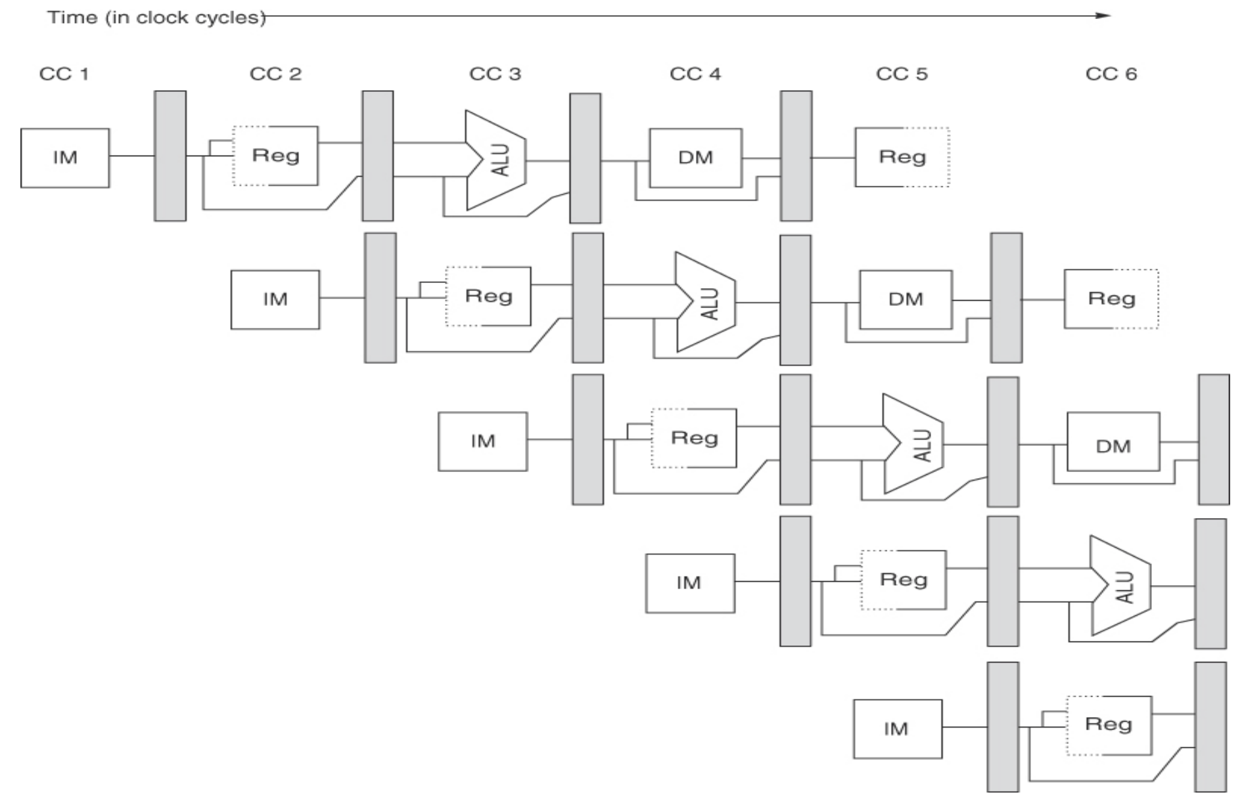
Designing a 5-stage Pipeline

Slide 43
Designing a 5-stage Pipeline
lw $1, 6($2)
add $3, $5, $0
sw $4, 8($6)

Slide 44

Next time…
Read chapter 4.5 – 4.7 from textbook
Next lecture
Introduction to pipelining hazards
Structural Hazards
Data Hazards
Resolving Structural and Data Hazards
maheshl@cs.utah.edu

