Slide 1

Prototype of Application
Will Be Designed as Shown is per
RBAC

Slide 2
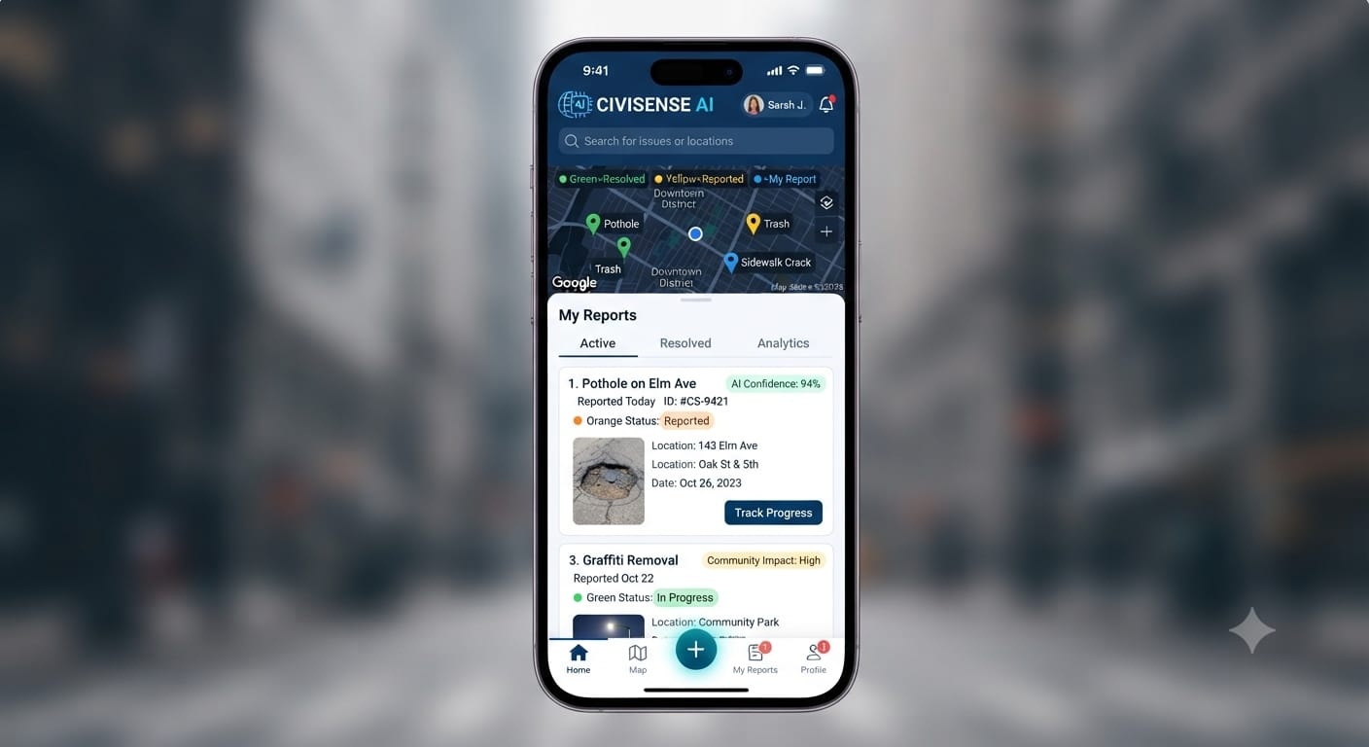
Citizen Interface

Slide 3
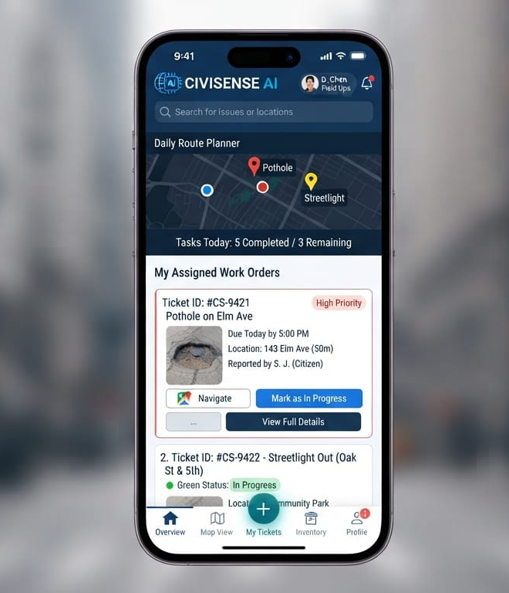
Supervisor /contractor Interface

Slide 4
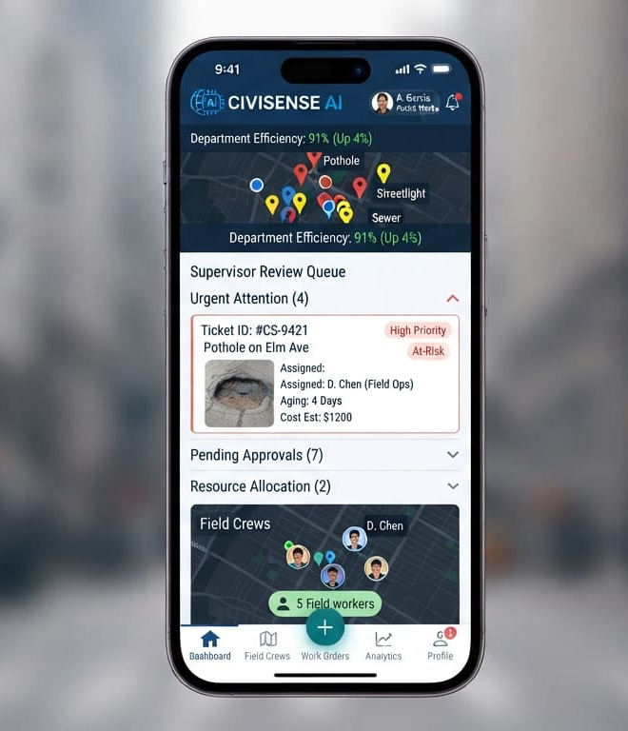
HOD Interface

Slide 5
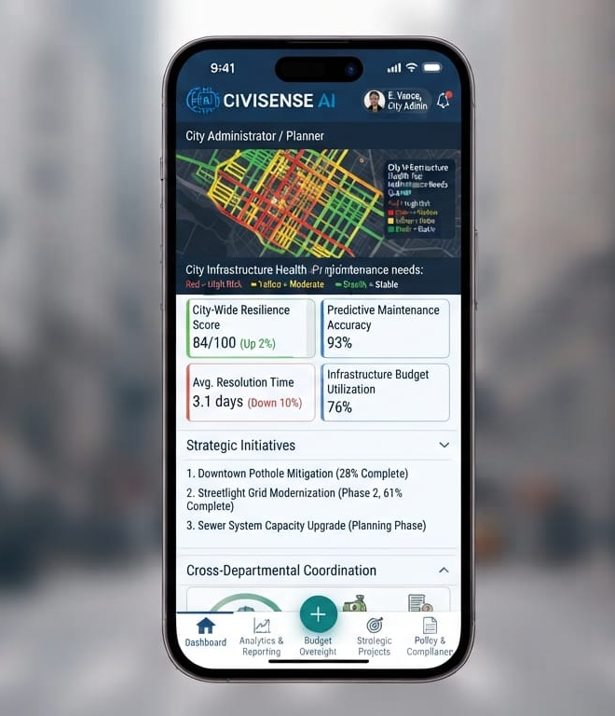
District president Interface

Slide 6
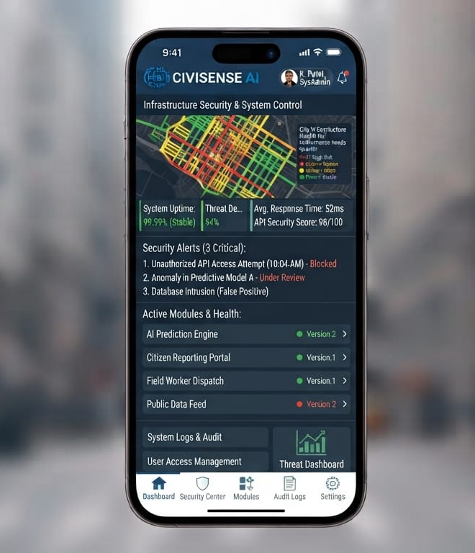
MLA Interface

Slide 7
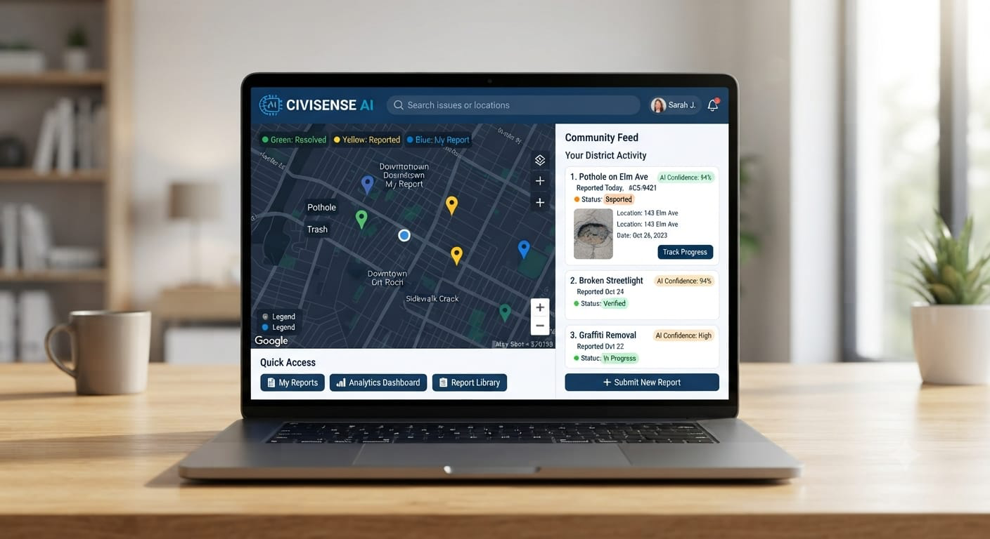
Web Interface

Slide 8
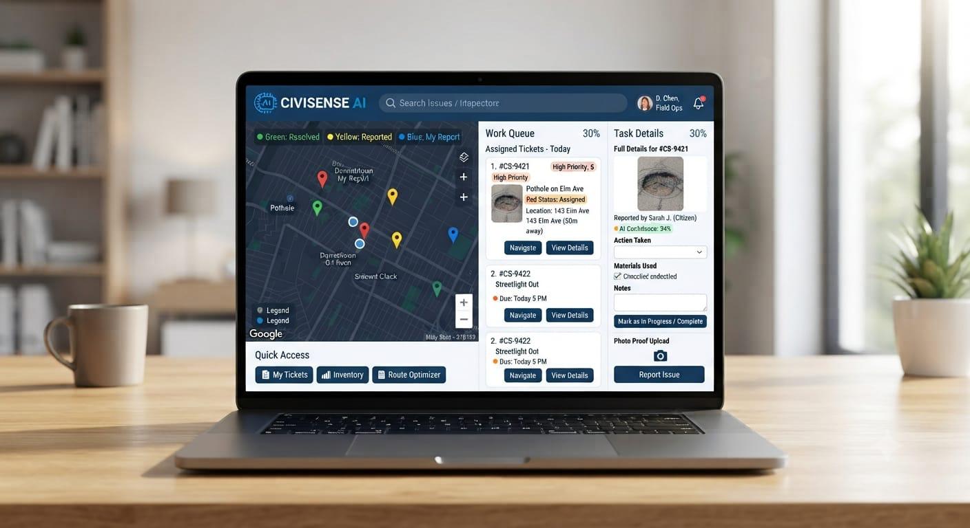
Web Interface

Slide 9
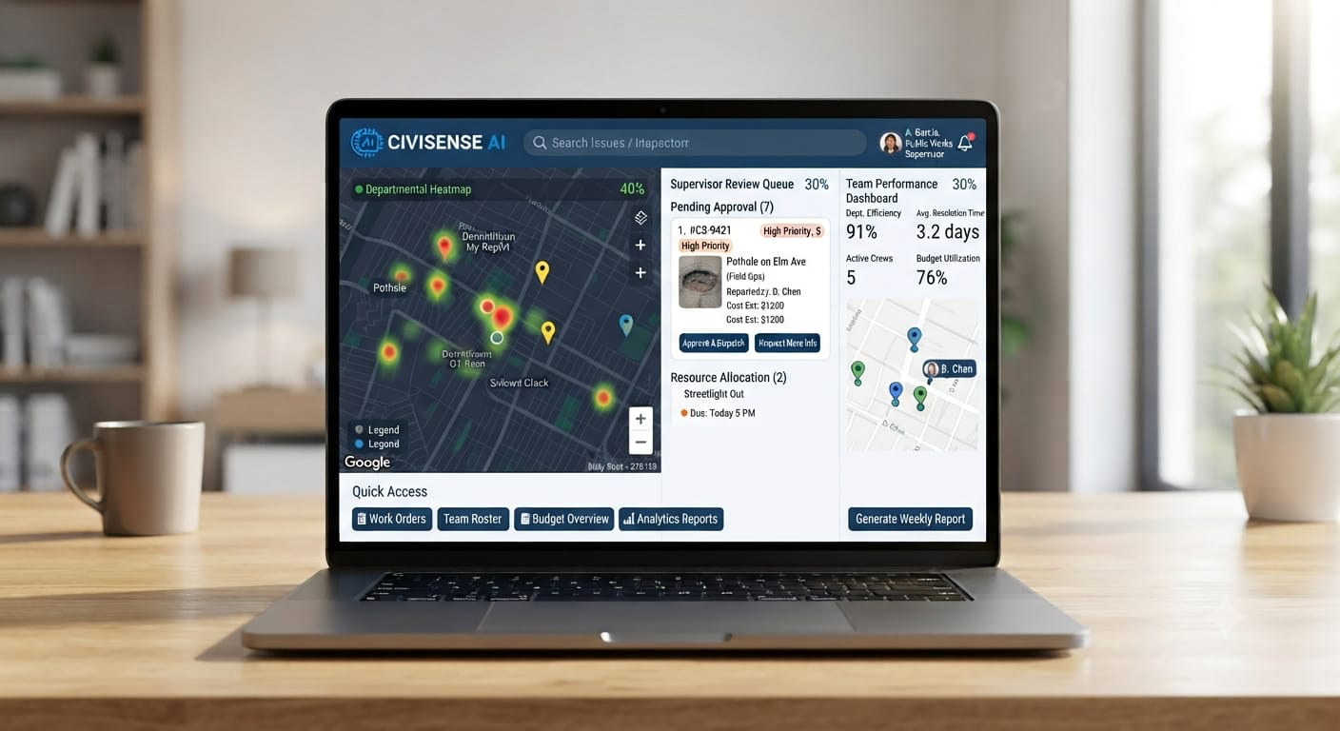
Web Interface

Slide 10
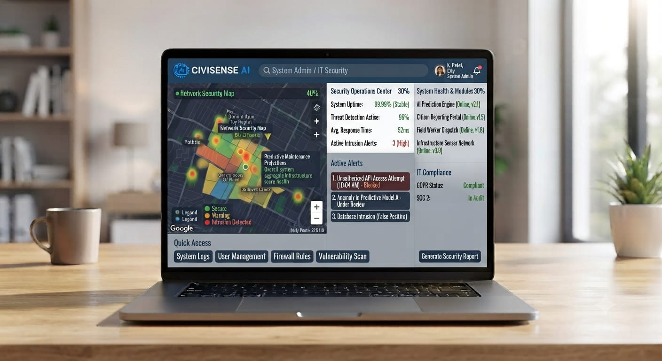
Web Interface

Slide 11
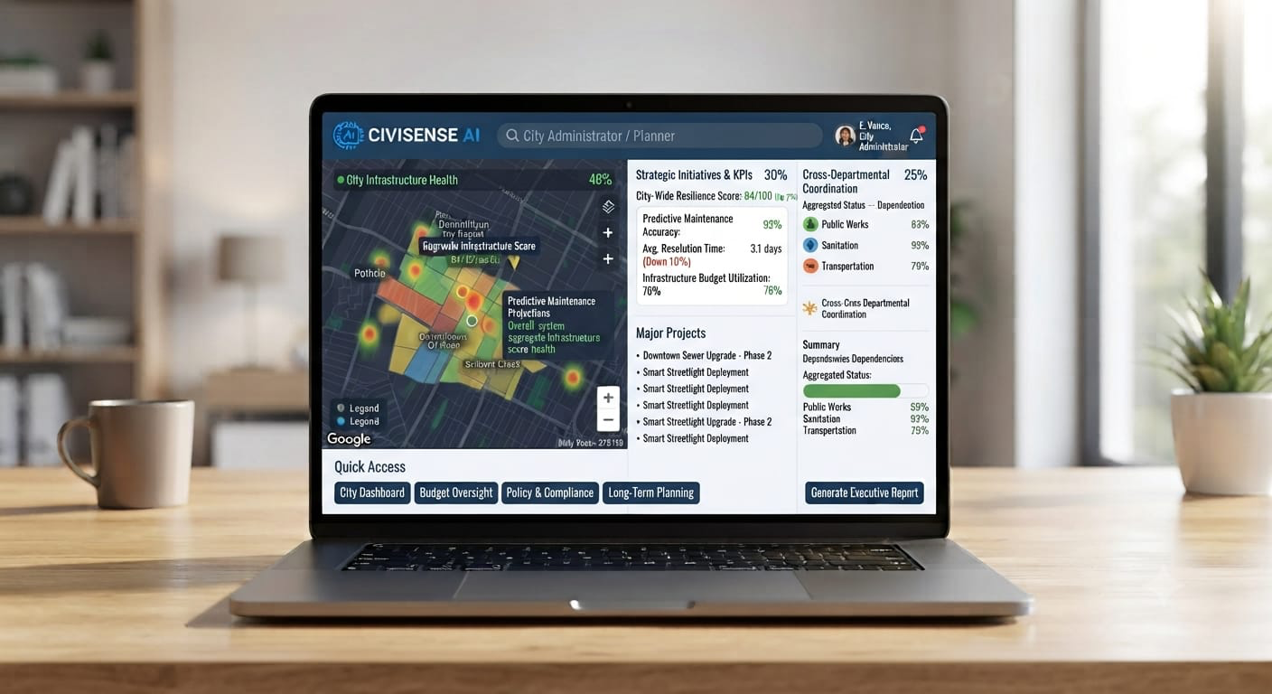
Web Interface

Slide 12
A simple view point of the project is displayed further as part of hackathon we will be developing same like
system for problem

